Slide 1
CULVERT MAINTENANCE

Slide 2

Culvert Maintenance
Similar to bridges
  approach road
  channel
Structurally different
  upstream end
  downstream end
  barrel

Slide 3
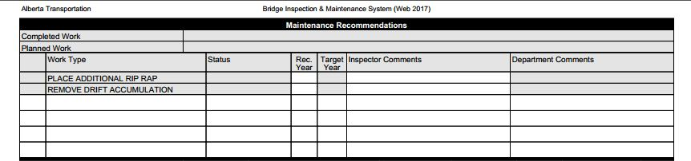
Maintenance Recommendations
CUL1, CULM and CULE form recommendations are identical

Slide 4
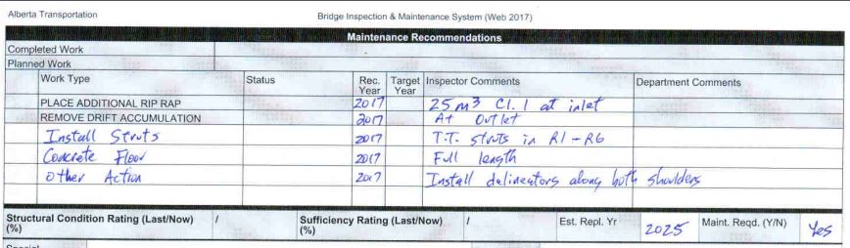
Maintenance Recommendations
CUL1, CULM, CULE form recommendations are identical

Slide 5
Approach Road Maintenance
Embankment
  slides, slumps, etc.
    repair by removing failed material & replacement with competent, compacted material
  remaining items same as for bridges

Slide 6
Upstream / Downstream End Maintenance
Upstream & Downstream ends have the same inspection items
Head Wall
  usually a low maintenance item
  broken, spalled concrete
    patch
  scaled concrete
    repair & seal (when salt applied to roads)

Slide 7
Upstream / Downstream End Maintenance (Cont’d)
Collar / Concrete Slope Protection
  scoured / eroded
    compacted fill and rock riprap
  settled & broken
    replace with fill and riprap

Slide 8
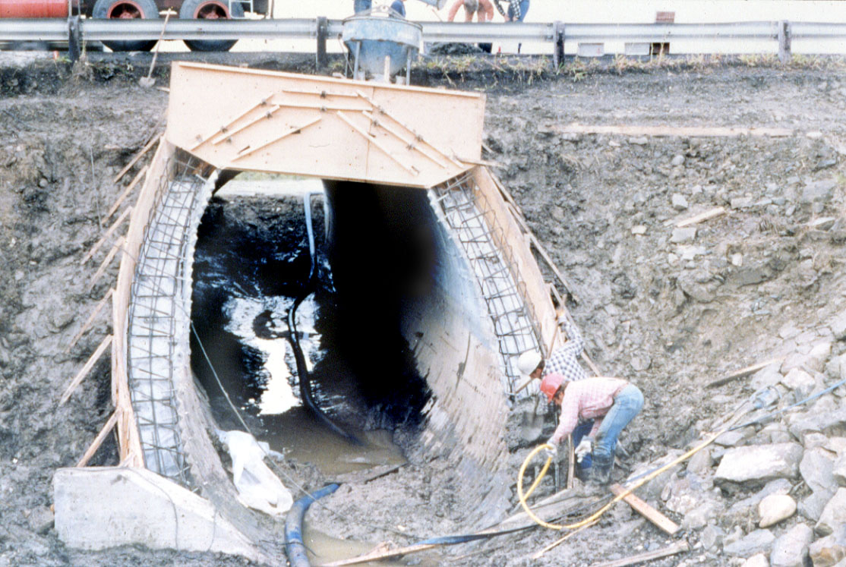
Adding end treatment to existing culvert.

Slide 9
Upstream / Downstream End Maintenance (Cont’d)
Wingwalls
  deteriorated concrete
    chip out and replace
  separated from barrel
    re-connect with steel plates
    fill gap with flexible material
  pushing inwards
    strut between

Slide 10
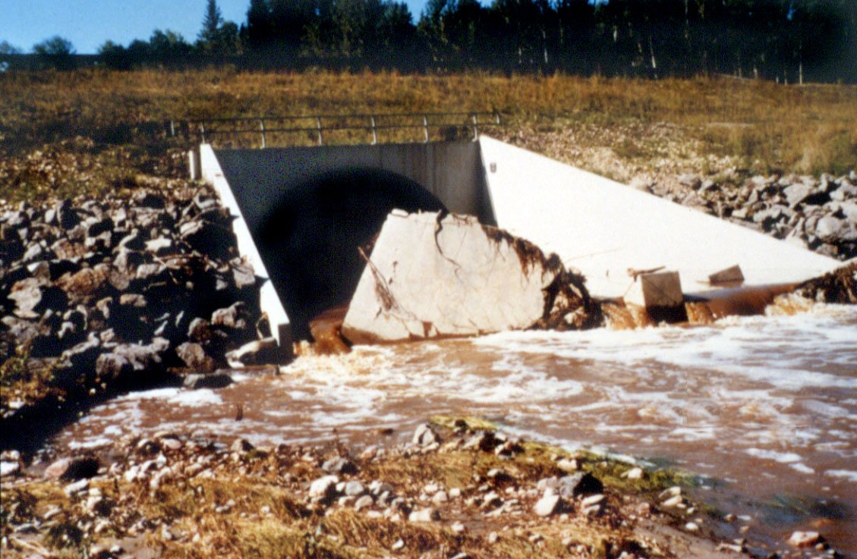
Damaged floor at outlet transition.

Slide 11
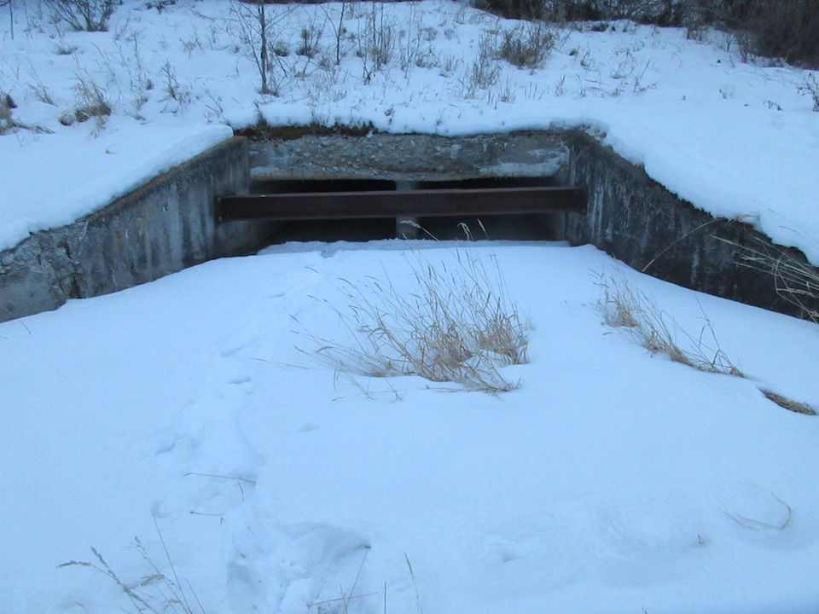
Horizontal Steel Strut

Slide 12
Upstream / Downstream End Maintenance (Cont’d)
Cutoff Wall
  usually buried if present
  if not present and a problem with piping
    Install cut off wall
    Install sand/cement filled bags

Slide 13
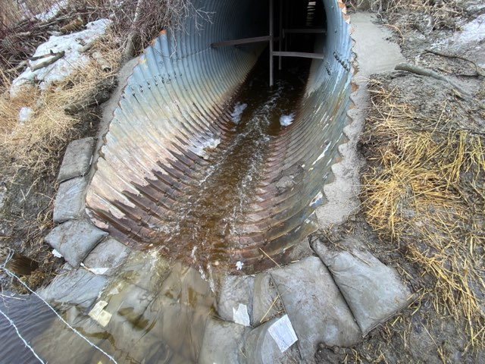
Cement / sand filled bags to repair inlet piping

Slide 14
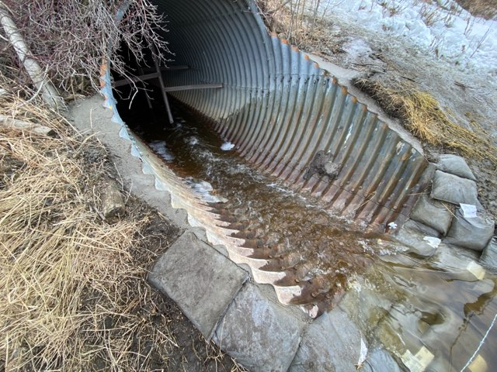
Adding cement / sand filled bags to inlet

Slide 15
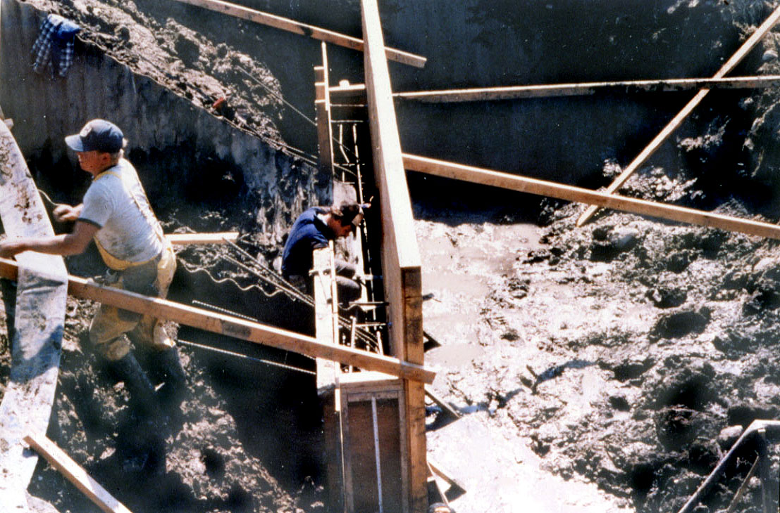
Adding cut-off wall to existing culvert.

Slide 16
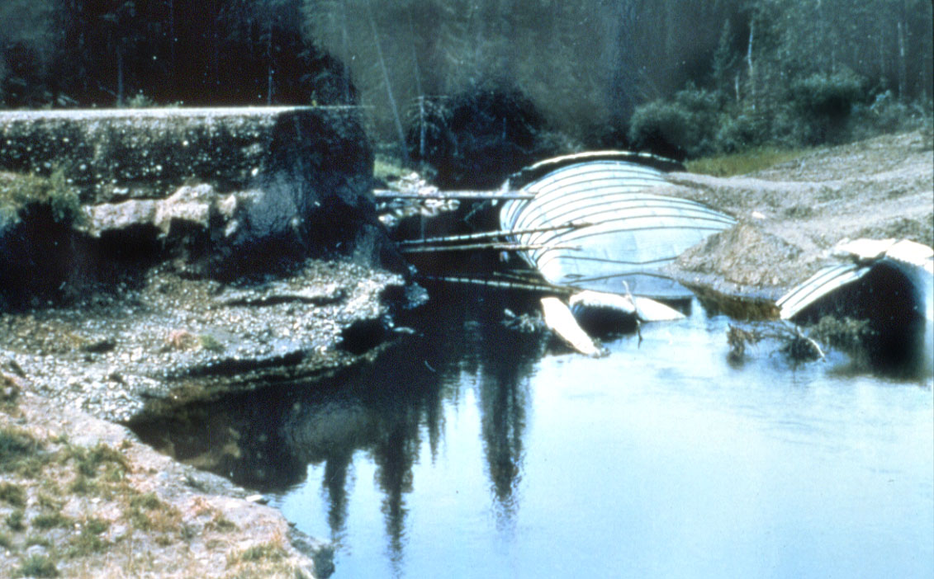
Wash out due to piping
(Brewster Creek Sunchild Road)

Slide 17
Upstream / Downstream End Maintenance (Cont’d)
Bevel End
  excessive heaving
    remove and reset with end treatment
    replace with new end treatment
  folding in
    add collar
    strut
  current end treatment requirements are:
    1.5 to 3.0m special conditions
    3.0 to 4.5m upstream end only
    >4.5m both ends

Slide 18
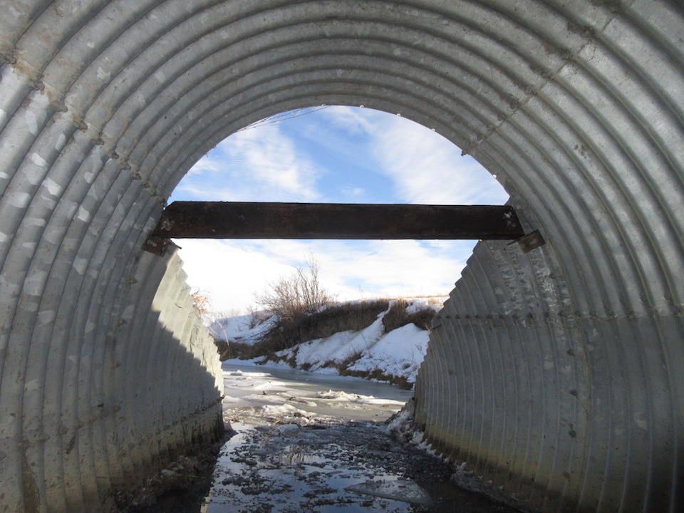
Bevel pushing inward – repaired with horizontal strut

Slide 19
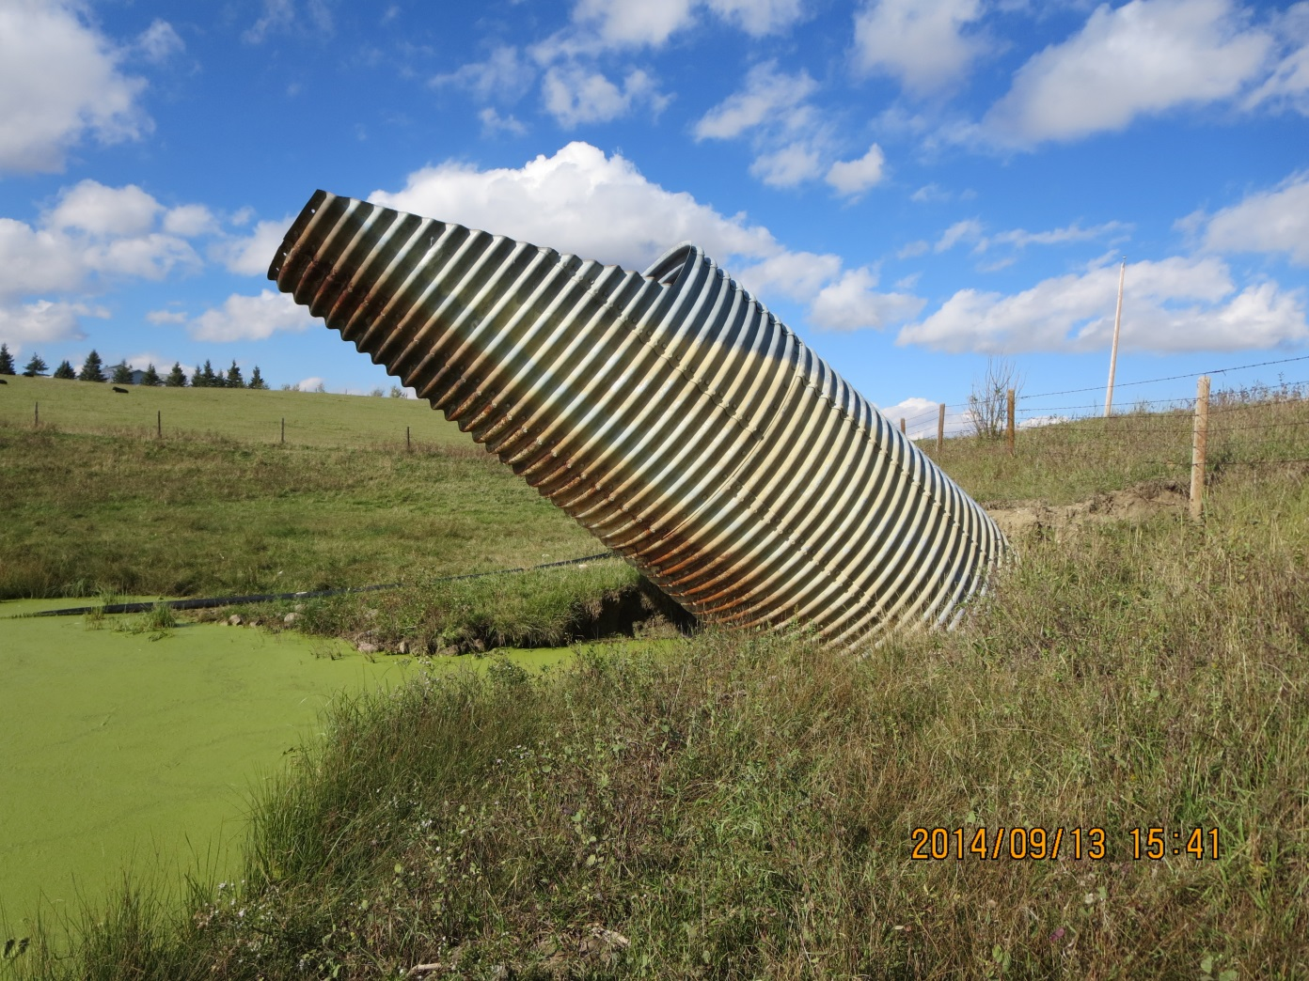
Heaved inlet on SPCSP culvert.

Slide 20
Upstream / Downstream End Maintenance (Cont’d)
Scour Protection
  Erosion / scour
    add suitable size rock riprap with filter cloth to apron and/or around collar or bevel
Scour / Erosion
  scour / erosion
    add rock riprap with filter cloth to suit velocities anticipated

Slide 21
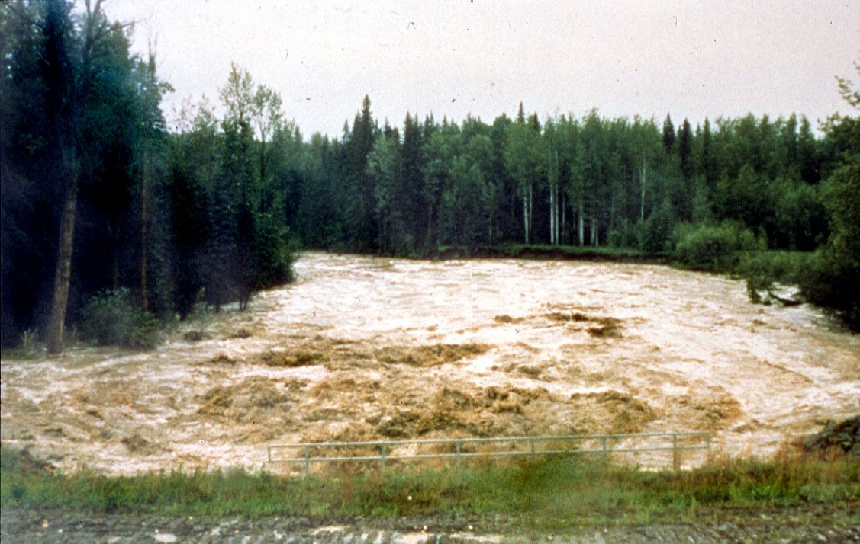
High velocity at outlet during high water
(Bald Mountain Hwy 40)

Slide 22
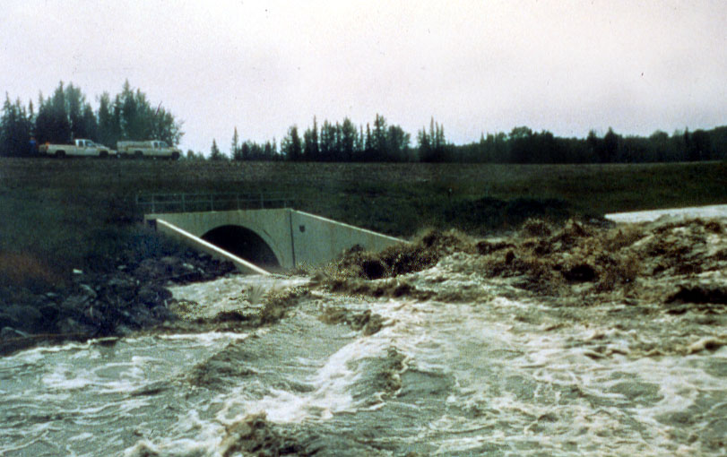
Extreme turbulence at outlet.

Slide 23
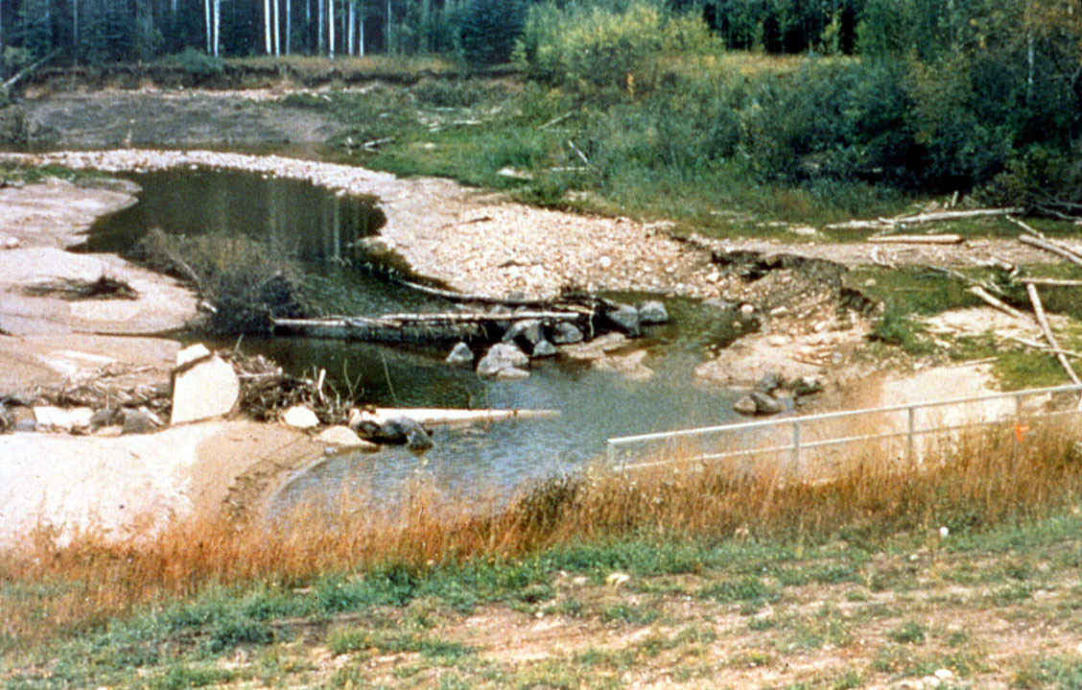
Downstream bed erosion and bank erosion at bend.

Slide 24
Downstream Apron Repair

Slide 25
Upstream / Downstream End Maintenance (Cont’d)
Rock Riprap Material Size versus Stream Velocity
  Riprap Class Allowable Velocity
  Class 1m - 2.0 m / sec
  Class 1 - 3.0 m / sec
  Class 2 - 4.0 m / sec
  Class 3 - 4.7 m / sec

Slide 26
Upstream / Downstream End Maintenance (Cont’d)
Degradation
  restore stream bed elevation
  add material
Aggradation
  restore stream bed elevation
  remove material

Slide 27
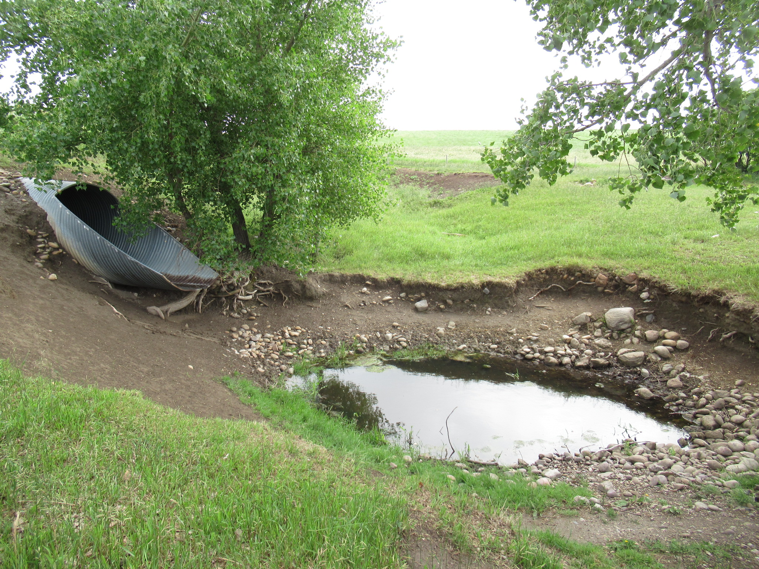
Stream degradation and scour hole.

Slide 28
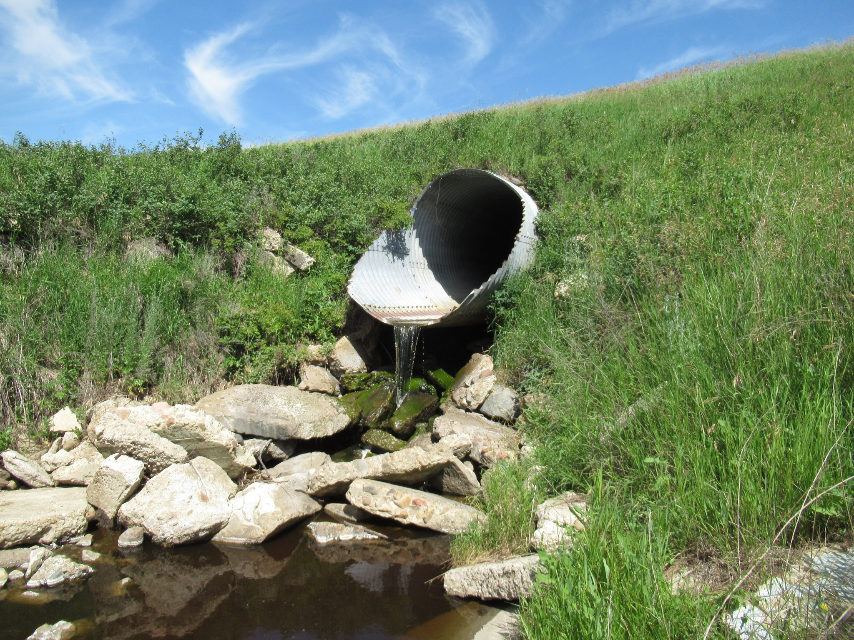
Hanging outlet due to degradation and scour.

Slide 29
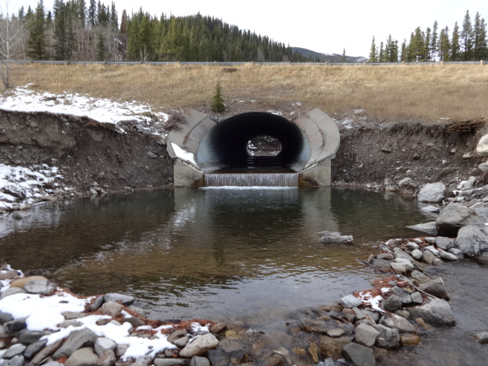
Typical scour and degradation at outlet

Slide 30
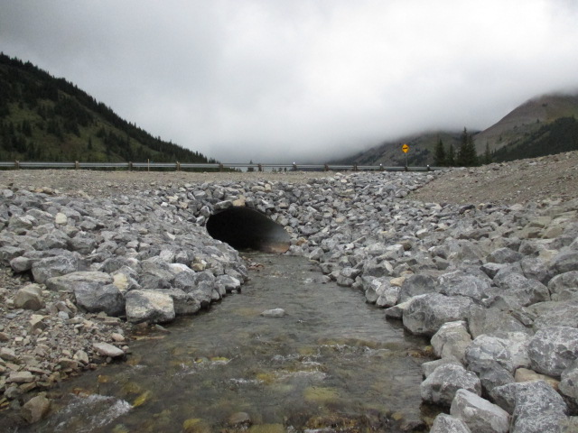
New rip rap added to bevel and apron

Slide 31
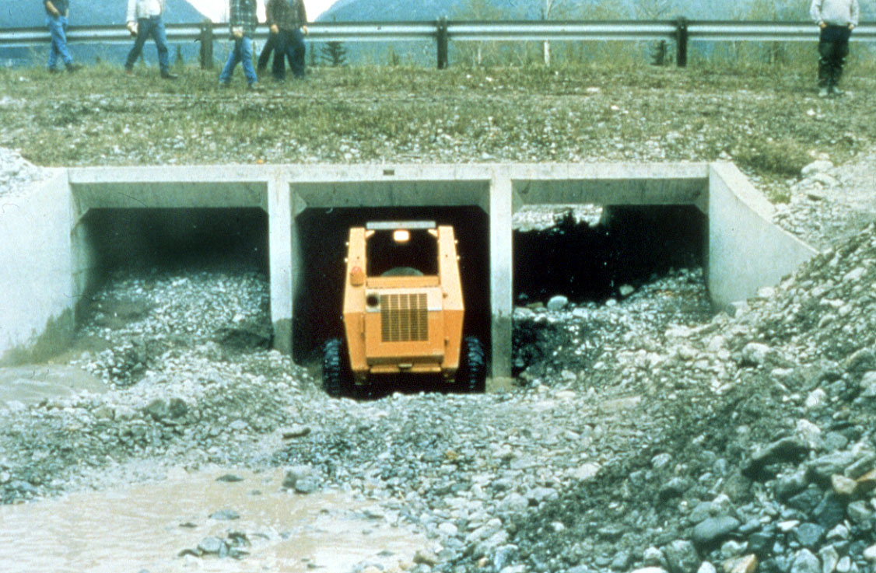
Streambed aggradation (Cougar Creek Canmore).

Slide 32
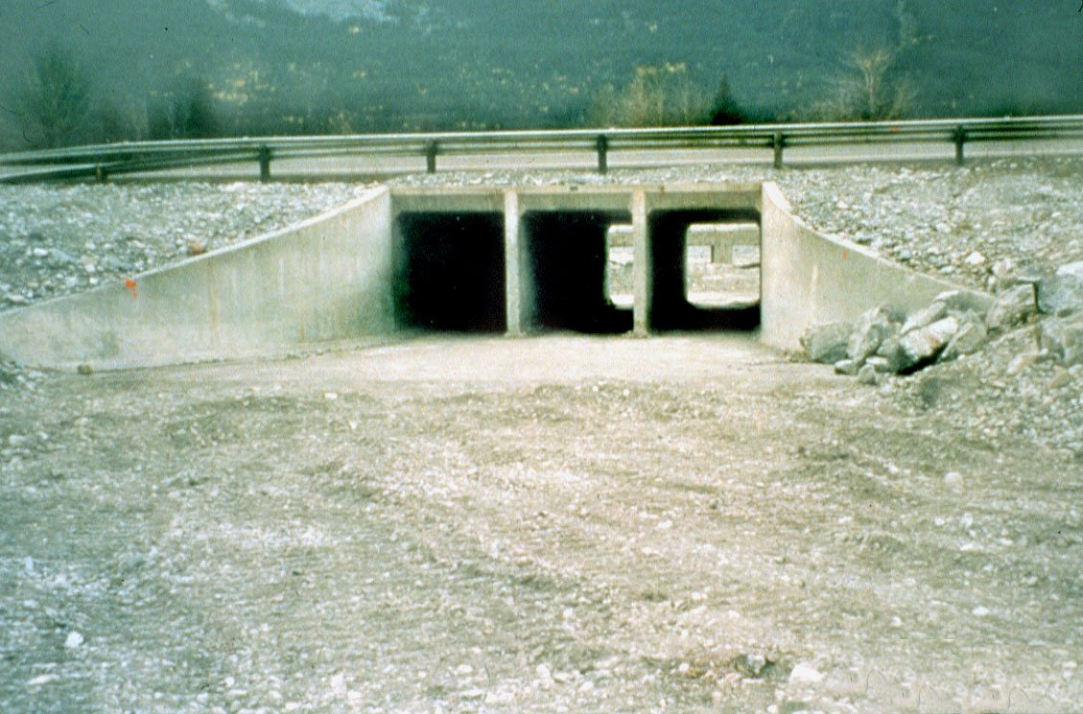
Restored inlet

Slide 33
Barrel Maintenance
Roof
  Sagging 15% or more
  Reverse curvature
    add struts (might be too late for liner due to reduced hydraulic capacity).

Slide 34
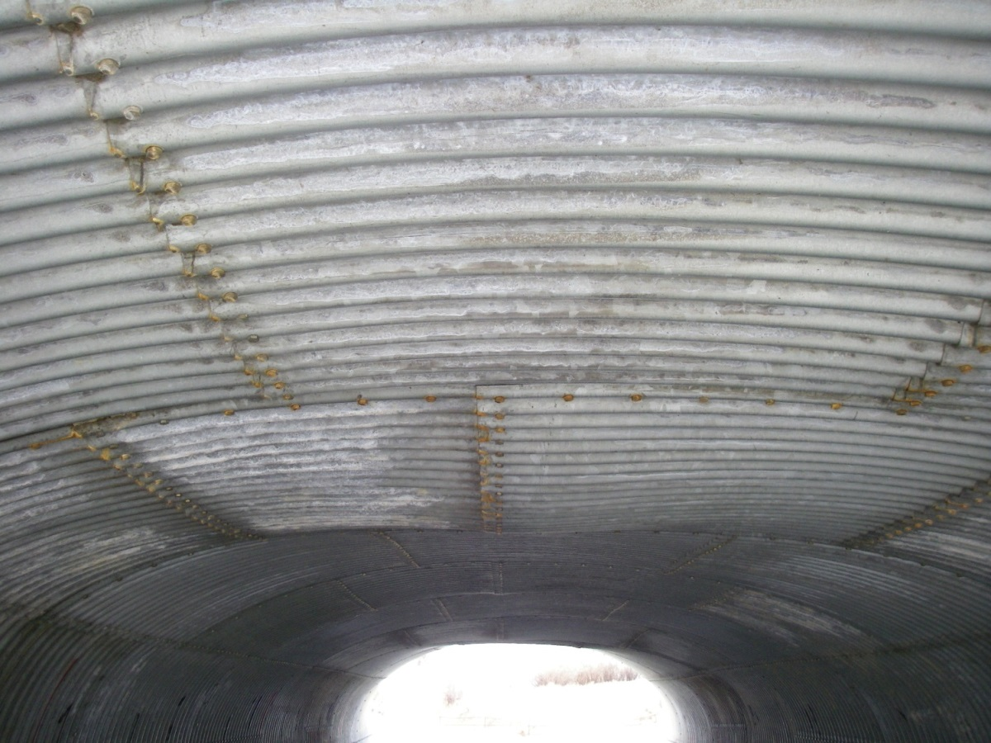
Reverse curvature in roof

Slide 35
Barrel Maintenance
Sidewall
  deflecting
    add struts (or install liner if adequate capacity)
  corroded
    Install liner
    cathodic protection (not as common as previously)

Slide 36
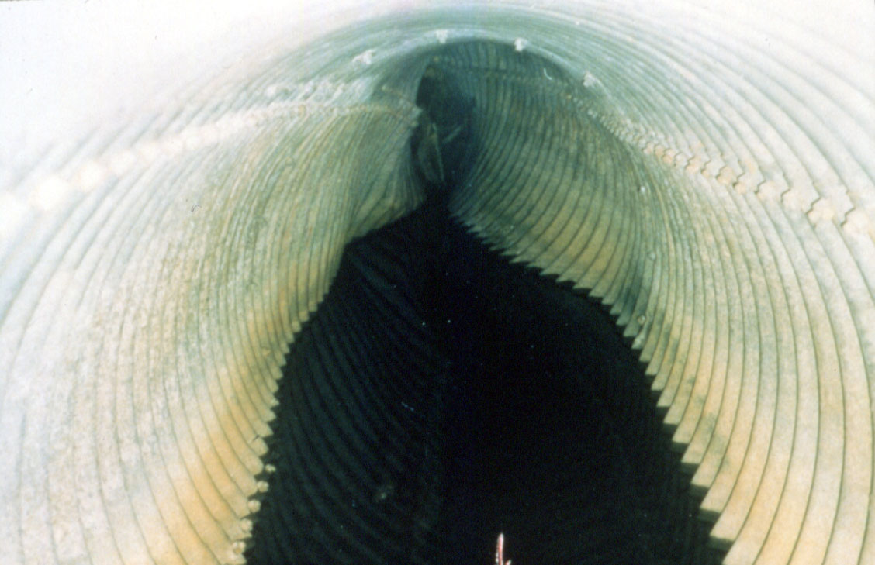
Failed SPCSP culvert (inadequate backfill).

Slide 37
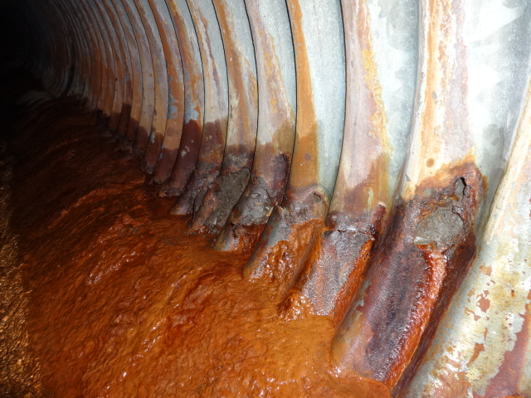
Soil side corrosion, perforated side wall.

Slide 38
Barrel Maintenance
Floor
  bulging
    Place U/S cut-off wall if piping
    add struts or install liner
  corroding
    cast concrete floor
    cathodic protection

Slide 39
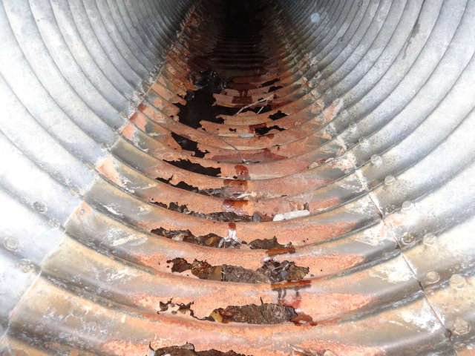
Severe Floor perforations

Slide 40
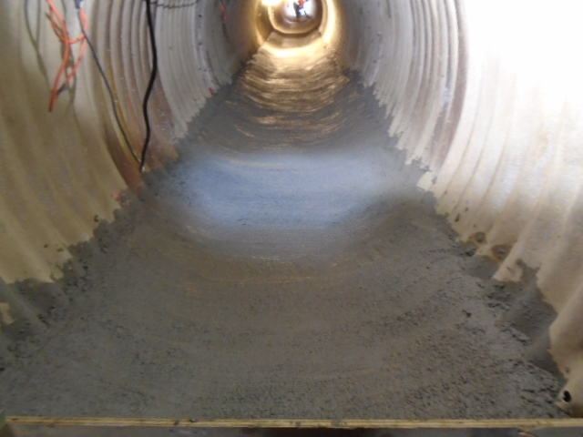
Floor perforations repaired with concrete floor

Slide 41
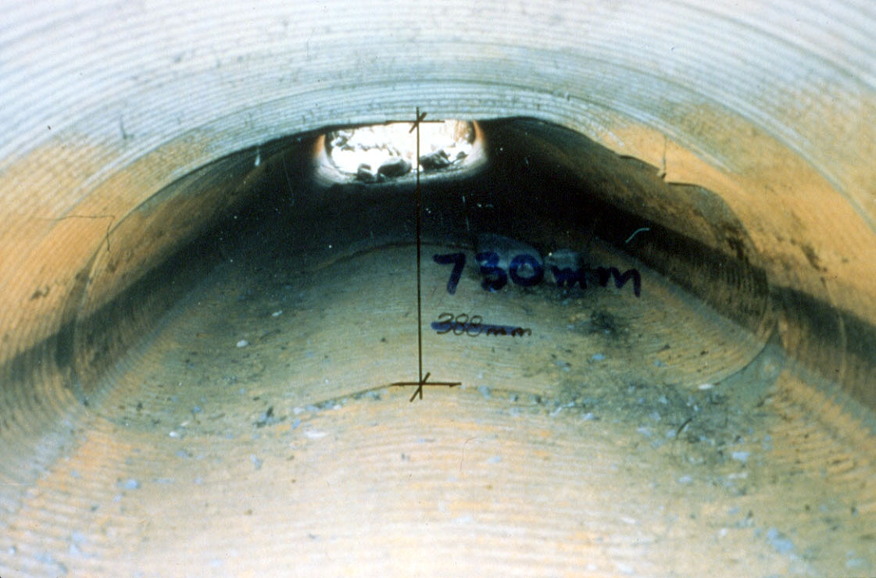
Arch shaped CSP with heaved floor and deflecting roof.

Slide 42
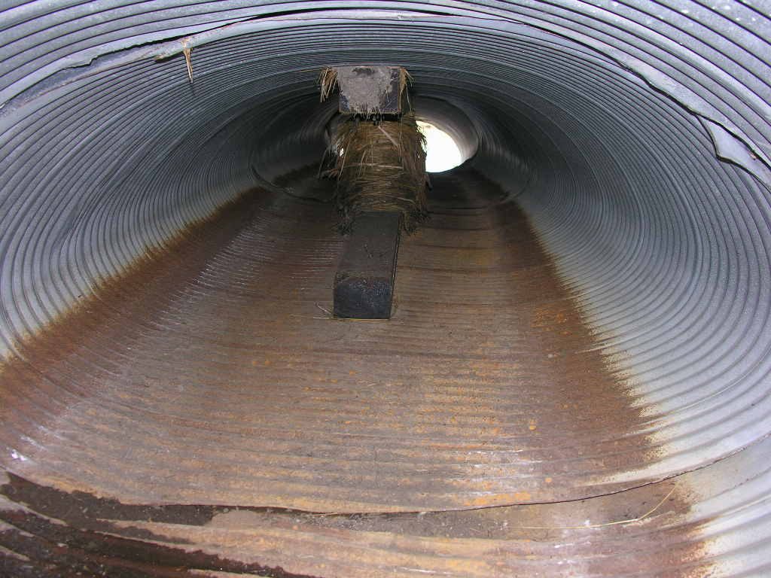
Strutted barrel

Slide 43
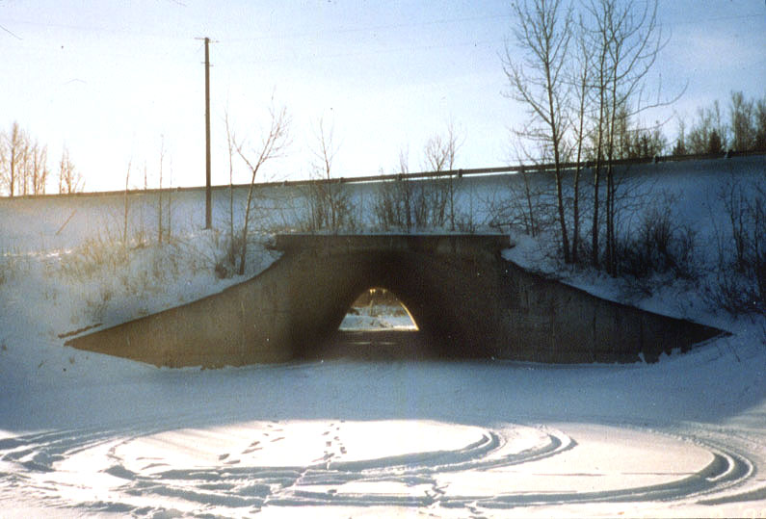
Concrete arch culvert with curved wingwalls in Feb. (Weed Creek)

Slide 44
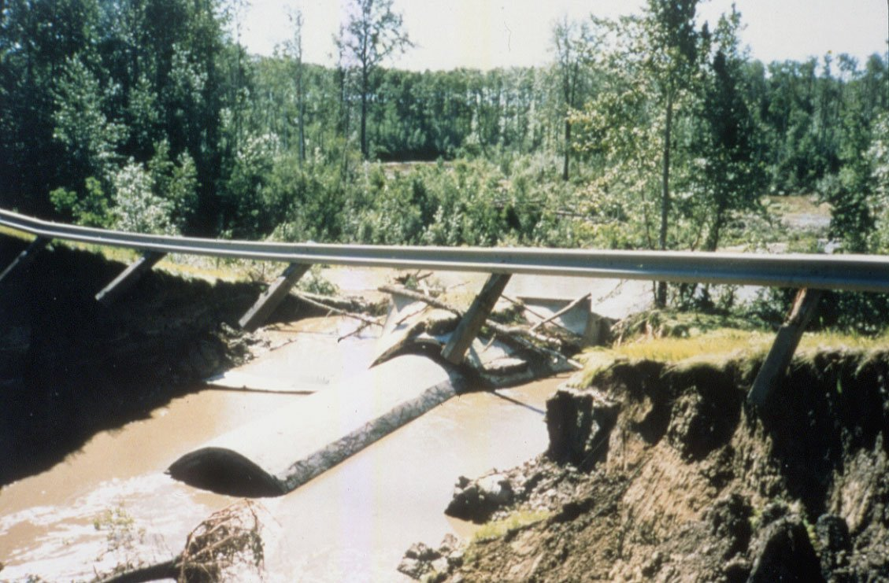
Arch culvert after high water in July.

Slide 45
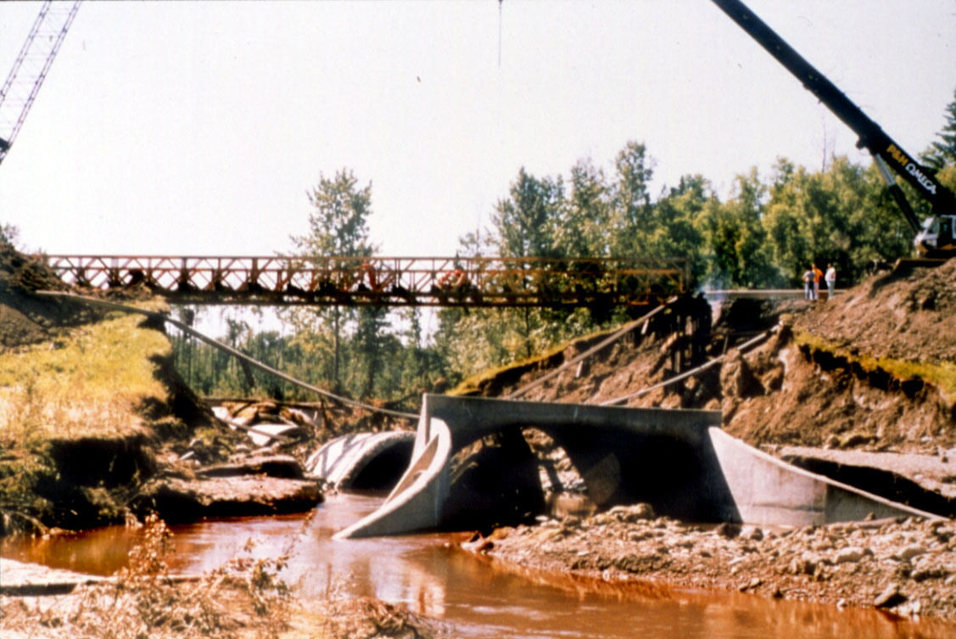
Culvert outlet after high water.

Slide 46
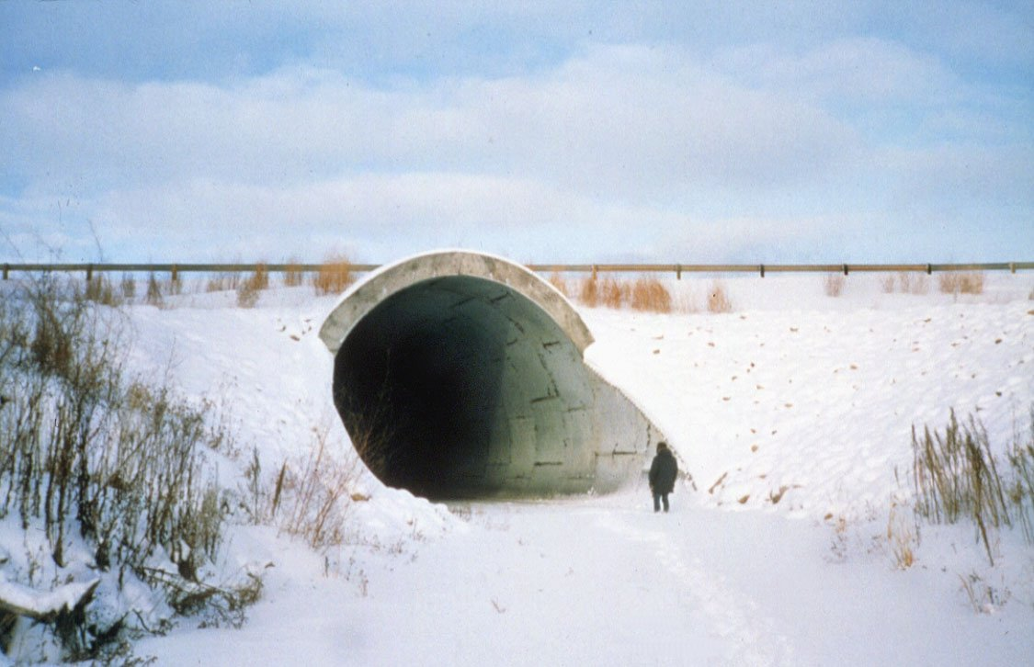
Inlet of new culvert, following winter.

Slide 47
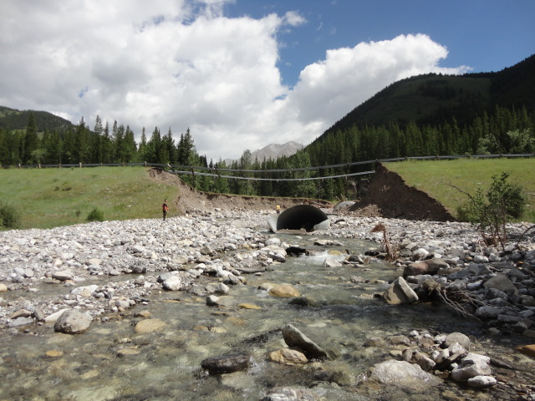
Hwy. 40 Lineham Creek – Washout of 4.3m SPE – 2013 Flood Event and drift blockage – Showing Outlet

Slide 48
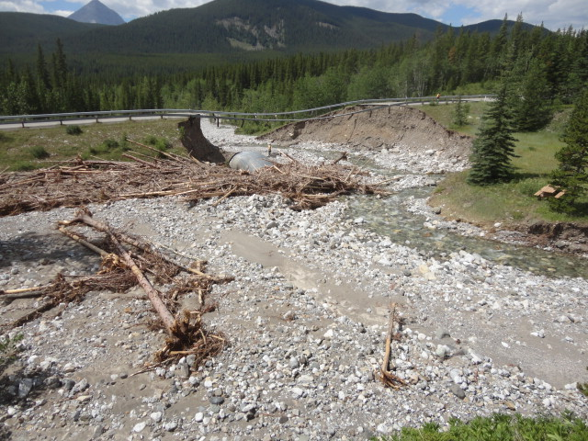
Hwy. 40 Lineham Creek – Washout of 4.3m SPE – 2013 Flood Event – Inlet blocked by drift

Slide 49
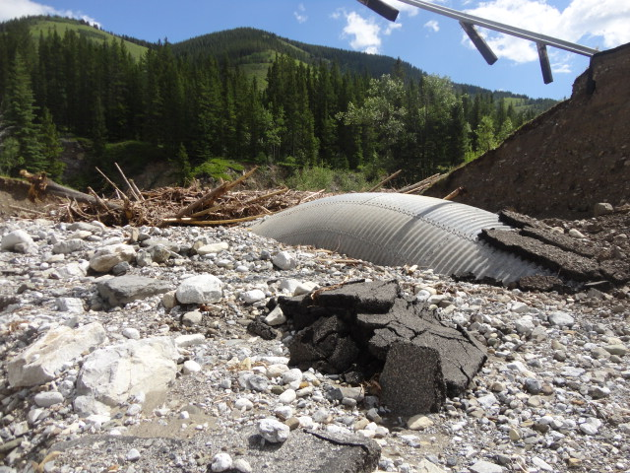
Hwy. 40 Lineham Creek – Washout of 4.3m SPE – 2013 Flood Event

Slide 50
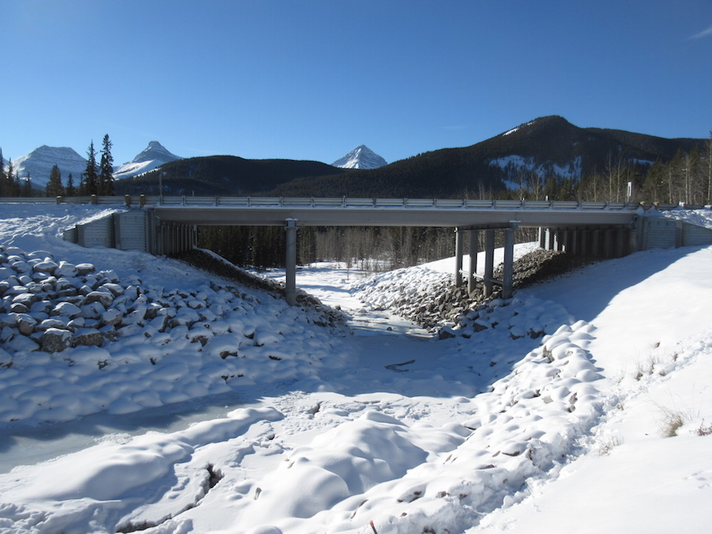
Hwy. 40 Lineham Creek – Replacement with 8-14-8M SLW girders in 2015

Slide 51
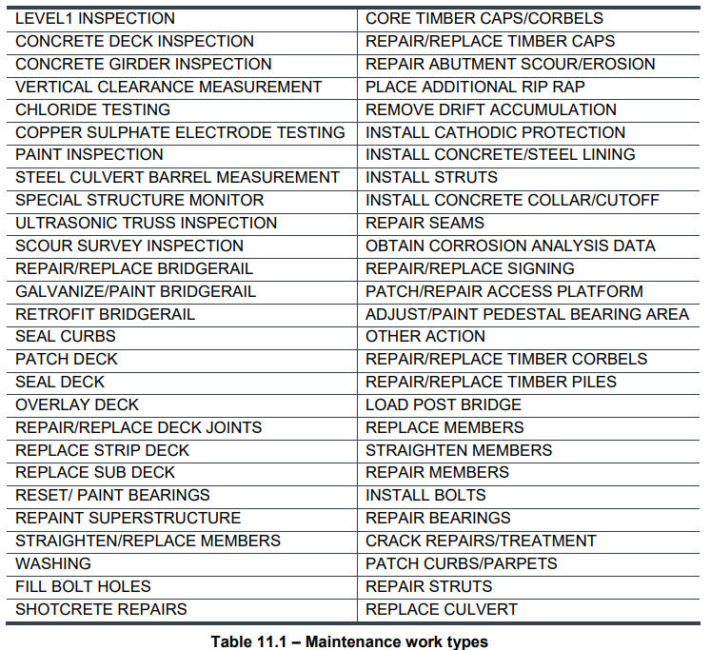
Table 11.1 Maintenance Work Types – Culverts & Bridges

Slide 52
Timber Strutting of Metal Culverts

Slide 53
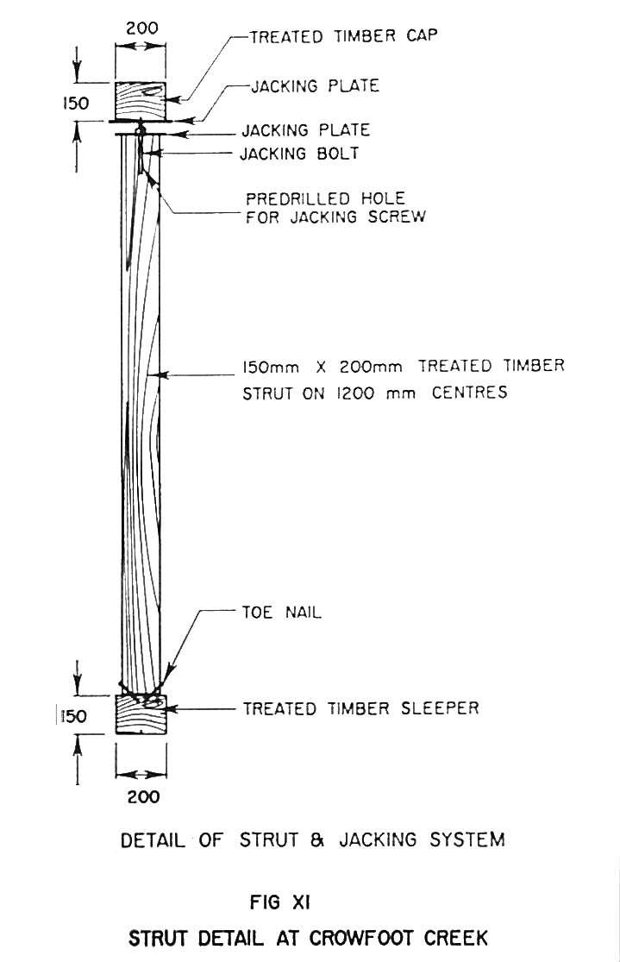
Strut detail (Crowfoot Creek Hwy 1).

Slide 54
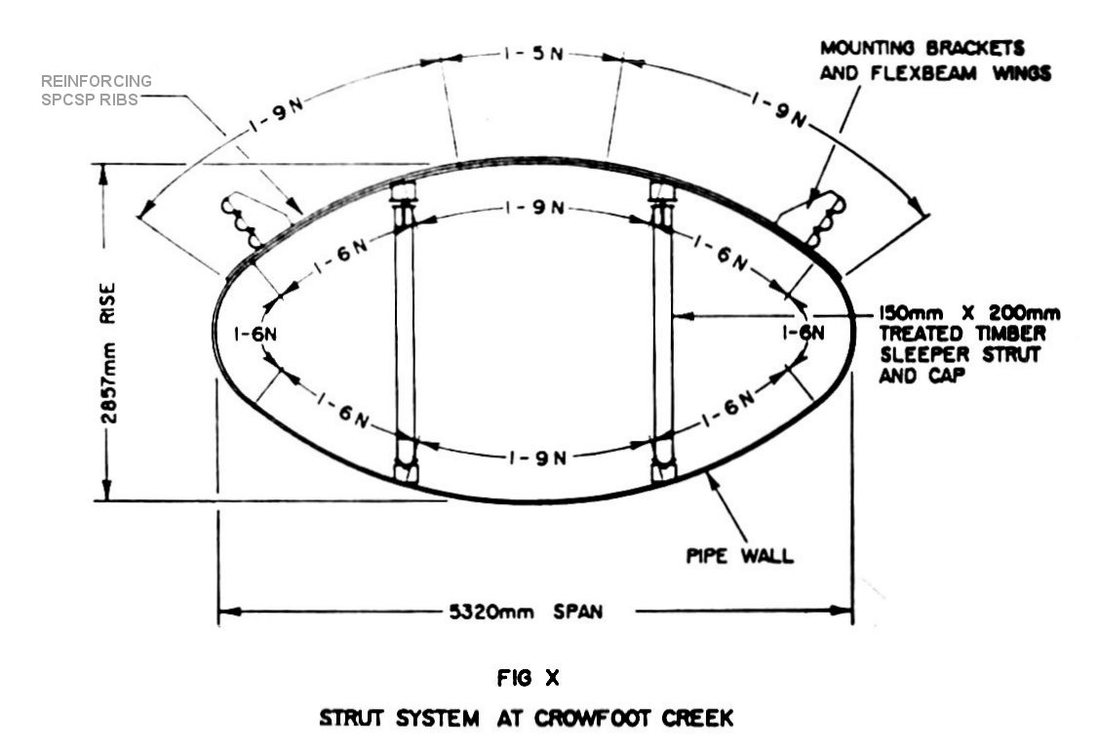
Strutting arrangement for a horizontal ellipse.

Slide 55
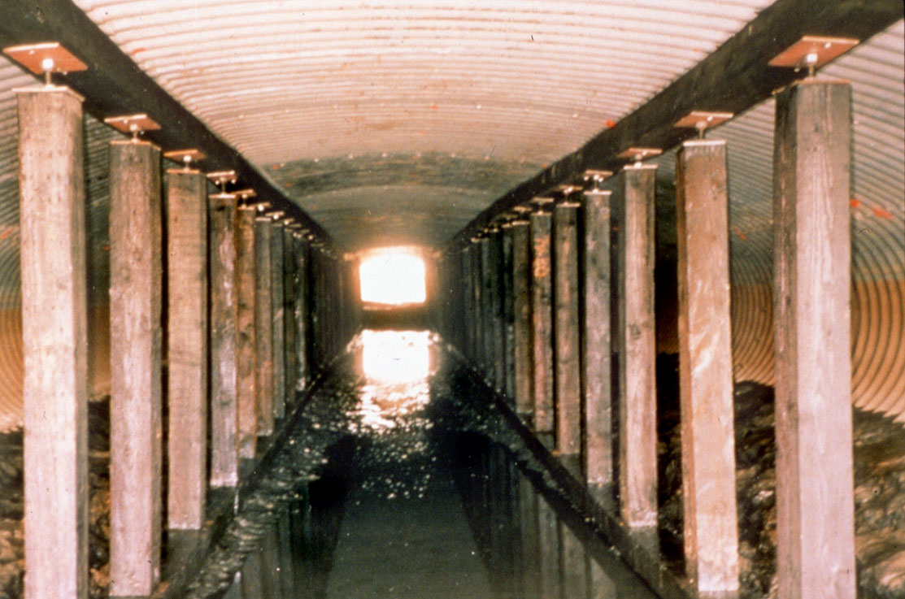
Completed installation of adjustable struts

Slide 56
Culvert Liners

Slide 57
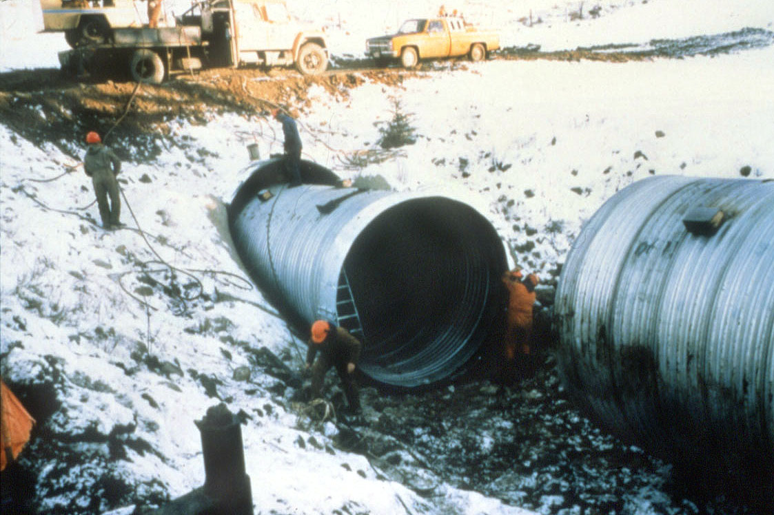
Installing a CSP liner.

Slide 58
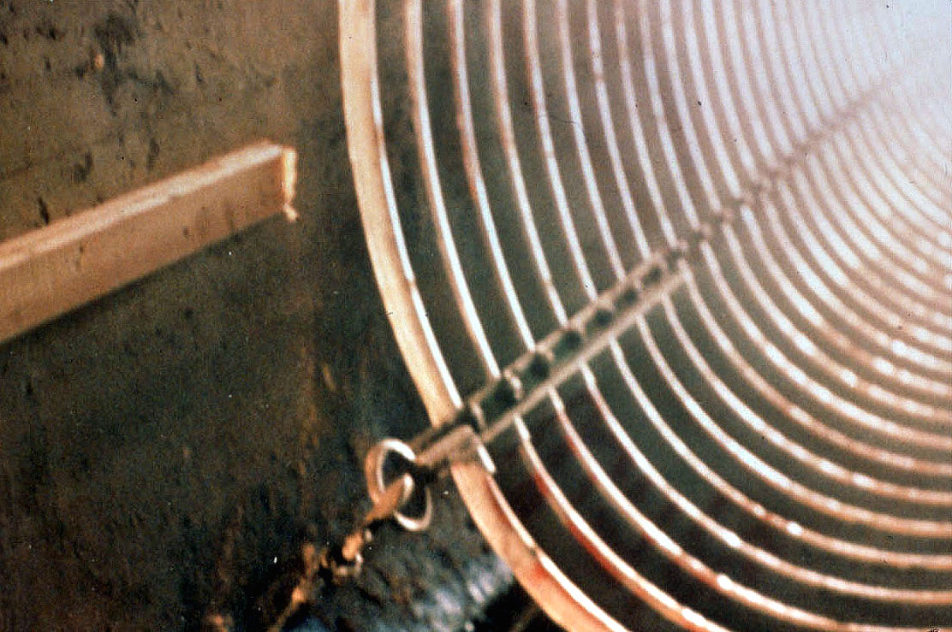
SPCSP liner is assembled outside and then pulled into an existing culvert.

Slide 59
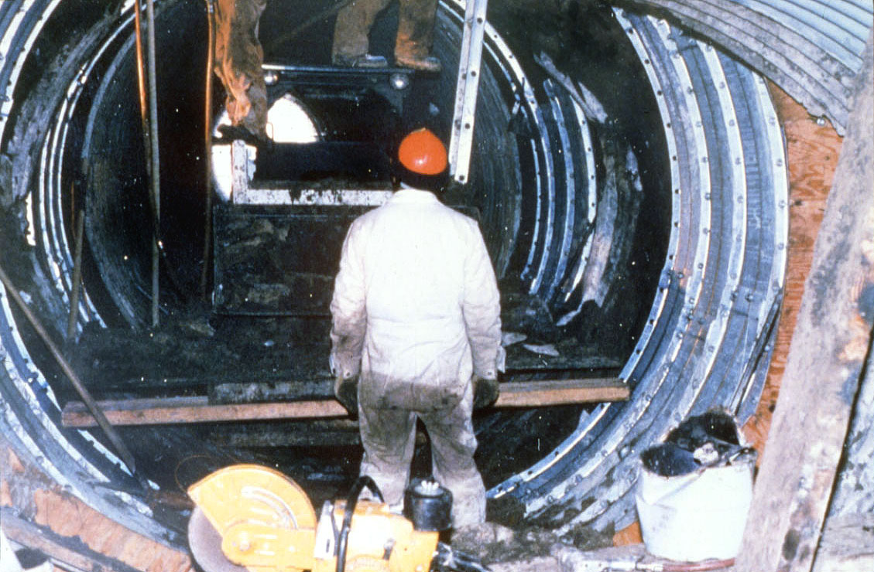
For larger culverts, tunnel liner plates are used.

Slide 60
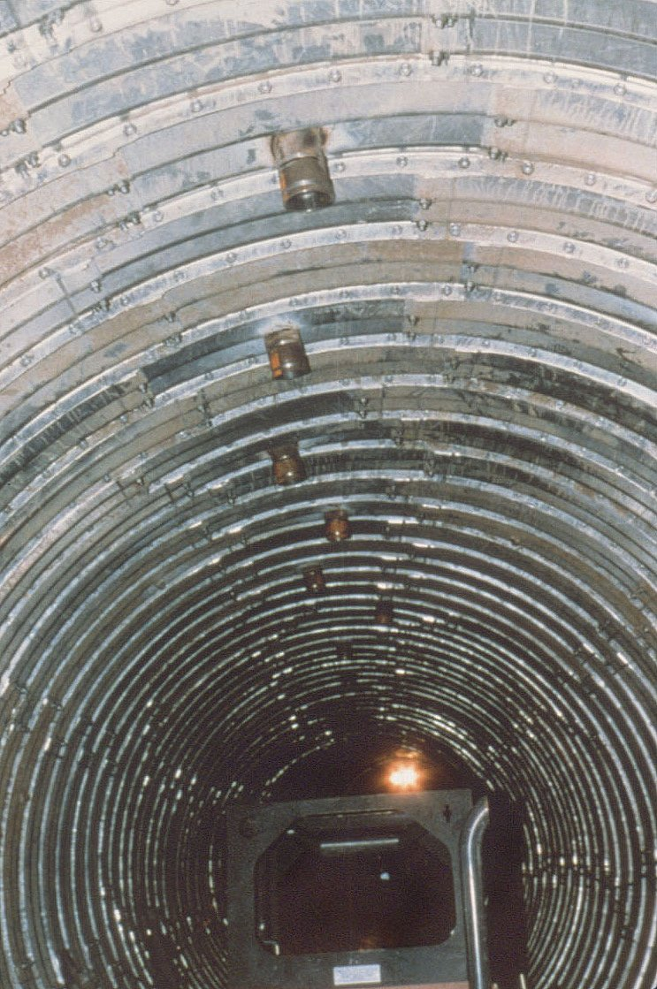
Liner installed ready for grouting.

Slide 61
Barrel Maintenance
Circumferential Seams
  separated
    inject concrete or grout
    Install inside coupler plates
Longitudinal Seams
  cracked
    monitor
    shotcrete reinforcement
    cast 1/2 arc concrete
    install liner

Slide 62
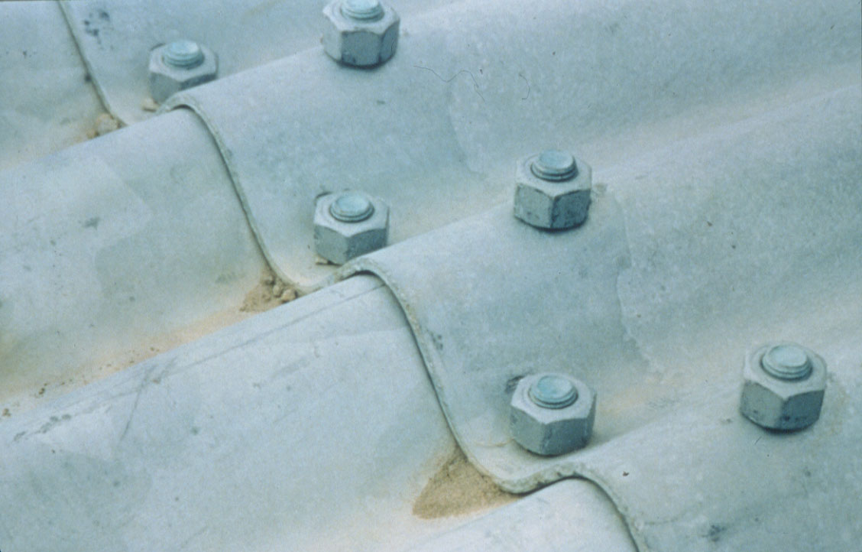
Properly lapped seam.

Slide 63
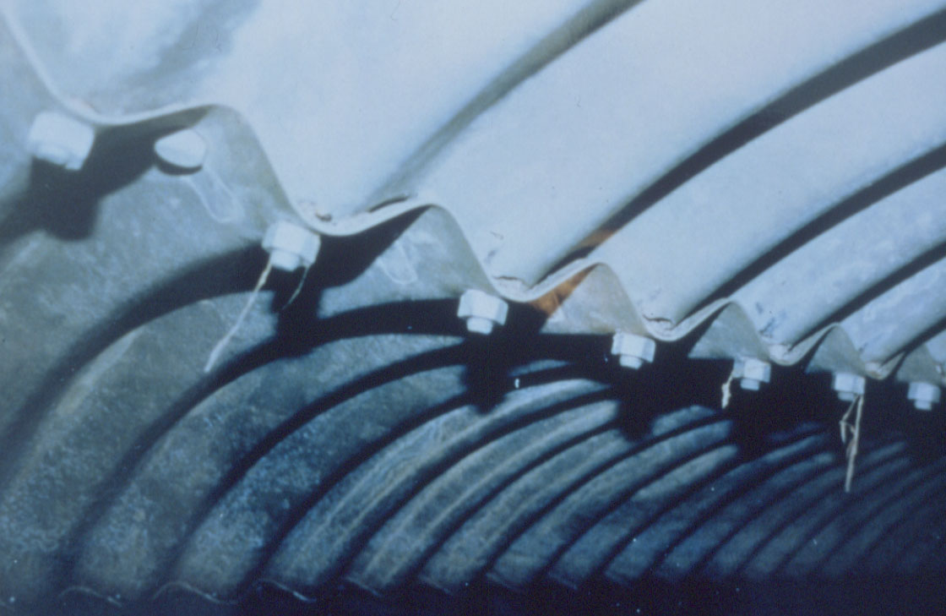
Incorrectly lapped seam with poor nesting

Slide 64
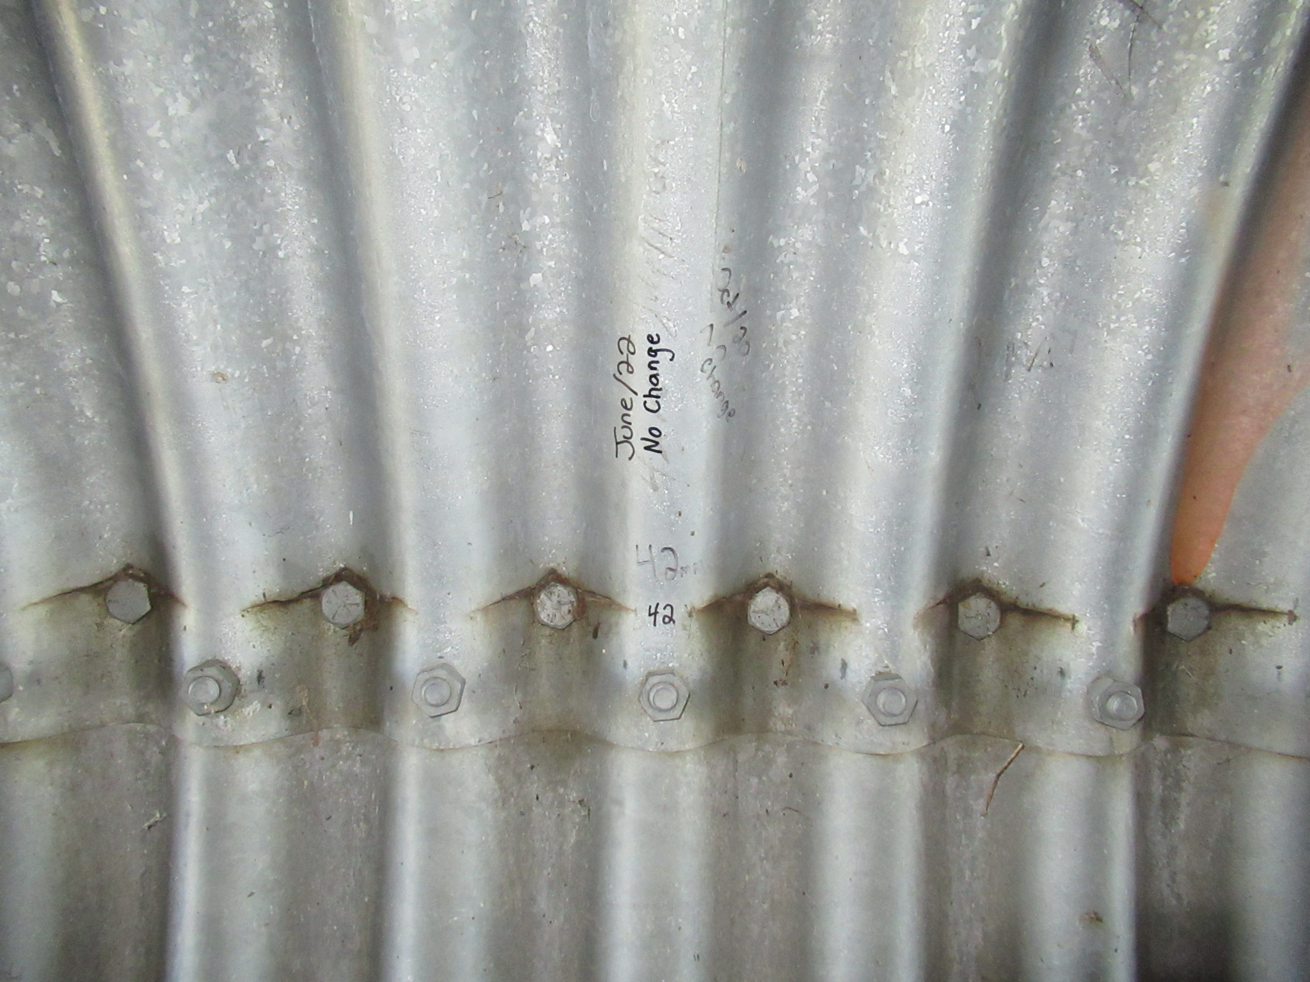
Incorrectly lapped seam with cracks

Slide 65
Longitudinal Seam Reinforcing

Slide 66
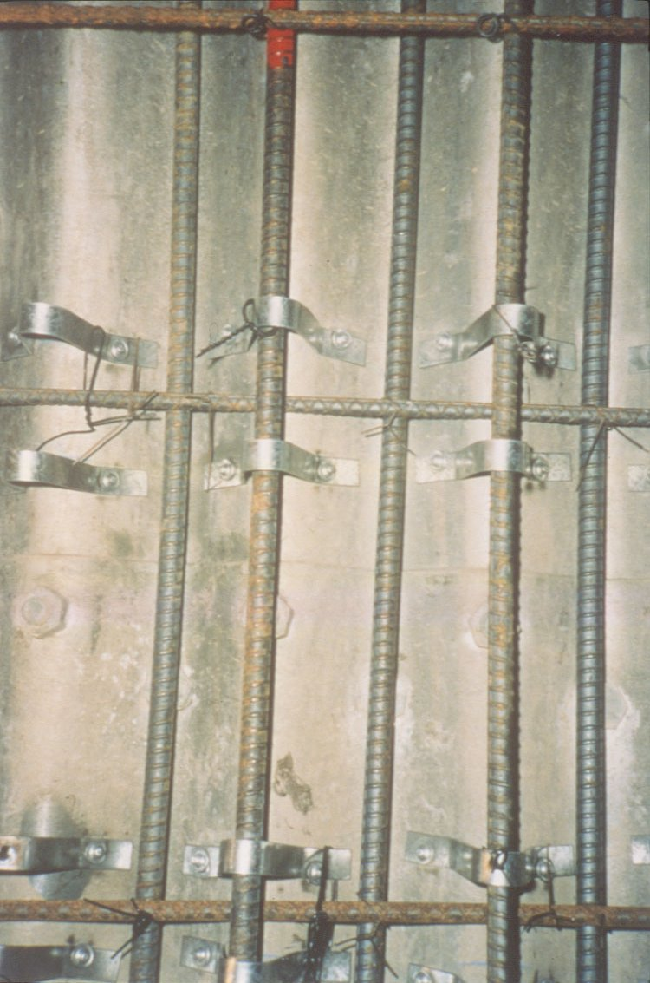
Reinforcing and shear connectors fastened to culvert.

Slide 67
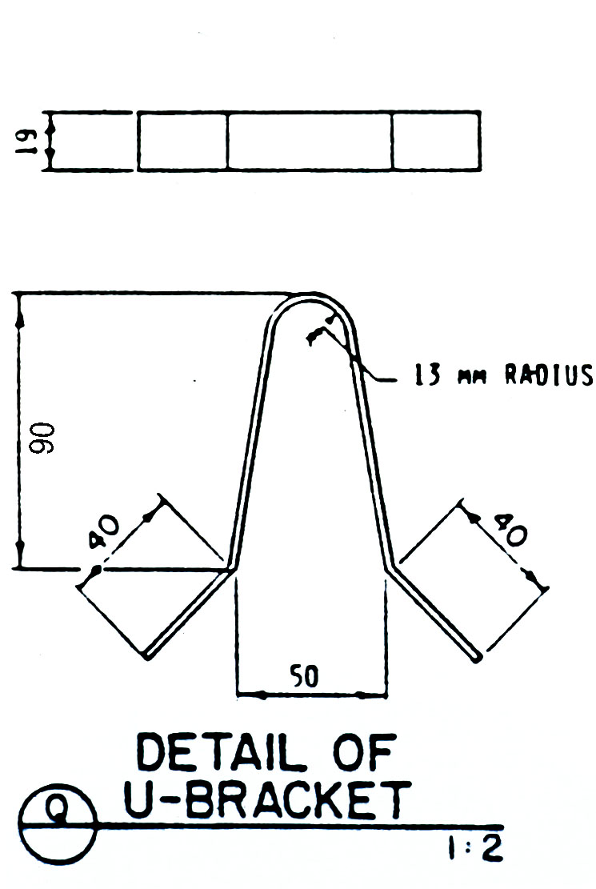
Shear connector detail.

Slide 68
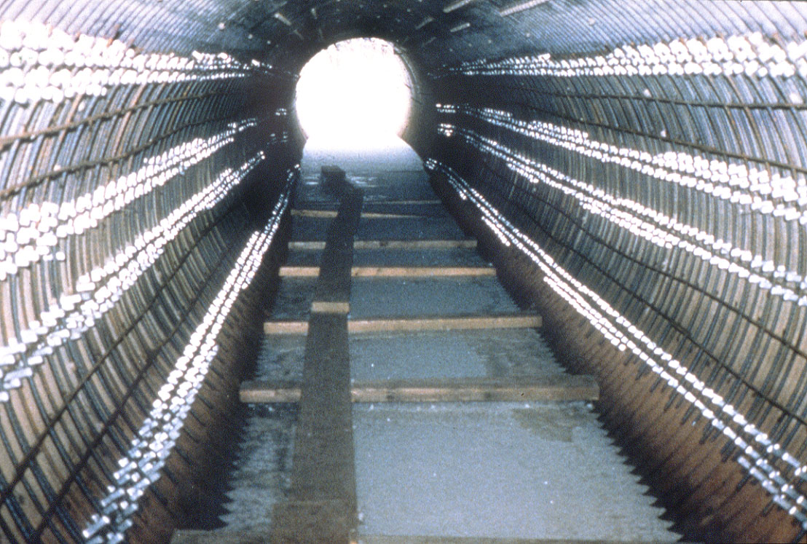
Shear connectors and rebar in place over cracked seam.

Slide 69
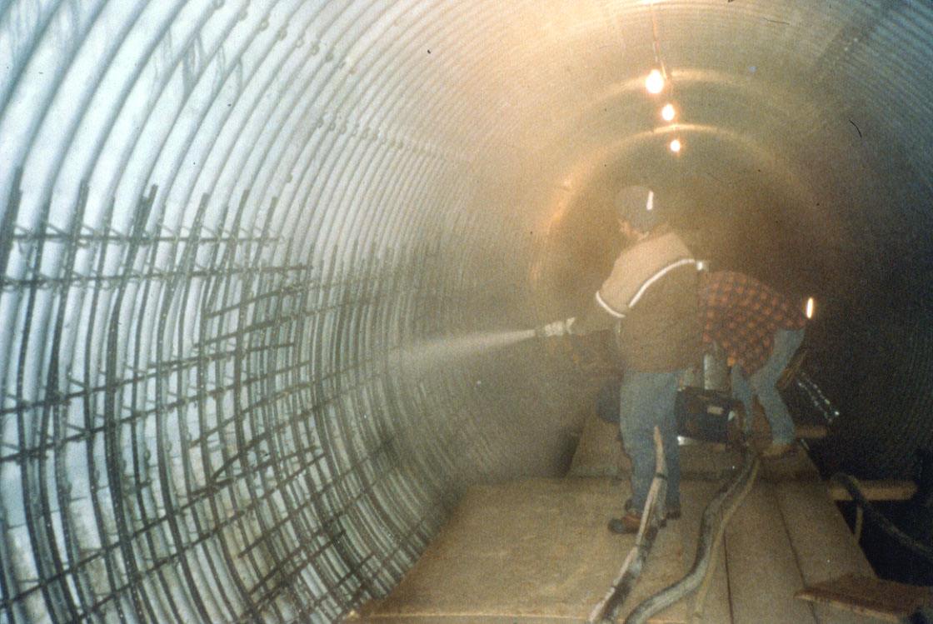
Applying the shotcrete.

Slide 70

Completed shotcrete reinforcing beams.

Slide 71

Bottom reinforcement for arch shaped culvert.
(Nose Creek Hwy 2)

Slide 72

Reinforcing installed for arch culvert reinforcement.

Slide 73

Floor cast inside arch culvert.

Slide 74
Barrel Maintenance
Coating
  Corrosion
    Soil side corrosion
    Liner
    Water side corrosion
    Concrete floor
    Liner

Slide 75
Barrel Maintenance (Cont’d)
Fish Passage Adequacy
  add baffles
    cast concrete
    rocks
    weir type
  repair / build downstream apron
Waterway Adequacy
  install additional culvert (jacking)
  remove drift or silt
  install stream lining

Slide 76
Channel Maintenance
Similar to bridges - Degrading (scour), Aggrading
Drift more of a concern
Beavers are common
High velocities at outlet

Slide 77

Drift collected at inlet

Slide 78

Drift in strutted barrel – 100% blockage

Slide 79

Questions?

