Slide 1
INSPECTION OF STEEL GIRDER BRIDGES

Slide 2
Introduction
Topics Covered in this Presentation:
Bridge superstructure systems
Defects in steel members
Failure mechanics
Fatigue
Constrained Induced fracture (CIF)
Inspection
Inspection of Pin & Hanger

Slide 3
Bridge Superstructure Systems

Slide 4
Bridge Superstructure Systems
Rolled beams
Manufactured from one piece of steel
Webs are stocky, therefore no intermediate stiffeners.
Used as simple spans with span length from 9 to 15 m
Rolled beams with cover plates
Cover plates were added to increase the capacity
Cover plates were welded or riveted to the flanges
Welded cover plates created fatigue prone detail

Slide 5
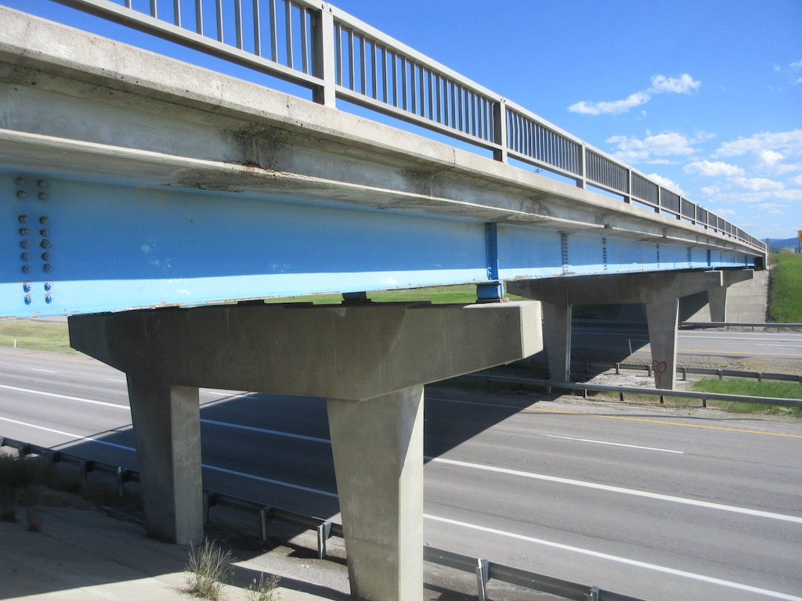
Bridge Superstructure Systems
Rolled Beam

Slide 6
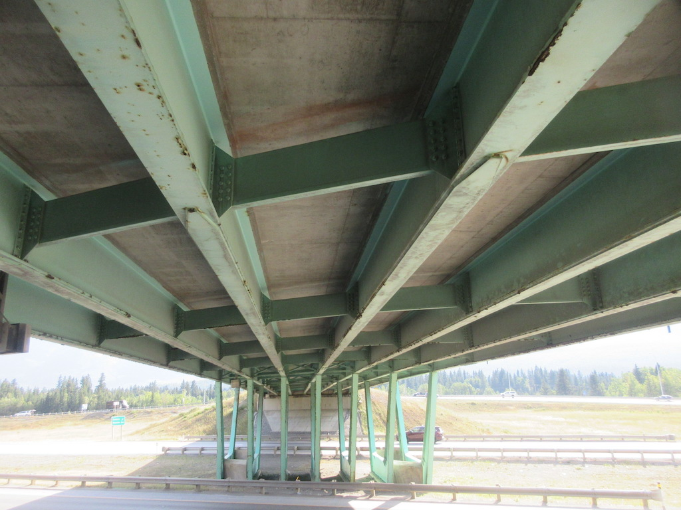
Bridge Superstructure Systems
Rolled Beam
with
Cover Plates

Slide 7
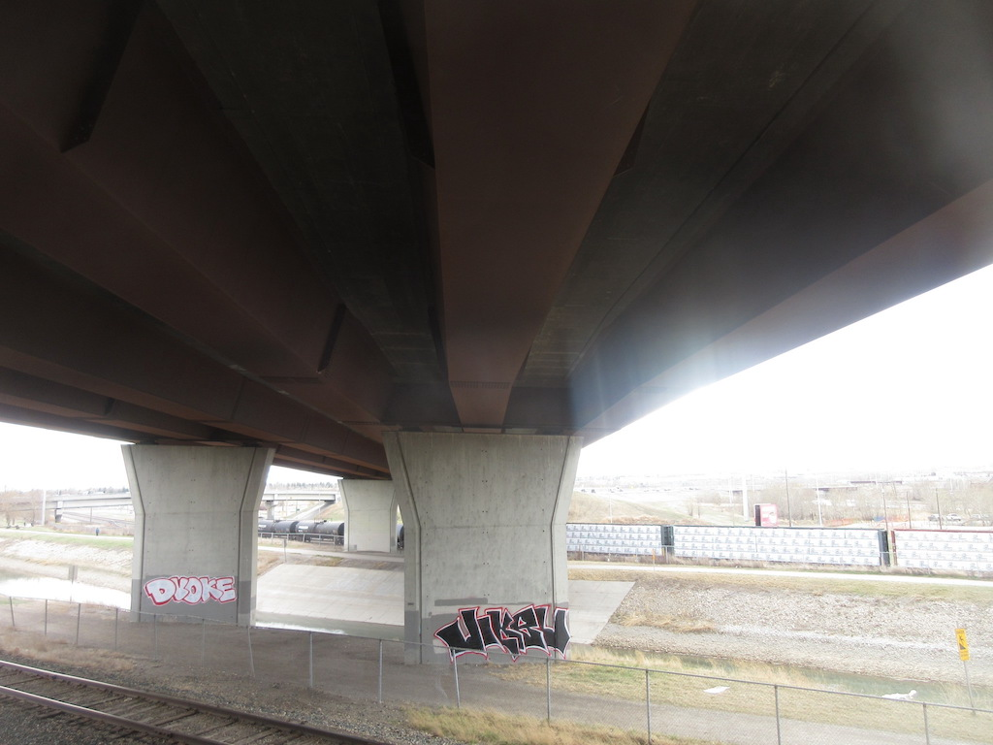
Bridge Superstructure Systems
Steel Tub Girders

Slide 8
Bridge Superstructure Systems
Built-up Girders
Similar in appearance as rolled beams
Custom fabricated, not produced in rolling mills
Fabricated from thin plates, hence require stiffeners
Older built-up girders were riveted, newer are welded plates
Continuous girders can have spans over 150 m

Slide 9
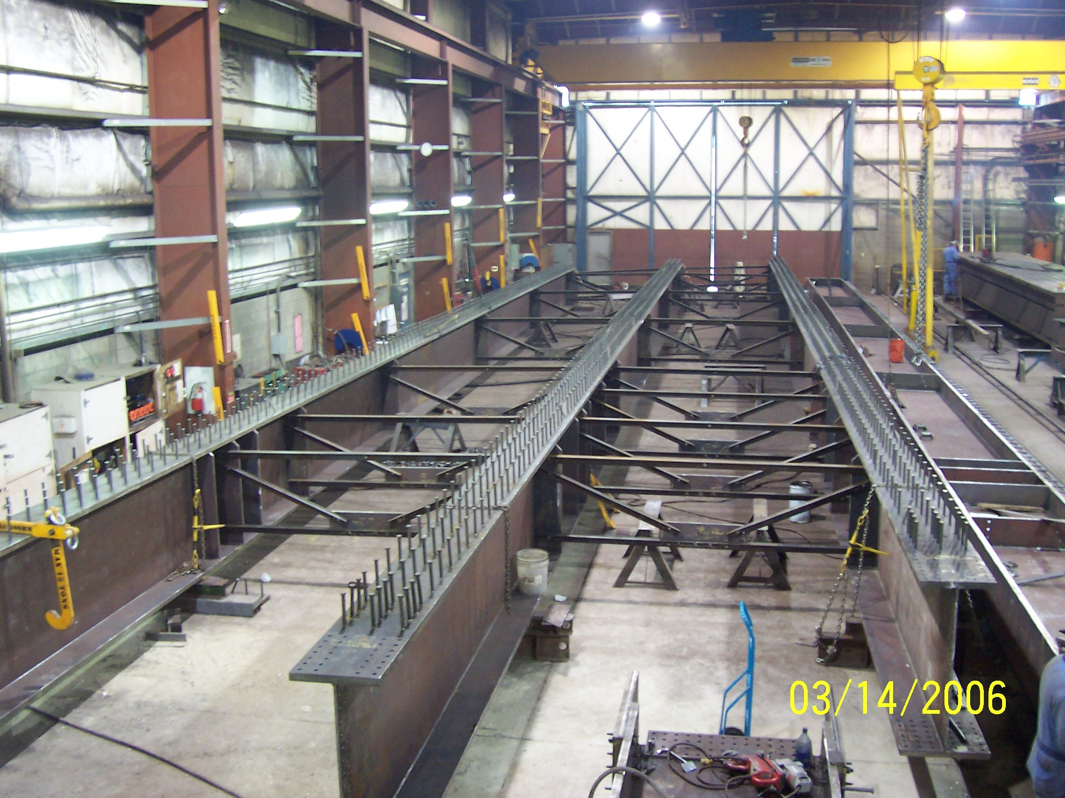
Bridge Superstructure Systems
Built-up
Girders

Slide 10
Bridge Superstructure Systems
Girders with Pin and Hanger
Analysis is simplified for a hinged structure
It moves drainage away from piers
Only one pin is required for rotation
For translation and rotation, two pins and hanger are provided
Steel Arches
Three types of arches: deck, through and tied
Arch spans range from 300 to 500 m
Notes:
Translation is a measure of how much a point in the structure has moved from its original position

Slide 11
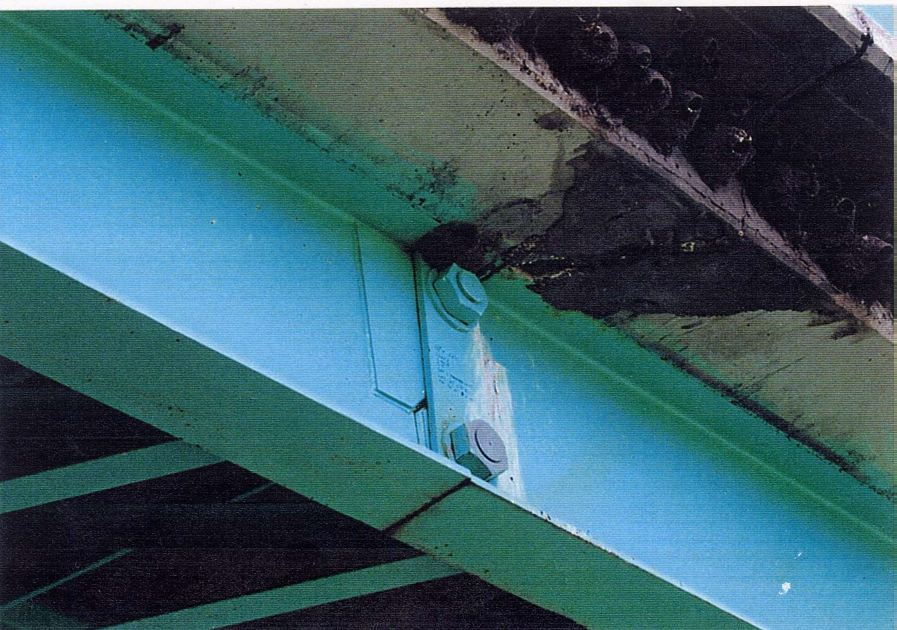
Bridge Superstructure Systems
Girder with
Pin & Hanger

Slide 12
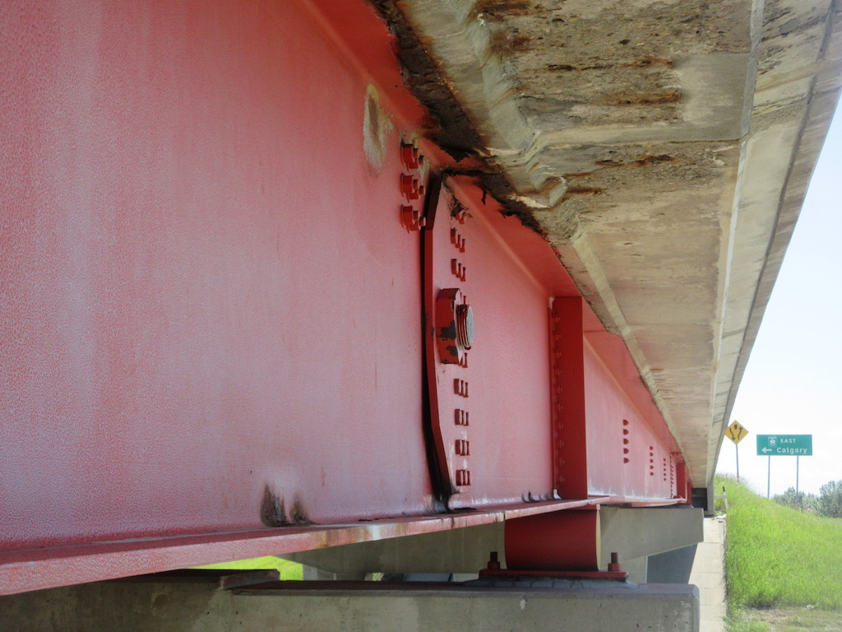
Bridge Superstructure Systems
Girder with
Pin

Slide 13
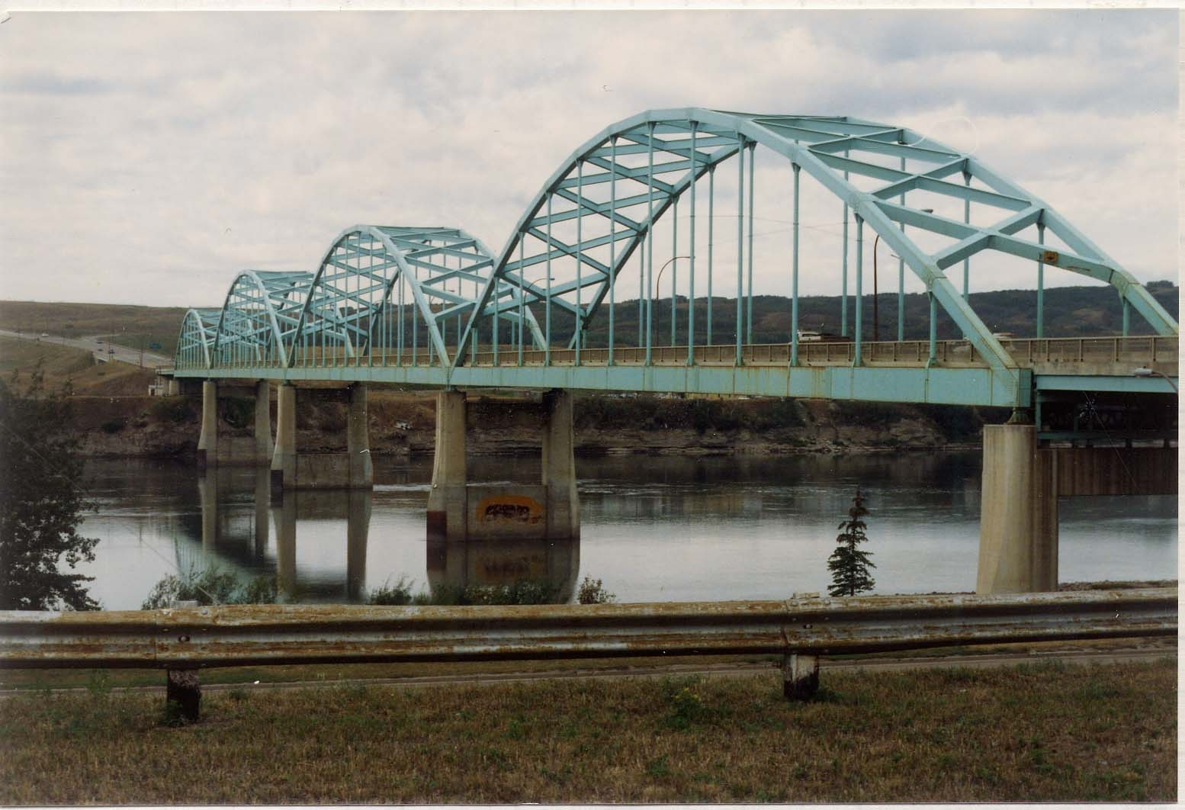
Bridge Superstructure Systems
Steel Arch

Slide 14
Bridge Superstructure Systems
Suspension Bridges
7. Trusses
Through Truss
Pony Truss
Deck Truss

Slide 15
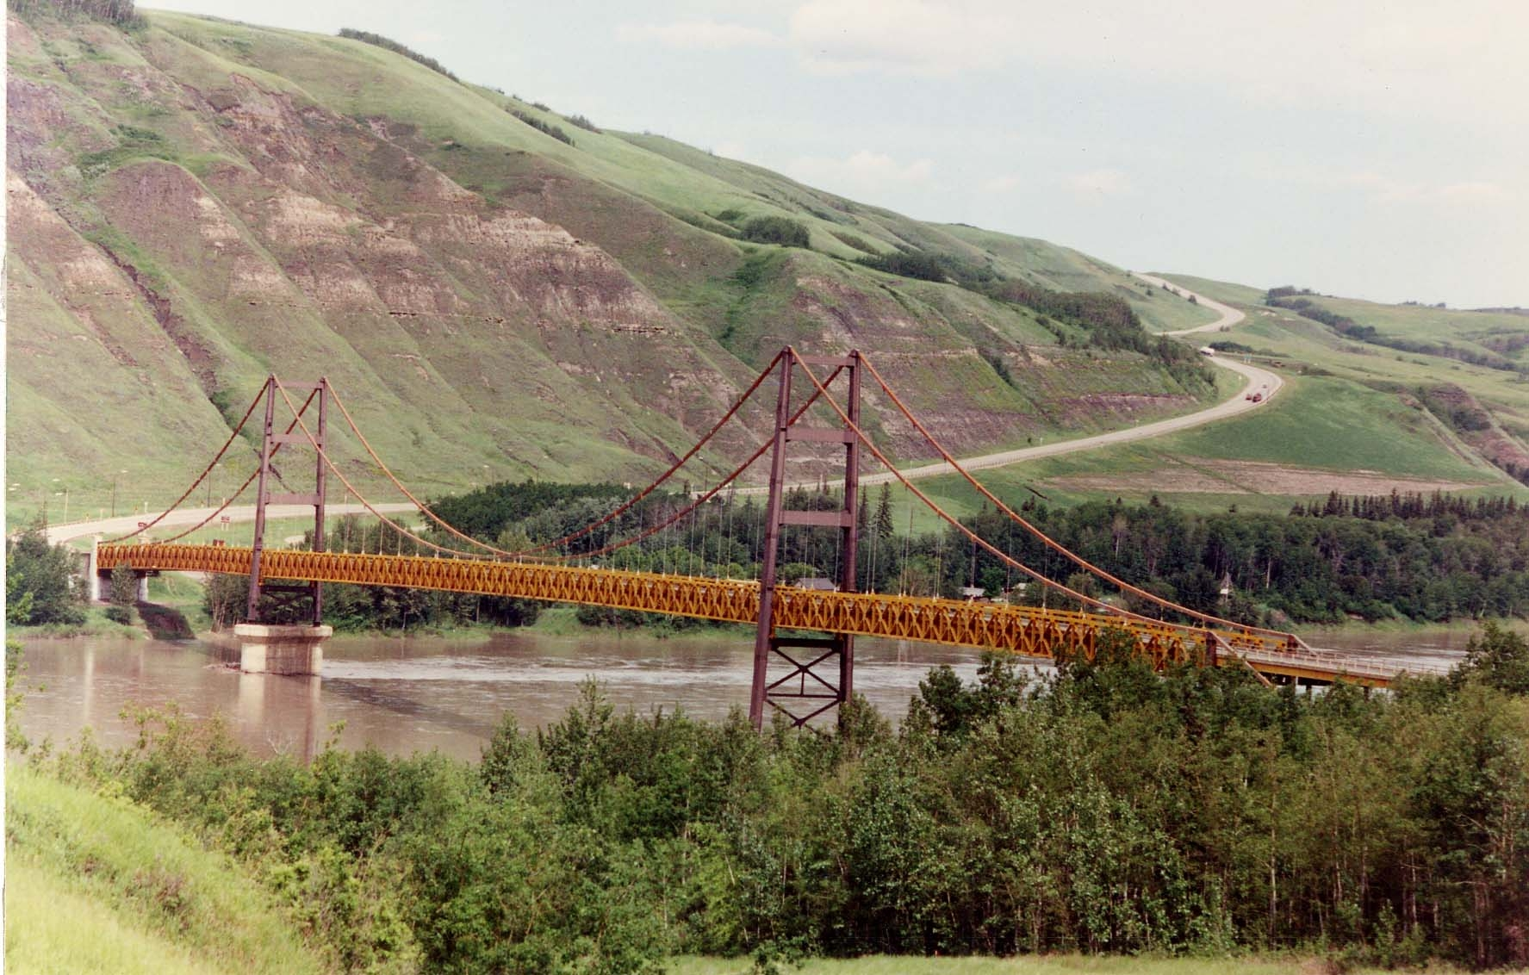
Bridge Superstructure Systems
Suspension
Bridge

Slide 16
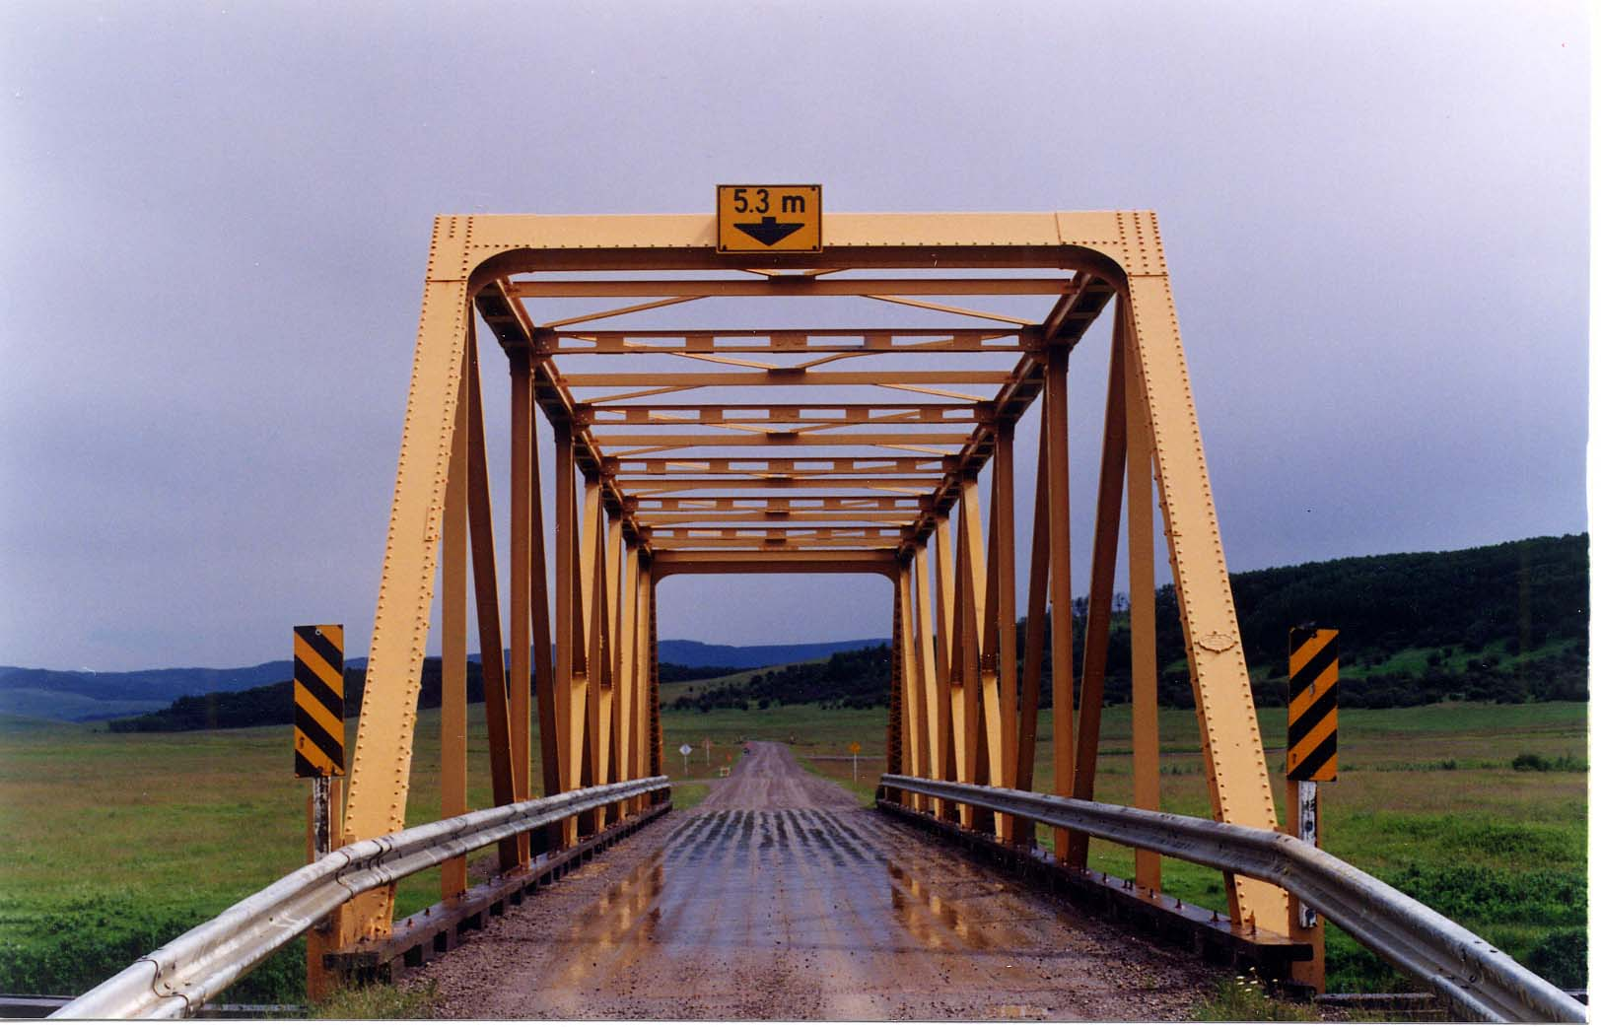
Bridge Superstructure Systems
Through Truss

Slide 17
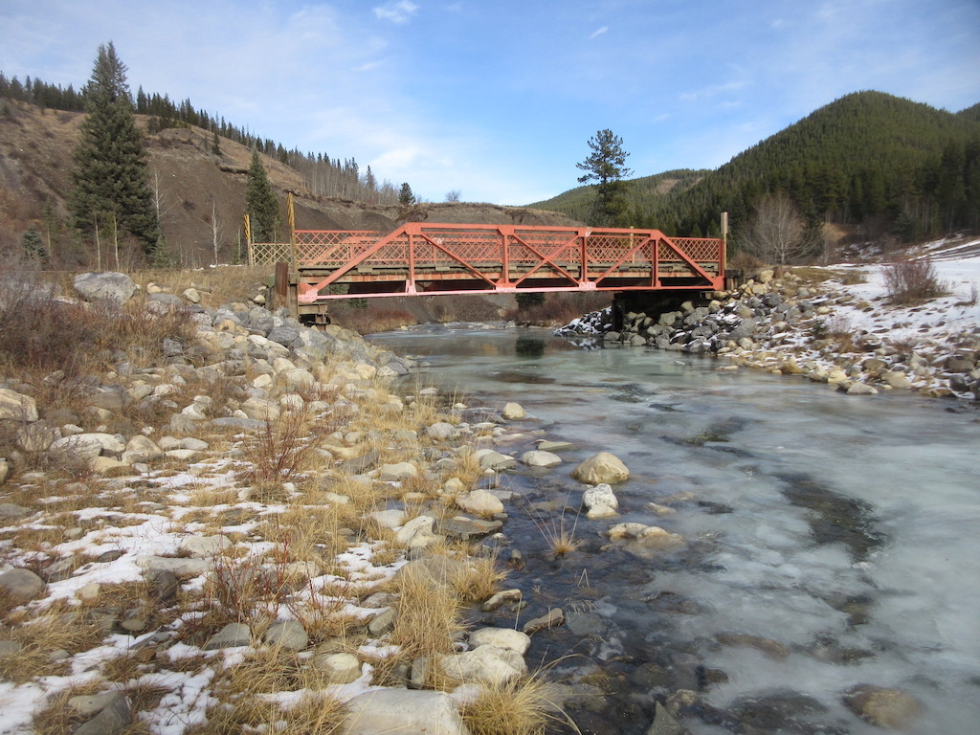
Bridge Superstructure Systems
Pony Truss

Slide 18
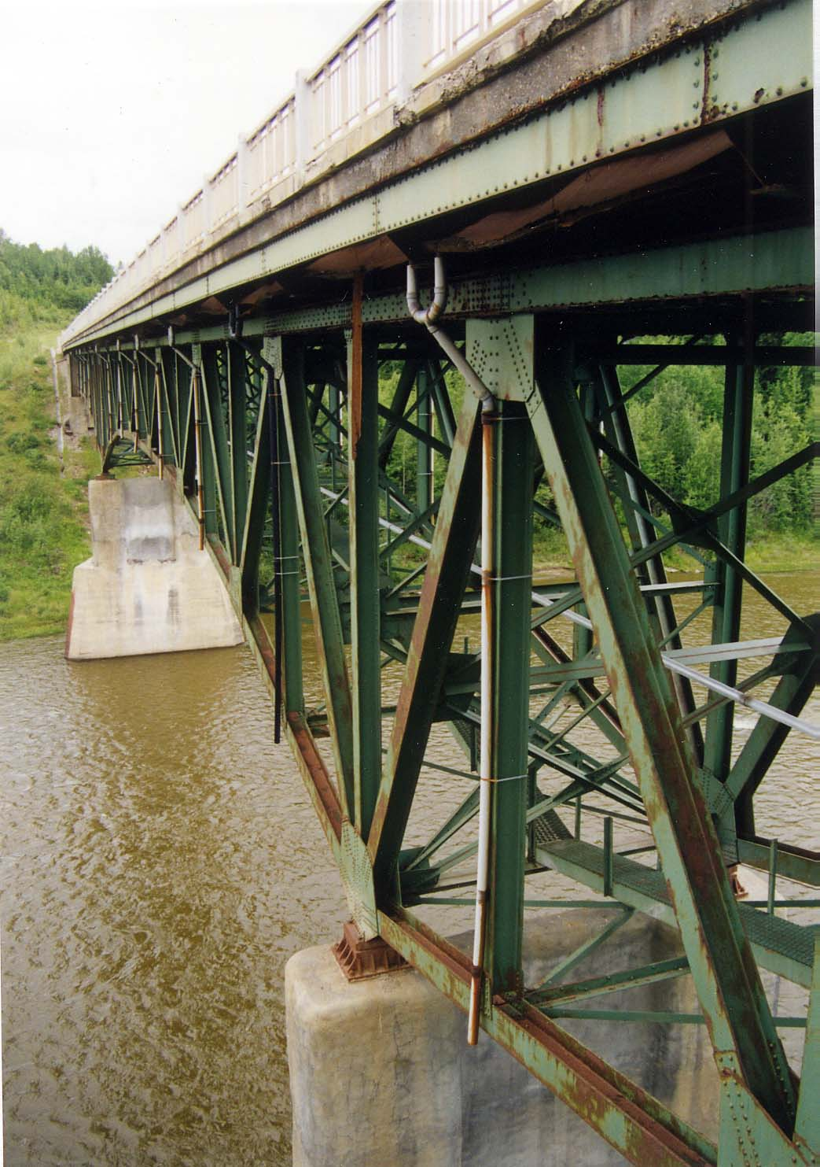
Bridge Superstructure Systems
Deck Truss

Slide 19
Primary and Secondary Members
Primary Members for Bridge Systems 1 to 4
Fabricated girders / Rolled beams
Diaphragms for curved girders
Pin and hanger
Secondary Members for Bridge Systems 1 to 4
Diaphragms

Slide 20
Primary and Secondary Members
Primary Members for Bridge System 7
Trusses (chords, web members)
Floor beams
Stringers
Secondary Members for Bridge System 7
Bracing

Slide 21
Defects in Steel Members

Slide 22
Steel Damage and Deterioration
Corrosion
Environmental corrosion
Stray current corrosion
Stress corrosion
Cracking
Fatigue
Impact
Excessive loading
Deformation
Excessive Loading
Impact
Heat Damage

Slide 23
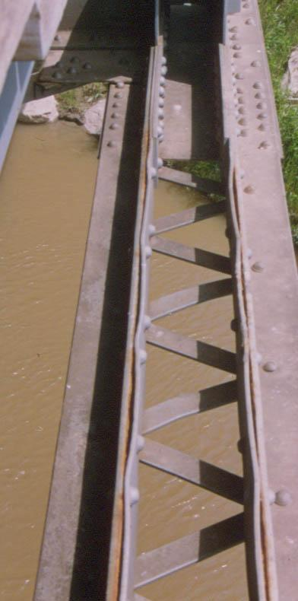
Steel Damage and Deterioration
Corrosion

Slide 24
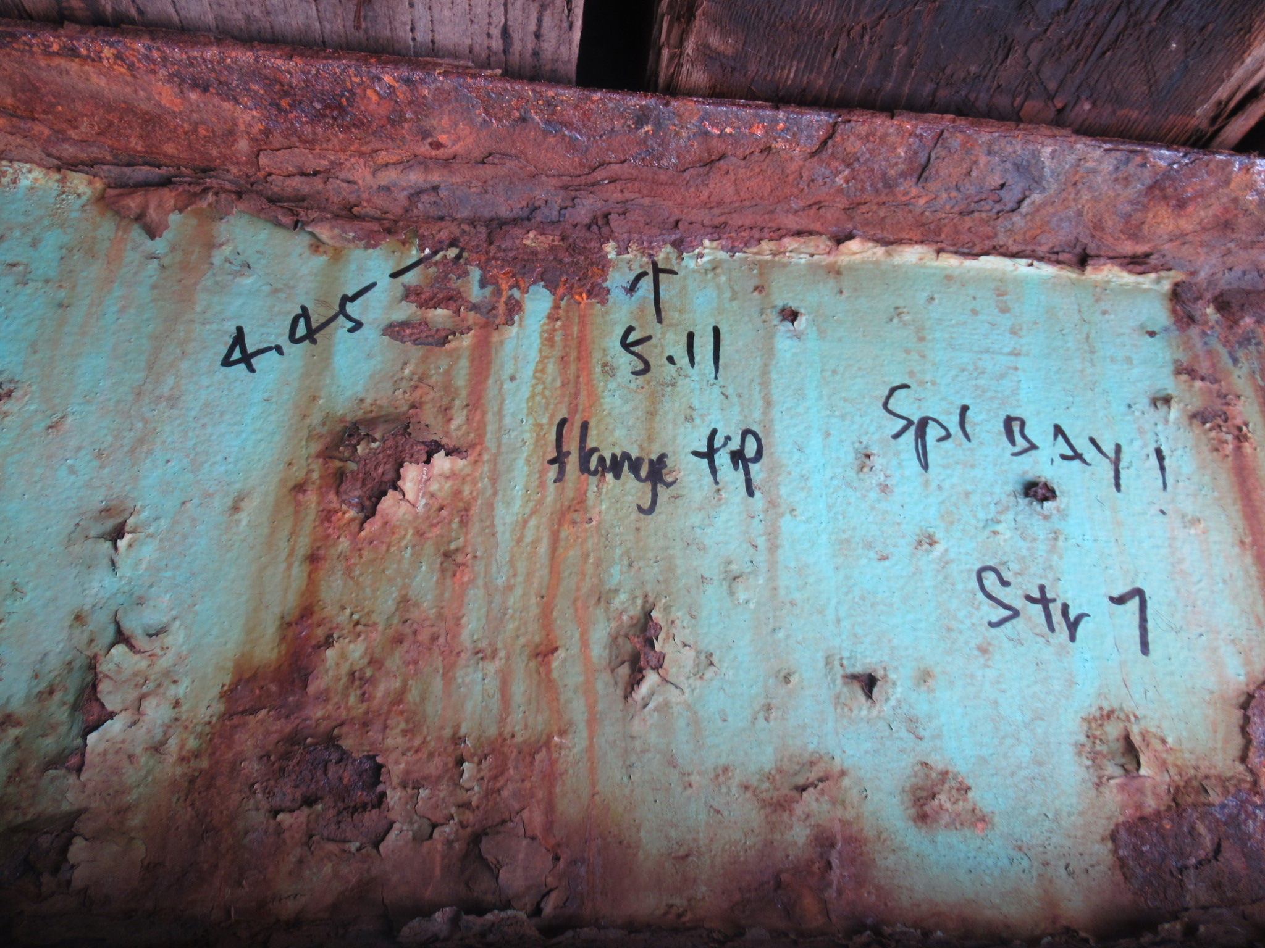
Steel Damage and Deterioration
Corrosion

Slide 25
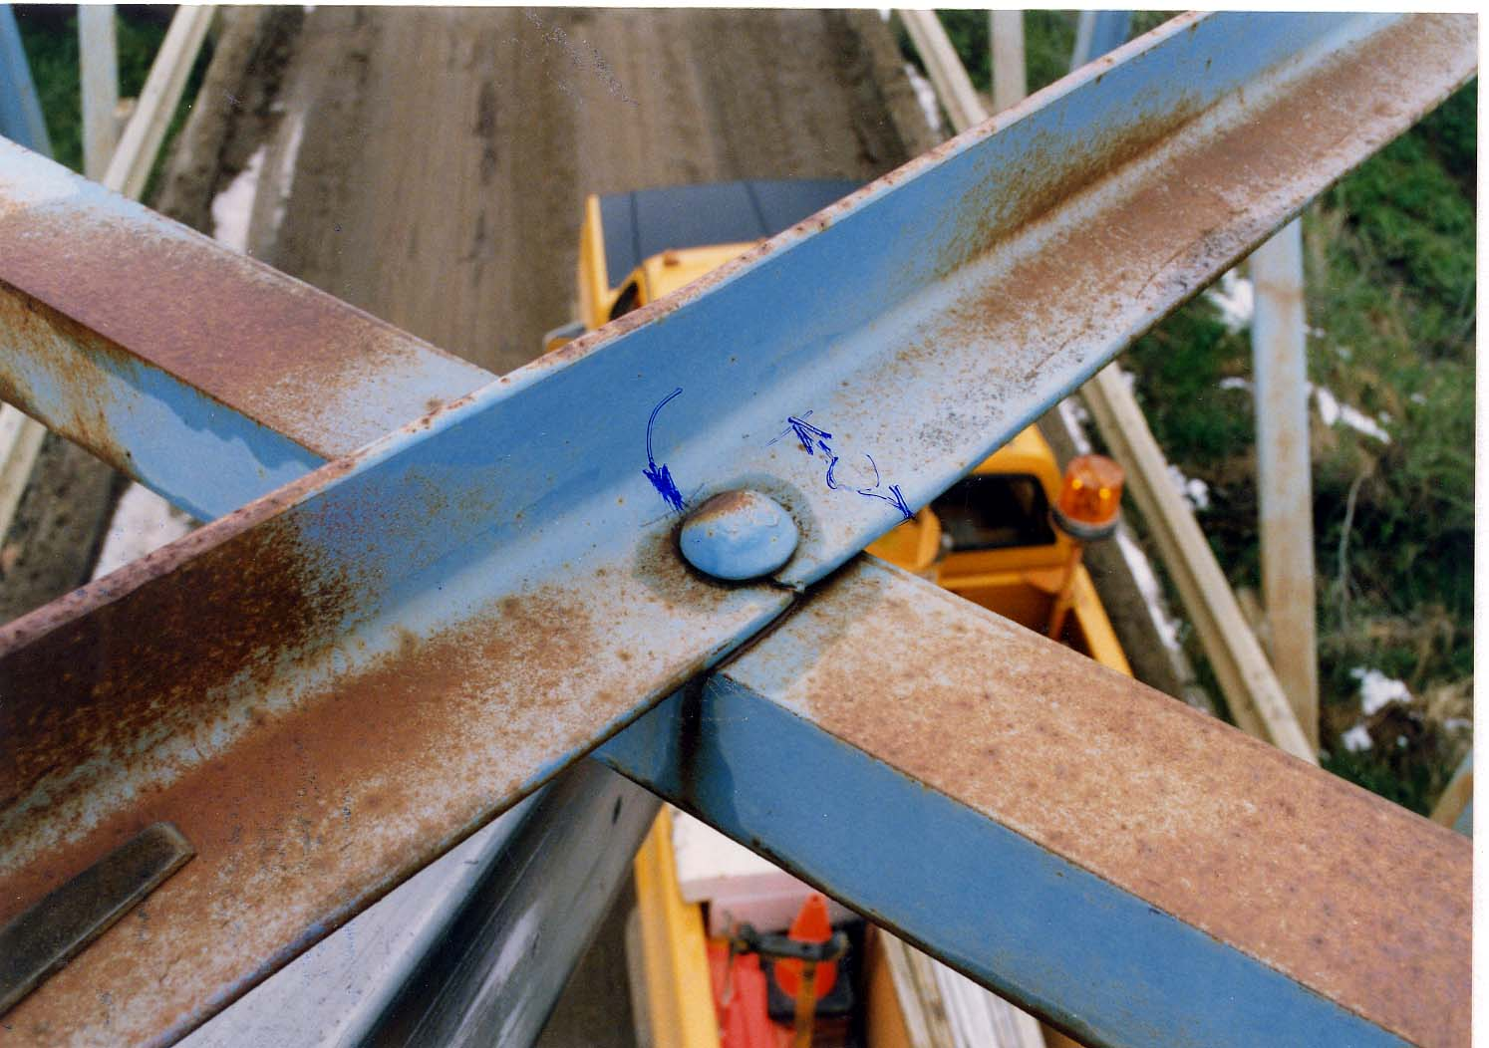
Steel Damage and Deterioration
Fatigue Crack

Slide 26
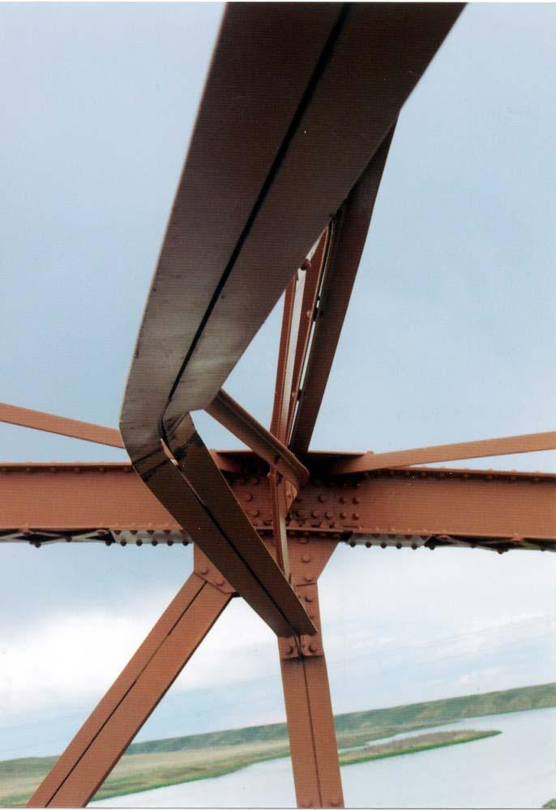
Steel Damage and Deterioration
High Load Impact Damage

Slide 27
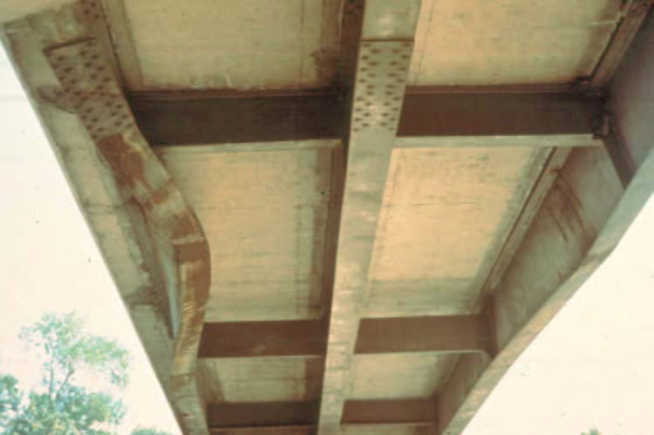
Steel Damage and Deterioration
Impact Damage

Slide 28
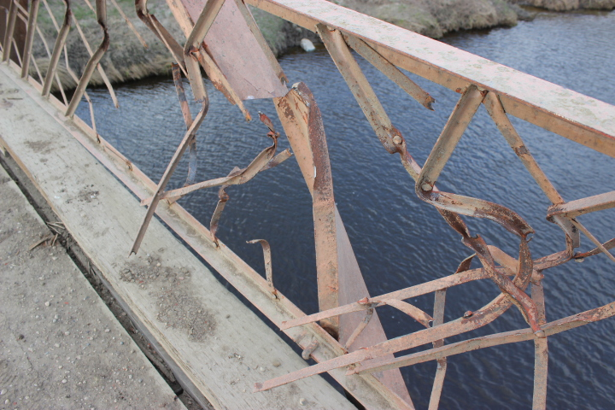
Steel Damage and Deterioration
90% failure of diagonal – wide load impact damage

Slide 29
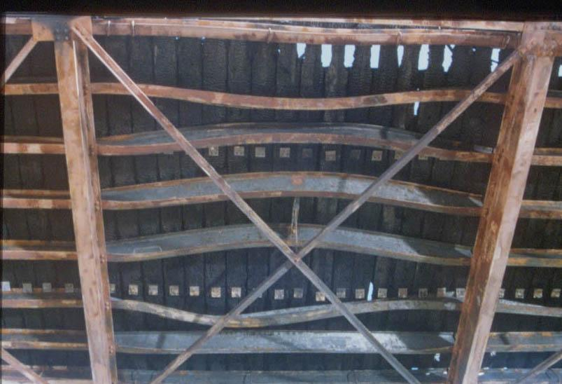
Steel Damage and Deterioration
Fire Damage

Slide 30
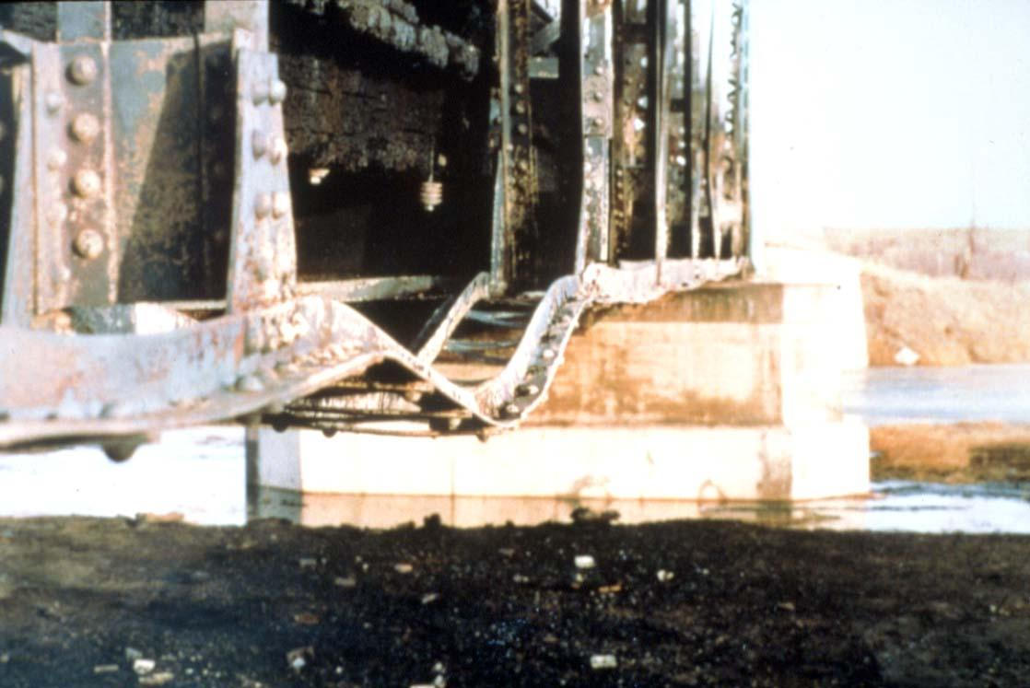
Steel Damage and Deterioration
Fire Damage

Slide 31
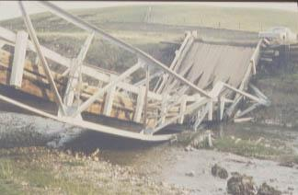
Steel Damage and Deterioration
Overload
Damage

Slide 32
Fatigue & Fracture in Steel Members
Fatigue
Tendency of a member to fail at a stress level below its yield stress when subjected to repeated loading
Fracture Critical Member (FCM)
Member is in tension
Member is non-redundant, its failure causes partial or total collapse of a structure

Slide 33
Failure Mechanics
Describing the process by which a member fails when subjected to fatigue.

Slide 34
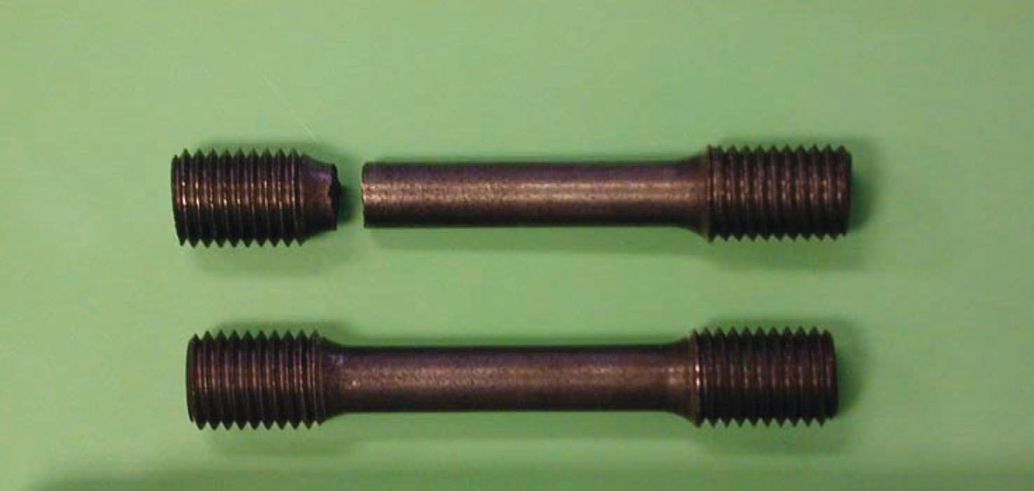
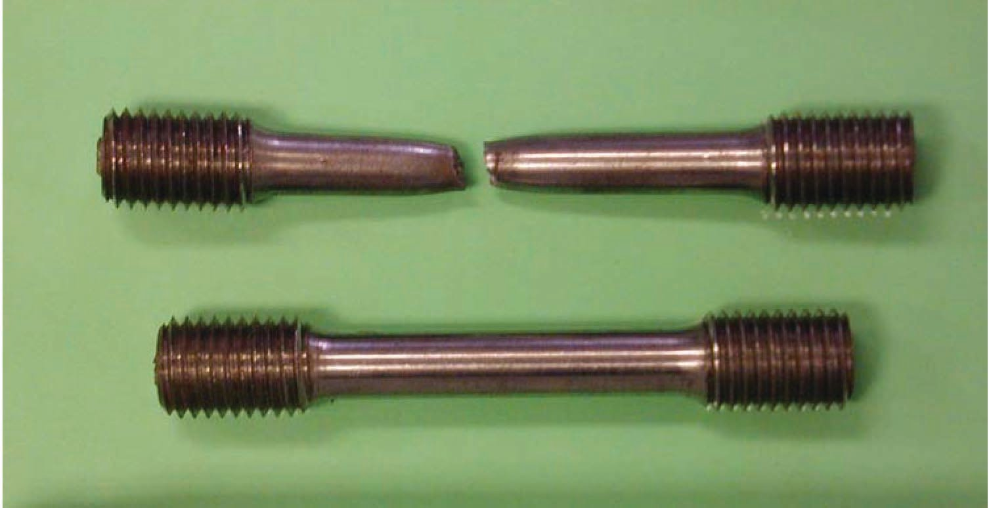
Types of Fractures in Steel Members
Brittle Fracture
Ductile Fracture

Slide 35
Fatigue Crack Categories
Fatigue Failure Process
Fatigue failure process consists of three stages:
Crack initiation
Crack propagation
Fracture
Details and Defects
Out-of-plane Distortion

Slide 36
Factors Affecting Fatigue Crack Initiation (Details & Defects)
Plug welds
Tack welds
Material flaws
External flaws (Surface scabs)
Internal flaws (Non-metallic inclusions, Rolled in plate defects)
Weld flaws
Non-visible flaws (IP welds, Porosity, Slag inclusions)
Visible flaws (Undercut, Overlap)
Fabrication Flaws
Cutting of plates, Holes, Coping

Slide 37
Factors Affecting Fatigue Crack Initiation (Details & Defects)
Transportation & Erection Flaws
Nicks
Notches
Indentation
In-Service Flaws
Collision damage
Improper heat straightening
Torched or notched holes

Slide 38
Plug Weld

Slide 39
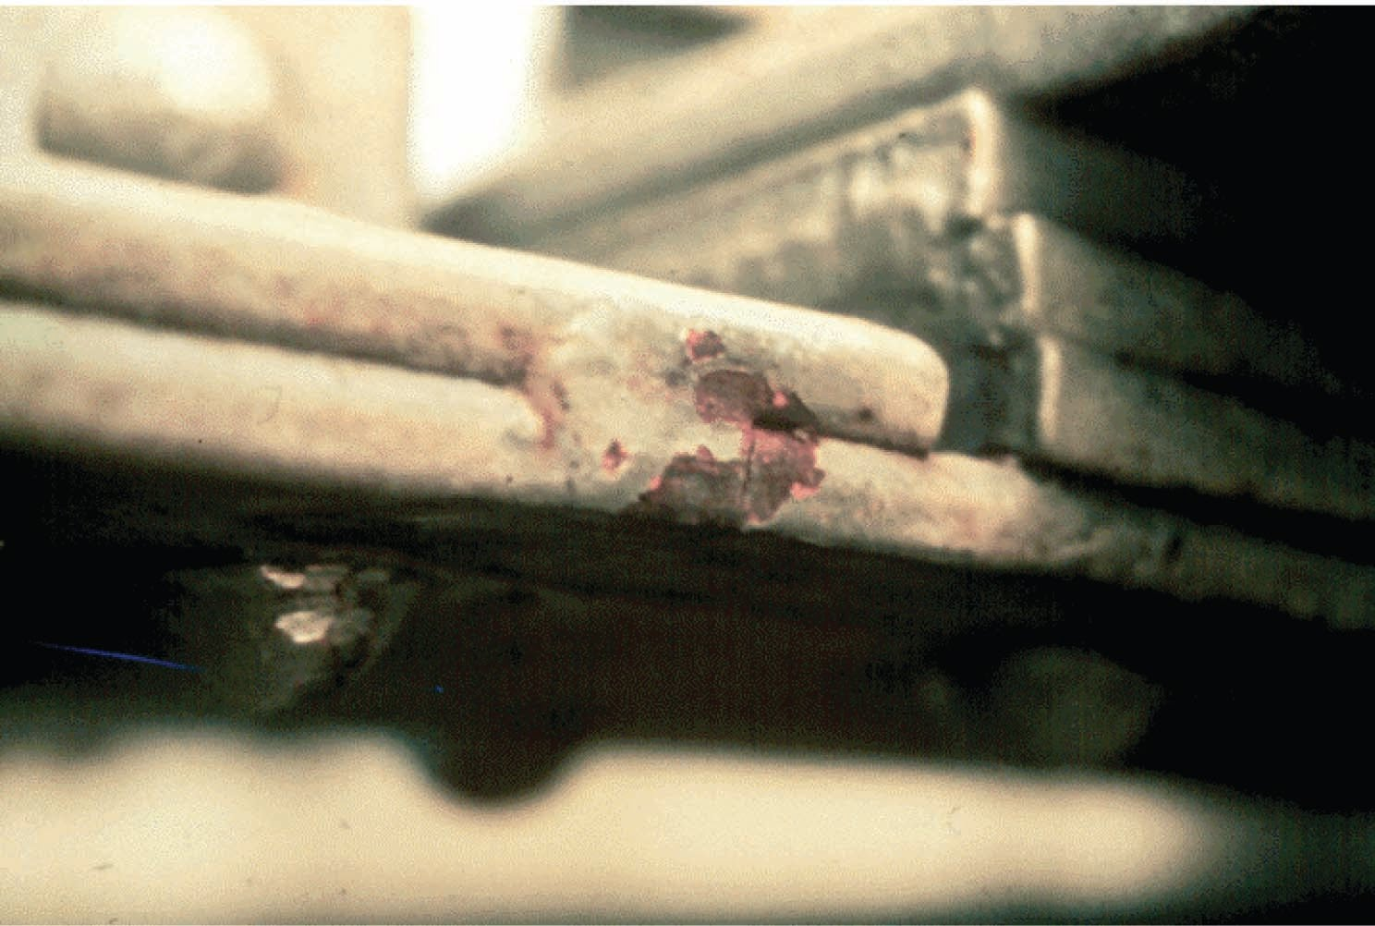
Tack Weld

Slide 40
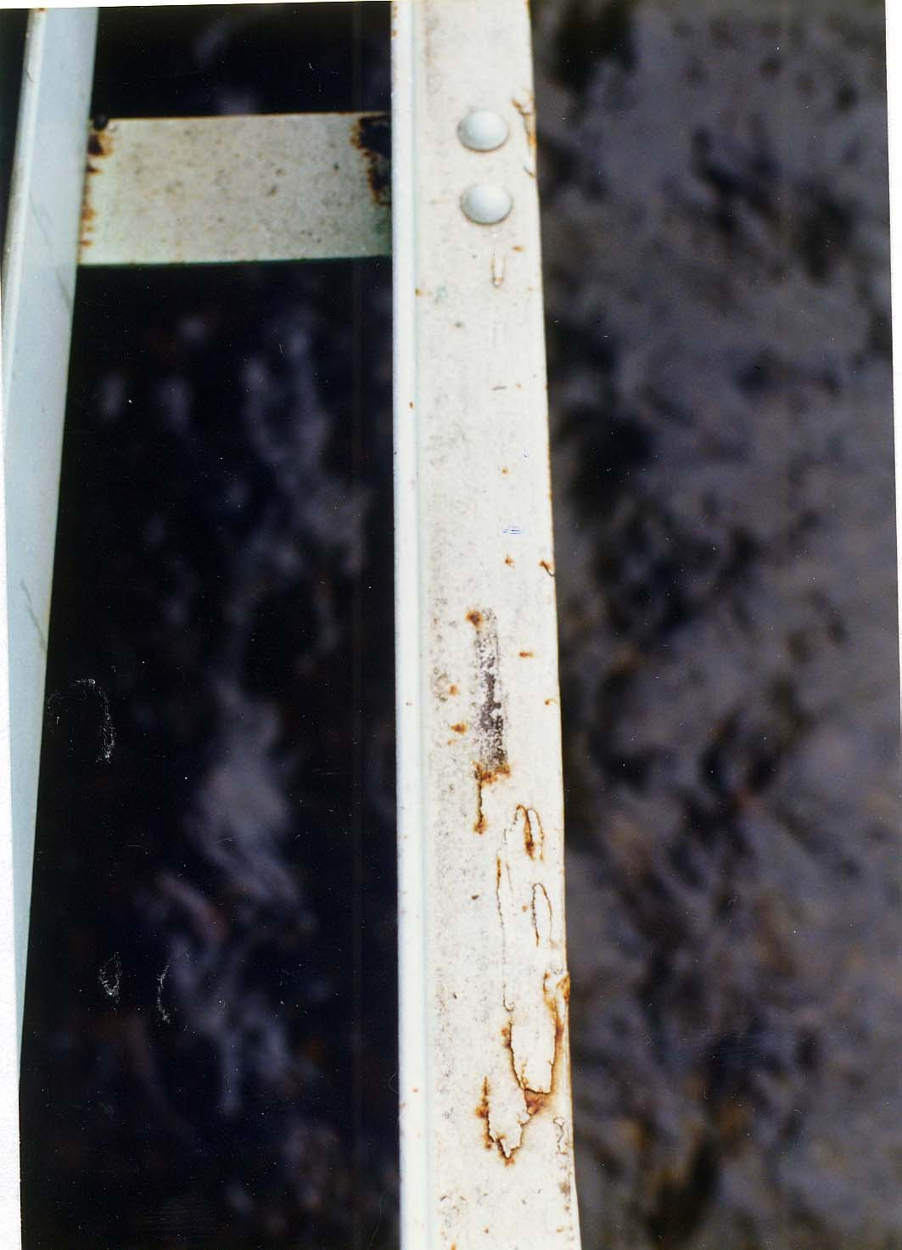
Material External Flaw

Slide 41
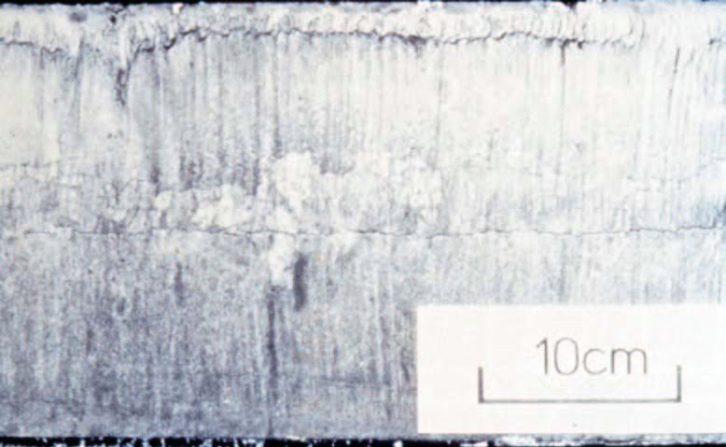
Material Internal Flaw

Slide 42
Incomplete Penetration Weld

Slide 43
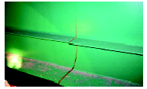
Incomplete Penetration Weld

Slide 44
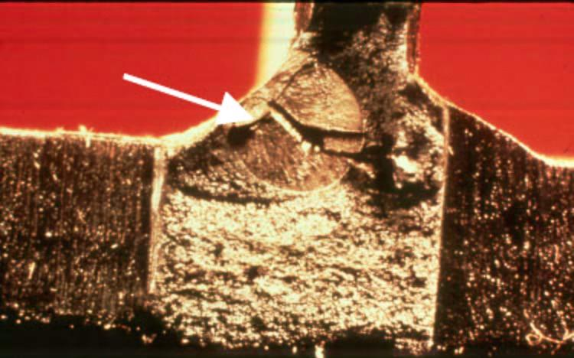
Weld Crack Due to Slag Inclusion

Slide 45
Fillet Weld Draws
UNDERCUT
OVERLAP

Slide 46
Improper Web Coping
Web Cope

Slide 47
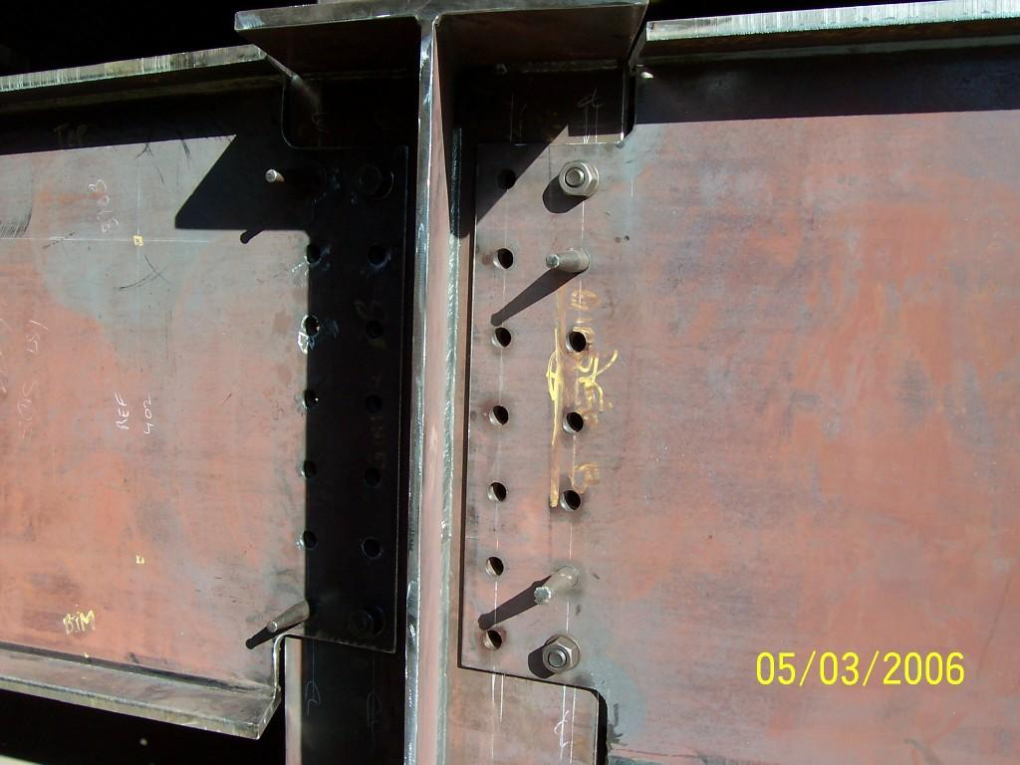
Correct Web Coping

Slide 48
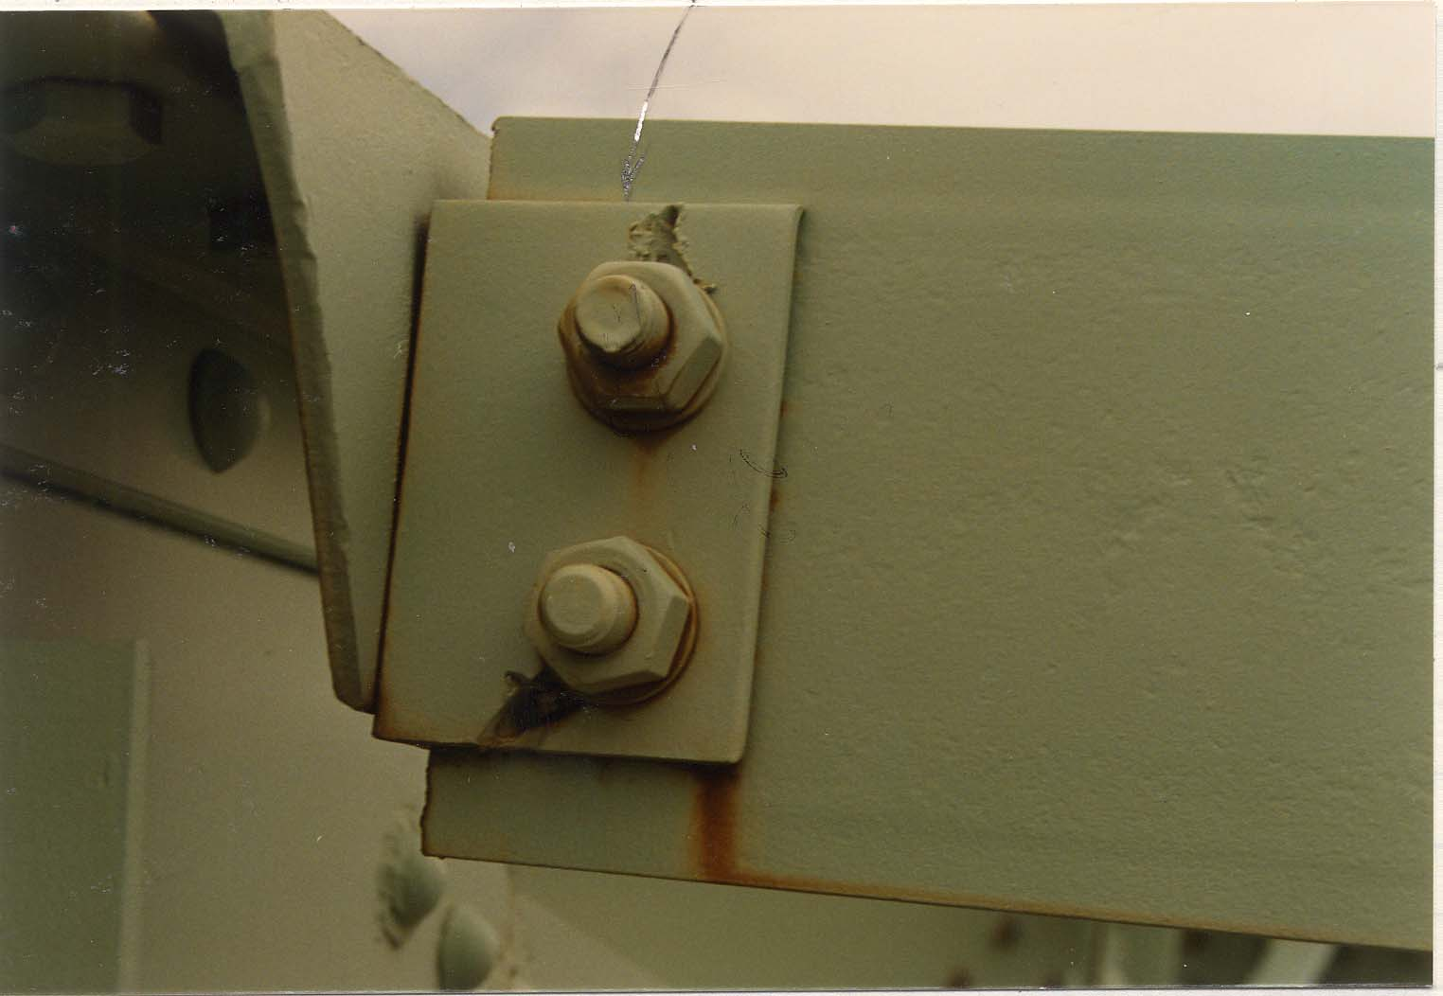
Torched Hole

Slide 49
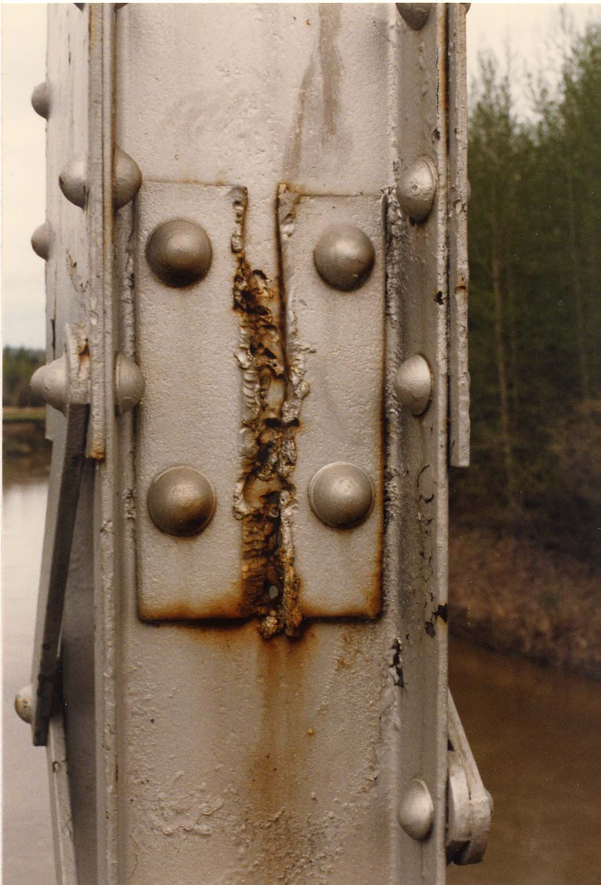
Torched Damage

Slide 50
Factors Affecting Fatigue Crack Initiation (Out-of-plane Distortion)
TOP FLANGE
WEB GAP
WEB
STIFFENER

Slide 51
Girder Differential Deflection
DECK
DIAPHRAGM
STIFFENER

Slide 52
Girder Web Gap Distortion
WEB GAP
TOP FLANGE
DISTORTION
STIFFENER
WEB

Slide 53
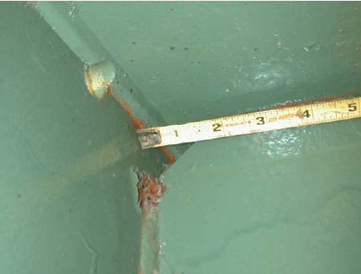
Girder Web Gap Distortion

Slide 54
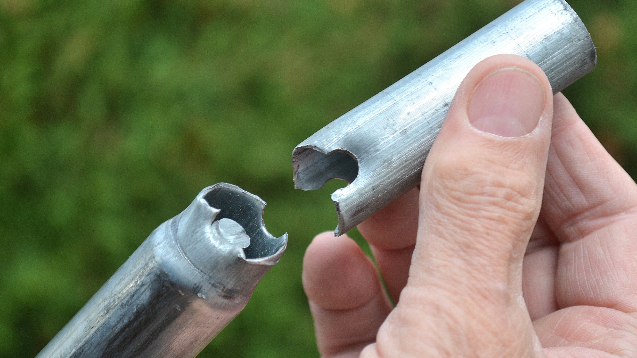
Factors Affecting Fatigue Crack Propagation
Stress range
Number of cycles
Types of details
Flange cover plates
Transverse stiffeners
Bolted joints
Longitudinal stiffeners

Slide 55
Stress Range
Compression
Tension
Compression
Tension
-
Min.
Stress
+
-
Min.
Max.
+
Stress
Max.
Range
Stress
Stress
Stress
Stress
Range

Slide 56
Flange Crack Growth Process
Rolled Beam
Cover Plate
Weld

Slide 57
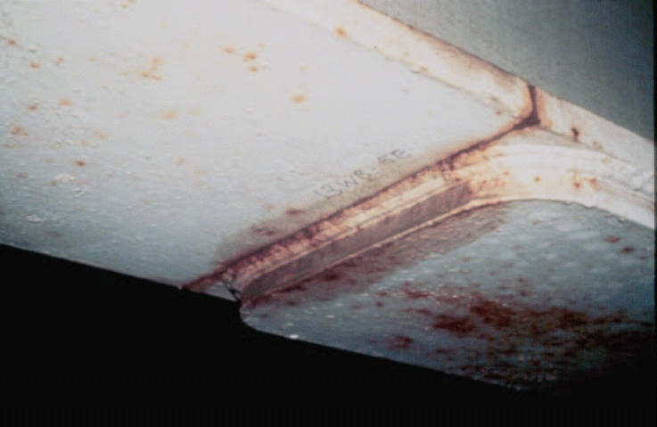
Through Crack at a Cover Plate

Slide 58
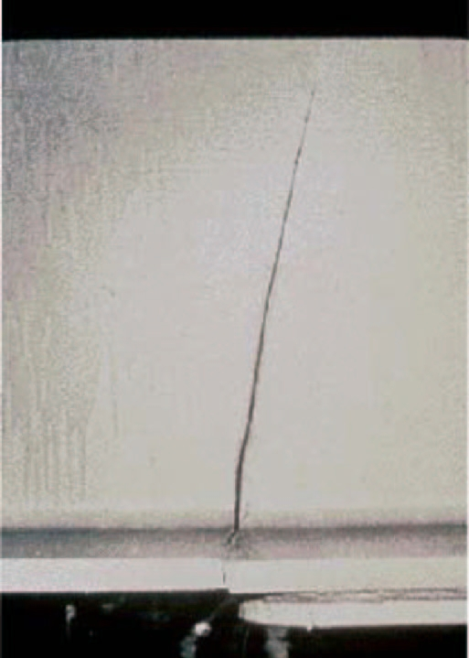
Crack Propagation Into the Web

Slide 59
Crack Growth at Transverse Stiffener Welded to Web
Web
Stiffener

Slide 60
Constrained Induced Fracture (CIF)
Fracture is not due to fatigue or number of cycles
Occurs suddenly with no prior signs
Fractures are at intersecting welds or at small gaps between intersecting welds
Girder fracture at Hoan bridge Milwaukee was due to CIF

Slide 61
Constraint Induced Fracture (CIF)
GIRDER
GUSSET
STIFFENER

Slide 62
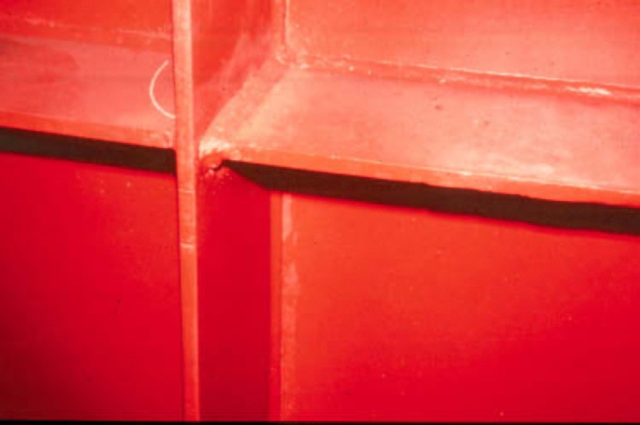
Constraint Induced Fracture (CIF)

Slide 63
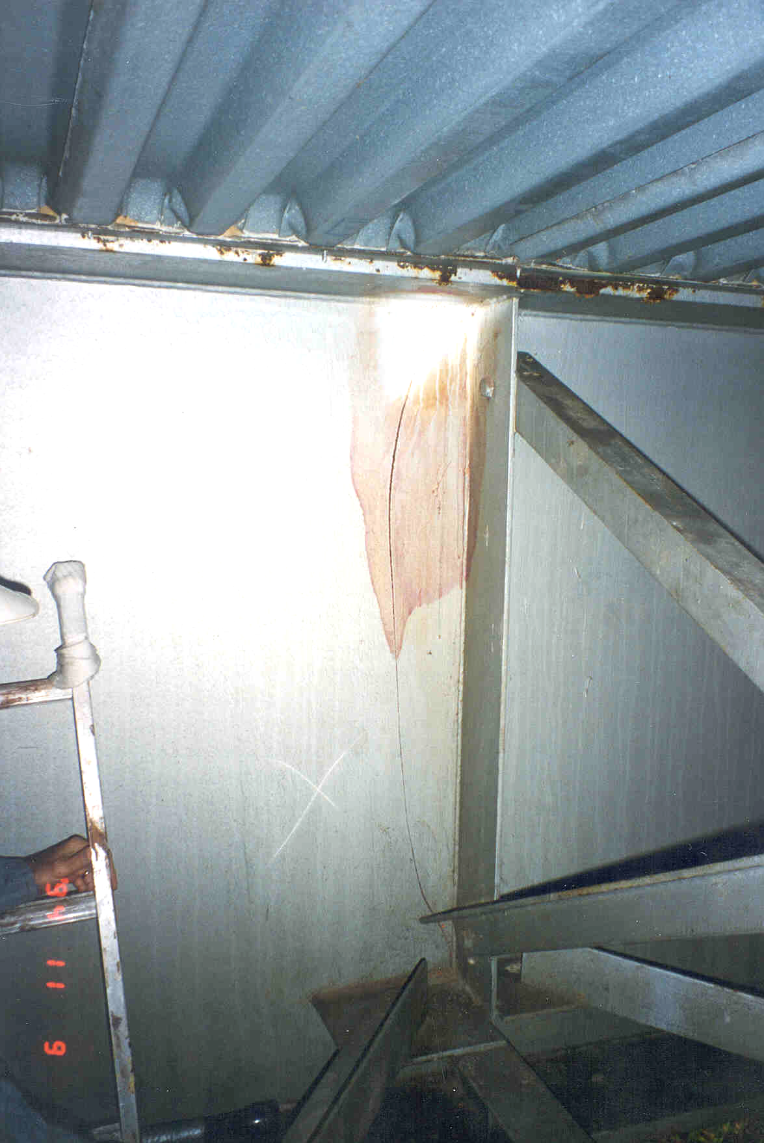
Constraint Induced Fracture (CIF)
Web Fracture

Slide 64
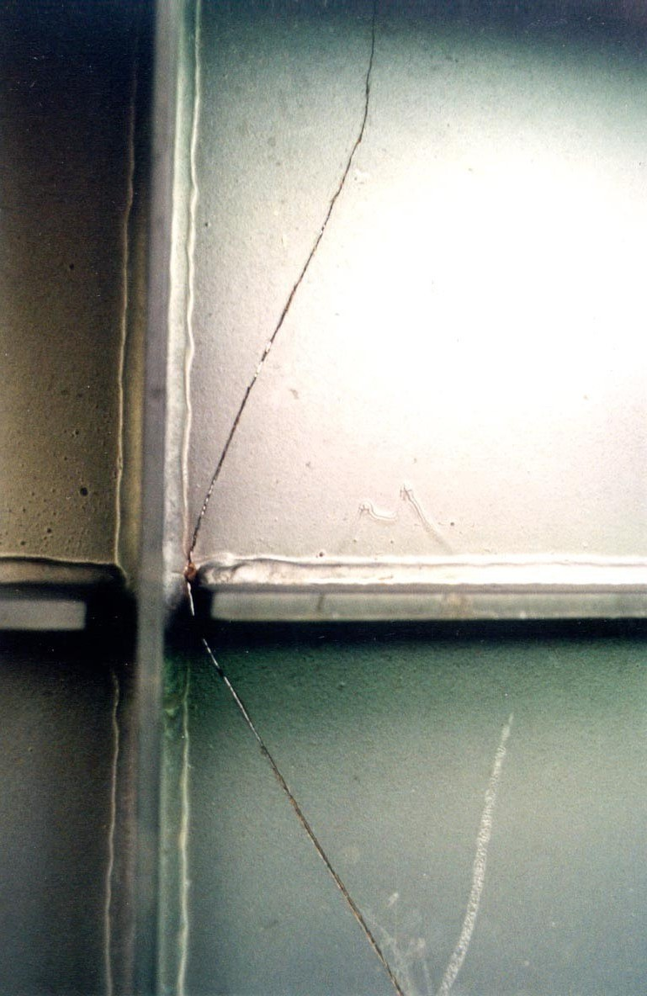
Constraint Induced Fracture (CIF)
Transverse Stiffener
Longitudinal Stiffener
Web

Slide 65
Inspection of Steel Members

Slide 66
Inspection Procedures & Locations
Procedures
Visual
Hands-on inspection
Physical
Removal of dirt, paint etc.
Identification
Fatigue crack may be identified by the development of rust stains
Advanced Inspection Techniques

Slide 67
Inspection Procedures
& Locations
Locations
Bearing areas
Shear zones
Flexure zones
Fatigue prone details
Out-of-plane distortion
Constraint induced fracture detail
Secondary members
Areas that trap water and debris
Areas exposed to traffic

Slide 68
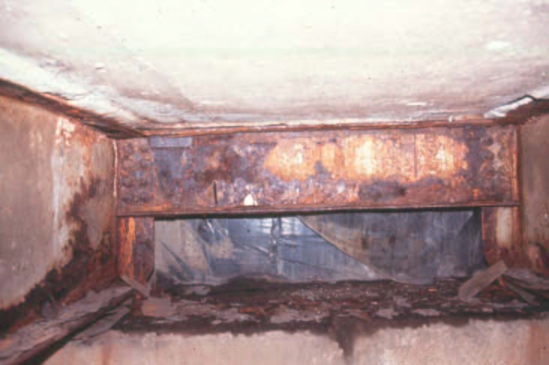
Corroded Shear Zone & Diaphragm

Slide 69
What to do if a Crack is Detected?
Determine significance of crack on load carrying capacity
Evaluate cause of cracking
Show sketches with details of size and location
Drill hole at the tip to arrest the growth
Check with dye penetrant
Take good photographs showing all the details
Note: Cracks perpendicular to primary stresses are very serious
Cracks parallel to primary stresses are less serious

Slide 70
Inspection of Pin and Hanger

Slide 71
Pin Location
ABUT. #1
70'
HINGE
PIER #1
45'
F.S.
PIER #2
HINGE
70'
ABUT. #2
90'
90'
90'

Slide 72
Pin Detail
Shear
Plates
Girder
Girder
Pin
Shear Plates
Bottom Flange
Web

Slide 73
Design Stresses in Pin
Nut
Pin

Slide 74
Actual Stresses in Pin

Slide 75
High Stress in Pin Due to Corrosion
Pin
Corrosion

Slide 76
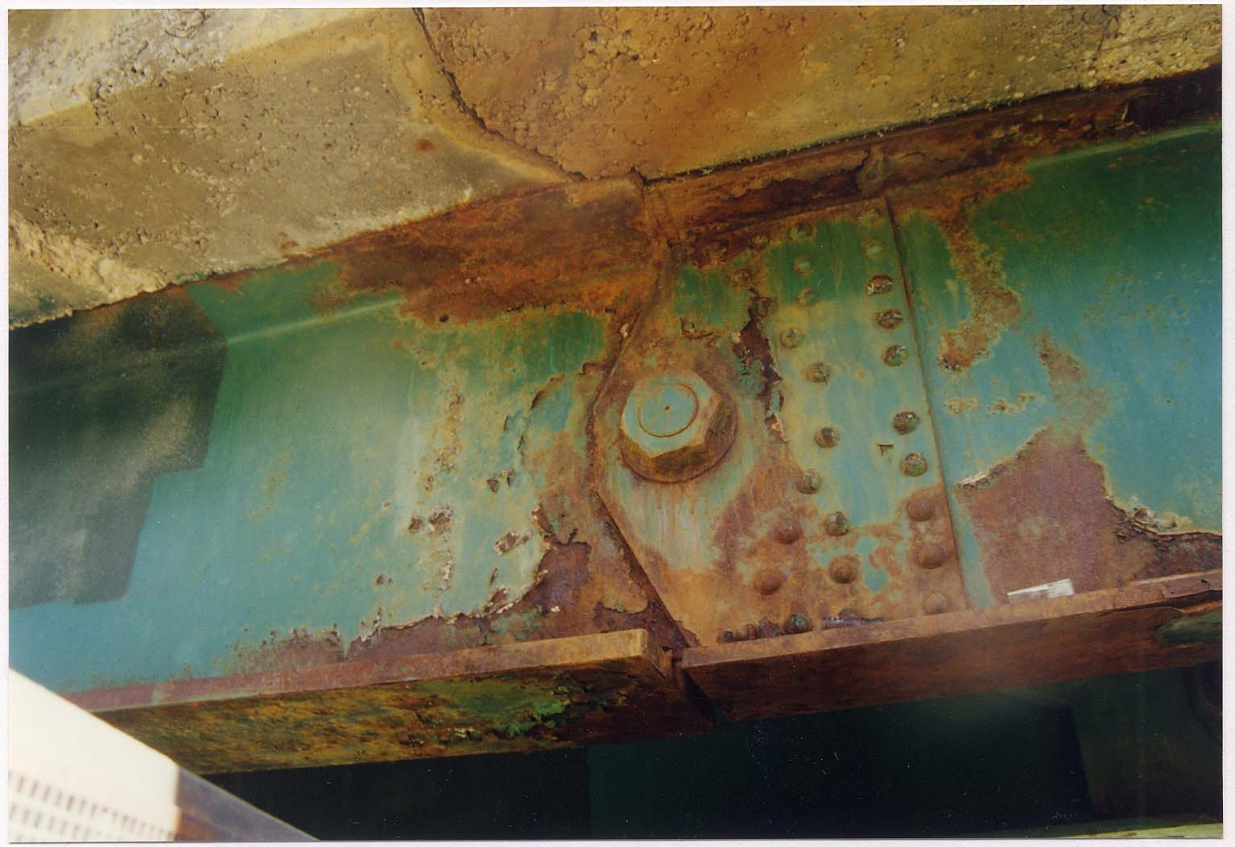
High Stress in Pin Due to Corrosion

Slide 77
Hanger Location
ABUT. #1
PIER #1
HANGER
HANGER
PIER #2
ABUT. #2
91'
170'
114'
ANCHOR SPAN
SUSPENDED SPAN
ANCHOR SPAN

Slide 78
Hanger Details
Suspended span
Anchor span

Slide 79
Stresses in Hanger
Actual
Tension
Actual
Tension
Moment

Slide 80
Deterioration of Pin & Hanger
Pin
Frozen
Corroded
Cracks in welded shear plates
Hanger
Twisted or bent
Ceased
Cracks in edges

Slide 81
Inspection of Pins
Procedure
Determine if pins are functioning
Visual inspection not very effective
Ultrasonic inspection is required
Remove nuts if possible

Slide 82
Pin Measurements
Bottom flange
elev. alignment
Bottom flange gap

Slide 83
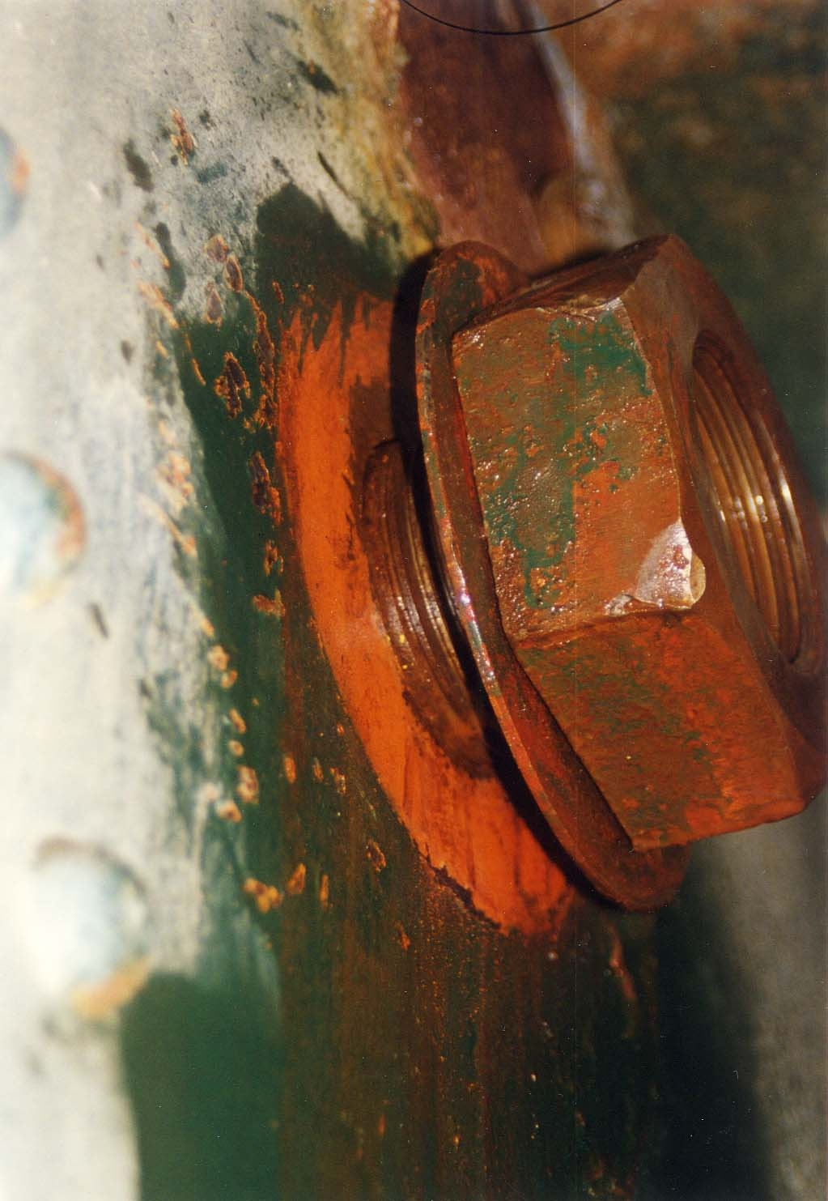
Preparation for Inspection

Slide 84
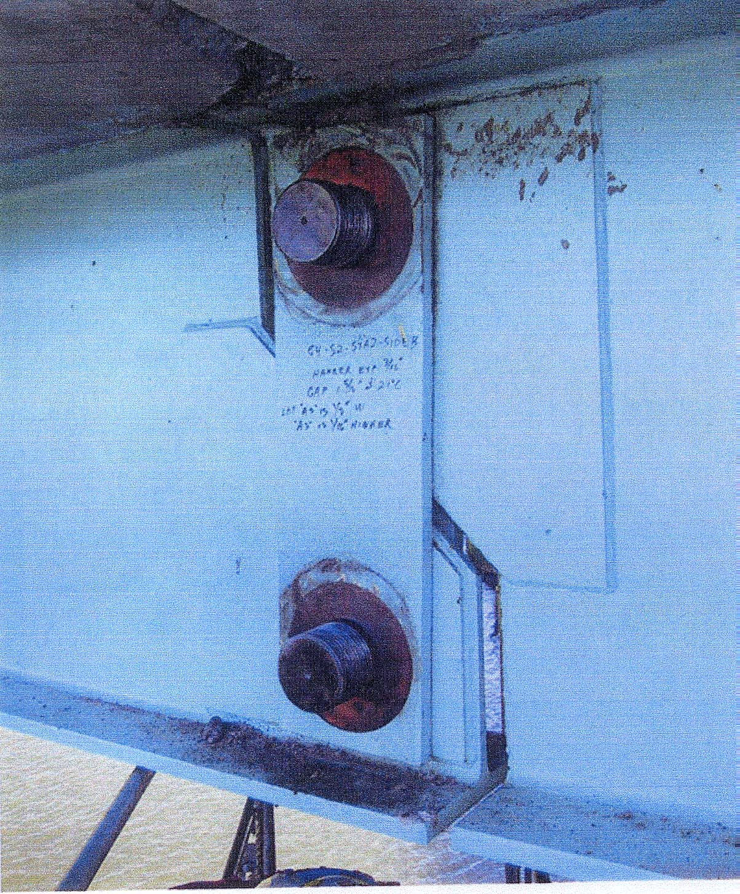
Removal of Nuts

Slide 85
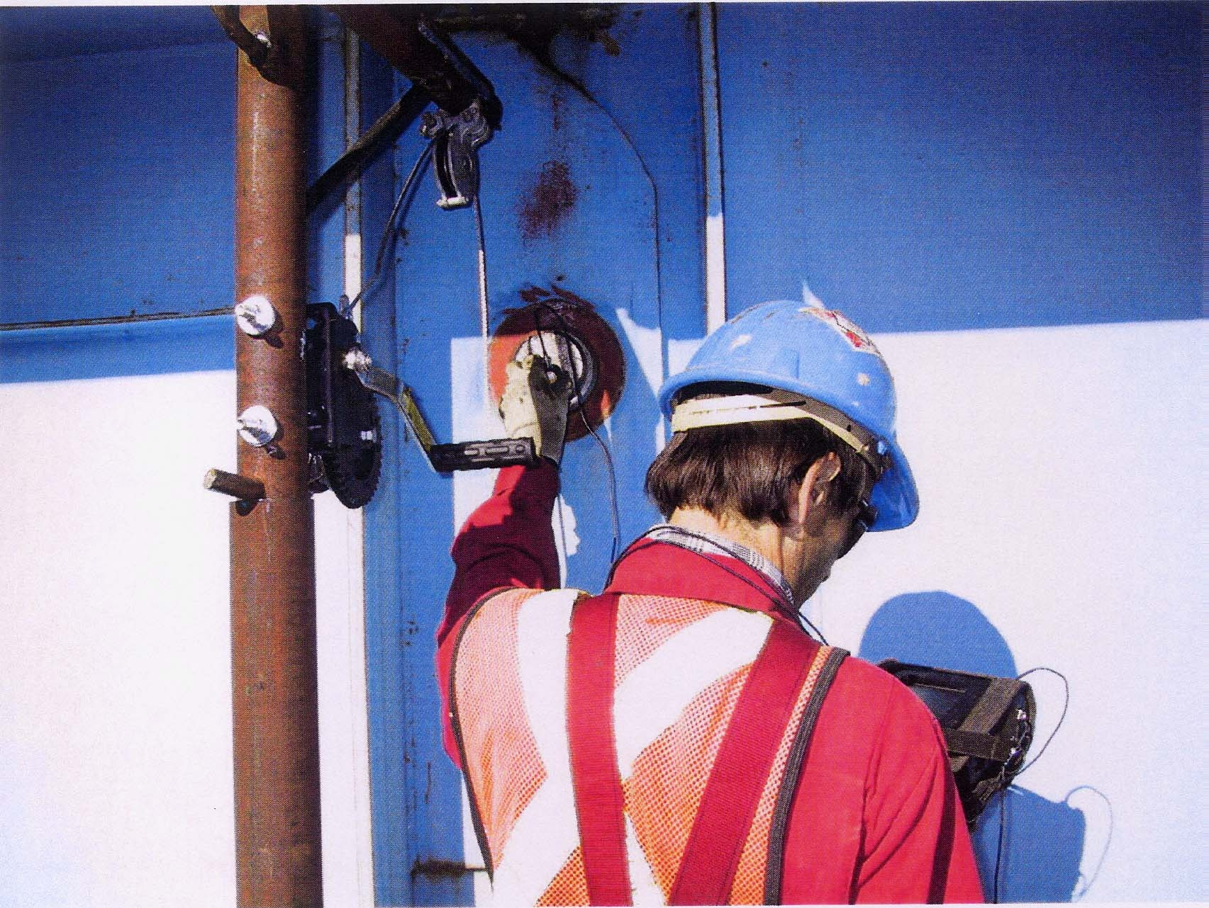
U/T Inspection

Slide 86
Inspection of Hangers
Procedure
Report any corrosion
Hanger plate is as critical as pin.
Examine edges
Check hangers for bowing, out of plane bending

Slide 87
Measurements in Pin & Hanger
2
3
1
Suspended span
2

Slide 88
Questions?

