Slide 1
STEEL - PROPERTIES

Slide 2
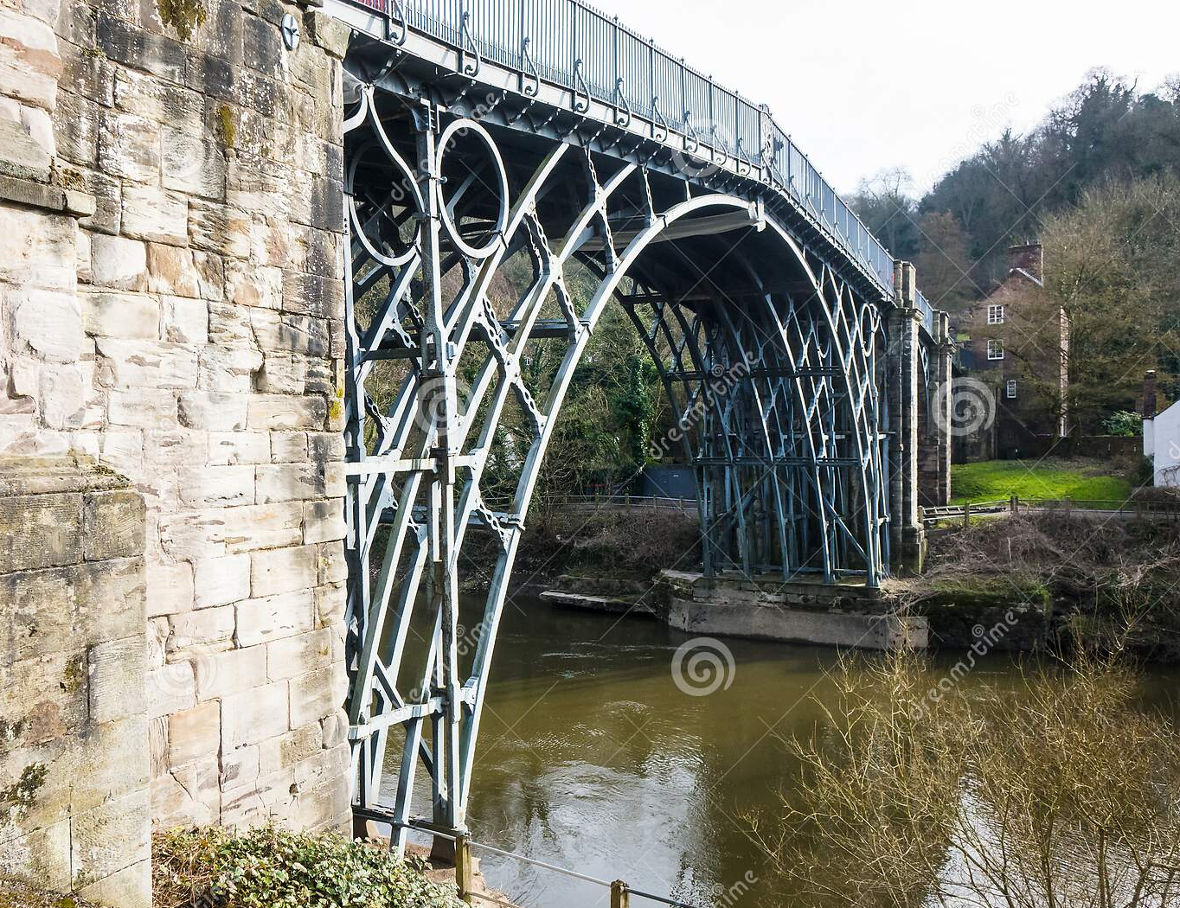
History of Steel
Cast Iron
Cast iron preceded wrought iron.
It is brittle, has high carbon content with low tensile strength.
It has excellent casting properties.
It was mainly used to carry axial compression loads.
Wrought Iron
It replaced cast iron, because of good tensile strength properties.
Notes:
Severn Bridge, built 1779 – worlds first wrought iron bridge

Slide 3
History of Steel
Steel
Steel gradually replaced wrought iron until about 1890.
Steel available in commercial quantities only in the last 100 years
The chemistry of steel was not controlled until about 1960
Strength and elongation were guaranteed but not the chemistry
This was satisfactory for riveted structures but not for welded details

Slide 4
History of Steel
Steel
Welding was first introduced in bridges in about 1936.
During the World War, US produced a large number of welded cargo vessels.
Many of these ships broke apart due to brittle fracture of steel adjacent to the welds.
Welding contributes to brittle fracture because of introduction of severe cooling rates in the steel adjacent to the weld HAZ (Heat Affected Zone).

Slide 5
History of Steel
Examples of failed Steel Structures
St. Maurice Bridge Quebec failed in January 1951. It was four years old.
The Freemont Bridge in Portland had a failure in truss joint in 1971.
St. Paul, Minnesota girder in the Lafayette Street Bridge failed 1975.
Laval Que.– Concordia Overpass 2006 – 5 people died.
447‘ (136m) Fern Hollow bridge in Pittsburg collapsed & fell 100’ 2022
https://www.youtube.com/watch?v=5_tesnnihRk&ab_channel=USATODAY

Slide 6
Iron
Iron in the pure form is a soft, shiny metal like aluminum.
However, it is never found in this state.
Iron oxidizes extremely easily.
In nature it is always found as an oxide.

Slide 7
What is Steel?
Alloy
Metal prepared by adding other metals or non-metals to secure desirable properties.
Steel
It is an alloy of iron, carbon, and other trace elements.

Slide 8
Steel Making Process
Iron ore, coke, and limestone are major raw materials.
Coke is obtained by distilling coal.
Raw material is charged into a Blast furnace which has a temperature of 1600°C
Iron melts at the bottom.
Solidified iron is called “Pig Iron”

Slide 9
Steel Making Process
Molten metal from Blast furnace is taken into Basic Oxygen furnace
Chemical analysis of the molten material is done
Steel semis, billets are heated to 1200°C for rolling and finished products.

Slide 10
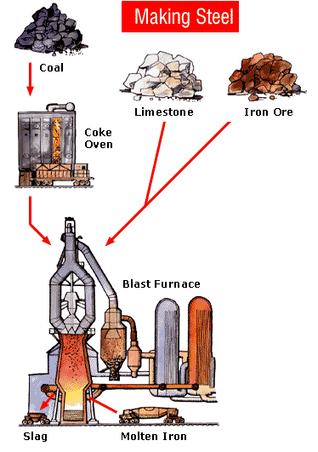

Slide 11
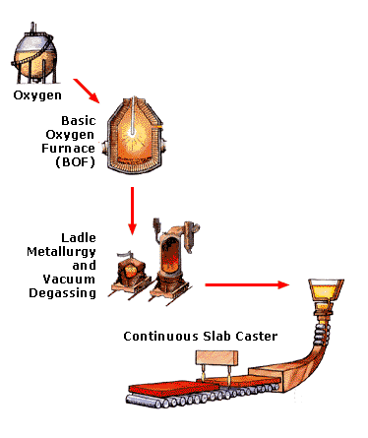

Slide 12
Effects of Carbon
Increased carbon in steel:
Increases strength
Increases hardness
Increases hardenability
Reduces ductility
Reduces toughness
Reduces machinability

Slide 13
Effects of Carbon
% Carbon | Yield Strength (ksi) | % Elongation | Comments
4.0 |  |  | Grey cast iron
2.5 |  |  | White cast
1.1 to 1.7 | 90 – 100 | 0 | Very high carbon steel
0.9 to 1.1 | 110 – 118 | 0 | High carbon steel
0.7 to 0.9 | 94 – 118 | 8 – 14 | Spring steel
0.55 to 0.7 | 75 – 94 | 14 – 19 | Higher carbon steel
0.3 to 0.55 | 65 – 75 | 19 – 24 | Medium carbon steel, weldable with care
0.15 to 0.3 | 48 – 65 | 24 – 28 | Mild steel for bridges
0.05 to 0.15 | 40 – 48 | 28 – 34 | Very mild steel, pure iron
Notes:
50 ksi = 350 MPa

Slide 14
Effects of Carbon
-
-
-
-
-
-
-
-
-
9
8
7
6
5
4
3
2
1
0
0
0
0
0
0
0
0
0
Brinnel Hardness Scale
EL
%
EL
U.T.S
%
30
20
10
-
-
-
0
0
0
0
5
0
5
0
-
-
-
-
-
-
U.T.S Tons/in²
B.
H
3
2
2
1
1
5
0. 0. 0. 0. 1. 1.
2 4 6 8 0 2
Carbon %
Notes:
Strength and hardness increase.
Ductility decreases

Slide 15
Effects of Other Alloying Elements
Sulphur
Higher sulphur causes porosity and hot cracking in welding
Can cause brittleness in hot metal
Increases hardenability
It is not desirable and is kept as low as possible
Its ill effects are reduced by adding other alloying elements such as manganese.

Slide 16
Effects of Other Alloying Elements
Phosphorus
Like sulphur it is not desirable and is kept as low as possible
It increases strength and hardenability.
It reduces ductility and weldability.
Manganese
It is added to counteract the ill effects of sulphur
Increases strength, hardenability and notch toughness
It reduces weldability

Slide 17
Effects of Other Alloying Elements
Silicon
It is used as de-oxidizer in steel making and produces fine-grained steel.
0.15 to 0.50 range is desirable and is known as “killed steel”.
It increases strength and hardenability.

Slide 18
Effects of Other Alloying Elements
Aluminum
Chromium
Copper
Columbium
Molybdenum
Nickel
Tungsten
Vanadium

Slide 19
Basic Metallurgy
Grains
The crystals of metals are referred to as grains.
The smallest grain of metal contains a large number of atoms.
Space-lattice
All grains are composed of atoms bound together in a definite pattern or structure. This atomic structure is called space-lattice.

Slide 20
Basic Metallurgy
Structure of a Metal
The characteristics of the structure of a metal are due to:
The atoms making up the metal.
The manner in which the atoms are arranged.
Space-lattice Types
There are 14 possible space lattice types.
The body centered cubic (BCC) has 9 atoms.
The face centered cubic (FCC) has 14 atoms.

Slide 21
Space-Lattice Types
Body Centred
Face Centred

Slide 22
Grain Size
Grain Size, um
450
375
300
225
150
75
110 40 16 10 6 4.5 3 2.25
50
0
-50
-100
-150
-200
-
-
-
-
-
-
-
-
DBTT
Yield Stress, MPa
Ductile Brittle Trans Temp. °C
Yield Stress
5 10 15 20
Grain size, d^{-1/2}, mm^{-1/2}
Notes:
Yield stress increases with grain size.
Ductility decreases with grain size

Slide 23
Cooling Molten Iron
F C
Liquid
2780 (1527)
BCC
Solid
(Delta iron)
2550 (1398)
FCC
Gamma iron
1670 (910)
Non-magnetic iron
(Alpha iron)
BCC
1415 (770)
Magnetic iron
(Alpha iron)
BCC
Room
Temperature
Time

Slide 24
Temp. Effect on Yield Stress
40
36
30
F_{y}
Stress (ksi)
20
10
0
400
800
1200
1600
2000
Temperature °F
Notes:
Heat straightening up to 1100 F

Slide 25
Definitions
Annealing
Heating and holding at a suitable temperature and then cooling at a suitable rate, for such purposes as reducing hardness, improving machinability, facilitating cold working, producing a desired microstructure, or obtaining desired mechanical, physical, or other properties.
Hardenability
Steel property which describes the depth to which the steel may be hardened during quenching.

Slide 26
Definitions
Hardness
A measure of a material's resistance to localized plastic deformation.
Heat Treatment
The way to produce particular microstructures and properties in steel by heating and cooling.
Killed Steel
Steel deoxidized with a strong deoxidizing agent, such as silicon or aluminum, to reduce the oxygen content to such a level that no reaction occurs between carbon and oxygen during solidification.

Slide 27
Definitions
Normalizing
In this process, the steel is heated to about 100 F above the transformation range, held there only briefly and then cooled in still air. This process refines the grain.
Quenching
In heat treatment, the step of cooling metals rapidly in order to obtain desired properties.

Slide 28
Definitions
Stress Relieving
Heating to a suitable temperature, holding long enough to reduce residual stresses and then cooling slowly to minimize the development of new residual stresses.
Tempering
It is the process at which hardened steel is reheated at some point below the transformation range and cooled in air or water.
Notes:
Welding for stress relieving

Slide 29
Definitions
Toughness
An indication of steel's capacity to carry load and absorb energy, particularly in the presence of a notch or a crack.
Transformation Temperature
The temperature at which a metal when cooled changes from one type of structure to another.
Notes:
Both are very important for bridges.

Slide 30
Physical Properties
Strength
Compression
Tension
Fatigue
Ductility
Weldability
Fire Resistant
Corrosion Resistant
Notch toughness
Machinability
Formability

Slide 31
Tensile Stress – Strain Curves
Elastic Range
Stress is proportional to strain. In this range there is no permanent deformation.
Plastic Range
In this strain increases without the appreciable increase of stress.
Strain Hardening Range
In this strain increase is accompanied with increase in stress.
Proof Stress
Stress required to cause a specified small , permanent extension.

Slide 32
Tensile Stress – Stain Curves
120
0.2% OFFSET YIELD STRENGTH
(PROOF STRESS)
A514 STEEL
100
80
HEAT TREATED HIGH STRENGTH
CARBON STEEL
STRESS, KSI
60
A414 STEEL
40
A36 STEEL
20
PLASTIC RANGE
STRAIN-HARDENING RANGE
ELASTIC RANGE
INELASTIC RANGE
0.002
0.005
0.010
0.015
0.020
0.025
0.030
STRAIN IN PER IN
Notes:
Elastic range
Plastic range
Strain hardening range
Proof stress

Slide 33
Charpy Test
Charpy Test
Charpy test is used to determine metal toughness i.e., impact strength
Impact Energy
It is the work done to fracture the specimen as measured by the Charpy test.
Impact energy = Elastic strain energy + Plastic work during yielding + Work done to create fracture.
Notes:
Important test for toughness. How much energy absorbed at a specific temperature

Slide 34
Charpy Test
Starting position
End of swing
Hammer
Specimen
Anvil
Notes:
Do we want the end of swing to be higher or lower?
Lower, more energy absorbed by sample.

Slide 36
Charpy test Specimen
10
2
55
10

Slide 37
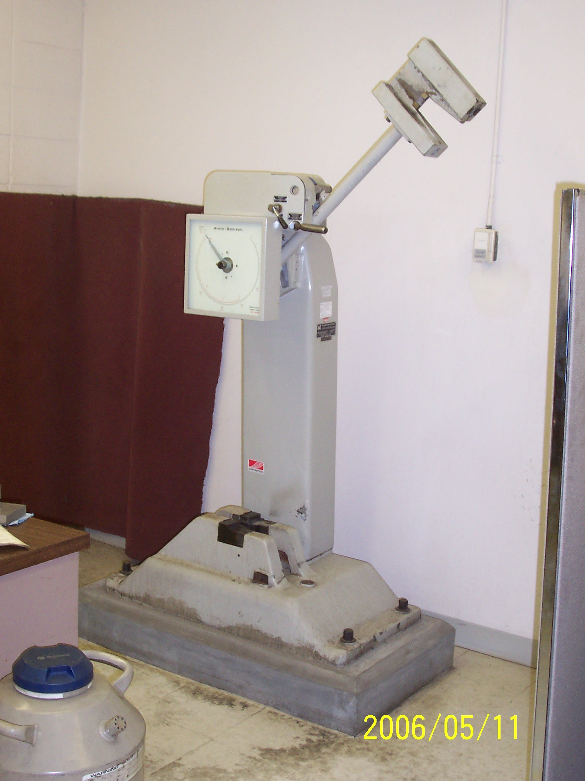
Charpy Test

Slide 38
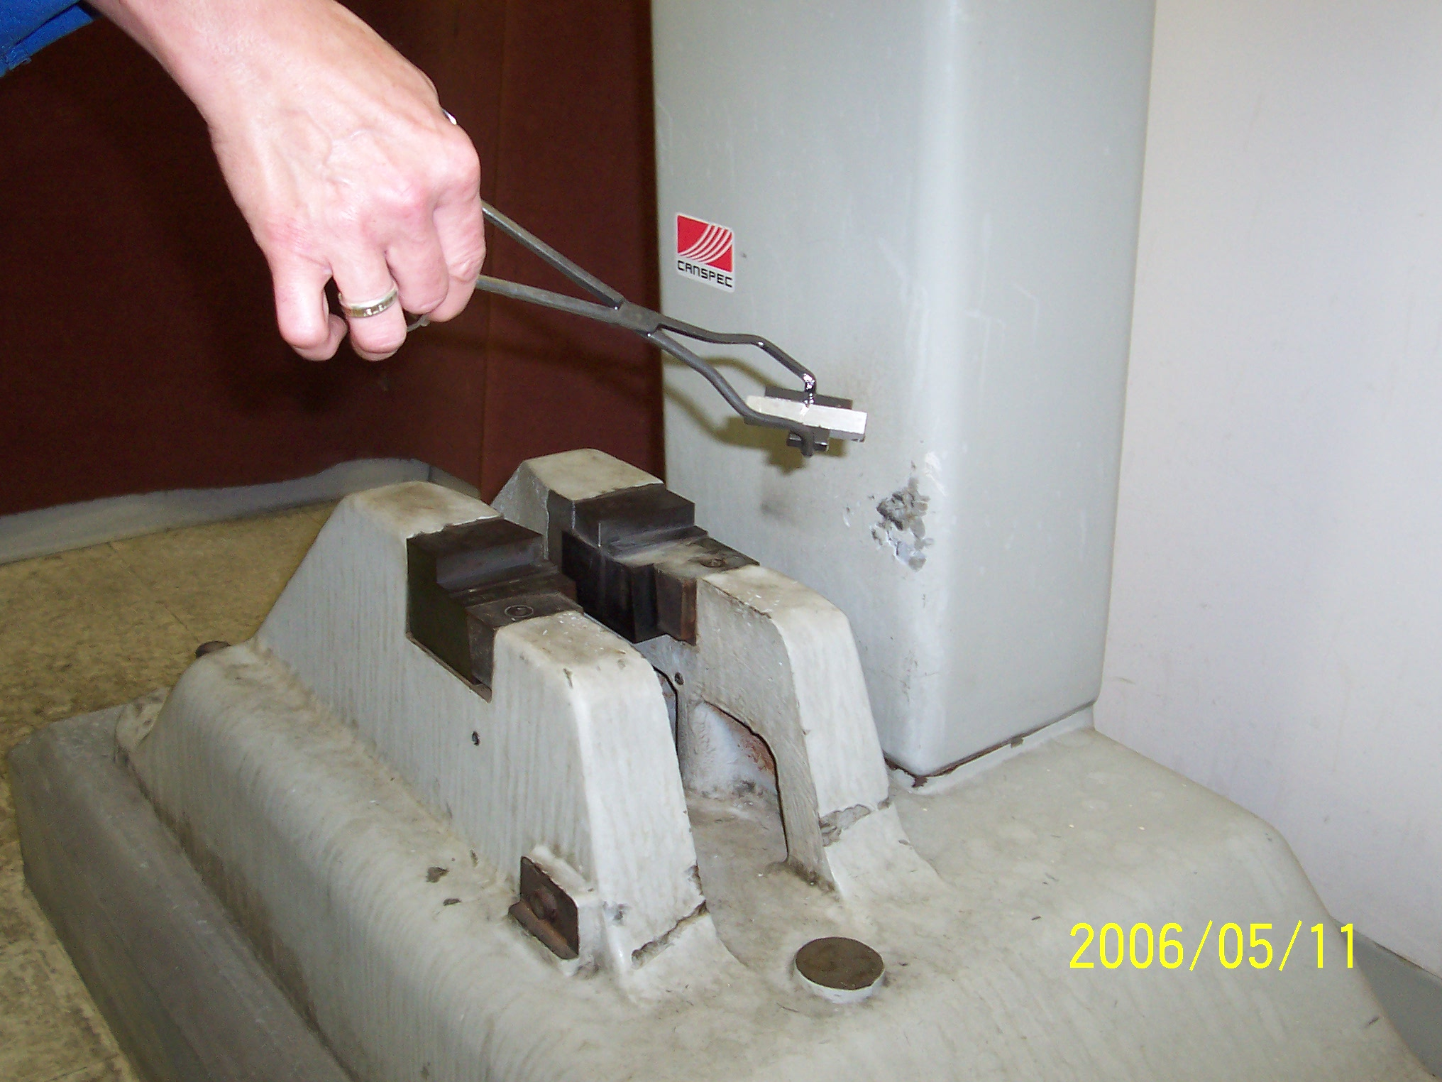
Charpy Test
Notes:
At low temperatures -30C samples are cooled to this then quickly tested.

Slide 39
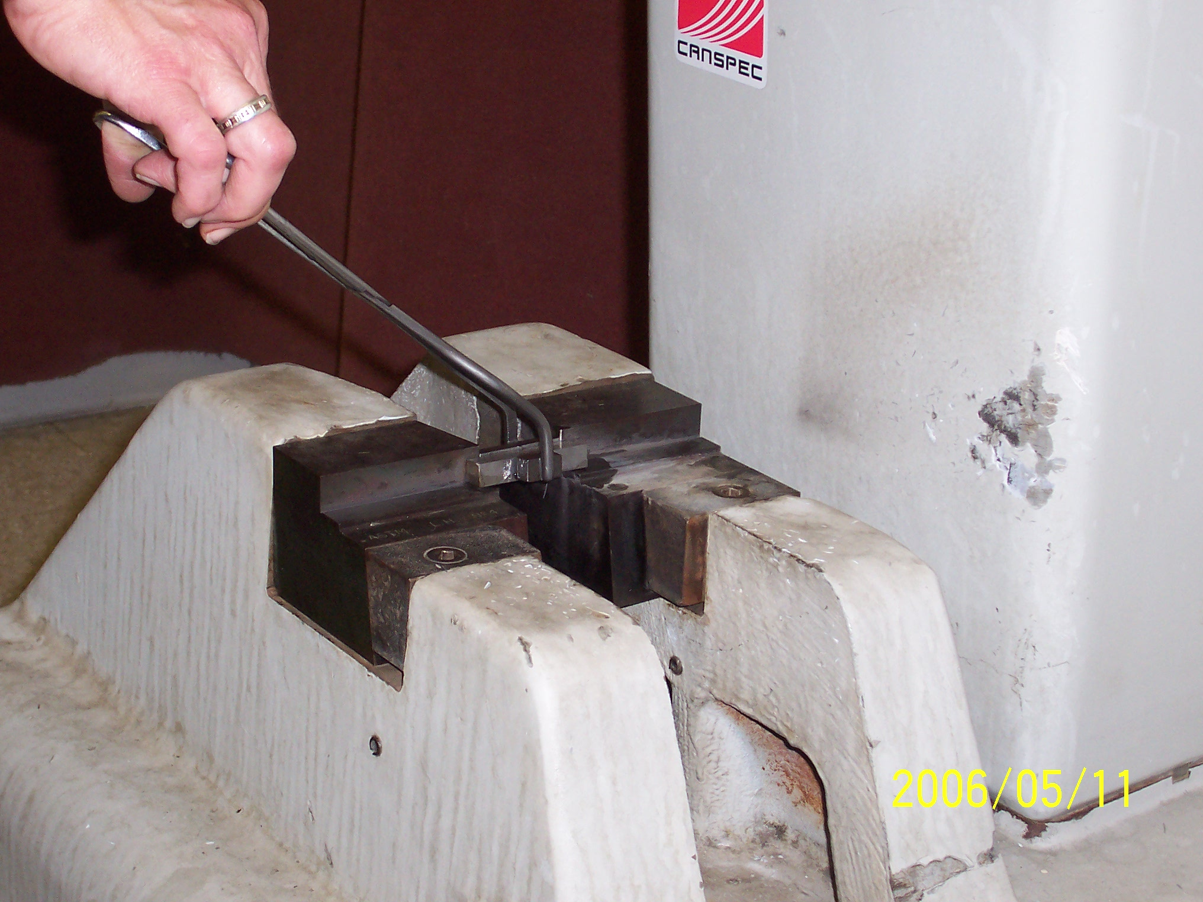
Charpy Test

Slide 40
Factors Affecting Fracture Behavior
Impact load
Sub zero temperature range
Notch

Slide 41
Common Steel Shapes
Wires
Cables
Steel Plates
Steel Bars
Rolled Beams
Built-up Shapes

Slide 42
Types of Steel
Steel Designation | Yield Strength (ksi) | Comments
OH Steel | 26 | Used until about 1905
EIC Steel | 30 | Used until about 1935
A7 | 33 | Used until about 1960
A36 | 36 | 1960 to Present. (First steel with guaranteed chemistry)
G40.8 (A35) | 40 | Normalized and used by Alberta up-to 1968
G40.12 (A572) | 44 | Normalized and used by Alberta up-to 1968
A441 | 50 | Normalized and used by Alberta up-to 1968
Notes:
A36 guaranteed chemical composition. Weldability

Slide 43
Current CSA C40.21 Steels
Type | Nominal yield strength, MPa
 | 260 | 300 | 350 | 380 |  | 400 | 480 | 550 | 700
 | Grade
W | 260W | 300W | 350W |  | 380W* | 400W | 480W | 550W | -
WT | 260WT | 300WT | 350WT |  | 380WT** | 400WT | 480WT | 550WT | -
R | - | - | 350R |  | - | - | - | - | -
A | - | - | 350A |  | - | 400A | 480A | 550A | -
AT | - | - | 350AT |  | - | 400AT | 480AT | 550AT | -
Q | - | - | - |  | - | - | - | - | 700Q
QT | - | - | - |  | - | - | - | - | 700QT
* This grade is available in HSS, angles and bars only
** This grade is available in HSS only
Notes:
W – Weldable
A – Atmospheric (Corrosion Resistant)
T – Tough (Category “CAT” 2 or 3, 27J -20 or -30)

Slide 44
CSA Charpy Impact Requirements
Standard Charpy impact test temperature for specified category
Category | Standard test temperature ºC
1 | 0
2 | -20
3 | -30
4 | -45
5 | To be specified by purchaser
Notes:
27J is required test energy

Slide 45
CSA Charpy Impact Requirements
Standard Charpy impact energy for specified grade
Grade | Absorbed Energy (Joules)
260WT | 20
300WT | 20
350WT | 27
400WT | 27
480WT | 27
350AT | 27
400AT | 27
480AT | 27
700QT | 34

Slide 46
What are the three most important properties for plate steel?
Strength?
Cost?
Corrosion Resistant?
Notch toughness?
Machinability?
Formability?
Weldability?

Slide 47
Strength
Yes, for structural applications strength is a very important property, a bridge member must support a given load without yielding.

Slide 48
Cost
No, cost is always an issue with design and material selection. In this case cost will need to be considered but is only the fourth choice as there are other properties that are more critical.

Slide 49
Corrosion Resistant
No, it’s very important but can be dealt with by painting. Also, the component can generally be checked visually for signs of corrosion and repairs made where appropriate.

Slide 50
Notch Toughness
Yes, toughness is one of the top three properties to consider because we must guarantee structural components against sudden catastrophic failure.

Slide 51
Machinability
No, This is not a very important property in this case because the steel is rolled to plate, flame cut and dressed to final size then welded together.

Slide 52
Formability
No, It is important that the steel can be rolled into plates however little subsequent forming is required meaning that extremely good formability is not required.

Slide 53
Weldability
Yes, this is an extremely important property as items like ships, oil rigs and bridge girders are constructed from a number of steel plates that are welded together to form the final product.

Slide 54
Questions?

