Slide 1
MAINTENANCE & REHABILITATION OF CULVERTS

Slide 2
Introduction
Widely used, started in 1950
  low cost alternative to bridges
  road system expansion in 60s and 70s
Installed by road builders
  local road authorities
  district forces (day labour)
Designs by Bridge Engineering then Regional Bridge staff, now consultants

Slide 3
Technical Developments
Early history - many problems
  spectacular uplift failures
  undersized
  deformation and cracking
Need for quality backfill and compaction not recognized
Importance of end treatments

Slide 4
Culvert Inspection
Regular inspection initiated in mid-80s
  before major problems or failures reported
inspection provides early detection of changes
most defects develop slowly
poor backfill often detected at first inspection
As constructed records shape at ends, quarterpoints and middle

Slide 5
Structural Problems
Include:
  Deformation
  Cracked seams
  Corrosion
Usual causes
  poor quality backfill
  frozen backfill
  poor compaction
  poorly prepared foundation
  corrosive environment
  piping

Slide 6
Structural Problems Deformation
Heaving floors
Bulging walls
Sagging roof
Severity measured as percent of design shape
Contributing factors
  backfill low shear strength
  culvert material low bending strength
  load carried in ring compression and soil-steel interaction

Slide 7
Structural Problems Cracked Seams
Primary cause is deformations
  sometimes deformations small; 5%
  may occur at one or more seams
Contributing factors
  incorrect laps
  over torquing bolts
  improperly curved plate
Severity measure
  number of seams cracked
  location of seams
  remaining steel between cracks

Slide 8
Structural Problems Corrosion
Corrosion
  electrochemical process that converts metal to natural state
Environmental requirements
  differences in potential
  electrolyte
  Oxygen
Corrosion types
  electrolytic
  galvanic
Severity measure
  percent rust pitting or perforation
  static potential
    950 mV galvanizing is good
    800 mV galvanizing is failing

Slide 9
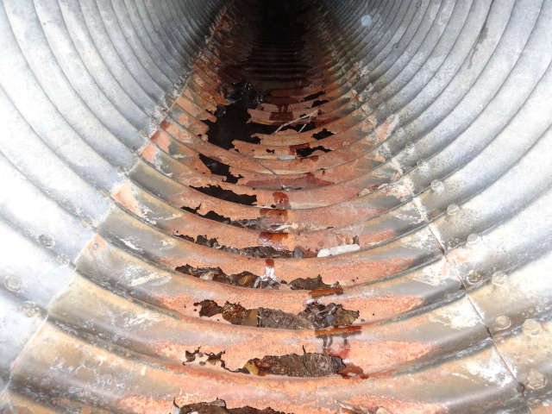
Waterside Corrosion on Culvert Floor

Slide 10
Soilside Corrosion Damage

Slide 11
Corrosion
Electrolytic corrosion
  caused by external stray currents
  other cathodic systems
  overhead power lines
Galvanic corrosion
  materials of different potential in an electrolyte
  impurities in metal
  differences in coatings
  surface defects
  moist soil good electrolyte
  generates own current

Slide 12
Electrolytic Corrosion Mechanism

Slide 13
Galvanic Corrosion Mechanism

Slide 14
Repairs and Maintenance Methods
Monitoring
Strutting
Liners
Crack repairs
Cathodic protection

Slide 15
Monitoring
Should be recommended sparingly – only when measurable (Section 13.9.1.2)
First option, low cost
  structure may stabilize – especially deflections
Provides ongoing record
  mark ends of cracks
  measure magnitude and location of deformations
  establish reference points
  photographs

Slide 16
Strutting
Oldest, often cheapest method
Effective for extreme distress
Not suitable for drift and ice locations
Components
  vertical struts between sleepers
  cut to length, jacked in place
  timber or steel
Life ~25 years for timber – maybe longer for steel struts

Slide 17
Timber Strut with Adjustable Turn-screw

Slide 18
Strut Layout for Horizontal Ellipse Culvert

Slide 19
Timber Strutting of Metal Culverts

Slide 20
Installing Struts

Slide 21
Completed Installation

Slide 22
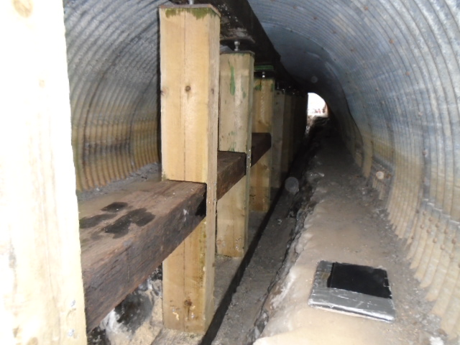
TT Struts and Braces

Slide 23
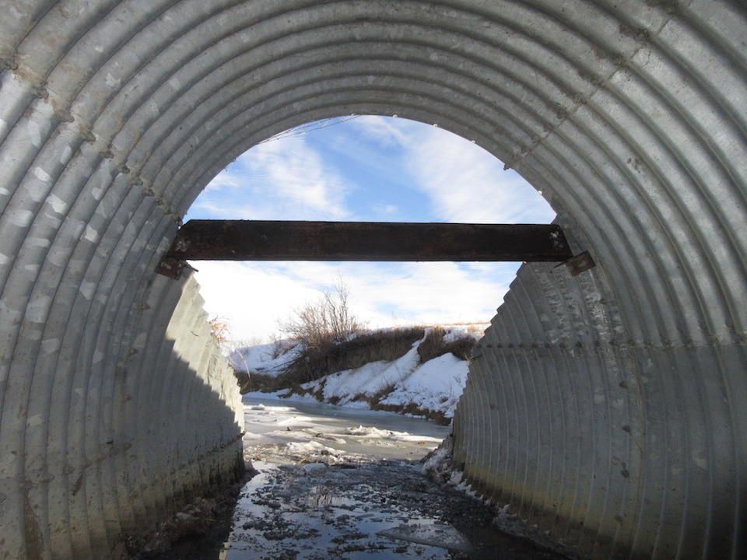
Horizontal TT Strut

Slide 24
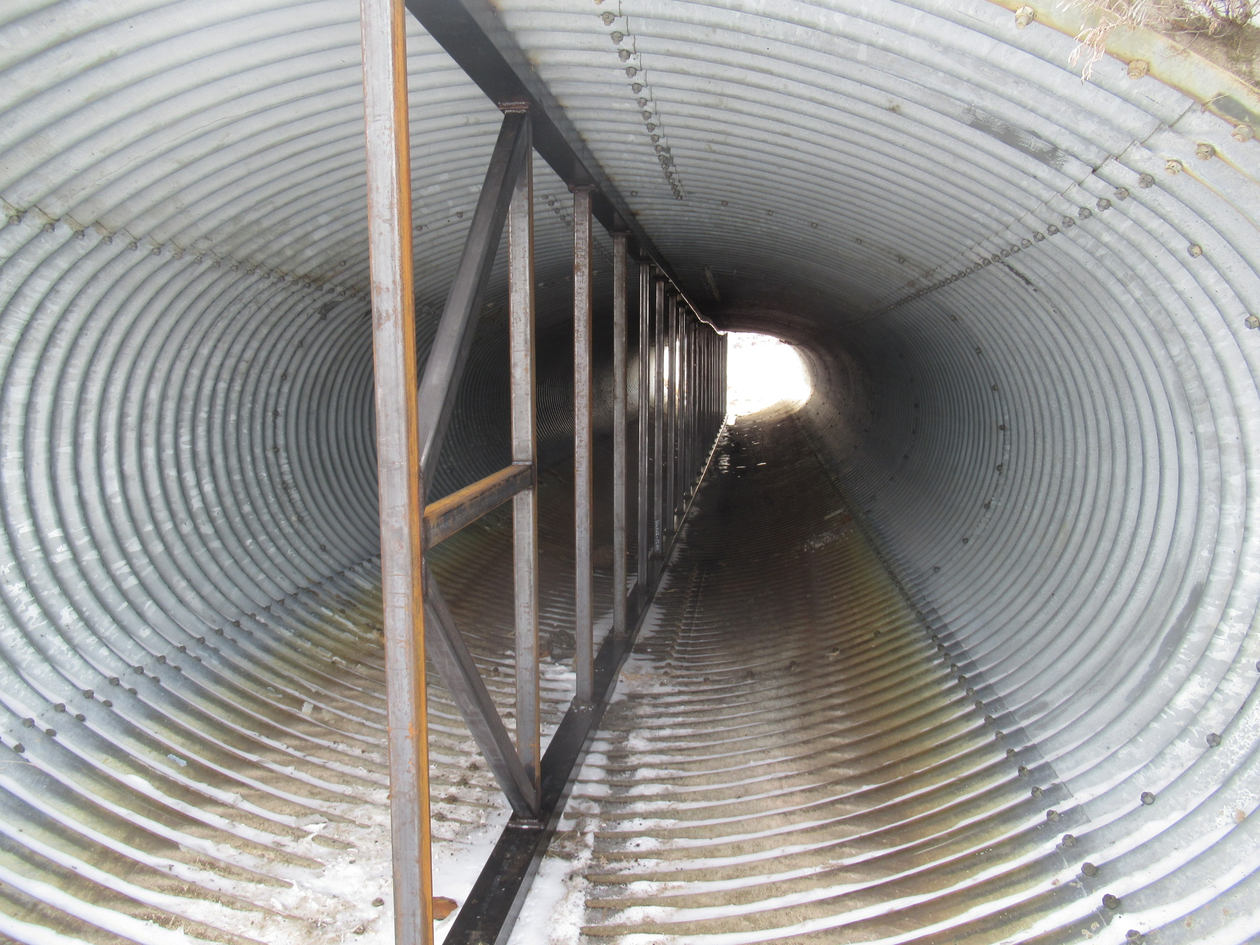
Steel Struts

Slide 25
Liners
Used when culvert cracked or corroded
Reduces hydraulic capacity
Increases velocities, back water
Not suitable for large deformations
Life 30 to 40 years

Slide 26
Culvert Liners

Slide 27
Liner Types
CSP culvert
  1.5m to 3.0m culverts
SPCSP
  larger than 3.0m culverts
  limited length
Tunnel liner
  large culverts and long length
Smooth wall pipe
  Usually <1.5 m diameter culverts

Slide 28
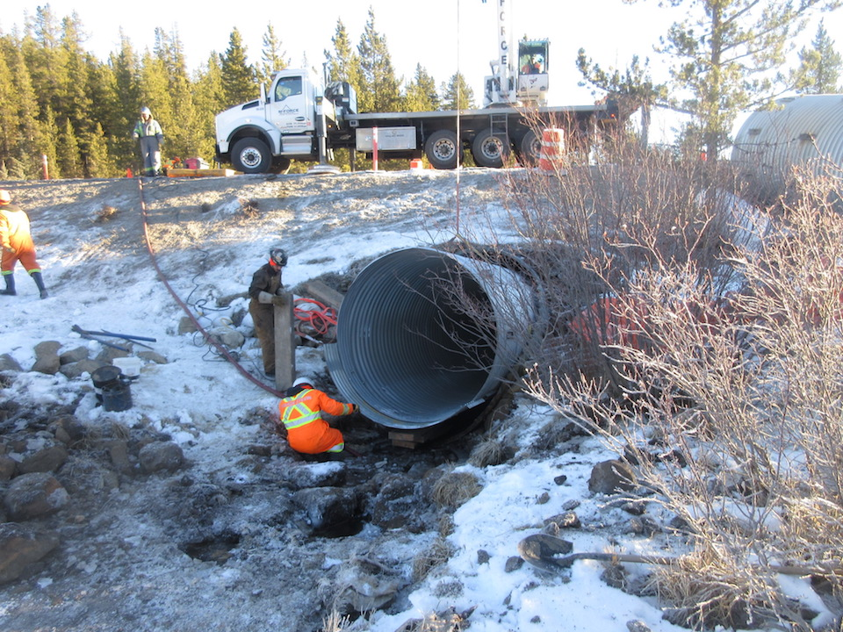
Installing CSP Liner into Existing SPCSP Culvert

Slide 29
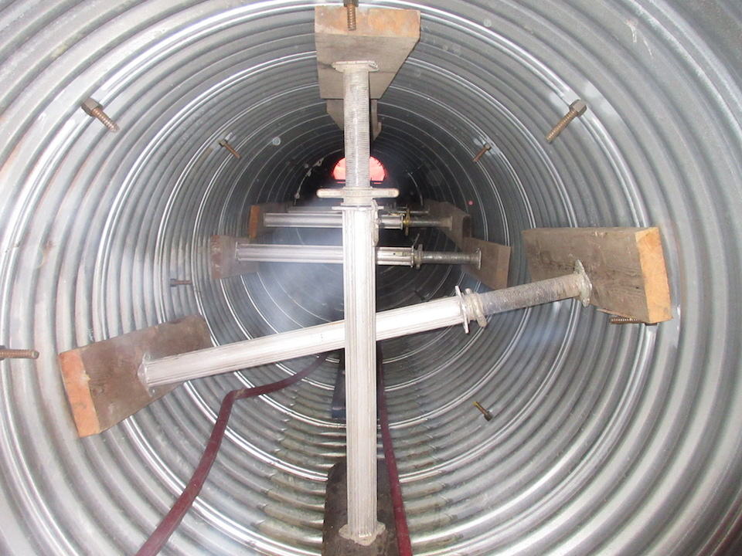
Internal Bracing Installed Prior to Grouting

Slide 30
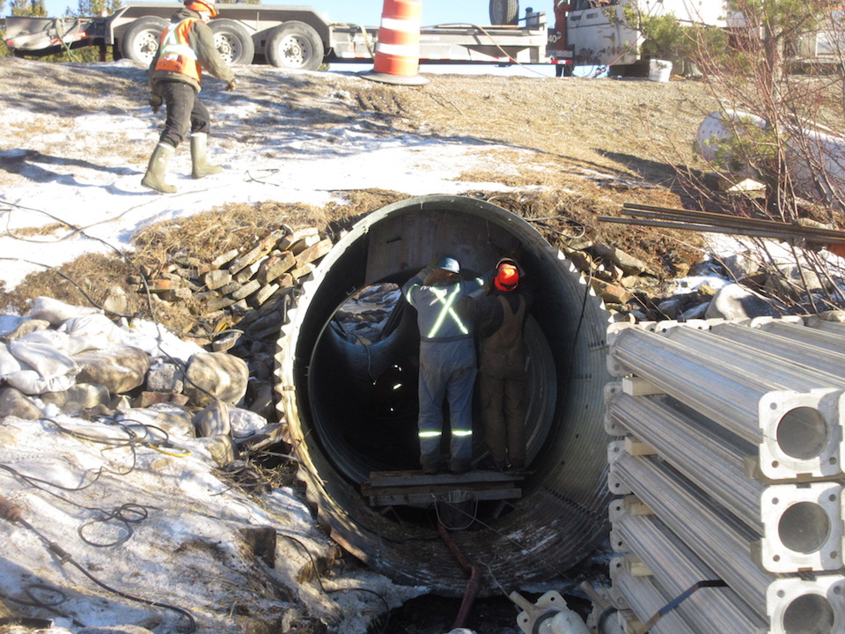
Installing Steel Headwalls at Ends of Pipe to contain grout

Slide 31
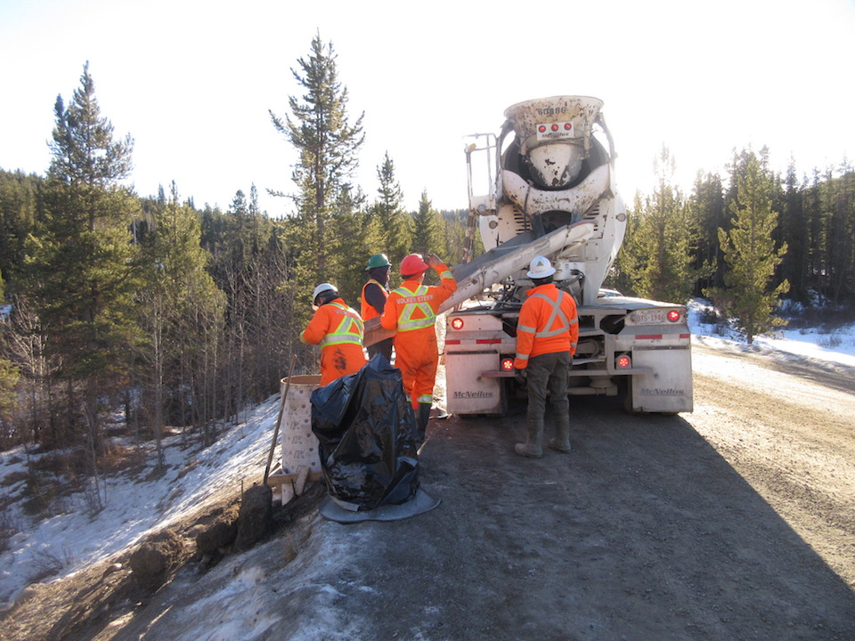
Grout / transit mix installed through holes cut into roof of original pipe.

Slide 32
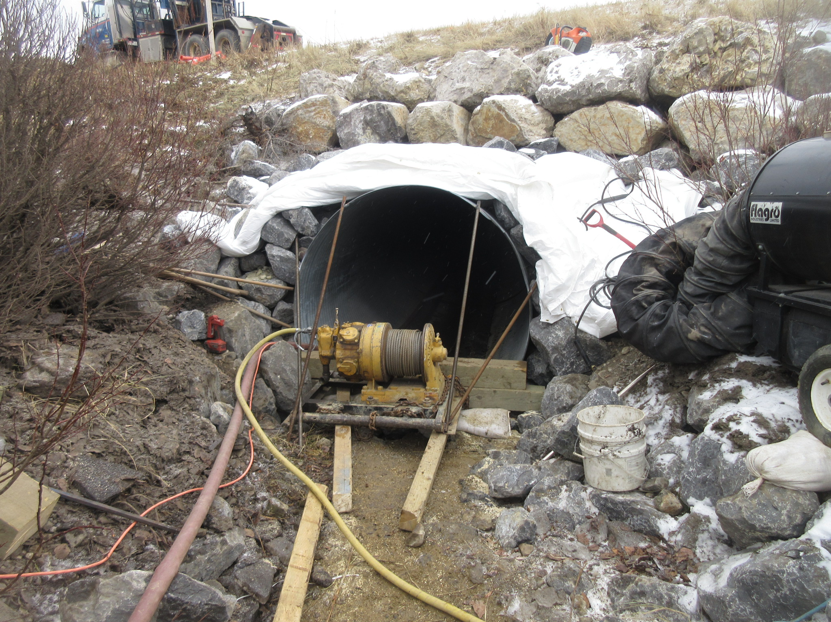
Winch at Outlet to pull new CSP liner into pipe

Slide 33
Victaulic Connector for Concrete Pump

Slide 34
Installing Tunnel Liner Inside Culvert

Slide 35
Tunnel Liner Ready for Grouting

Slide 36
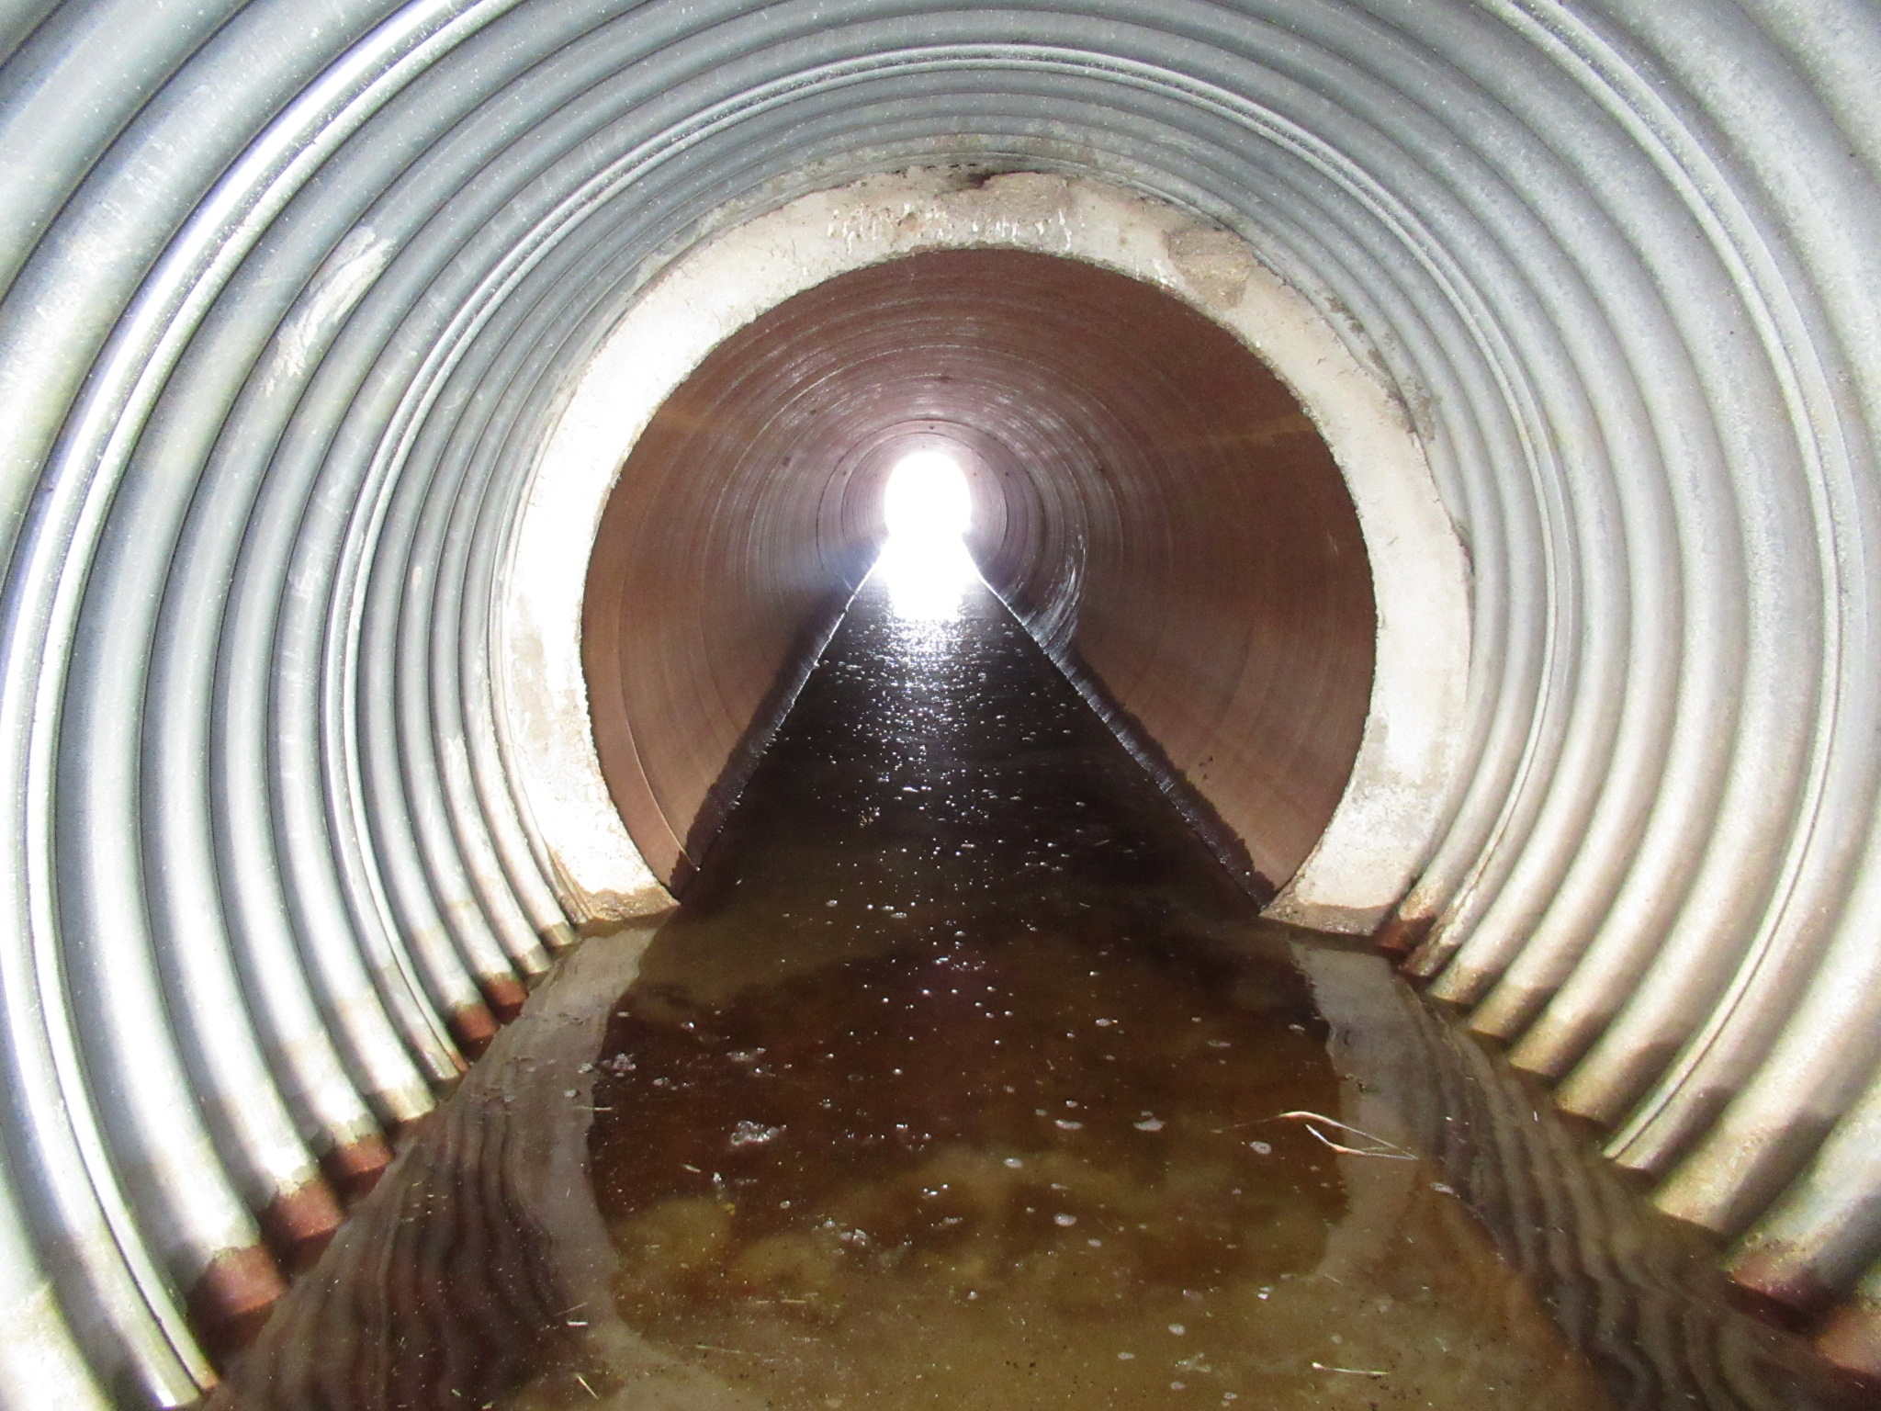
Smooth Wall Steel Pipe Liner in CSP

Slide 37
Concrete Floors
Repair severe perforations of invert
Reinforce cracked seams and sidewall deformation of arch culverts
Reduces hydraulic capacity

Slide 38
Details of Concrete Floor for SPCSP Arch

Slide 39
Reinforcing Steel Arrangement

Slide 40
Concrete Floor Cast

Slide 41
Finished Floor and Ponywall

Slide 42
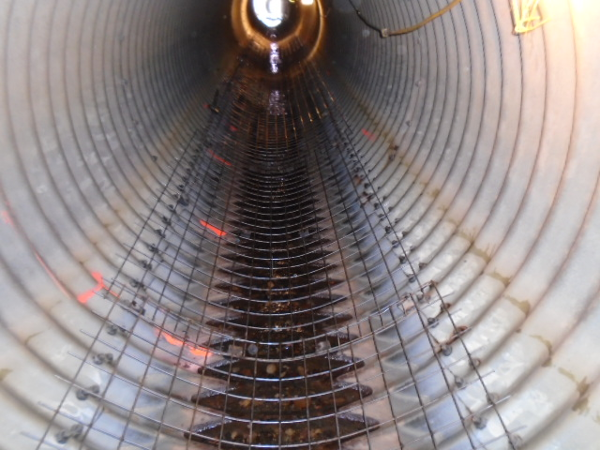
Reinforcing Steel Arrangement – Wire mesh

Slide 43
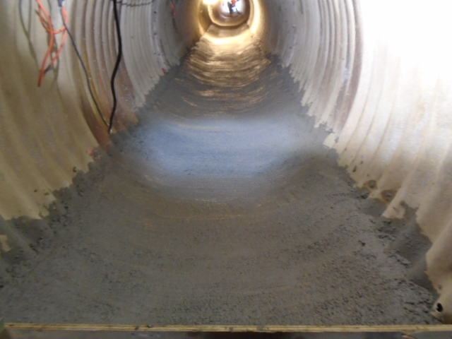
Pouring Concrete Floor

Slide 44
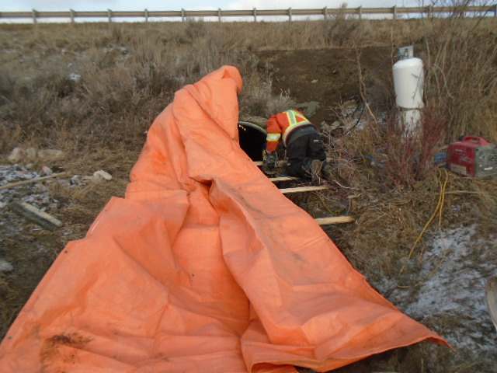
Ends of Pipe Tarped off to heat.

Slide 45
Crack Repair Methods
stop drilling crack ends
welding cracks
reinforcing plates
  welded
  Bolted
reinforced concrete
  arch culverts
shotcrete

Slide 46
Shotcrete Reinforcing
Preferred method for repairing cracks
Stiffens joint and transfers ring compression
sprayed over shear connectors and rebar
20-year life
Not suitable for:
  small cracks
  cracks on both sides
  severe corrosion
  large deformations

Slide 47
Longitudinal Seam Reinforcing
Longitudinal Cross Section

Slide 48
Pump and Mixer for Prewetting

Slide 49
Detail of Reinforcing and Shear Connectors

Slide 50
U-bracket Shear Connector

Slide 51
Sandblast Equipment

Slide 52
Heaters

Slide 53
Reinforcing and Shear Connectors Ready for Shooting

Slide 54
Shooting Concrete Mix

Slide 55
Completed Crack Reinforcing Beam

Slide 56
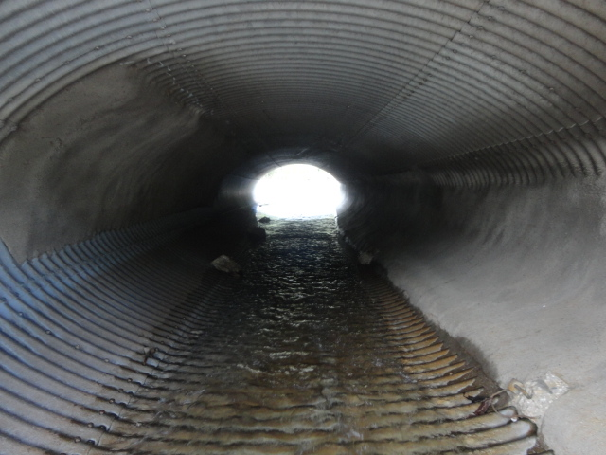
Completed Crack Reinforcing Beam

Slide 57
Cathodic Protection
Prevents corrosion
  impressed uniform potential
  anode sacrificed to protect structure
  soil side corrosion only
System types
  impressed current system
  passive system

Slide 58
Cathodic Protection
Impressed current system
  20 to 60 volts and 4 to 16 amps
  available power on site, 120/240 AC
  power supply, anode bed, electrolyte
  life - 15 to 25 years
Passive system
  dissimilar metals create current and potential
  many magnesium anodes sacrifice to protect structure
  1 to 2 amps and 1 to 2 volts
  life - 15 to 25 years

Slide 59
Passive Cathodic Protection

Slide 60
Culvert Cathodic Protection

Slide 61
Anodes

Slide 62
Anode Cross-section

Slide 63
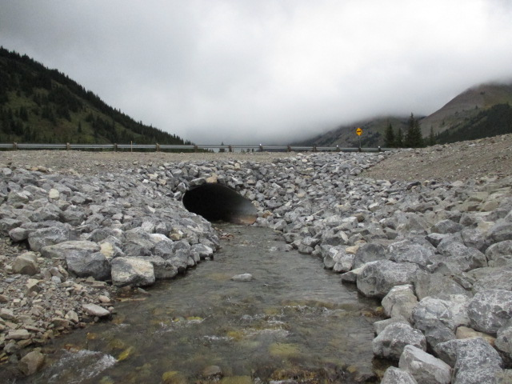
Downstream Restoration

Slide 64
Jacking Culvert Under Highway

Slide 65
Environment Controls - Siltation Fence

Slide 66

Questions?

