Slide 1
ALBERTA TRANSPORTATION CLASS
A BRIDGE INSPECTION CROUSE
Level II Inspection of Concrete Bridge Elements
Notes:
Good afternoon. As Garry has mentioned my name is Dave Besuyen and I’m the Bridge Materials Engineer here at the Department.
As part of my duties, I am responsible for managing the Level II inspection/testing program for concrete bridge elements - and those Level II Inspections will be our focus for the next hour or so.

Slide 2
Overview
Function of Level II Inspections for Concrete Bridge Elements
Level II Concrete Inspection/Test Methods
  Equipment
  What does test data indicate
  How is the data used
Notes:
We’ll start by touching on the function of Level II Inspections and examine the different inspection/test methods used in assessing concrete elements. We’ll also look at some of the equipment used, what test data indicates, and how that data is used in assessing the bridges condition.

Slide 3
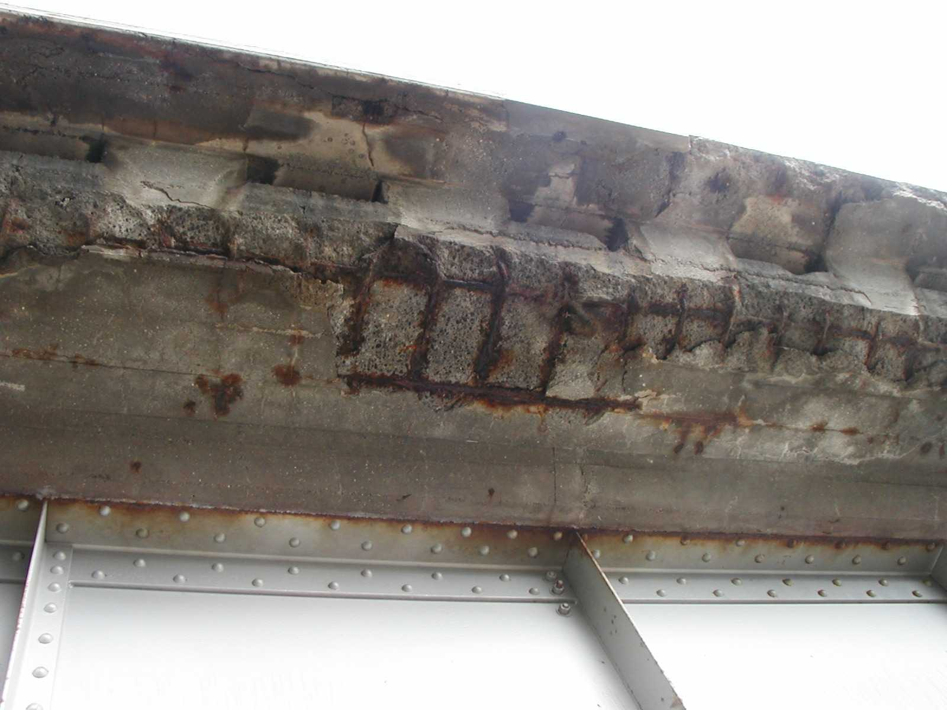
This Didn’t Happen Overnight
Notes:
How long did it take a condition like this to develop?
When would the best time have been for doing preventative actions?
Deterioration rates, remaining service life are important concepts in which level 2 test methods can be used develop appropriate management strategies.
They allow us to predict the safest and most cost-effective times for doing repairs, so that budgets and plans can be in place.

Slide 4
∆ y
∆ x
Notes:
One of the biggest questions in developing a long term management strategy for a bridge is when is the best time to do maintenance or repairs? As materials, design concepts, quality of construction are unique to each bridge it is not good management practice nor is it cost effective to make generalizations regarding service life of a bridge inventory.
As an example, throughout the service life of a concrete bridge deck there are different management strategies that can be implemented. However as the level of damage to the deck increases the number of management strategies available are reduced and repair options become increasingly intrusive. Level 2 inspections help determine where we are along this curve and assist in determining the appropriate action at the appropriate time.
The rate of deterioration can also be determined from this figure and is defined as the slope of a line tangent to the damage/time curve. Rates are low early in a decks life and increase over time.

Slide 5
Level of Damage
Cost of Work
Overall
OVERALL LEVEL OF DAMAGE
Notes:
Areas along the curve can be grouped into management strategies that are preventative, rehabilitative, or require complete replacement.
The overall of level of damage on the vertical axis can also be substituted with the cost of repair work and reiterates the importance of determining the optimum timing for repair to maximize service life and minimize cost.

Slide 6
Alberta Transportation Level II Inspections of Concrete Elements
Level II BIM Manual
Chapter 2 - Concrete Deck Inspection
Chapter 3 - Copper Sulfate Electrode Testing
Chapter 4 - Chloride Testing
Notes:
Alberta Transportation schedules regular level II inspections for bridge structures with concrete bridge decks.
These level II inspections include a detailed concrete deck inspection, copper sulfate electrode testing, and chloride testing. An inventory of approximately 800 bridges are inspected/tested on a cyclic basis and monitored to determine the optimum window for repair.
The inspections and methods describe in the Level II manual are specific for bridge decks but can also be applied to other concrete bridge elements if required. Alberta Transportation has chosen to focus on decks/curbs as they typically have the highest rates of deterioration and make up the most significant amount of our rehabilitation dollars.

Slide 7
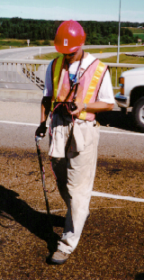
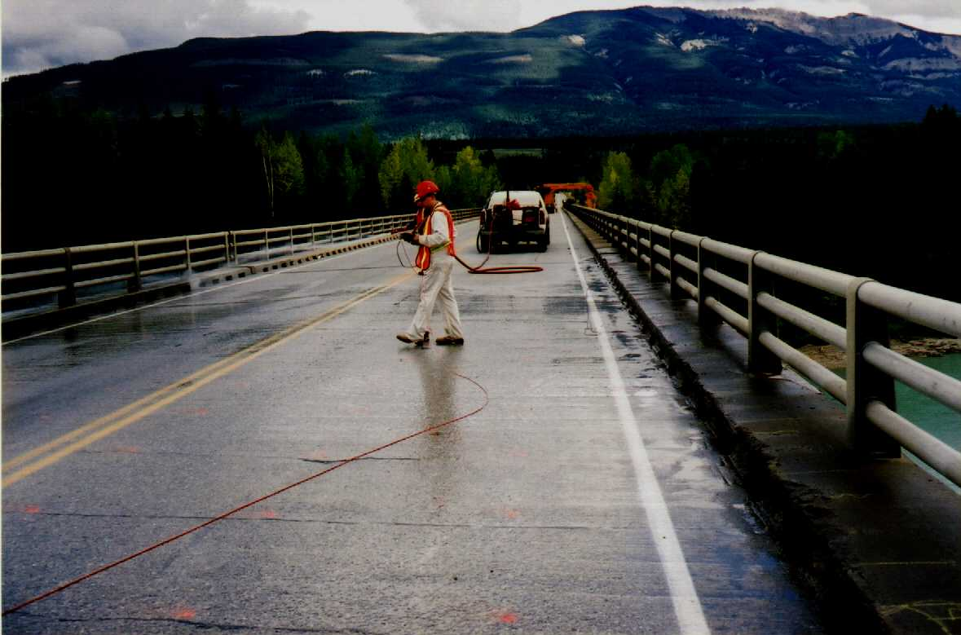
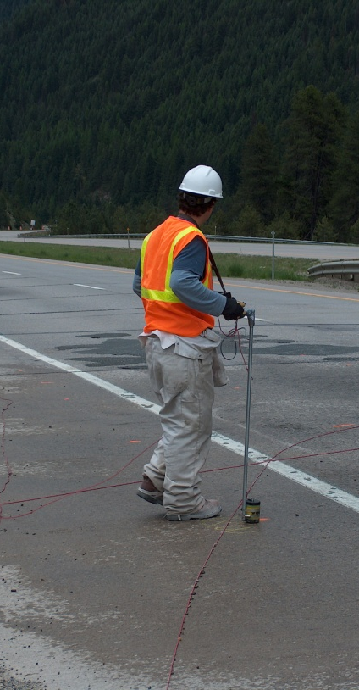
Chapter 3 - Copper Sulfate Electrode (CSE) Testing
Notes:
Alberta Transportation has been using Level II Copper Sulfate Electrode Testing or CSE Testing to evaluate the corrosion condition of bridge decks since 1977. Alberta Transportation test methods are patterned after ASTM C876.
After many years of testing the data collected from all structures was examined and resulted in the development of Alberta specific bridge deck life prediction models. These prediction models assist in determining the optimum timing for repairs.
The most important aspects of CSE testing which make it such a viable level II method are:
A> It is non destructive in nature
B> It is fast and minimizes lane closures
C> Because of the speed - a large number of readings can be taken providing a high degree of statistical accuracy. This also makes the testing
very economical.
D> Using the data and prediction models we can identify problems in well in advance of actual physical damage appearing.

Slide 8
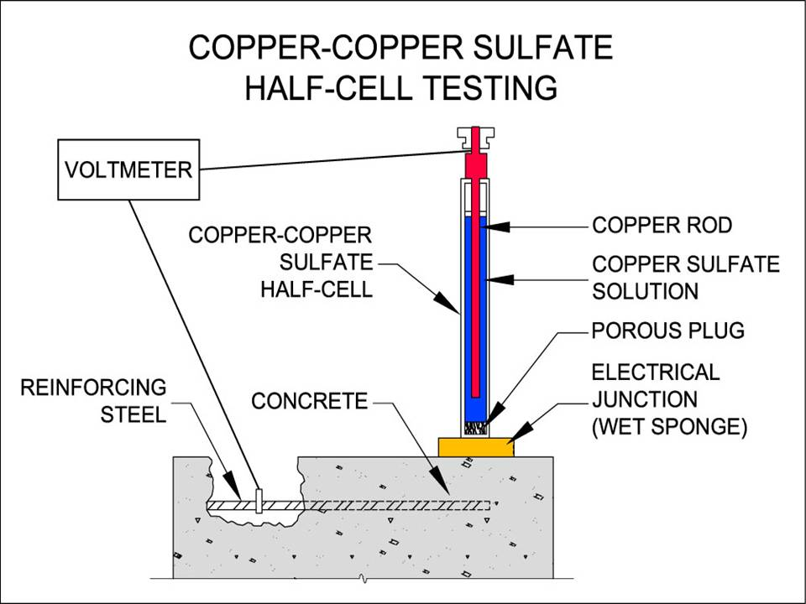
Chapter 3 - Copper Sulfate Electrode (CSE) Testing
2OH⁻
Chloride Contaminated Concrete
-350 mV
Anode
2e ⁻
Fe Fe²⁺ + 2e ⁻
Fe²⁺ + 2Cl⁻
FeCl₂
FeCl₂ + 2OH⁻
Fe(OH)₂ + 2Cl⁻
2Fe(OH)₂ + ¹/₂O₂
Fe₂O₃ + 2H₂O
¹/₂O₂ + H₂O + 2e ⁻
2OH⁻
-200 mV
Cathode
Notes:
Corrosion of reinforcing steel is an electro chemical process and CSE Testing measures small voltages emitted during those processes.
An electrical circuit is established between the mats of reinforcing steel and a copper-copper sulfate half cell. Lead wires are connected from the half cell and reinforcing steel to a voltmeter.
I’ve brought in some CSE equipment to give a better representation of what is used in the field.
The first step in testing a deck is to establish a ground connection to the reinforcing with the lead wire. For the vast majority of our bridge decks this connection is not directly to the reinforcing, but rather other steel elements that are electrically connected to the reinforcing. This is typically a deck joint, anchor bolt, or deck drain. The most important step in establishing a ground connection is verifying that it is connected to the reinforcing steel, and this is done with the use of a multimeter.
The lead wire from the ground is then connected to the voltmeter, which in this case also has data logging abilities.
The half cell is also then connected to the voltmeter through this cane. The cane and an enter button was developed to speed in storing measurement, and save a few back muscles.
The tester can then walk along the grid pattern storing readings as he goes.

Slide 9
Chapter 3 - Copper Sulfate Electrode (CSE) Testing
ASTM C876 Interpretation of Results
Half-Cell Potential (Absolute Value) | Percent of Test Area
0.000 to 0.099 V 0.100 to 0.199 V | 0.0 1.4 | 1.4
0.200 to 0.299 V 0.300 to 0.349 V | 20.8 12.7 | 33.6
0.350 to 0.399 V 0.400 to 0.499 V 0.500 to 0.599 V 0.600 to 0.699 V 0.700 to 0.799 V | 14.7 30.8 19.5 0.5 0.5 | 65.0
Inactive Area (0 to -0.2 V)
90% Probability that active corrosion is not occurring.
Transition Area (-0.2 V to -0.35 V)
Potential for active corrosion is indeterminate.
Active Area (-0.35 V to -0.8 V)
Potential for active corrosion is indeterminate.
Notes:
The magnitude of the voltages measured with CSE testing fall into 3 categories indicating the PROBABILITY of active corrosion. Its important to note that the voltages are only a measure of PROBABILITY and not actual corrosion rates. Specific corrosion rates can not be measured or calculated using CSE testing.
The first range of voltages 0 to -0.2V indicates there is a 95% probability that active corrosion is not occurring.
The second range of voltages -.2V to -0.35V indicates the potential for active corrosion is indeterminate and is sometimes referred to as the transition area.
The third range of voltages are what we are most concerned with and this is the range less than -0.35 volts. This range indicates a 95% probability that active corrosion is occurring. In reinforced concrete, readings should not exceed -0.8V, the highest I’ve seen on an Alberta deck was around -0.6V.

Slide 10

Chapter 3 - Copper Sulfate Electrode (CSE) Testing
Notes:
Alberta Transportation records CSE readings on a 4ft by 4ft grid, and software is used to create contours of corrosion potentials – this is an eastbound bridge with travel lanes delineated. Areas with a high probability of active corrosion are highlighted in red and the lighter areas showing transition or inactive areas.
Does anyone see any interesting trends in the contour map of this bridge?
The driving lane in this case is showing a much higher probability for corrosion. The contour is taken from a bridge on a 4 lane divided highway in the mountains with light enough traffic that the majority travels in the right lane and repeatedly sees more deicing salts causing accelerated deterioration.
Contour maps can show areas of poor drainage, highlight the presence and effect of transverse cracks or other factors increase probability of corrosion.

Slide 11
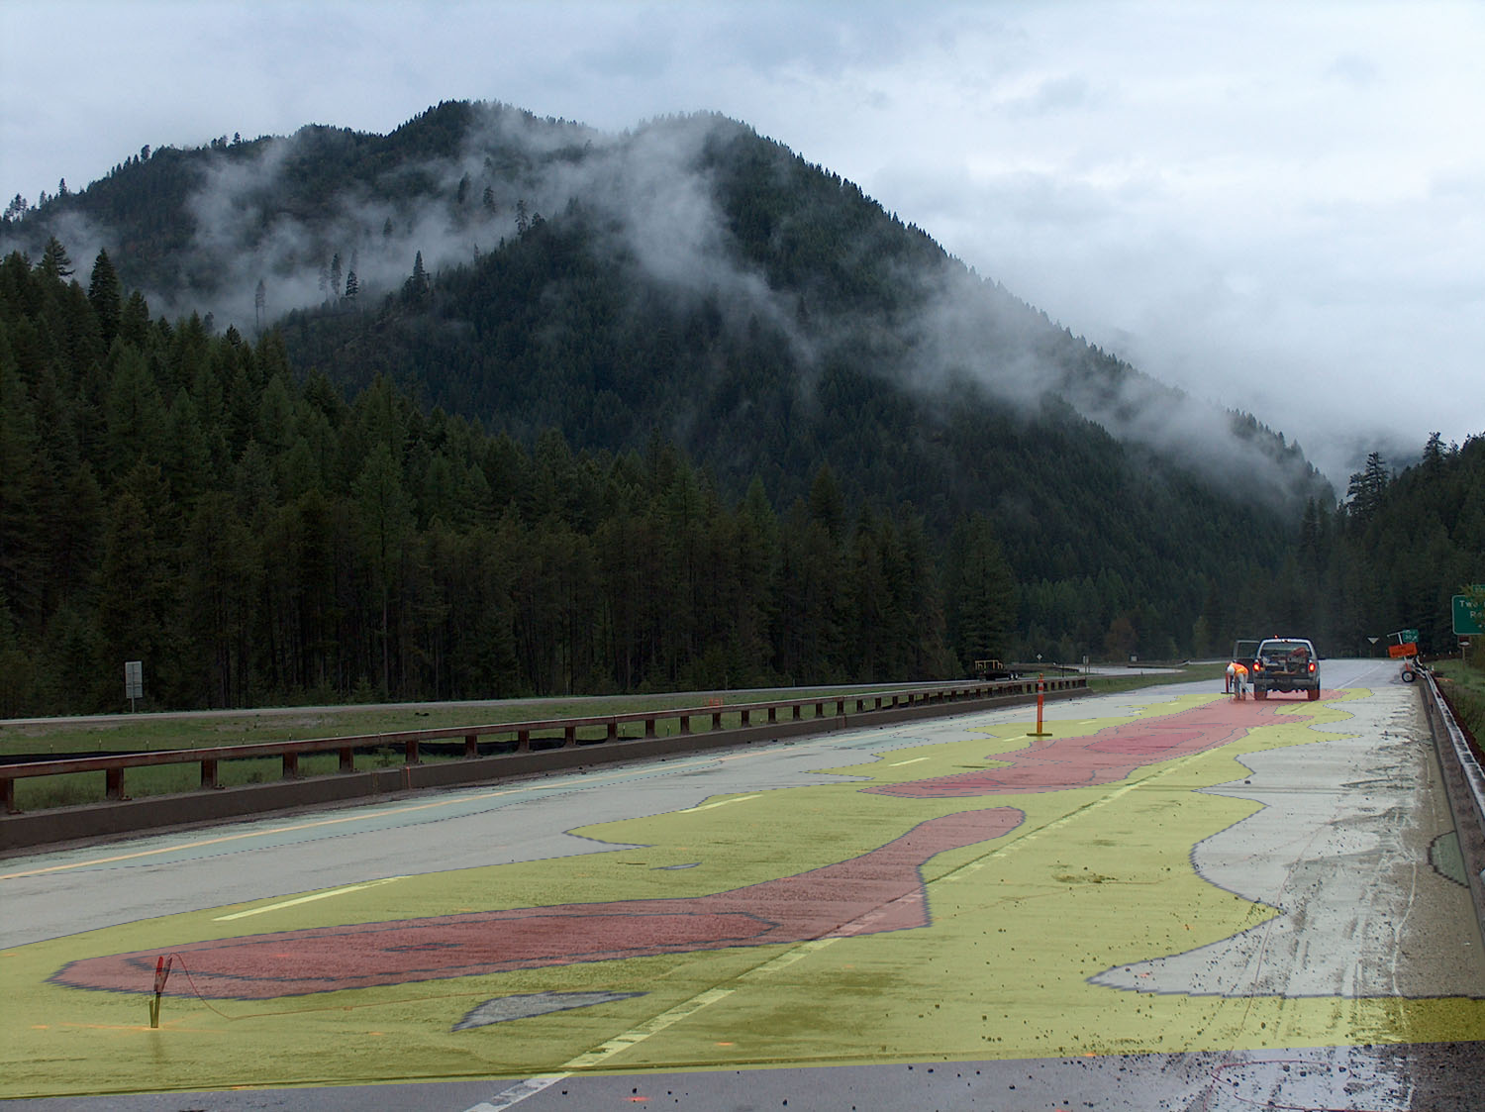
Chapter 3 - Copper Sulfate Electrode (CSE) Testing
Notes:
By placing the contour map on a photograph of the deck you can get a nice visual representation of where the CSE test data is coming from. This contour is similar to the last slide in that the driving lane is showing a much higher potential for corrosion.

Slide 12
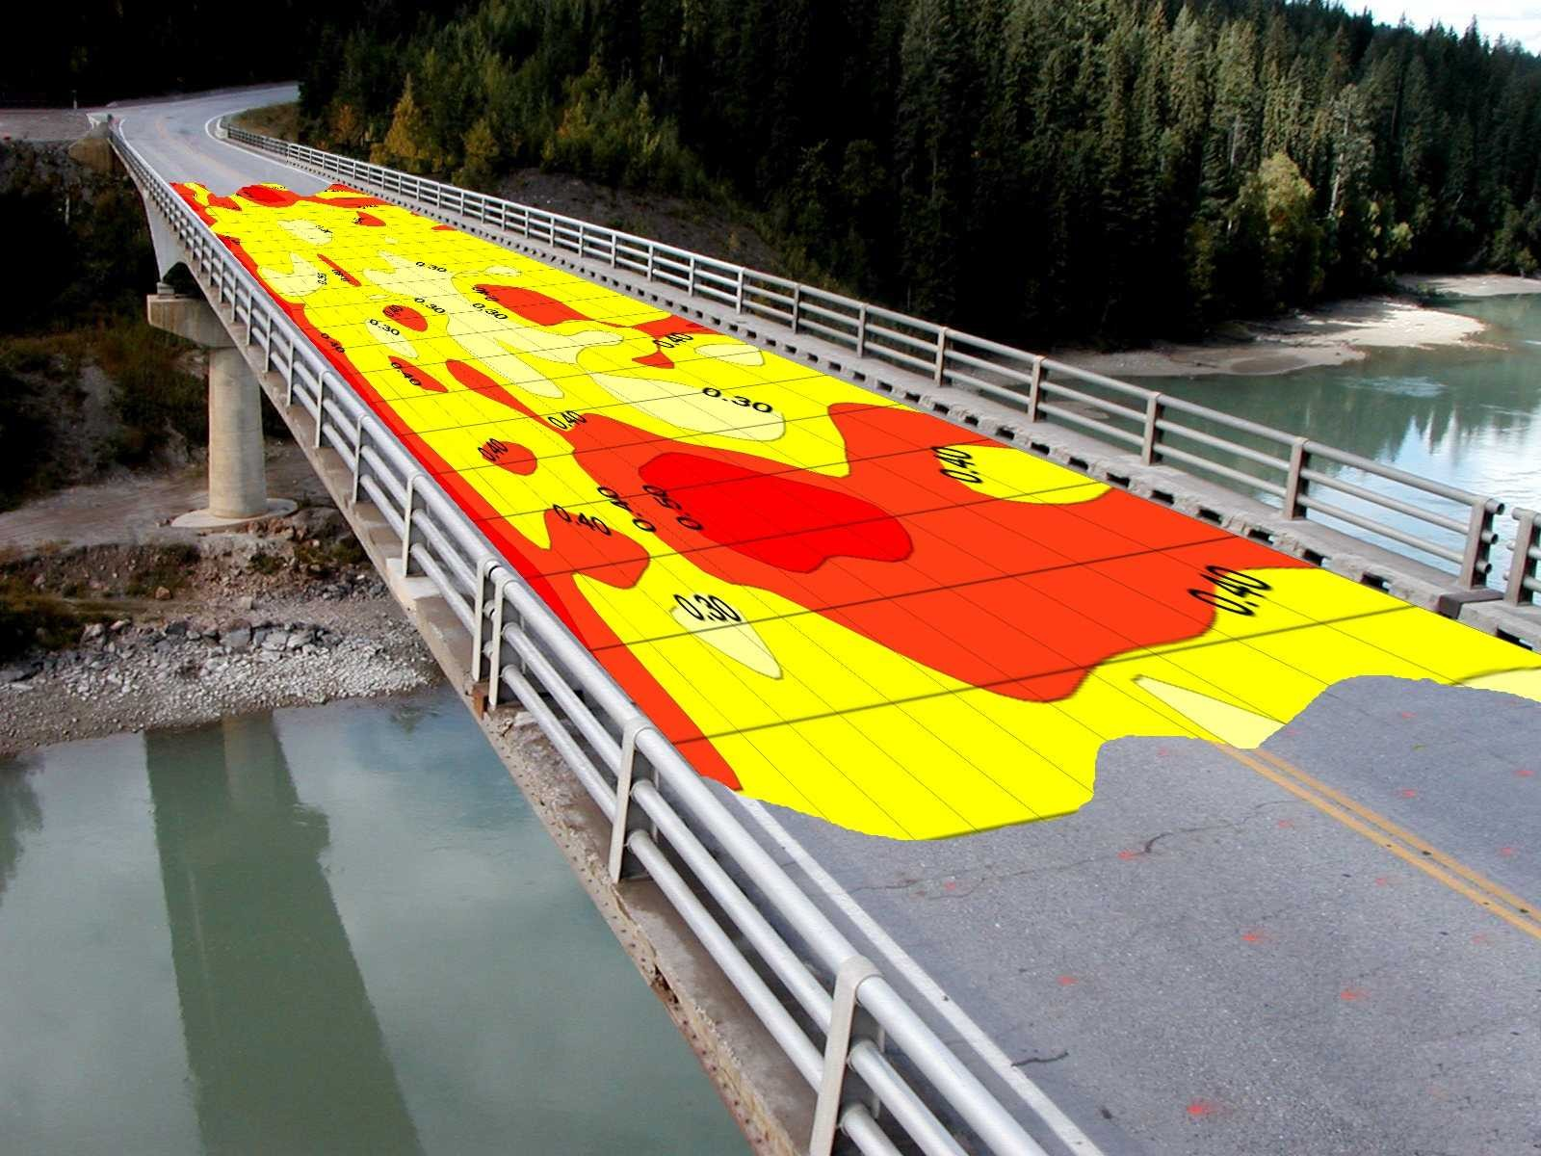
Chapter 3 – Copper Sulfate Electrode (CSE) Testing
Notes:
Another visual reputation of CSE testing of bridge decks.

Slide 13
CSE Prediction Model
Notes:
As I mentioned earlier Alberta Transportation studied the trends of CSE data on over hundreds of decks since the program began. Out of these studies, prediction models were developed to assist in determining the optimum timing for rehabilitation.
Many of the secondary or 3 digit highways were paved in the late 1980’s and early 1990’s which resulted in significant increase in application of deicing chemicals, this model shows the result of such a change in corrosion to an unprotected deck.
The red line with the purple dots shows actual test data and the blue line is projected CSE results from the time of rehab.
The prediction model considers several factors such as type of rehabilitation, span type, environmental exposure, drainage and among others.
Using the figures generated over years of testing we can also determine the effectiveness of the repair, measured by the difference in upper and lower inflection points and also the total life gained as a result of completing the rehab.

Slide 14
Alberta Transportation Guidelines for Using CSE to Determine Timing of Repairs
5 year window for 2nd Rehab
Time for 2nd Generation Rehabilitation
Notes:
Another CSE prediction model.
When 20% of the deck area is showing 95% probability of active corrosion Alberta Transportation considers this to be a good time to complete a rehabilitation. This is often referred to as a 1st Generation rehab.
After the first generation rehab, Alberta Transportation uses the 50% active area to guide the timing for a 2nd generation rehabilitation. Typically we will try to hit a 5 year window once this level is reached.
One important note to make about the Alberta prediction models is that we use -0.3V as the definition of active corrosion, which is moderately more conservative than the ASTM C876 interpretation of -0.35V.

Slide 15
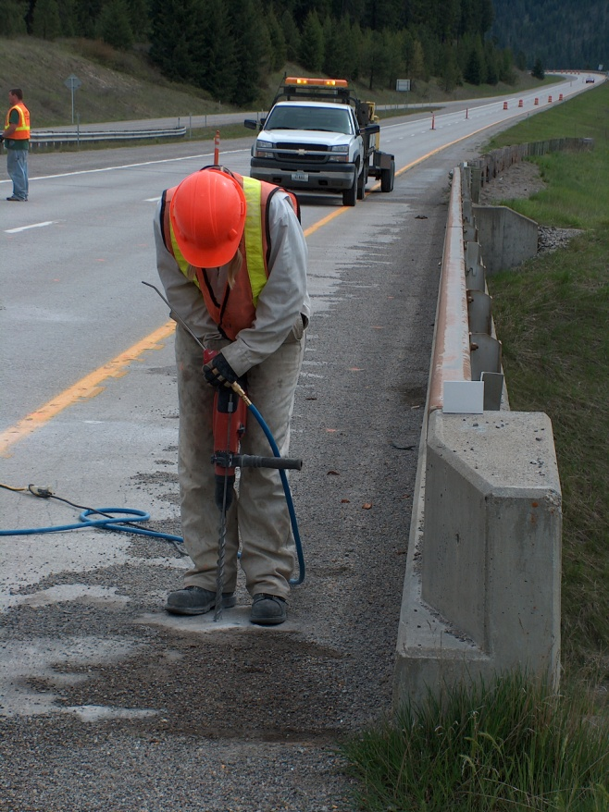
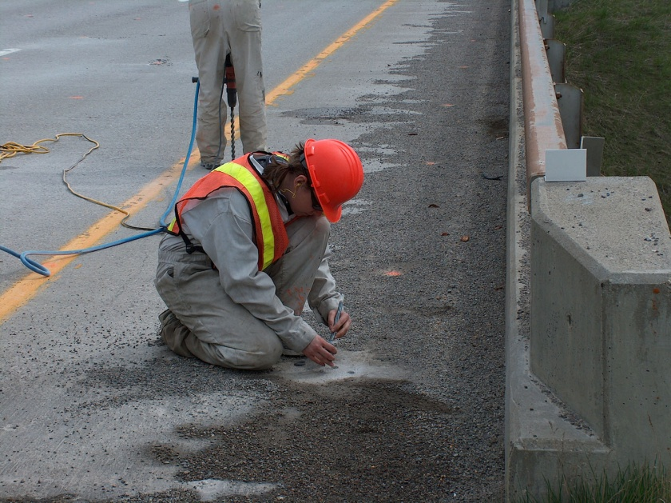
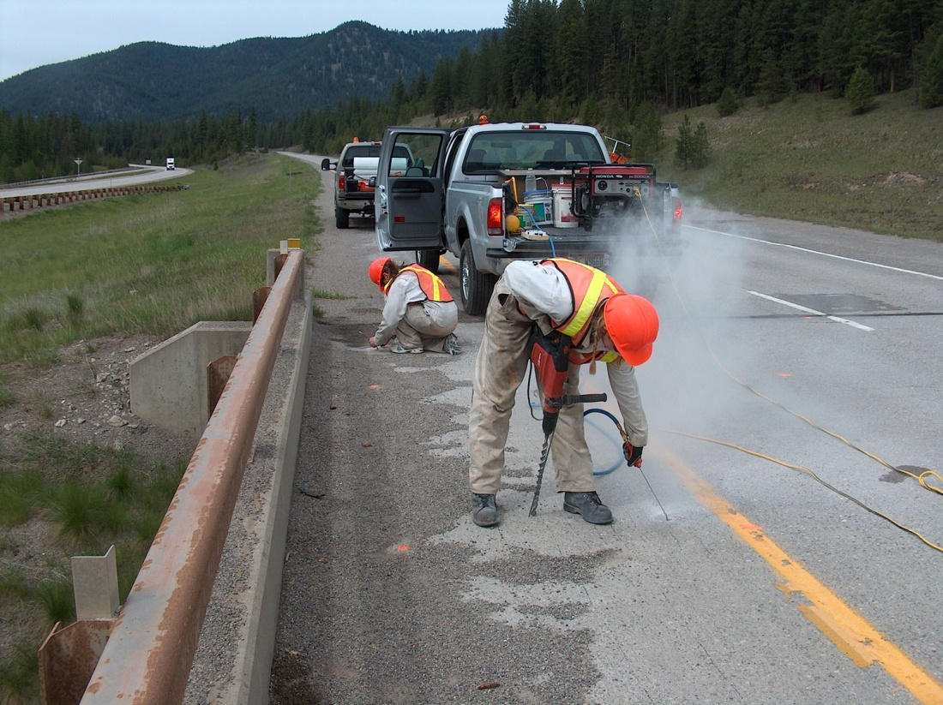
Chapter 4 – Chloride Content Testing
Notes:
Alberta Transportation also uses Chloride Content Testing to evaluate the condition of concrete elements and again this is typically focused on bridge decks. Chapter 4 in your level II manual describes the test method in detail.
Shown in these pictures is some the equipment required for field testing. A concrete hammer drill with measuring device, air compressor, generator, tools for collecting samples and storing specimens.
Chloride content testing is not completed on a scheduled cycle as is CSE because as you can see the testing is destructive in nature. We don’t want to be turning bridge decks into swiss cheese and creating defects that could increase deterioration rates. However, at certain times in a bridge decks life it is warranted to ensure that the right rehab strategy is chosen.
As CSE testing is probabilistic in nature in some cases it can yield results that may seem unrealistic given the visual condition of the deck, age of the deck or exposure conditions. Chloride testing is often prescribed to provide additional information in which we can determine a concrete elements condition.

Slide 16
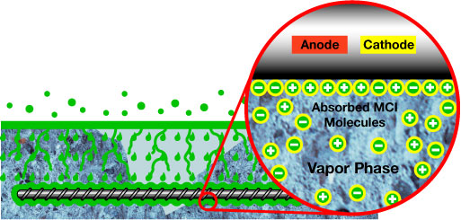
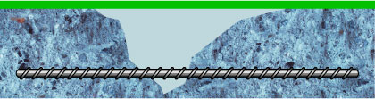
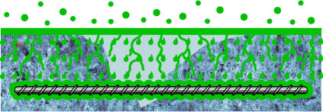
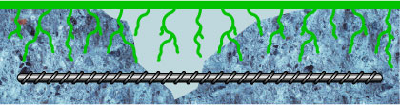
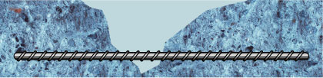

Chapter 4 – Chloride Content Testing
    0.03 % Chloride per unit weight of concrete is known as the corrosion threshold value.
Notes:
Chloride ions are absorbed by concrete’s cement paste as a result of the application of deicing chemicals. Over time and prolonged exposure to these deicing chemicals the concentration of chloride ions will build and begin to diffuse deeper into the concrete.
Different concretes will have significantly different rates of diffusion resulting from mix constituents and deicing chemical application rates.
When the concentration of chloride ions exceeds a certain level at the reinforcing steel there is a high probability that conditions are right for corrosion to occur as the chloride ions breakdown concrete’s natural passivity. Again similar to CSE results, the data represents a Probability that corrosion is occurring.
This critical concentration or threshold level is defined by Alberta Transportation as 0.03% per unit weight of concrete.

Slide 17
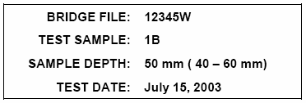
Chapter 4 – Chloride Content Testing
Increasing Cl⁻ Contamination
Waste
12.5
Sample
13 mm
50 mm
Sample
Waste
Increasing Depth
> 0.03%
Sample
Waste
100 mm
Sample
½”
Typical Results – CIP Deck
Notes:
There are several methods of determining chloride contents. Alberta Transportation uses the rapid chloride test method, which involves collecting pulverized concrete powder samples.
Samples are collected at varying depths to determine a chloride concentration profile.
3 standard depths are required at each test location. The top 5 mm of the concrete surface is discarded as it can contain contaminants that can affect results. Once the hammer drill bit reaches a depth of 5 mm the hole is blown clean with compressed air. Then drilling continues from 5 – 20 millimeters, powder is collected and identified as sample A, representing the 12.5 mm depth.
Sample B is collected between the depths of 40 – 60 mm and Sample C is collected between the depths of 90-110 mm.
A typical chloride diffusion profile for a cast-in-place deck would look similar to this. Higher concentration at the surface and decreasing with depth.
Can anyone tell me where along this chloride profile would you be most concerned with the concentration?
Ans: that’s right it is dependant on where the reinforcing is located. If the chloride concentration was above the 0.03% Cl per unit weight of concrete the probability for active corrosion would be high.

Slide 18
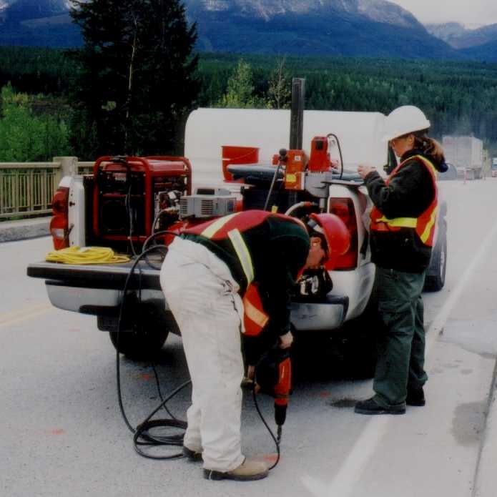
Chapter 4 – Chloride Content Testing
Rapid Chloride Test Method
Advantages
Speed of testing
Economical
Tests completed on site
Disadvantages
Testing completed on site
Not to be taken on decks with
waterproofing membranes in good
condition
Notes:
The principal advantages of Rapid Chloride Testing are:
Speed of collecting samples minimizes lane closures
Results are obtained faster than laboratory procedures.
Testing is economical. Lab testing is approximately 7 times more expensive.
The portable test kit allows for testing to be done on site. This allows for overview of results on site and discrepancies can reviewed, retested and resample if required with having to remobilize to site.
Some disadvantages are:
Testing on site can be affected by weather conditions. Conditions are not as controlled as a in a laboratory setting and can make testing difficult.
In general chloride testing should not be completed on bridge decks with waterproofing membranes in good condition. If there is significant > 10% debonding/cracking of the ACP membrane system and rehab is considered chloride testing is permitted.
It is required as part of the level II test that 1 of every 6 samples be sent to the laboratory for quality assurance of field testing.

Slide 19
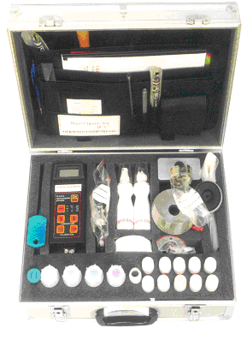
Chapter 4 – Chloride Content Testing
RCT-500
Calibration Liquids
Electrode Solution
Notes:
To date the rapid chloride test kit unit used for Level II testing on Alberta Transportation projects has been the Germann Instruments RCT 500.
The unit contains an electrometer, probe, calibration liquids, powder measuring devices, testing vials among other gadgets.
A brief overview of the test procedure is as follows:
Setup the electrometer and probe
Calibrate the electrometer by inserting the probe into the calibration liquids. Calibration is done in order of increasing concentration as to not contaminate each calibration liquid.
Testing is usually done with 2 people and as one calibrates the other is preparing samples for testing.
Each collected powder sample is carefully measured and mixed with a testing solution and then shook for 5 minutes.
After calibration and preparation of samples, the probe is inserted in the sample to obtain a reading.
The Electrometer measures an electrical resistance which is converted using the calibration results to determine a % Cl- per unit weight of concrete.

Slide 20
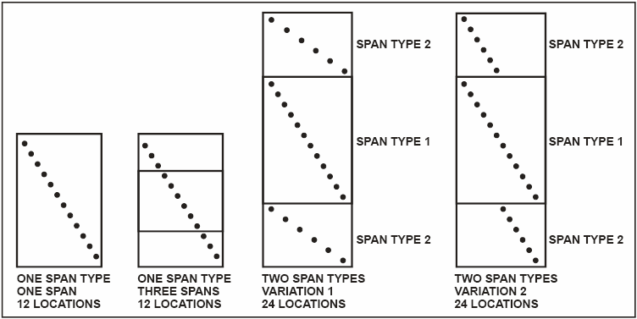
Chapter 4 – Chloride Content Testing
Selection of Test Locations:
Notes:
Chloride concentrations can vary significantly from location to location on a bridge deck.
To account for this variation the Level II chloride test method requires 12 chloride test locations per span type. Test locations are staggered diagonally across the bridge deck to gather a representative sample of shoulder, driving lanes and deck drainage patterns.
No matter how many spans as long as the spans are of the same type the standard 12 test locations are required. If there are two span types 24 locations are required.
Test locations are to be taken on sound concrete free of defects such as cracks, delaminations, spallls etc that could affect normal diffusion patterns.

Slide 21
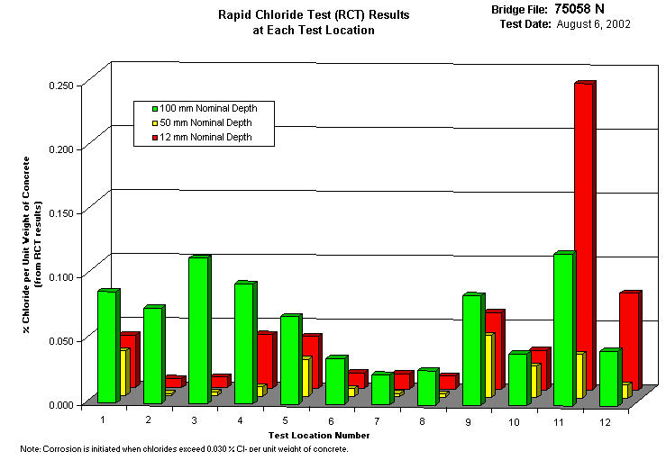
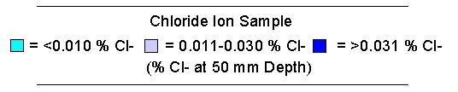
Chapter 4 – Chloride Content Testing
Typical Results:
Bar Chart
Plan View of Bridge Deck
Notes:
Chloride results are typically presented in a Bar chart and on a plan view of the bridge deck.
The bar chart shows the location number and corresponding chloride concentration at each test depth.
The plan view of the deck show the location of the chloride test and the concentration a single test depth. The locations can be color coded to represent the chloride concentration for that location.

Slide 22
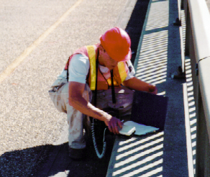
Chapter 4 – Chloride Content Testing
Quantitative
  Rating Methodology Different than Level I
Programmed
  Cyclic Basis to Monitor Condition
Specialized tools
  For Portions of the Inspection
Notes:
The Concrete Deck Inspection described in the second Chapter of the Level 2 BIM manual is a quantitative condition inspection that focuses on concrete decks and other related components of a bridge.
It is primarily a visual inspection that groups areas of like condition and quantifies signs of concrete deterioration such as cracking, staining, scaling spalling, delamination among others.
Level II concrete deck inspections are completed on scheduled cycle depending on the bridges location and exposure conditions. They typically coincide with the CSE schedule.
Specialized tools are required for portions of this inspection.

Slide 23
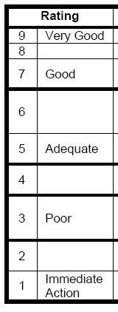
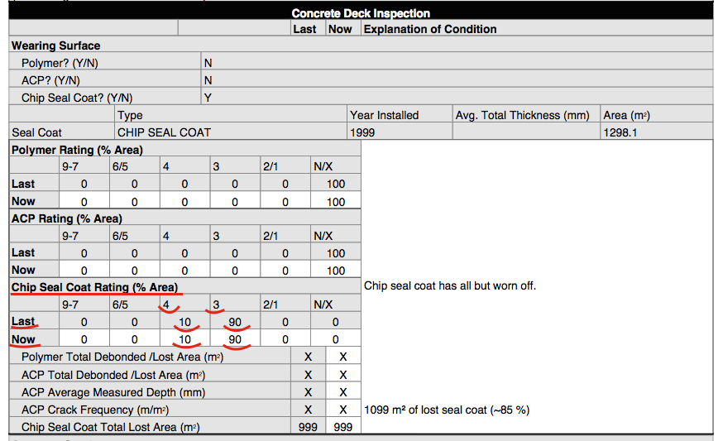
Chapter 4 – Chloride Content Testing
Rating Methodology:
Notes:
The 1-9 rating scale is consistent between Level 1 and the Level II inspection. The difference being in a Level 2 inspection quantitative measurements are used to determine the rating.
For a given element, areas of like condition are grouped together and assigned a rating. The Inspector is also required to record the Percentage% of the element inspected.
For example, lets look at a bridge deck that has had a chip seal coat placed over a concrete deck. The chip seal coat has all but worn off, with approximately 20% remaining.
In this case, of the 20% remaining and inspected, 10 % was rated in the 4 category, and 90% was rated in the 3 category.
Both the Polymer and ACP boxes were rated at 100% X since they are not present and do not apply.
All forms and data are currently available electronically, similar to the current BIM Level 1 form.

Slide 24
Chapter 2 – Concrete Deck Inspection
Level II Concrete Deck Inspection Form Sections:
  Wearing Surface
  Concrete Overlay
  Concrete Deck
  Edge Elements (curbs/barriers/ medians/sidewalks)
  Deck Joints
Notes:
Deck elements with detailed ratings include:
Wearing Surface
Concrete Overlay
Concrete Deck
Edge Elements (curbs/barriers/medians/sidewalks)
Deck Joints

Slide 25
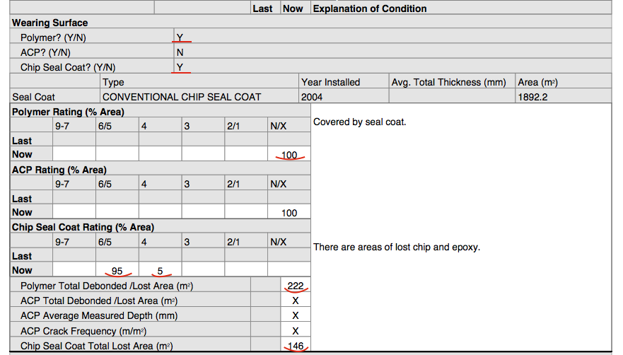
Chapter 2 – Concrete Deck Inspection
Notes:
As we saw in an earlier slide the wearing surface section allows for detailed rating of Polymer overlays, Asphalt (ACP), and Chip Seal Coat.
The polymer, asphalt, and chip seal coat will have a (Y/N) field followed by inventory items retrieved from BIS if entered.
Rating details would be filled in as discussed in our previous example. The Level 2 manual describes conditions in which the wearing surface should be rated. These are quite detailed and require careful studying, cheat sheets similar to the forms used for precast girder ratings & culvert barrel measurements are helpful.
The “Measured damage section” requires a delamination survey, often referred to as a chain drag. The survey allows the inspector to quantify delamination or debonding of the wearing surface from the underlying deck in square meters. The quantities from the survey are then entered into the respective categories.
In this example there is a Chipcoat covering the Polymer Overlay, so the inspector rated the Polymer at 100% “N”
95% of the Chipcoat was rated in the 6/5 category, and the remaining 5% was rated in the 4 category.
The inspector found 222 square meters of debonded Polymer and 146 square meters of missing Chipcoat.

Slide 26
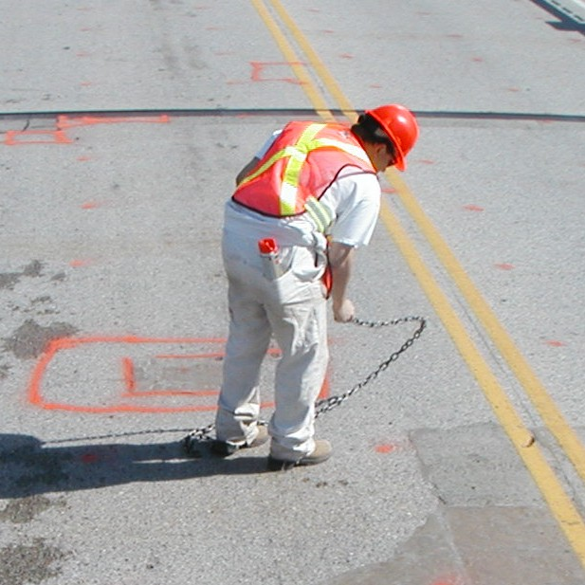
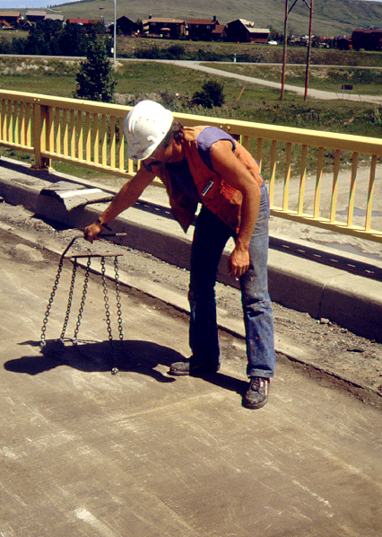
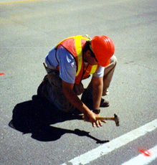
Chapter 2 – Concrete Deck Inspection
Deck Delamination Survey
ASTM D4580
Notes:
The deck delamination survey can be completed using a variety of test equipment. Typically for a bridge deck a chain would be used because of the large surface area. A hammer is more often used when examining smaller areas in detail such as potential chloride locations or vertical services which tend to make using a chain more difficult.
The test method measures changes in sound when it is struck or drug over the concrete. A hollow sound or change in pitch indicates discontinuity in the wearing surface or deck. Areas are then mapped out and an damaged area recorded.

Slide 27
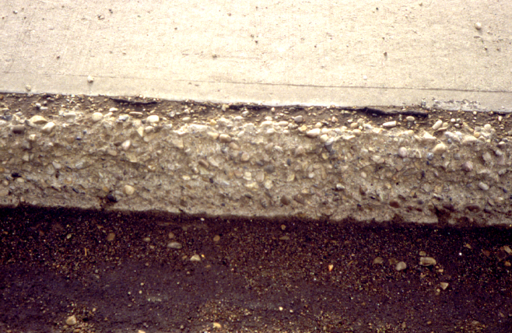
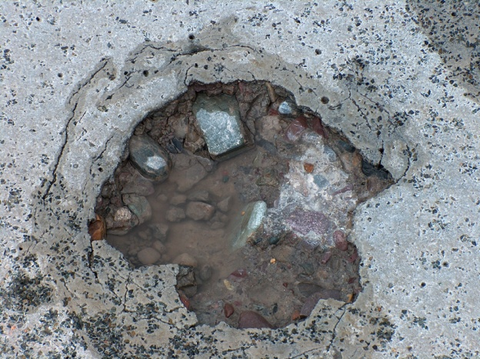
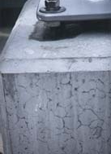
Chapter 2 – Concrete Deck Inspection
Measured Damage:
Scaling
Staining
Cracking
Spalling
Notes:
Some photos of the damaged areas that are quantified in the level 2 concrete deck inspection.
Cracking, staining, scaling and spalling

Slide 28
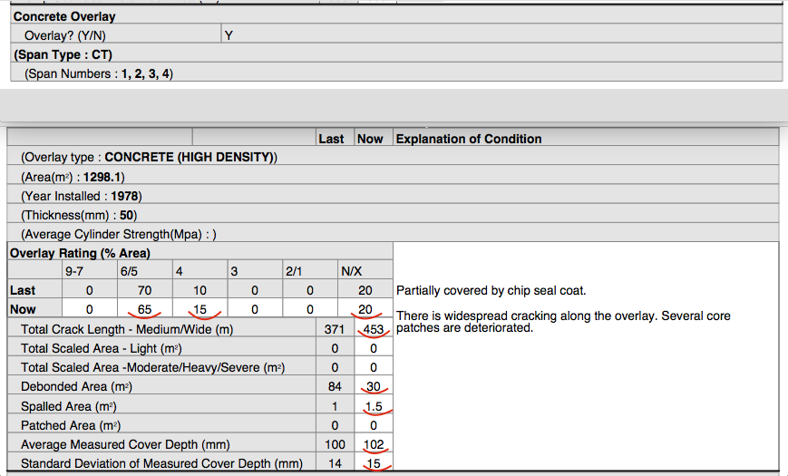
Chapter 2 – Concrete Deck Inspection - Concrete Overlay
Notes:
The concrete overlay section of the form is similar to the wearing surface section and includes a place for inventory and ratings.
One of the important differences between the two sections is the types of measured damage recorded.
Total length of medium/wide cracks, scaled, debonded/delaminated, spalled and patched areas are noted.
This information is very important in determining the overall condition of the deck.
Crack width and the severity of scaling definitions are identical to the level 1 definitions.
Can anyone tell me how a quantitative measurement such as total crack length would be significant in assessing the condition of deck when analyzing CSE and Chloride test results?
Yes – A high count of medium to wide cracks could justify high CSE results in an instance where chloride contents are low. Chloride location selection avoids cracks and the presence of cracking negates the protection provided of low permeability concrete.

Slide 29
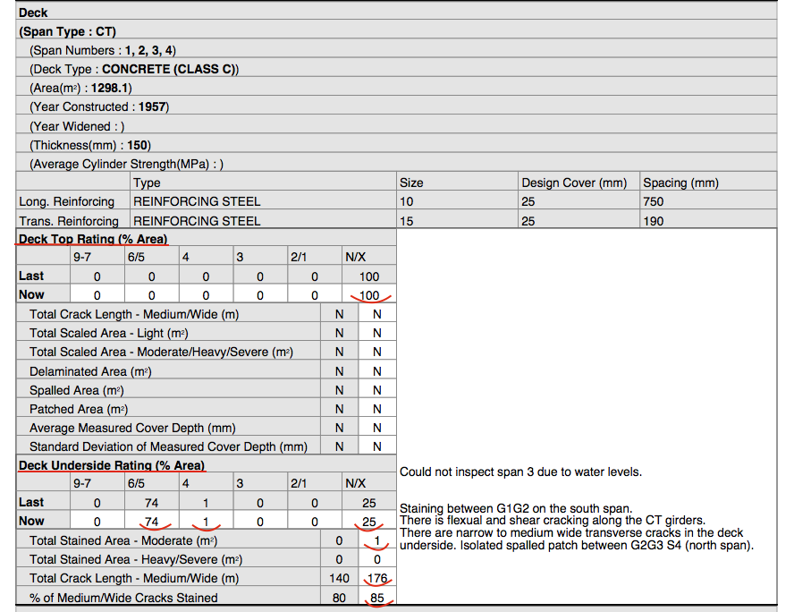
Chapter 2 – Concrete Deck Inspection - Concrete Deck
Notes:
The deck section is similar again in layout, but records information for both the top of the deck and the deck underside.
In the case of our chip coat on polymer overlay example the deck top rating would be ‘N’, but we could potentially rate the deck under side. If we were looking at a steel girder bridge the deck underside area inspected would be in the order of 85%
Crack length again is recorded for both the top of the deck and underside.
The underside of a deck can be a telling story. Cracks along the deck underside that are either stained or not stained will give you a good indication of how the protection system is performing. Red stains indicate the presence of corrosion where white stained cracks would indicate concrete deterioration.

Slide 30
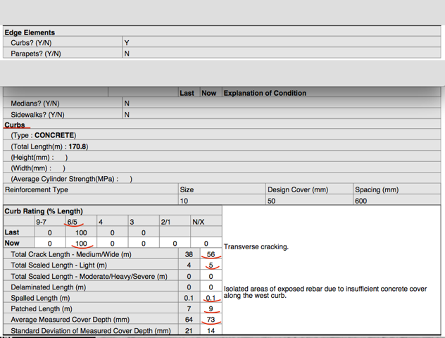
Chapter 2 – Concrete Deck Inspection - Edge Elements
Notes:
The Edge Elements section layout is again similar, and I won’t go into details here and avoid trying to put you to sleep, but the rating detail information is outlined in the manual.
Edge elements are defined as concrete curbs, medians and sidewalks.
Cracks, Scaling, Delaminations, Spalling, and Patched areas are recorded in Lineal Meters
Scaling is broken down further into lineal meters of Light scaling and Medium-Heavy-Severe scaling.
The concrete cover of the edge element is recorded in mm.

Slide 31
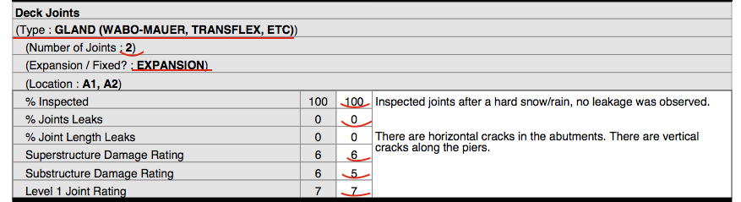
Chapter 2 – Concrete Deck Inspection - Deck Joints
Notes:
Deck joints also have a section in the Concrete Deck Inspection Level II form and provide detail ratings.
Detailed measurements for similar joint types are taken to determine the number of leaking joints and the %percentage of their length leaking.
Ratings are assigned to the portions of superstructure and substructure elements that are affected by the deck joint.
In this example we have 2 strip seal expansion joints – 1 at each abutment
There was no leakage noted by the inspector (0% recorded) and consequently no damaged noted on the Superstructure or Substructure (both rated 6).
The overall Joint rating was recorded as 7.

Slide 32
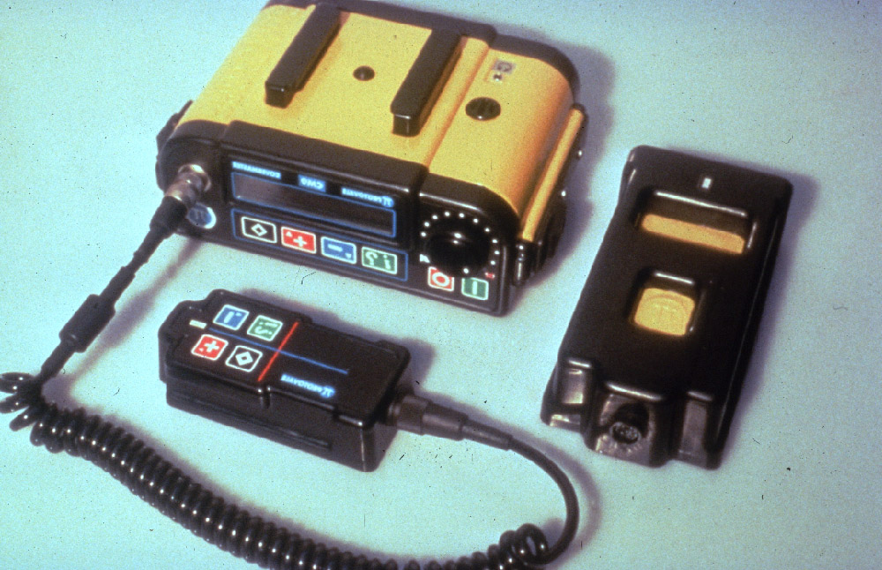
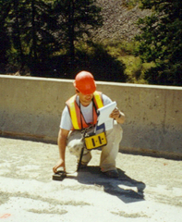
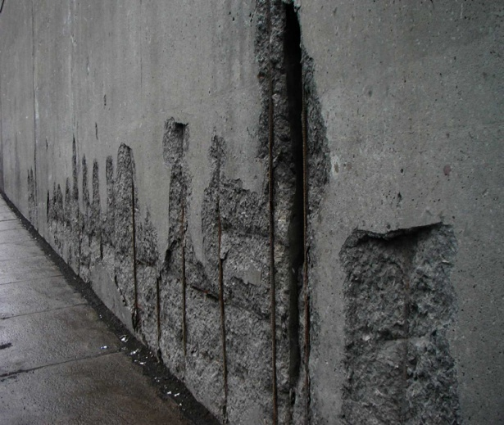
Concrete Cover Measurement
Notes:
Another important variable influencing the results of all of our level 2 concrete tests/inspections is concrete cover. Concrete cover is a good indicator of durability and assists in determining potential for active corrosion.
After corrosion processes have developed it is one 2 factors that suppresses the manifestation of cracking and ultimate concrete spalling.
As part of the regular CSE and Deck Inspection program, cover depth measurements are required to be reported for both the deck and edge elements. The photo here shows a pachometer often referred to as a rebar detector with two different search heads, one for shallow cover and one for deeper depths.

Slide 33
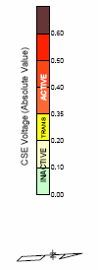
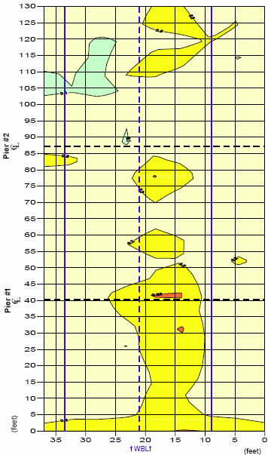
CSE Results
+ Cover Depth Results
+ Deck Inspection Results
Notes:
Once Level II data is collected, repair and management strategies can be formulated. It is very important to look at all of these types of data together when establishing the condition of concrete element. If the focus is solely on one set of information the potential for missing an important piece of the puzzle exists.
In our bridge deck example we’ve collected our CSE test results and created a contour map of the areas showing probabilities of inactive, transition, and active corrosion. We see a trend that the driving lane has a much higher potential for corrosion than the passing lane or shoulders.
Then comparing the cover depth measurement survey, also plotted as a contour map, we see that the driving lane has areas of lower cover contributing to higher corrosion potentials.
The delamination survey or chain drag results confirms the presence of damage is concentrated in the driving lane. The deck had a polymer overlay that had debonded along the driving lane allowing moisture and chlorides access to the concrete.
The inspection noted wide cracks over the piers in the negative moment regions of this continuous cast-in-place deck and other transverse cracks that were reflected through the polymer overlay.

Slide 34
+ Chloride Test Results
5
4
Notes:
Also examining the chloride results we see that locations 4 and 5 have high potentials for corrosion as the reinforcing is at a located at an average of 2.45 inches. Referencing back to the damage, rebar and CSE plots we see that these 2 locations are located in the driving lane and with adjacent deterioration of the polymer overlay ingress of chlorides is much more probable at these locations.
In this example the different sets of level 2 data are in agreement and indicating that the driving lane deterioration will be governing the timing of repairs. This is not always such a perfect picture and we must complete side by side comparisons to tell us what’s really going on.

Slide 35
Other Level II Inspection/ Testing Methods for Concrete Bridge Elements:
Thermography
Ground Penetrating Radar (GPR)
Schmidt Hammer
Coring
Linear Polarization
Notes:
There are several other level II inspection methods that can be used to evaluate concrete bridge elements. Each having its advantages and disadvantages.
A few of the ones I wanted to briefly mention were:
Thermography
Ground Penetrating Radar or commonly referred to as GPR
Schmidt Hammer
Coring
Corrosion Rate

Slide 36
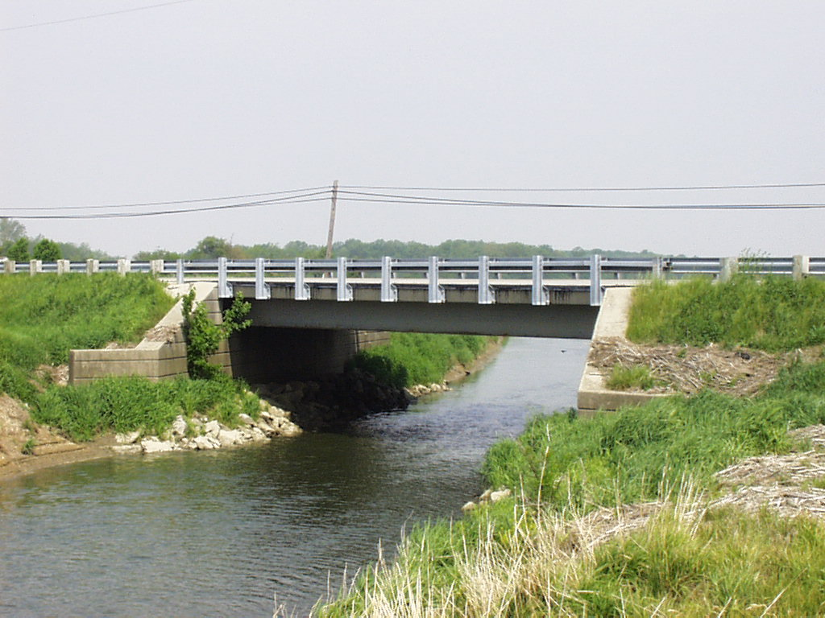
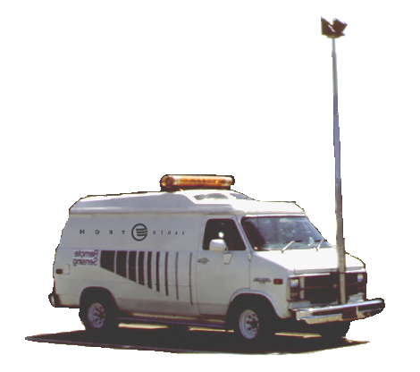
Thermography Data Collection:
Notes:
Thermography data collection, for concrete bridge decks, usually utilizes vehicle mounted equipment that drives over the deck in several passes to document the presence of damage in the form of delamination and/or debonding. This is particularly a good method for asphalt covered decks where a chain drag can not deck damage very well.

Slide 37
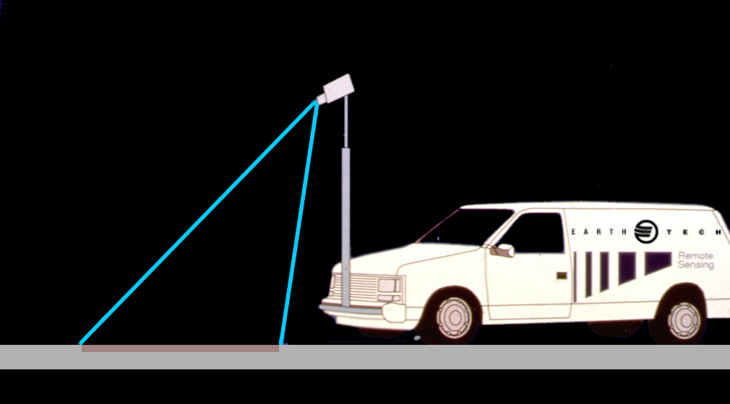
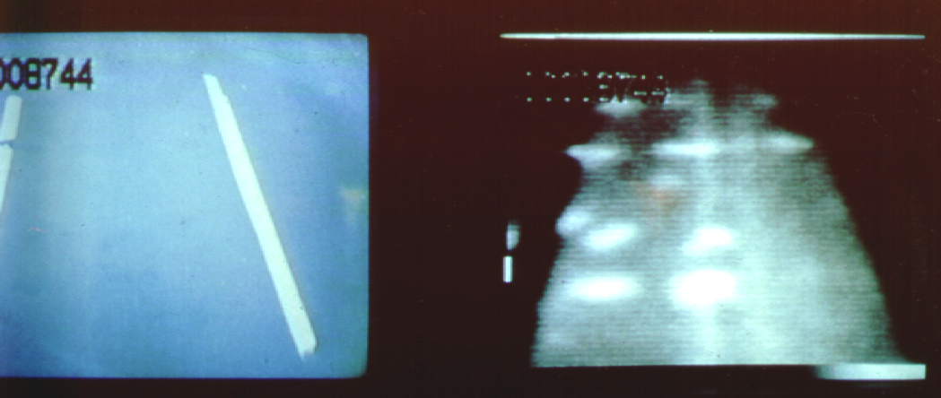
Thermography
Live Action Camera
Thermography Camera
85º
78º
Delamination
Reinforced Bridge Deck
Notes:
When the bridge deck surface is heated by the sun's infrared radiation, the delaminated areas heat up at a faster rate than the adjacent thicker sound concrete. This is due to the fracture plane of the delamination acting as a small insulator and trapping the heat. During a summer day, these "hot spots" on the surface are generally 2 °C to 5 °C warmer than the surrounding solid concrete and are detectable and made visible by an infrared camera.
A videotape of bridge deck is made in conjunction with the thermographic image to distinguish between debris of surface discolorations and true thermal patterns. The hot spots are shown in the lighter colors here and indicate delaminations.
One significant disadvantage of this method is that data collection is limited to sunny days when heat flow results in detectable thermal gradients. Experienced operators are required and the equipment is very expensive. This type of testing only measures existing damage.

Slide 38
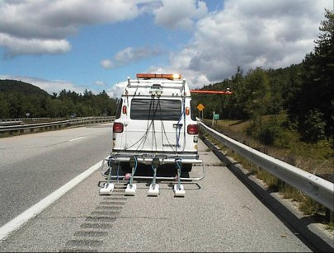

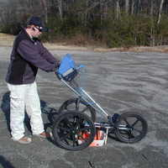
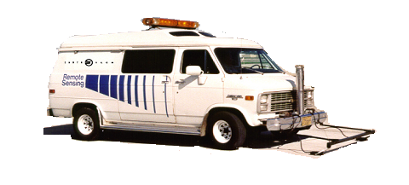
Ground Penetrating Radar Data Collection:
Notes:
Another method of detecting existing concrete damage is Ground Penetrating
The radar antennas emit very short, precisely timed pulses of radiofrequency energy into the concrete surface. When the pulses transition from one material to another such as from an asphalt wearing surface to a concrete bridge deck part of the energy echoes back to the surface. A computer records how "loud" this echo is and how long it took to return to the antenna. The raw data is analyzed by a software program, which generates reports.
In a mobile sensing application a vehicle unit can travel at speeds up to 20 miles per hr depending on the surface.
This method is very accurate in determining location of reinforcing steel and anomalies at both the top and bottom reinforcing mats. However, results can be affected by usually wet conditions, debris accumulation or abnormally shallow reinforcement.
GPR was used in the forensic investigation of the Laval Bridge collapse, it was able to determine the location of rebar along the shear failure plane.

Slide 39
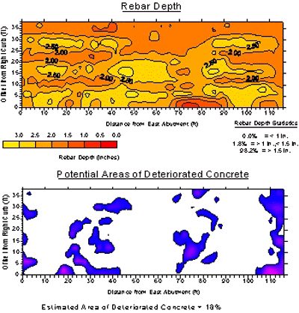
Ground Penetrating Radar Data
Asphalt
Delam
Rebar
Notes:
Here are some typical presentations of GPR data.
The figure on the left captures a typical cross section of a concrete deck with an asphalt wearing surface. The depth of the asphalt, reinforcing steel can be determined as well as anomalies representing delaminations.
In addition contour maps of cover depths can be generated along with plots of deteriorated areas. It is common practice that concrete cores be taken to confirm the information presented by GPR. This was also included in the forensic investigation of the Laval Bridge Collapse.

Slide 40
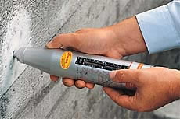
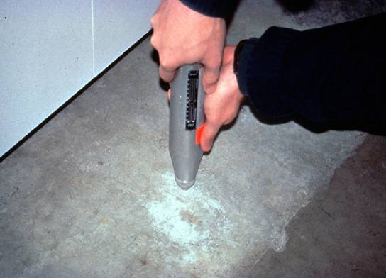

Schmidt Hammer
Notes:
The Schmidt Hammer is a non destructive test method used to obtain an indication of the compressive strength of concrete. It is classed as an indirect measurement and does not give a direct measurement of the strength of the material. It simply gives an indication based on surface properties and is only suitable for making comparisons between samples.
The hammer measures the rebound of a spring loaded mass impacting against the surface of the sample. When conducting the test the hammer should be held at right angles to the surface which should be flat and smooth.
Prior to testing, the hammer should be calibrated supplied by the manufacturer. The average of 10 readings in a sampled area should be obtained using this method.

Slide 41

Coring
Notes:
Coring is a destructive test that can be used to determine several concrete properties.
Strength, hardened air void content, spacing factors, petrographic analysis, presence of debonding or delaminations can be examined by taking cores.
Significant variations in these material properties can be present between core samples and therefore several cores are required present an accurate picture. As coring is destructive in nature the Department tries to avoid this test, especially on bridge decks where these areas can cause accelerated deterioration.

Slide 42


Linear Polarization Testing
Notes:
Linear polarization testing uses simplified electrochemical corrosion theory to estimate the corrosion rate of reinforcing steel. This is accomplished by forcing an area to deviate from its equilibrium corrosion potential by 20mV and measuring the electrical current required to make the change. This current is then used to compute corrosion rates.
Test equipment is expensive and readings take 5 to 10 times as long to record as CSE testing.

Slide 43

Questions?

