Slide 1
BRIDGE PAINT
Paint – Physical Properties & Inspection

Slide 2
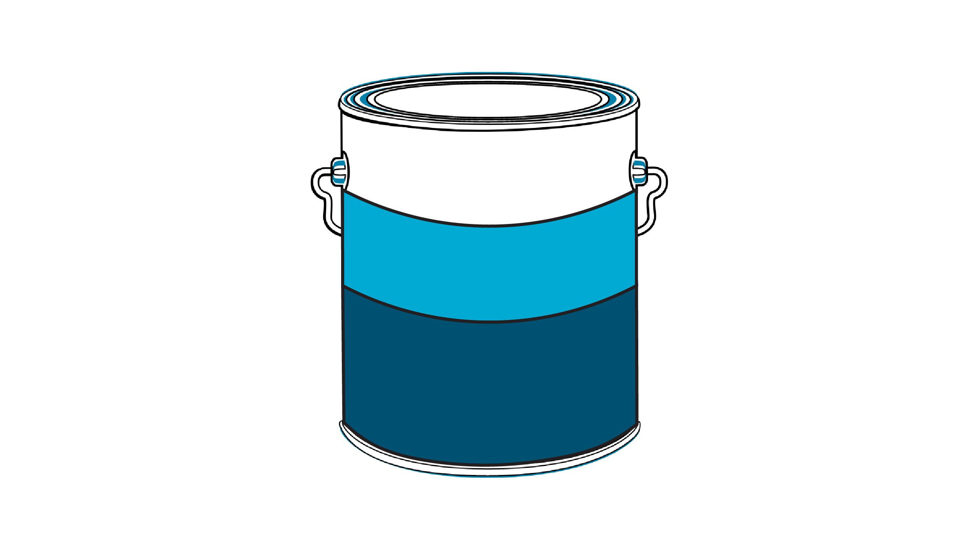
Paint
SOLVENT
VEHICLE
RESIN
PIGMENT
Notes:
Pigment extends the expensive resin, provides colour, hides the substrate, contains the corrosion inhibitors, reinforces the film, controls gloss and sag.
The resin is the binder that glues the pigments together, wets and adheres to the substrate and provides the smooth impervious film. Most of the properties of the film or paint come from the resin.
The solvent thins the resin pigment mixture to make it workable. It is the Volatile Organic Organic Compound (VOC) that you here about. If it is water it is not a VOC.
The combination of the resin and the solvent is called the vehicle.
Not all paints have solvents, they are replaced by catalysts in co-reactive paints such as epoxies.
Zinc rich over 85% zinc so particles touch, often porous unless carefully appied.

Slide 3
Types of Paint
Paints are generally solutions of solids such as pigments and other chemicals in a liquid carrier or vehicle used for transporting the solids to a surface needing protection. At the surface they may react chemically to polymerize.
Some common types are:
latex coatings - emulsion in water (acrylics and vinyl)
lacquers - solutions in which the solid resins do not change or react as the solvent evaporates, they become hard (chlorinated rubber, asphaltic coatings)
air oxidizing coatings - oil based coatings that react with oxygen to harden (alkyds, epoxy esters, linseed oil)
chemically reactive coatings - two component polymers sometimes without solvent (epoxy, urethanes)
Notes:
Types of paints are no longer easily put into generic groups as chemist combine more and more of the old traditional coatings into new products.
Original latex coatings were just that, emulsified latex or rubber in a water carrier as you can see now we have water borne acrylics and vinyls both of which would have been classified with lacquers.
Lacquers are high molecular weight polymers which form a film by evaporation of a solvent
Drying oil types - low molecular weight resins capable of converting to tough films through intermolecular reaction with oxygen catalyzed by the presence of metal soaps such as cobalt octoate (cobalt dryers)
These include natural oils such as linseed, soya and tung. Very slow to convert to a cured film.
Alkyds are natural oils chemically modified by reactions with acids or alcohols to improve rate of cure chemical resistance or ultimate hardness. Long oil has little modification short oil a great deal of modification.

Slide 4
Corrosion
Caused by thermodynamic instability of steel.
Is an electrochemical process.
The rate of corrosion is based on electric current generated by potential (voltage) differences with the steel.
Ohms Law: (current) I =
E (voltage)
R (resistance)
Notes:
Chemical change from iron to iron oxide and an electrical process involving current flow.
A corrosion cell requires oxygen and an electrolyte
An electrolyte is a solution in water of salts or other chemical compounds which will release ions
Ions are + and - charged electrical particles formed when salts split as they are mixed in water.
Two ounces of salt will split into 10²³ ions half positive and half negative.
You can’t have corrosion under completely dry conditions, therefore water is considered part of the corrosion process.
The current carrying efficiency of an electrolyte is largely determined by the number of ions it contains. Therefore a solution of salt in water is an excellent conductor but pure water which contains few ions is a poor current conductor.

Slide 5
Notes:
The corrosion cell or battery requires oxygen, water and ions.
Oxygen- all that is required is available from the air
Water- The atmosphere usually contains enough water to operate a cell
Ions- Salt spray, industrial pollution, smog and soil will dissolve available moisture to create ions

Slide 6
Chemical Reaction (1st Stage)
Anode (where visible corrosion occurs)
(iron) Fe Fe⁺⁺ (ions) + 2e⁻ (electrons)
Cathode (adjacent protected area)
a) 2H⁺ + 2e⁻ H₂ (hydrogen gas)
b) 4H⁺ + O₂ (air) + 4e⁻ 2H₂O (water)
c) O₂ + 2H₂O + 4e⁻ 4OH⁻ (alkali)
The alkali buildup attacks some paint.
Notes:
Chemical equations of the reactions for those of you who are into this.

Slide 7
Notes:
External circuit is the electrolyte internal is the steel itself.
Gaseous oxygen is dissolved in the electrolyte and freely available for reaction.
1- At the anode an atom of metallic iron is converted to iron ion and immediately reacts with water to form rust.
2- Current flow is set up between the anode and the cathode.
3- At the cathode receipt of the current results in the transformation of oxygen to caustic ion,
resulting in a highly alkaline solution on the surface as the caustic ion dissolves in the moisture on the surface.
4- At and above the surface the current is carried by the dissolved ions, heat is dissipated to the steel.
5- As the iron anode is eaten away a growing deposit of rust forms
6- Note the cathode is not attacked
7- the process will continue until all the iron is converted to rust or something happens to weaken or break the circuit.

Slide 8
Chemical Reactions (2nd and 3rd Stages)
2nd Stage:
Fe⁺⁺ (@ anode) + 2OH⁻ (@ cathode) Fe₂(OH)₂ (rust)
3rd Stage:
2Fe(OH)₂ + O₂ Fe₂O₃ (iron ore hematite) + H₂0
Notes:
If you take a solution of gelatin, and dissolve in it common salt to act as an electrolyte, shake it very well to dissolve oxygen within it and add two reagents one that turns pink wherever caustic is formed (cathode), and one which turns blue where the iron is attacked (anode)
Embed a steel test panel in the gelatin and allow it cool and gel. Thus all the ingredients of a corrosion cell are trapped within the gelled panel.
We observe:
Pink cathode areas randomly distributed on the face of the panel
Blue anode areas, where the steel is actually corroding, are formed on spots of the face of the panel, but are heavily concentrated along the edges and at drilled or punched holes in the panel
Worked areas are prone to be anodes.
Mill scale is cathodic

Slide 9
Requirements For Corrosion
Thermodynamically unstable metal (iron)
Electrolytic conduction of ions (water)
Electrical conductor of electrons (metal)
Electron acceptor (hydrogen ions or dissolved oxygen)
Notes:
Summation

Slide 10
Corrosion Current at Breaks in Paint Coating
Electrical current I =
PA = electrical potential @ anode
PC = electrical potential @ cathode
A_{p} = electrical potential @ anode from buildup of corrosion by products
C_{p} = electrical potential @ cathode from buildup of corrosion by products
RD = electrical resistance at the discontinuity (electrolyte)
RL = electrical resistance of the moisture outside the discontinuity
RC = electrical resistance of the coating
t = coating thickness
(PA - A_{p}) - (PC + C_{p})
RD t + RL + RC t
Notes:
It can be more complex if you get into the total circuit analysis but we just want to give a rough picture of what happens
We can also get corrosion from dissimilar metals setting up galvanic cells

Slide 11
Notes:
Crevice corrosion or pack rust
Crevices or pockets created by the design of the steel structures causes a special problem that is very difficult to combat. Crevices tend to corrode at a much greater rate than the adjacent metal areas.
The essential ingredients of the corrosion process must be present, oxygen, water and ions
Crevices hold liquid solutions of salts so more than enough water and ions are present to form an electrolyte.
The remaining ingredient is oxygen. The change of oxygen to caustic is associated with the cathode (the protected area)
If the two areas of metal are exposed, the one exposed to the most oxygen will become the cathode forcing the oxygen starved area to become the anode and to be corroded.

Slide 12
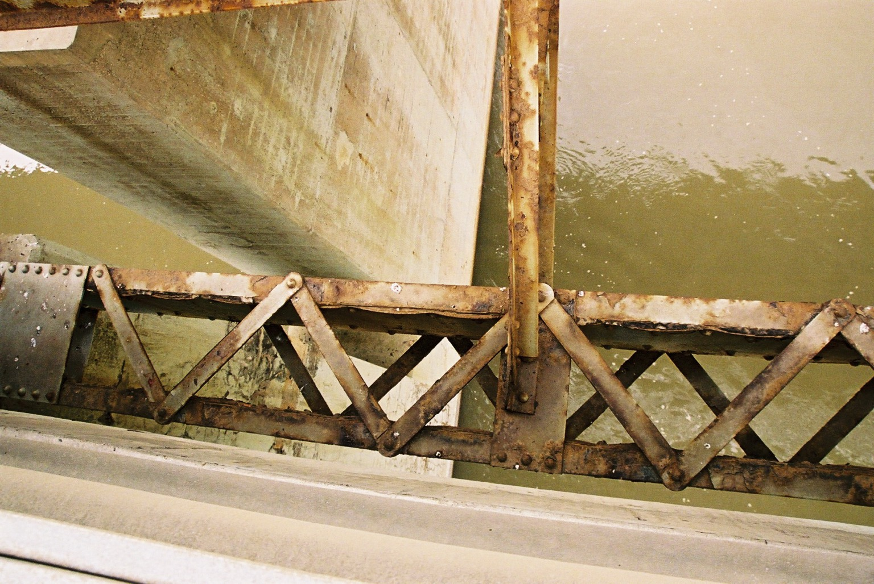
Pack Rust or Crevice Corrosion

Slide 13
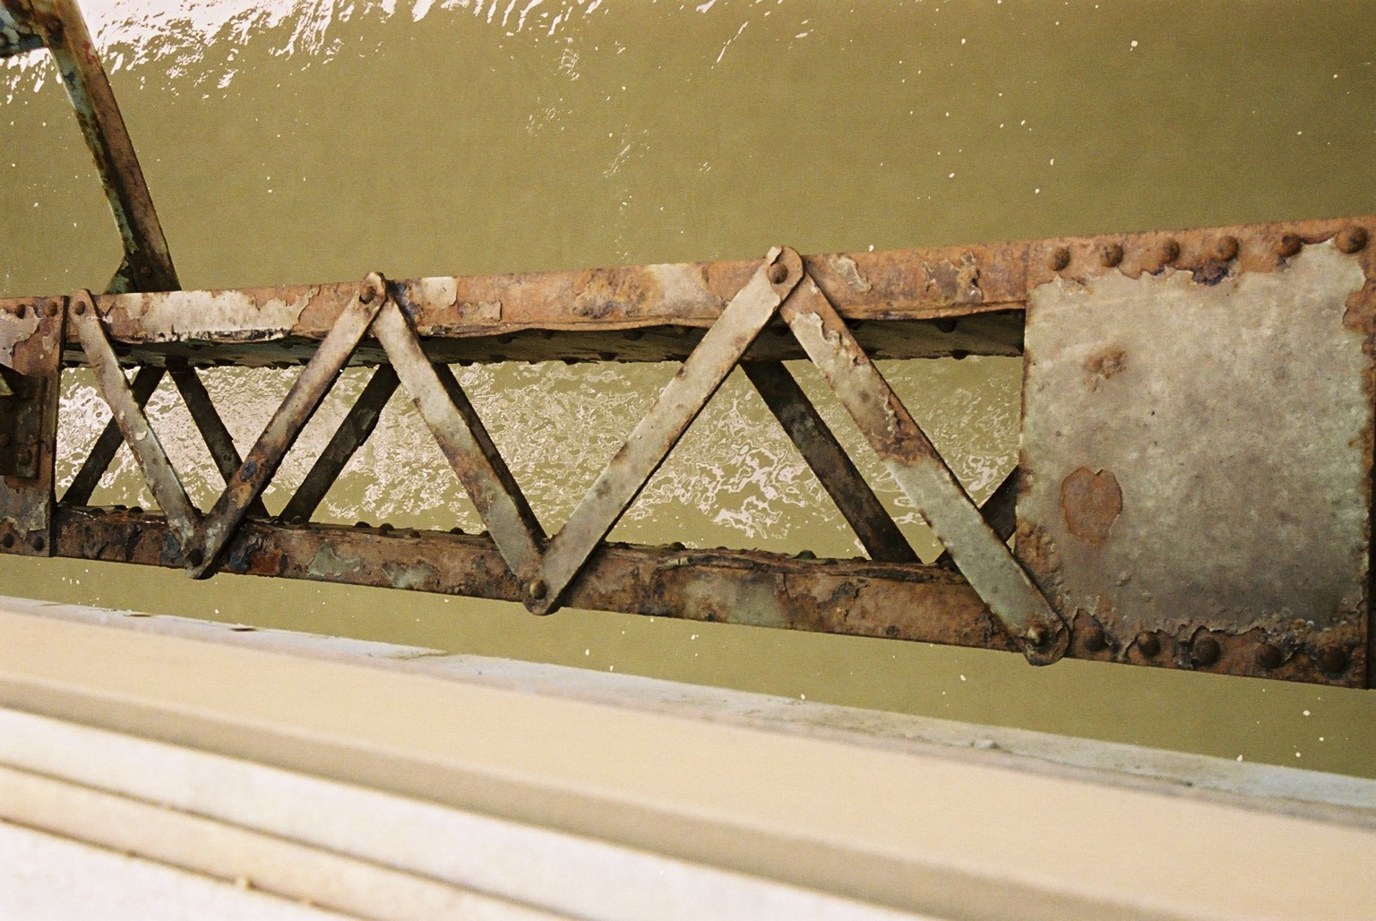
Pack Rust
Notes:
Point out wavy lines due to expanding corrosion products

Slide 14
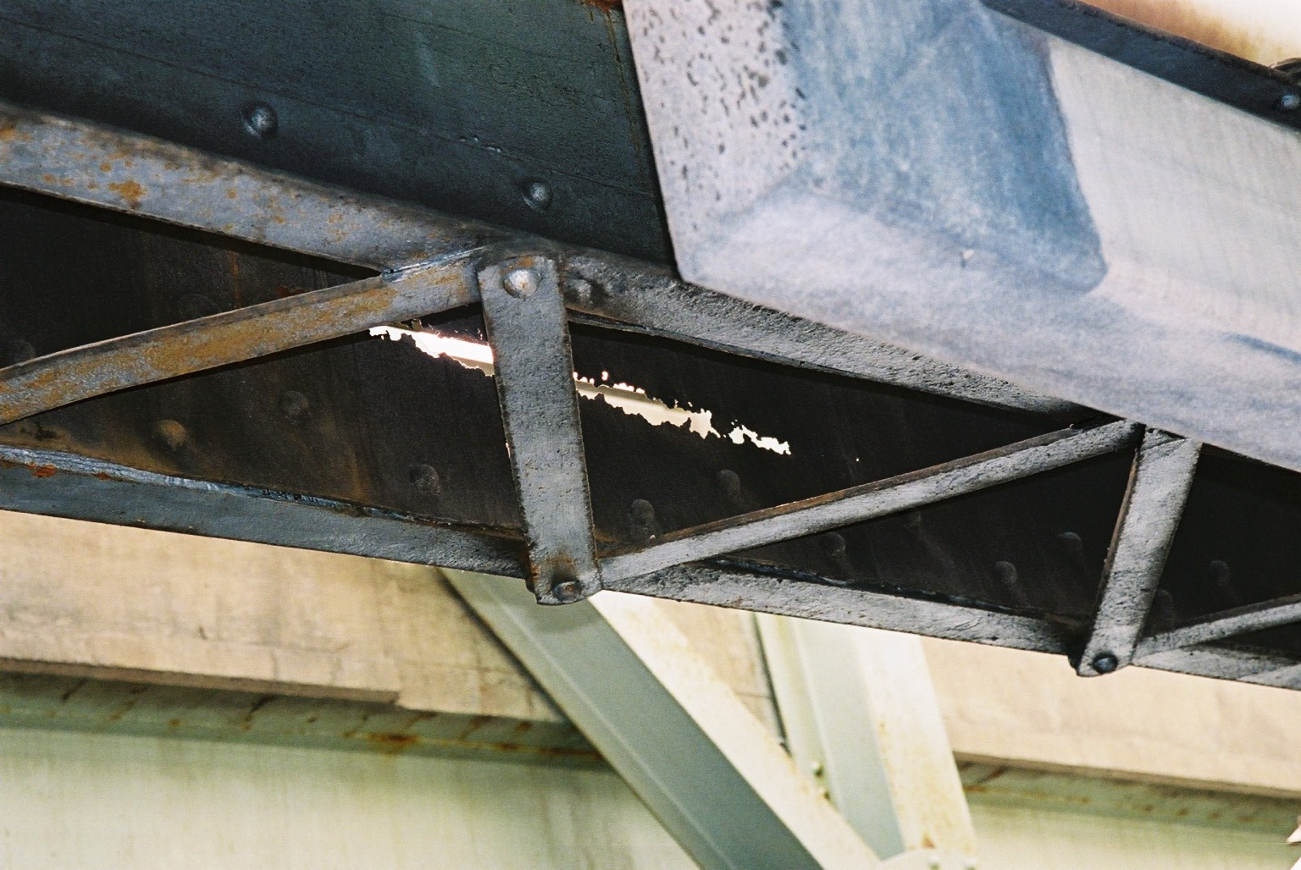
Perforated Bottom Chord

Slide 15
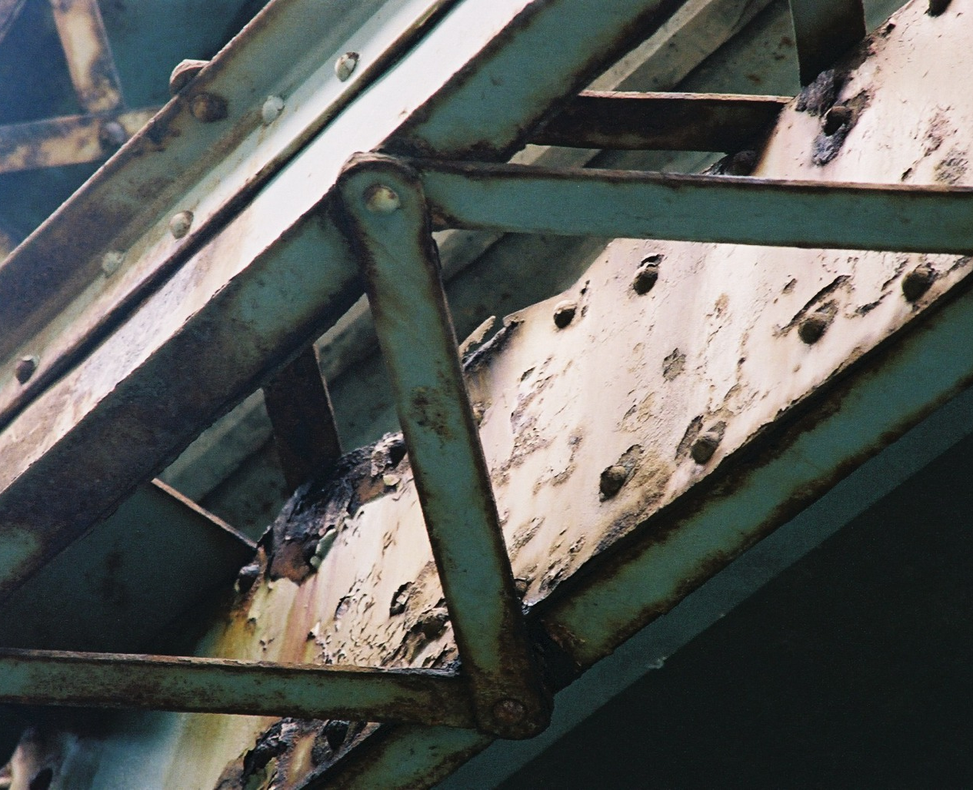
Distorted and Perforated Plate Due to Pack Rust

Slide 16
How Paint Works To Prevent Corrosion
Eliminates the electrolyte (separates it from the steel)
Increases the electrical resistance of the corrosion circuit
Reduces the concentration of electron acceptors (H⁺ and O₂)

Slide 17
Paint System Design
Primer Layer:
a) inhibitive
b) barrier (increase RC t) purpose - increase A_{p}, C_{p} and R
Intermediate Layer:
a) increase R
b) reduces pinholes and permeability
Topcoat:
a) ultraviolet resistance
b) colour
c) toughness
Notes:
A good primer should:
Provide good adhesion to the surface. It holds all the other coats to the surface (film tension)
Provide a good bond for subsequent coats
Should stop or retard the spread of corrosion from pinholes holidays or breaks in the film.
Intermediate coats should:
Provide adequate film thickness (body coat)
Provide a uniform bond for the top coat
It should be a superior barrier to chemical attach
Finish coats should:
Provide UV resistance
Colour
Appearance and toughness, gloss (self clean), resilience to blows

Slide 18
Wet Paint on Steel – Trapped Air
Paint thins on drying in relation to solids content
60% solids – 5mils wet – 3 mils dry
Notes:
Wet paint on steel with trapped air bubble
Paint thins on drying in relation to solids content
60 % solids
5 mils wet divide by 0.6
3 mils dry

Slide 19
Results in a Pinhole
Notes:
Film shrinks on curing (thin corners)
Develops internal stress
Transfer by horizontal shear to surface
Anchor pattern
Coefficient of thermal expansion different for paint and steel
Temperature changes increase stresses
Flaws or air bubbles cause pin holes
High or low energy coating

Slide 20
Notes:
Typical edge corrosion in real life

Slide 21
Notes:
Apply new paint over existing paint or mill scale
Over coating can cause curling and peeling

Slide 22
Notes:
Over coating can cause curling and peeling

Slide 23
Physical Properties of Existing Paint Needed For Encapsulation
1. Rust condition ≥ 7 (ASTM D610)
2. Thickness ≥ 3, ≤ 12 mils
3. Flexibility - chisel test
Adhesion between layers and to substrate
Chalking
Substrate (Tooke Test)
Notes:
Encapsulation is not as viable an alternative as it once was, we’ll discuss that later.
These tests are still an excellent way of evaluating the present condition of a coating system.
I will skip the rust until the end and discuss
Thickness - most paints thin with age and thus provide more pinholes etc. for corrosion to start
When coatings get too thick the film stresses can exceed the bond or adhesion.
Flexibility - Paints become brittle with age and crack due to film stress allowing corrosion to start
Explain film stress
As coating cure they develop internal shrinkage stresses which are offset by bonding to the underlying layer and distributing their stresses to that layer. Each subsequent coat adds stress to underlying layers. This is a transfer by shear stress, but if the top coat cracks then it tends to curl and peel away which is different than straight adhesion. That is why we use the adhesion test we do because it is actually a peel test too.
Chalking shows age of paint and also affects adhesion
Tooke test we will look at in a few minutes but it shows whether or not mill scale is present.

Slide 24
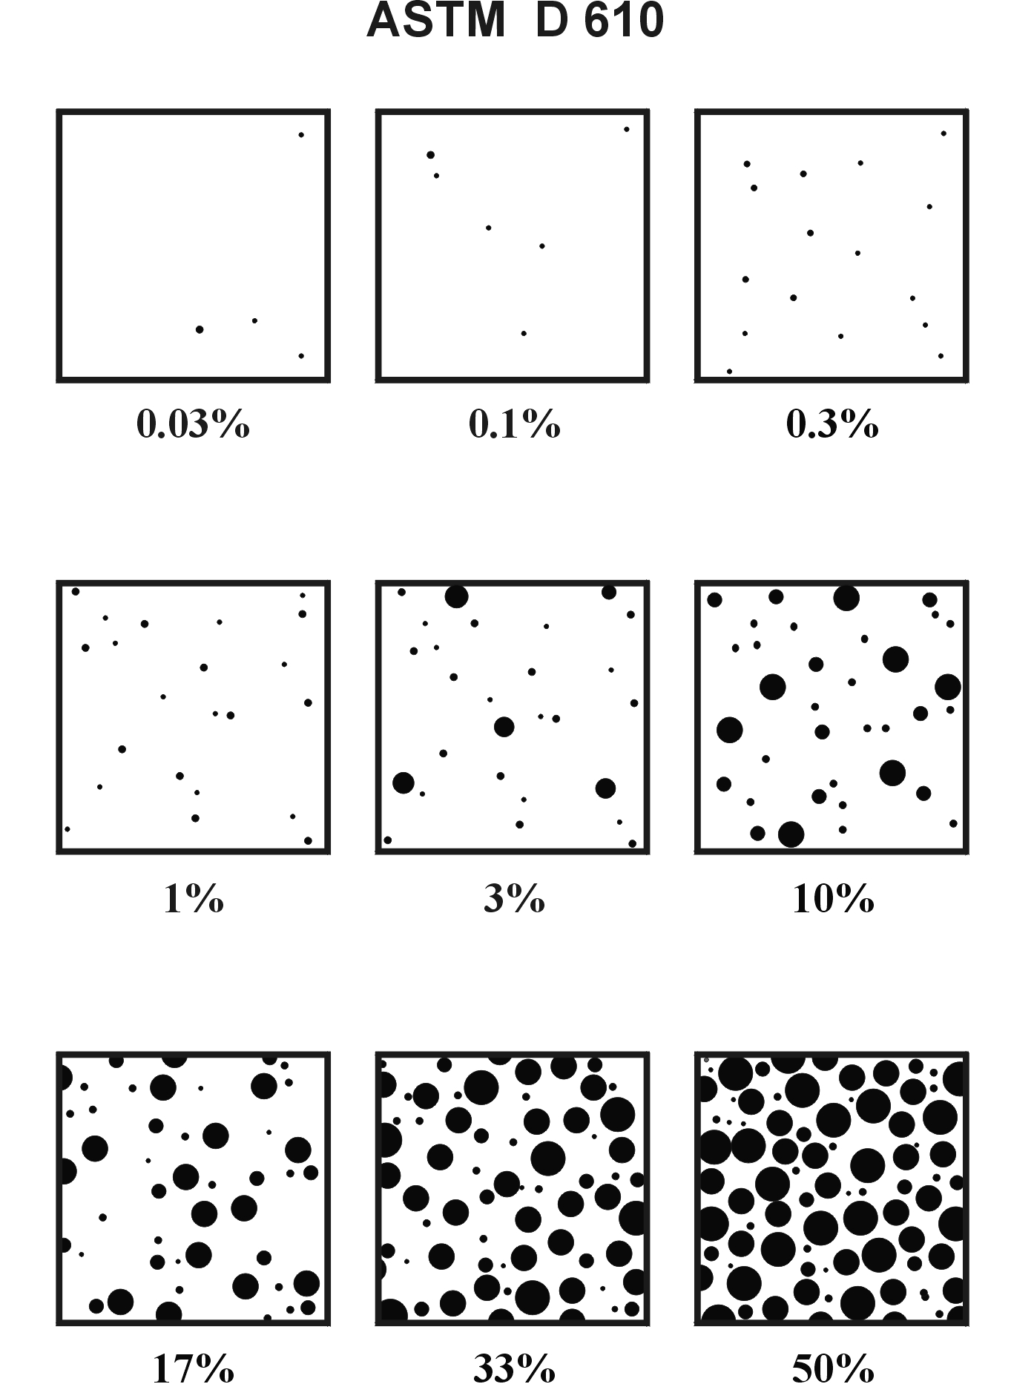
Notes:
These are numbered from 9 in the upper left corner to 1 in the lower right
The previous slide refers to 0.3% rust condition as being acceptable for recoating or encapsulation.
Be careful areas can be deceiving depending on the distribution of the rust

Slide 25
Notes:
Looking up at the bottom flange of a box girder showing many types of failure
Film tension causes cracks which curl and allow under film corrosion
Pinholes and osmotic blistering

Slide 26
Notes:
Typical failure of a well applied alkyd system, this is 27 years old and rust spots are forming at pinholes and other flaws as the film thins and ages.

Slide 27
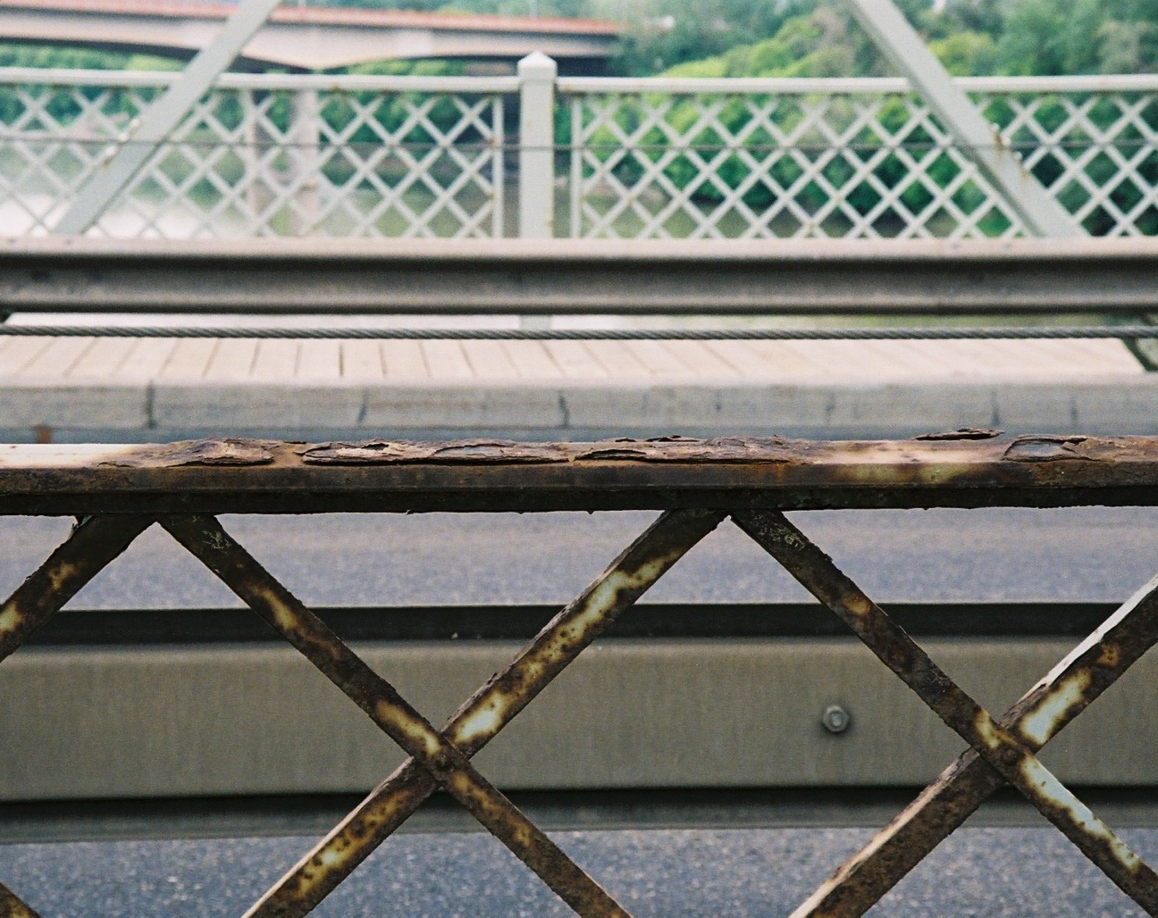
Blisters and Scaling

Slide 28
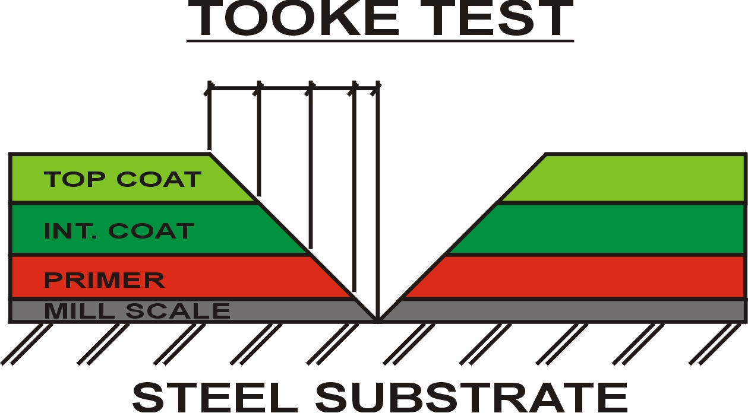
Notes:
Tooke gauge shows thickness of each layer and if mill scale is present.
Fifty power microscope with scale to measure width of exposed paint layer.
When paint is too old and flaky it chips badly when cut and dose not give good edge to measure

Slide 29
Notes:
Tape adhesion test
Most important test if you are contemplating over coating.
3B is the required result to think of overcoating
Be sure the test is representative of the structure

Slide 30
Notes:
A test site showing from left to right
Tooke test - black line helps to locate surface of the layer when looking through the microscope
Chisel test for flexibility
Tape adhesion test - shows brittle paint and a failed test
Note area has been rubbed with white rag for chalking and dirt test
Other spots are broken osmotic blisters

Slide 31
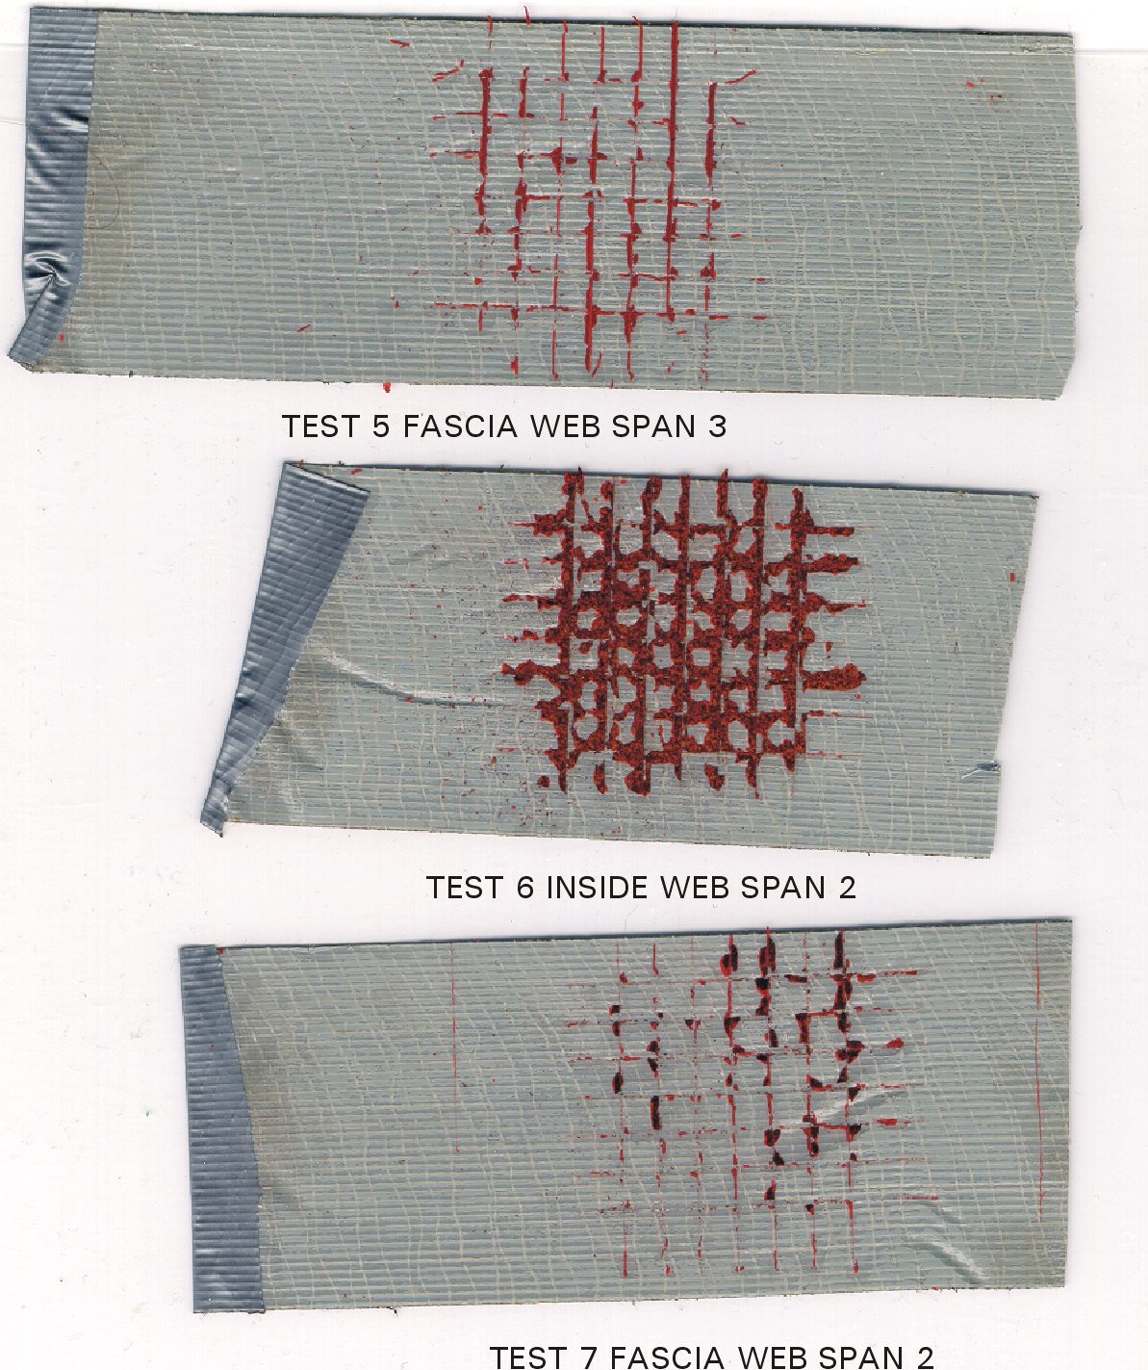
Notes:
Tape from adhesion tests, centre tape is from previous photo

Slide 32
Notes:
This shows a test from a very new and flexible paint with very poor adhesion
Note no edge chipping

Slide 33
Cause of Painting Cost Escalation
Various environmental and safety regulations concerning the removal and
disposal of lead-based paints.
Late 1980’s | No Containment | $15 to $20/ M²
Early 1990’s | Enclosure | $50 to $60/ M²
Mid 1900’s | 80% Recovery | $80 to $100/ M²
1999 | 90% Recovery | $120 to $140/ M²
2002 | 90% Recovery | $180 to $200/ M²
2004 | 90% Recovery | $300 to $350/ M²
Present | 100% Recovery | $500 to $550/ M²
Notes:
Federal Dept. of Oceans and Fisheries.
1999 started enforcing 90% recovery of blasting spoil and nothing goes in the water
Containment $ 6.00 / Sq. Ft.
Blast & Paint 3.00 / Sq. Ft.
Disposal .10 / Sq. Ft.
Health 3.00 / Sq. Ft.
Total $ 12.10 / Sq. Ft.

Slide 34
Questions?

