Slide 1
BRIDGE MAINTENANCE

Slide 2
Introduction
Inspection identifies maintenance needs
Inspection determines priorities for repair
“Maintenance Recommendations” difficult for inexperienced inspectors
Good judgement and common sense an asset.

Slide 3
BIM Rating System
Rating |  | Commentary | Maintenance Priority
9 | Very Good | New condition. | No repairs in foreseeable future.
8 |  | Almost new conditions. | No repairs in foreseeable future.
7 | Good | Could be upgraded to new condition with very little effort. | No repairs necessary at this time.
6 |  | Generally good condition. Functioning as designed with no signs of distress or deterioration. | No repairs necessary at this time.
5 | Adequate | Acceptable condition and functioning as intended. | No repairs necessary at this time.

Slide 4
BIM Rating System (Cont'd)
Rating |  | Commentary | Maintenance Priority
4 | Fair | Below minimum acceptable conditions. | Low priority for repairs.
3 | Poor | Presence of distress or deterioration. Not functioning as intended. | Medium priority for replacement, repair, and/or signing.
2 | Hazardous | Hazardous condition or severe distress or deterioration. | High priority for replacement, repair, and/or signing.
1 | Immediate Action | Danger of collapse and/or danger to users. | Bridge closure, replacement, repair and/or signing required as soon as possible.
N | Not Accessible | Element cannot be visually inspected.
X | Not Applicable | Element not applicable at this bridge.

Slide 5
Types of Maintenance
Preventative Maintenance
Routine or Minor Maintenance
Rehabilitation or Major Maintenance

Slide 6
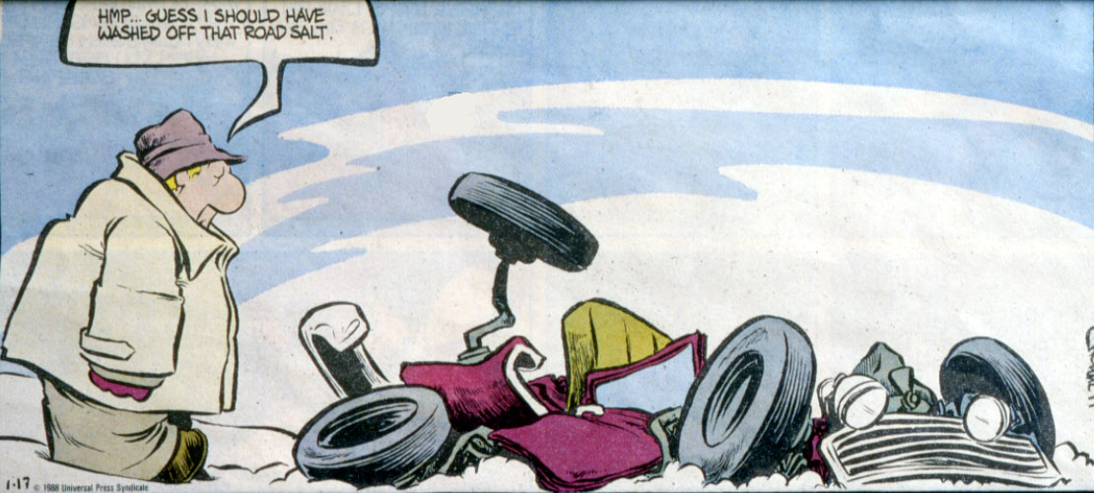
Duffy says, “Guess I should have washed off the road salt.”

Slide 7
Preventative Maintenance
Reduces rate of deterioration and extends life
Carried out on regular basis
Before problems or deficiencies occur
Examples:
  washing bridges
  remove gravel from deck
  sealing concrete deck and curbs
  asphalt cracks
  washing signs
  cleaning, replacing, adding signs

Slide 8
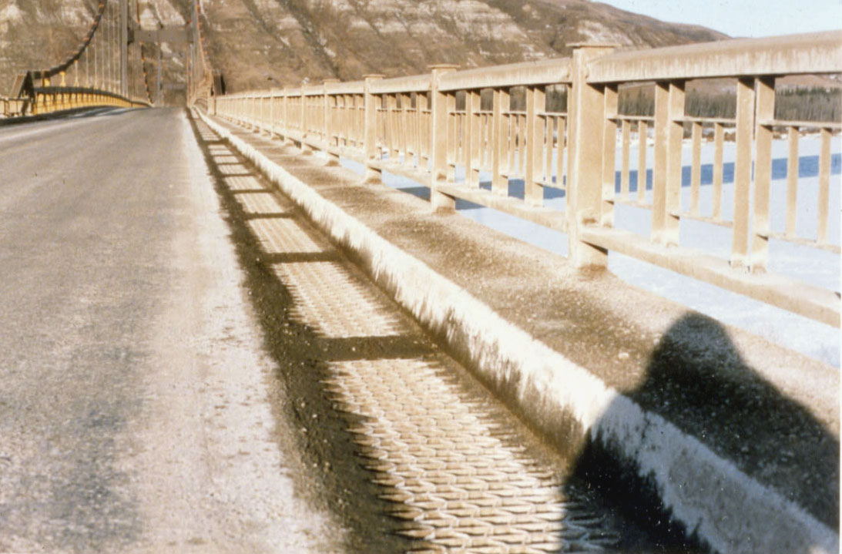
Dunvegan Bridge with coating of salt.
Estimated damage is $400,000 per year (Plus User Cost).

Slide 9
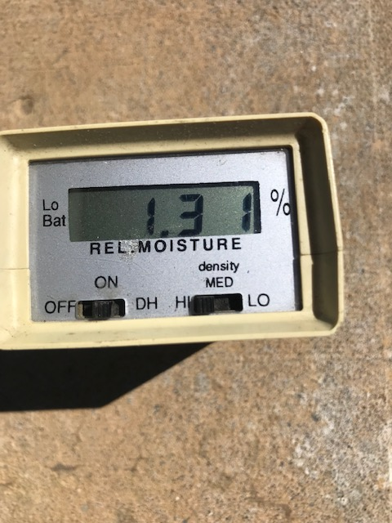
Applying concrete sealers to bridge curb
Confirm moisture content in concrete prior to application of sealer using a moisture meter

Slide 10
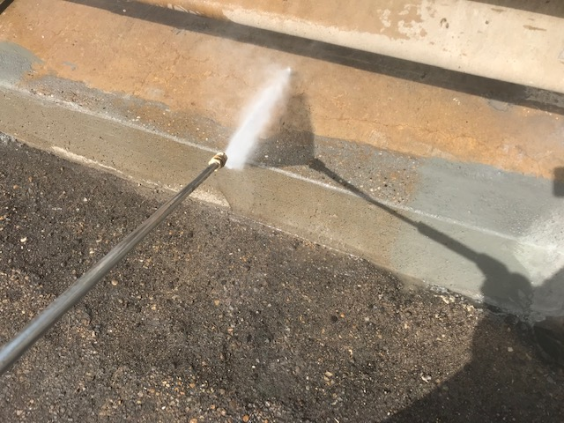
Applying concrete sealers to bridge curb

Slide 11
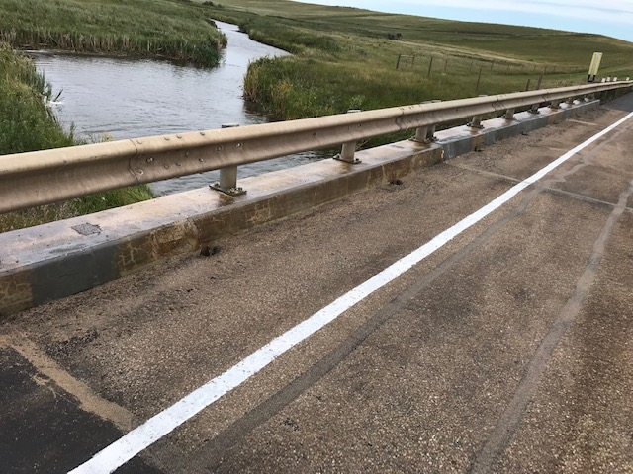
Freshly Patched and Sealed Concrete Curb

Slide 12
Routine or Minor Maintenance
Correct reductions in condition or functionality of bridge elements Primarily “patch up” work
Generally low cost
Examples:
  patch concrete
  patch strip deck
  repair bridge rail
  scour / erosion
  replace signs
  replace seals

Slide 13
Rehabilitation or Major Maintenance
Restores bridge to original condition or function or upgrades functionality
High cost
  do bridge assessment
  life cycle cost or cost benefit
Examples:
  deck overlays
  cap / pile replacement
  culvert liners
  cathodic protection
  girder replacement

Slide 14
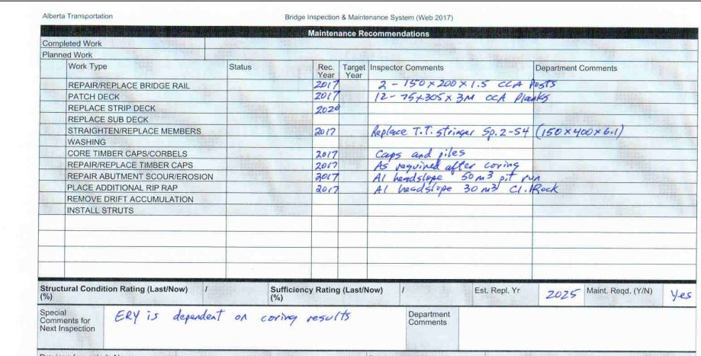
Treated Timber Bridge
Maintenance Recommendations

Slide 15
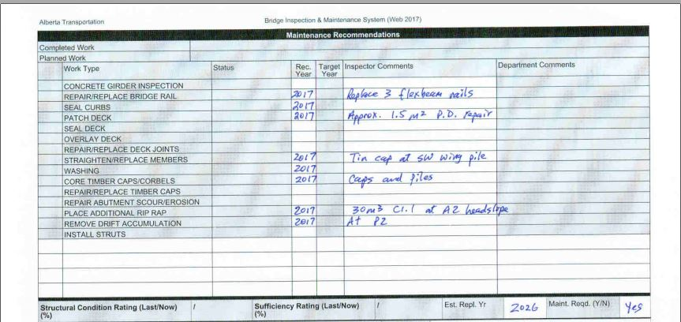
Reinforced Concrete Bridge
Maintenance Recommendations

Slide 16
Approach Road Maintenance
Horizontal & Vertical alignment rated for functionality not condition (do no require maintenance recommendations)
Approach bump (all bridges)
  increases impact loading on girders
  repair by patching or grading to restore grade line

Slide 17
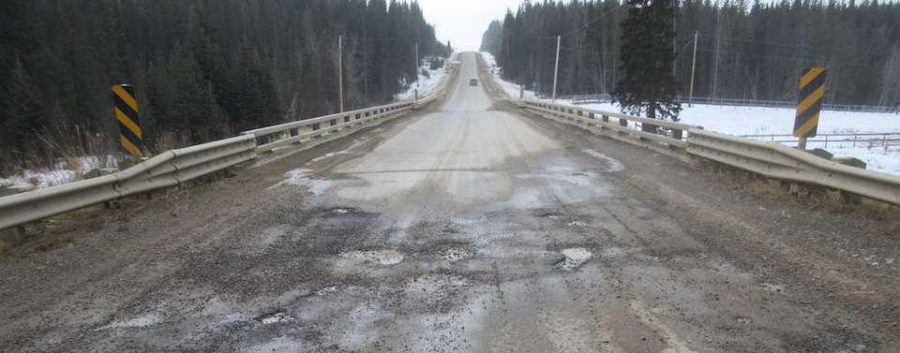
Approach bump and potholes

Slide 18
Approach Maintenance
Guardrail (all bridges)
  primarily accident damage
  repair or replace posts, flexbeam, or hardware
  upgrade standard when repairing
Drainage (all bridges)
  remove “windrow” under guardrail
  eliminate ponding
  drain water off approach, not onto bridge (undermining of trough drains)
  seal gaps at wingwalls

Slide 19
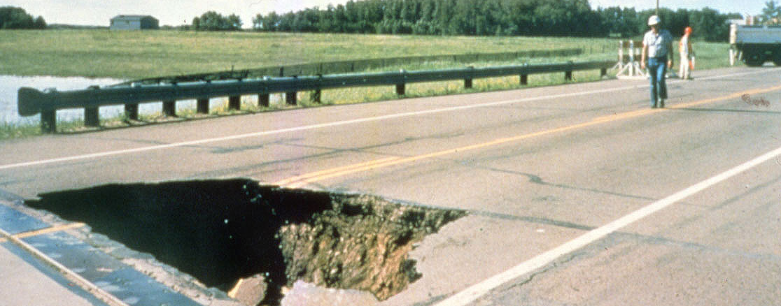
Scour hole in bridge approach caused by flood water erosion. (Battle River Hwy 2)

Slide 20
Superstructure Maintenance
Wearing surface
  remove gravel
  wash where salt or calcium chloride used
  concrete spalled / scaled
    patch concrete
    seal concrete
  strip deck rotten / holes
    patch / replace strip deck

Slide 21
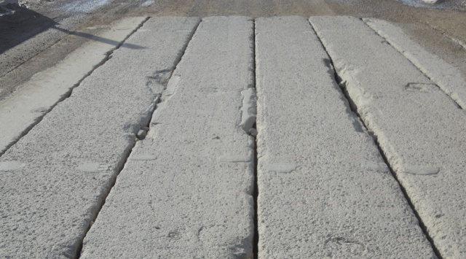
Gravel abrasion/worn edges on precast girders.

Slide 22
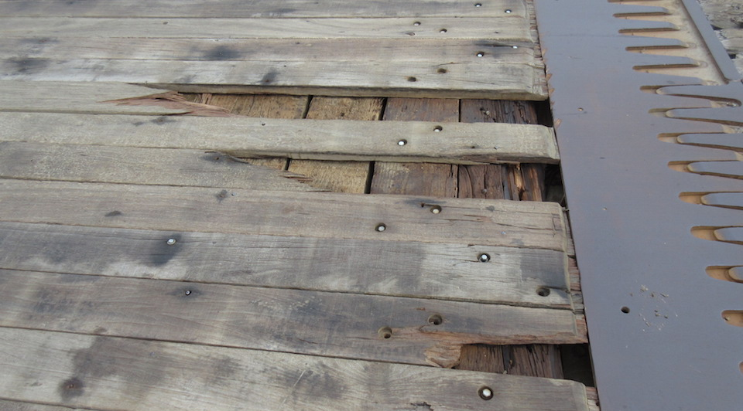
Missing and broken stripdeck

Slide 23
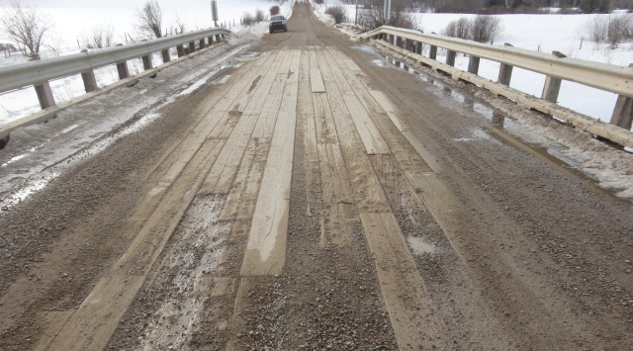
Worn/rotten timber strip deck.

Slide 24
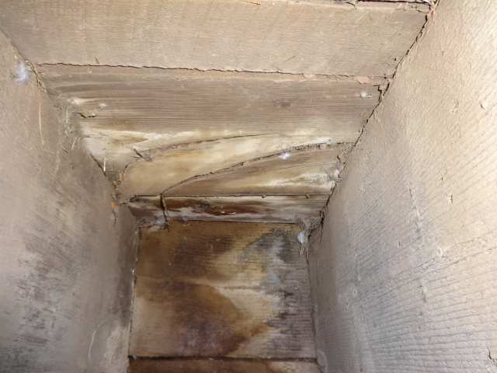
Rot in timber subdeck

Slide 25
Superstructure Maintenance
(Cont'd)
Deck
  subdeck rotten / “punky” nails don’t hold
    replace subdeck
  concrete girders worn or abraded
    concrete repairs
    concrete or ACP overlay
  concrete spalled or chipped
    repair concrete
  Lift or connector pocket grout failing
    patch / replace

Slide 26
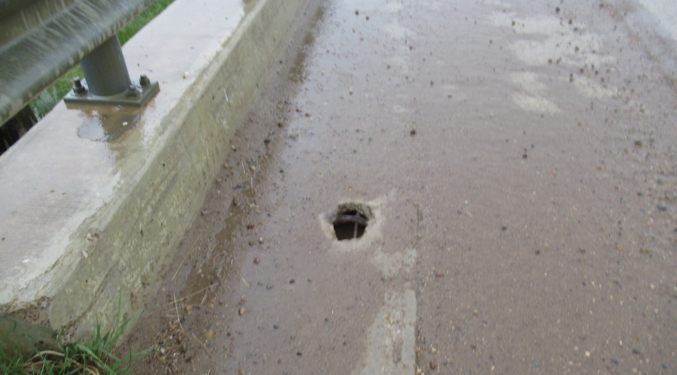
Punch-out at lift pocket in deck of precast girder.

Slide 27
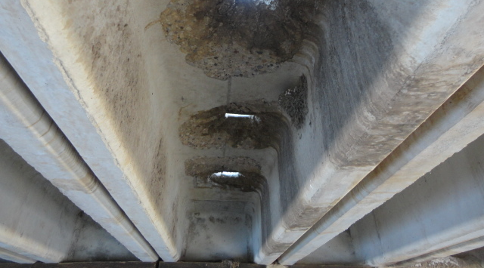
Underside of punch-out in precast girder.

Slide 28
Superstructure Maintenance
Deck joints
  loose or missing buffer angles
    patch or replace
  torn / leaking seals
    repair / replace seals
  rough joint
    patch / repair ACP

Slide 29
Superstructure Maintenance
Deck drainage
  plugged drains
    Clean/open during spring washing (also done on site by inspector)
  deck ponding
    mark area & arrange for retrofit drains

Slide 30
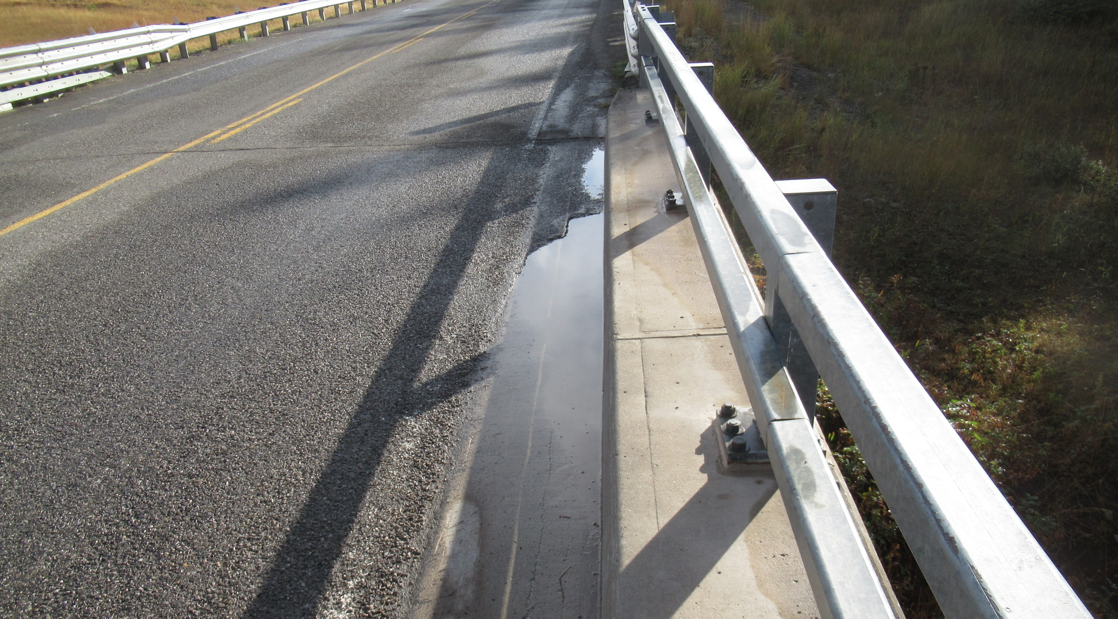
Ponding water on bridge.

Slide 31
Superstructure Maintenance
(Cont'd)
Curbs and Medians
  holes in voids
    patch before winter
  spalling
    partial depth repair
  split, broken wheel guards
    replace timber and/or hardware

Slide 32
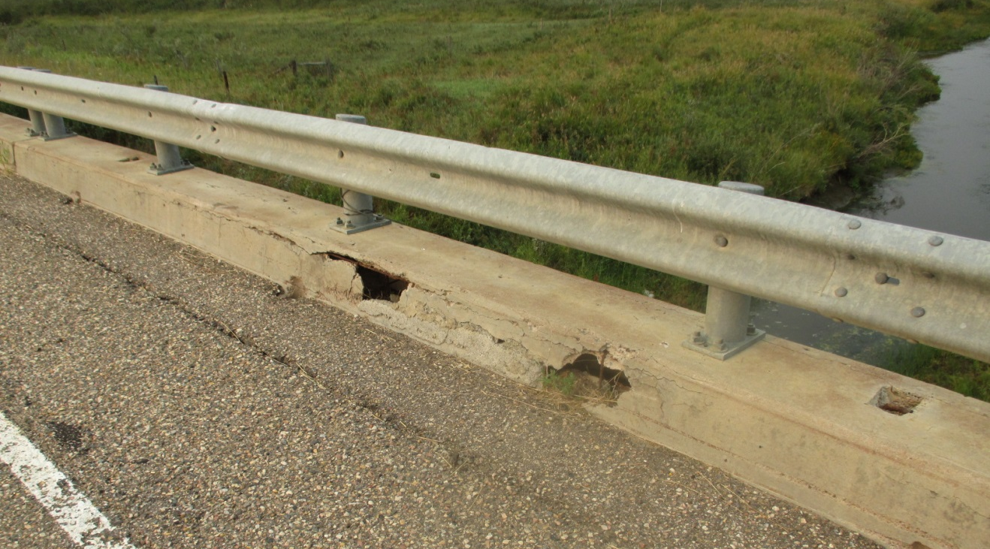
Holes in curb from low cover and plow abrasion.

Slide 33
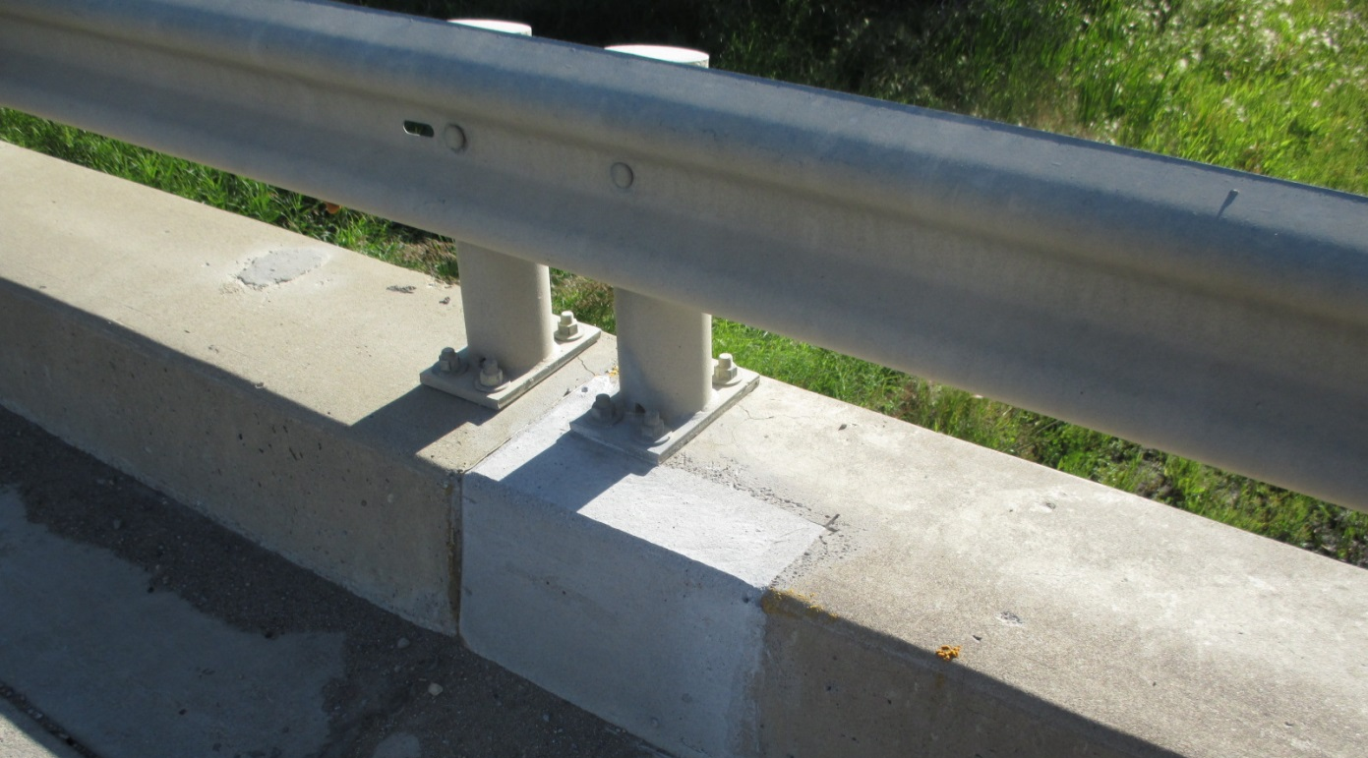
Partial depth repair to curb and post anchorage

Slide 34
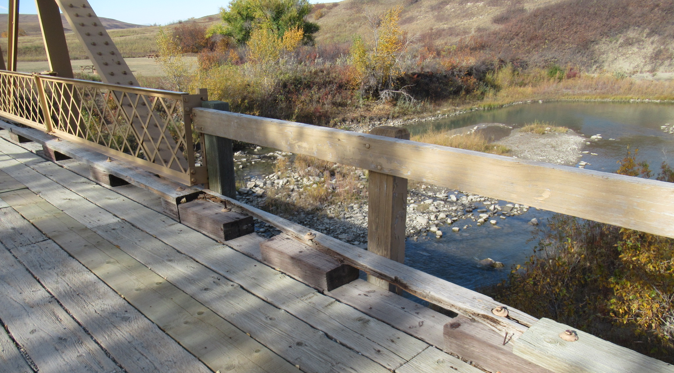
Rotten/Split Wheelguard

Slide 35
Superstructure Maintenance
(Cont'd)
Bridge Rail
  accident damage
    repair broken concrete
    replace post and / or rail
  rotten posts
    replace
  corroded posts / rail
    galvanize or replace
  when replacing, recommend considering upgrade to current standard

Slide 36
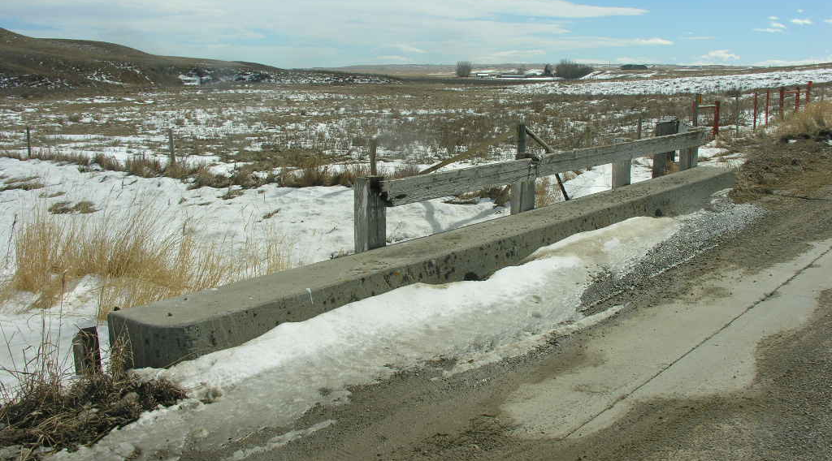
Missing section of rail and posts

Slide 37
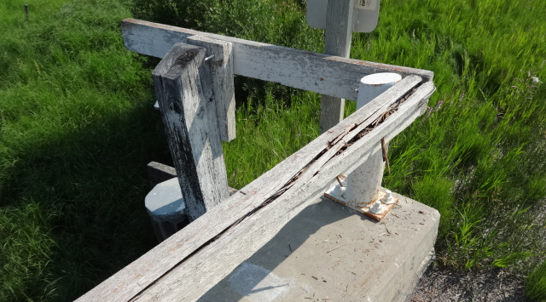
Rotted timber rail

Slide 38
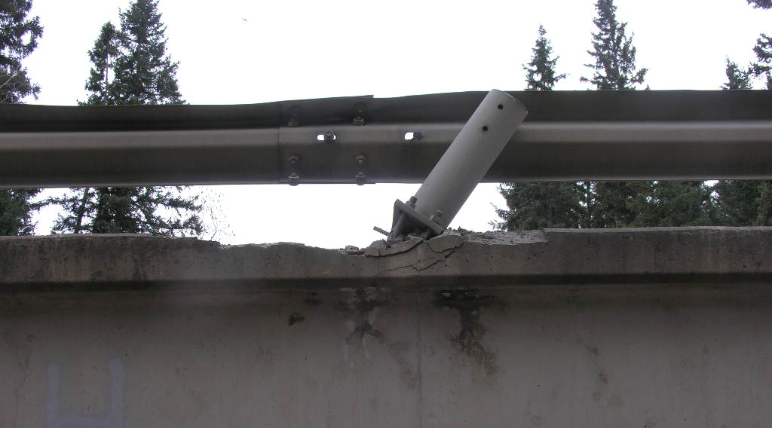
Damaged curb and post anchorage

Slide 39
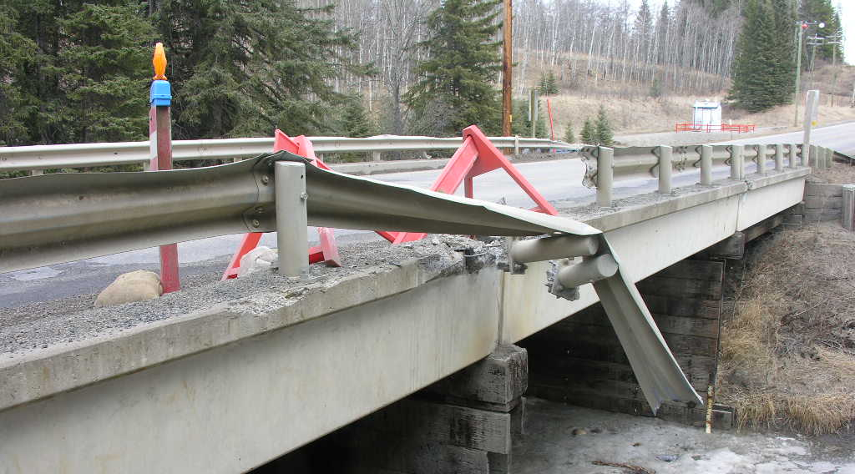
Damaged posts and rails.

Slide 40
Superstructure Maintenance
(Cont'd)
Girders
  cracked timbers
    replace
  spalled concrete
    Partial or full depth repair
    replace select girders
  girder longitudinal joint connections
    replace bolts, replace grout
  lift hook pockets
    replace grout
  concrete / ACP overlay

Slide 41
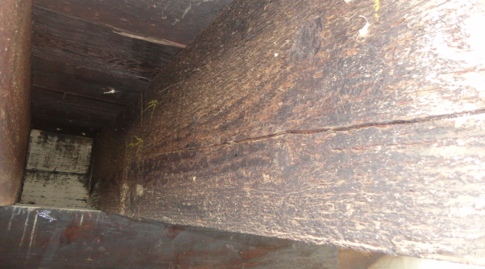
Overload crack on timber stringer.

Slide 42
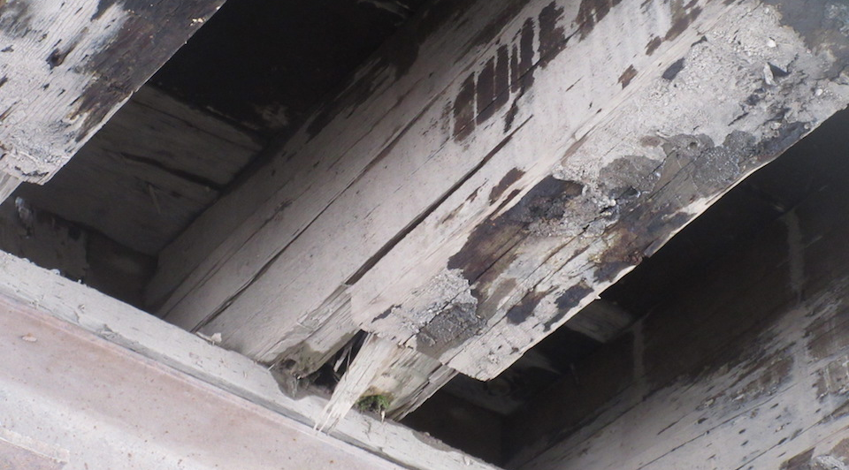
Rotten Timber Stringer

Slide 43
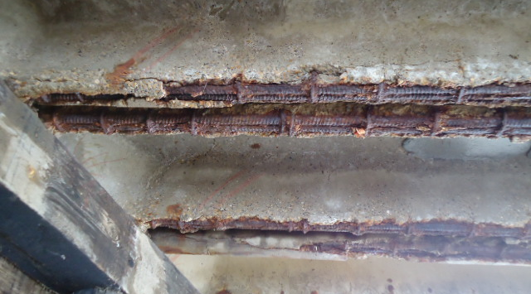
Spall in Anchorage Zone
(< 50% of main bar embedded in sound concrete)

Slide 44
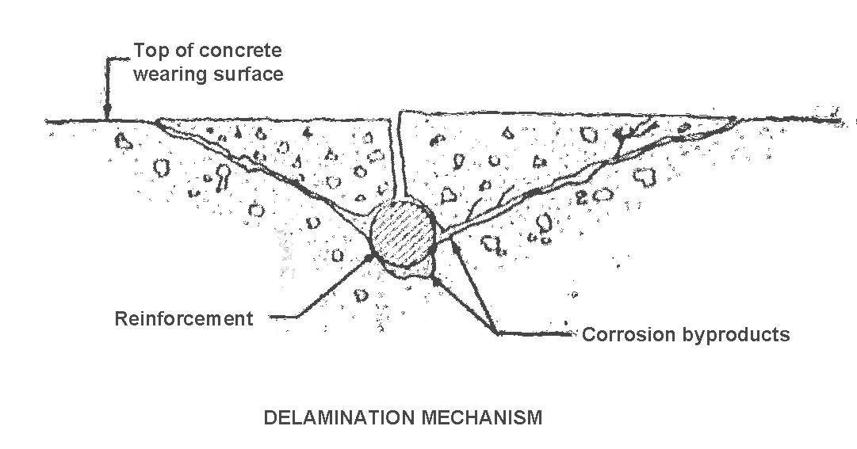
Concrete spalling mechanism by rebar corrosion.

Slide 45
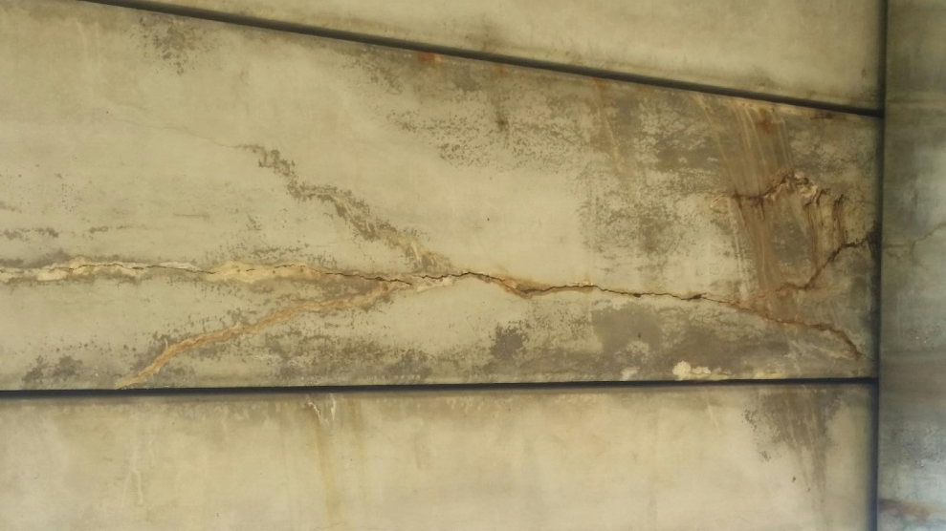
Corrosion cracking on pre-stressed girder underside

Slide 46
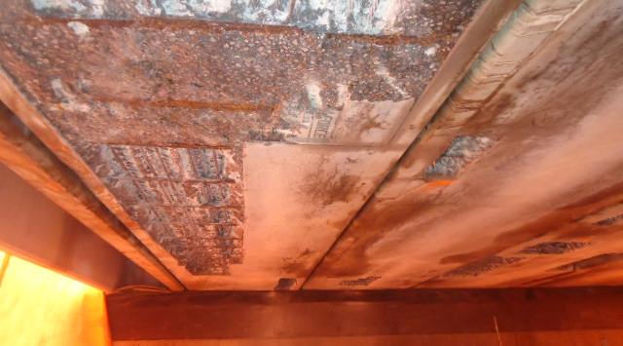
Girder being repaired with strand and stirrups exposed but still bonded

Slide 47
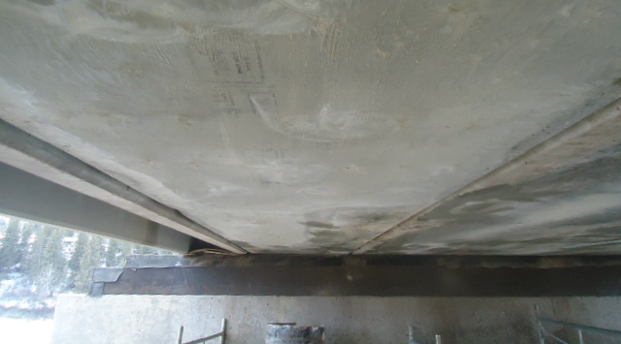
Repaired pre-stressed girder

Slide 48
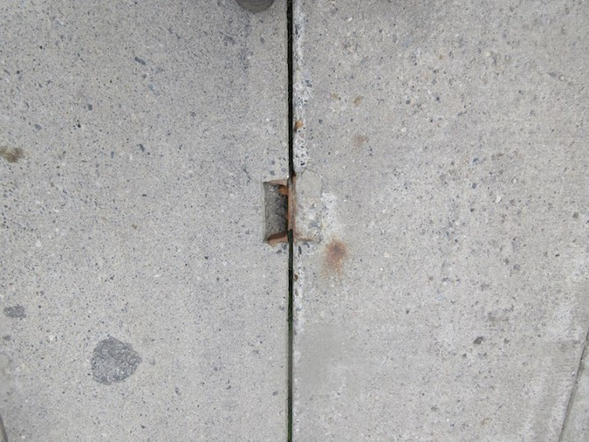
Failed bolted connector

Slide 49
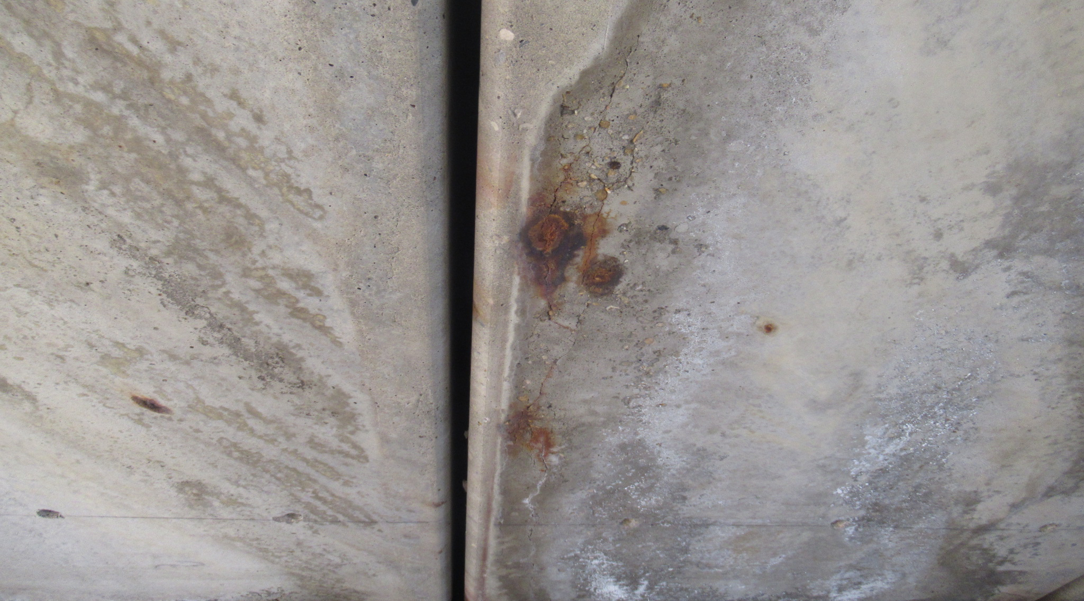
Wide Cracks with Corrosion Staining in Prestressed Girder

Slide 50
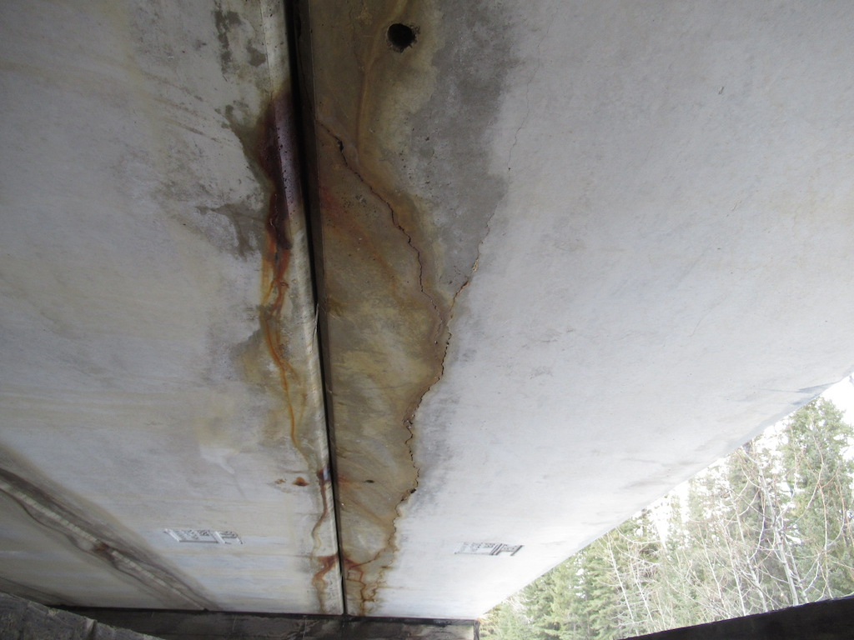
Water Damage to SM Curb Girder - Drilled holes to release trapped water in void

Slide 51
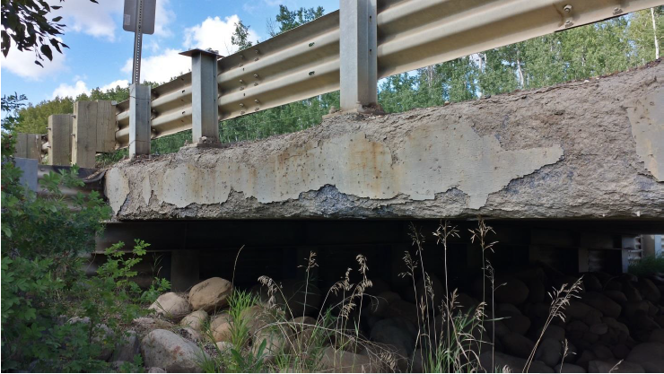
SC Girder Deterioration
Extensive scaling exterior girder surfaces, section loss along top and bottom corners. No exposed stirrups or prestressing strand. Section loss of BR post plinth. Girder rated 3. BR posts rated 3.

Slide 52
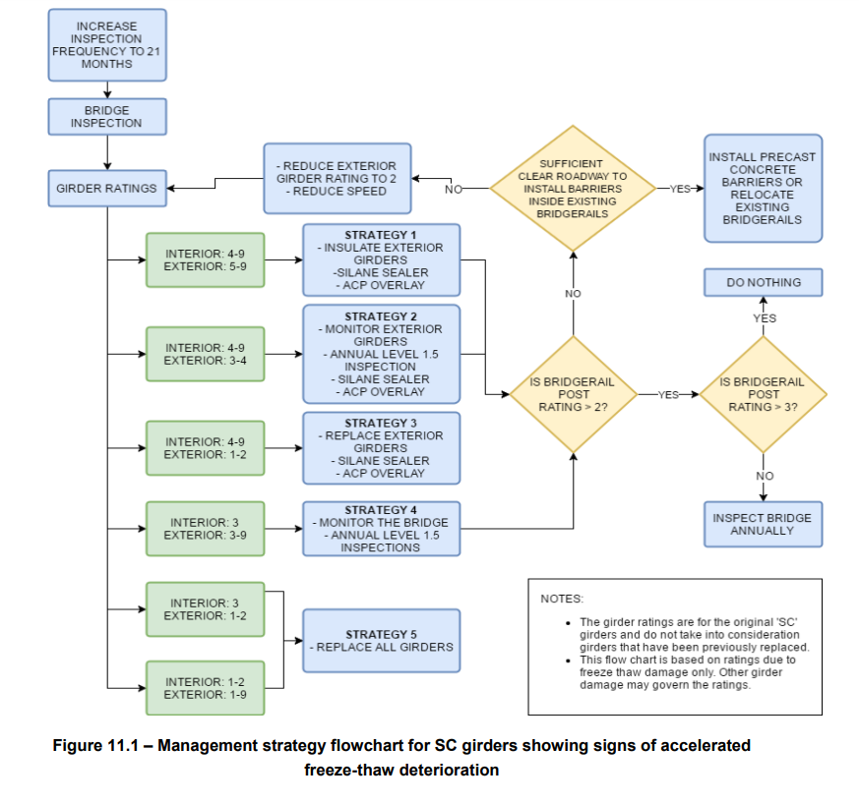
SC Girder Deterioration

Slide 53
Superstructure Maintenance
(Cont'd)
Span alignment
  not a rated item, if Y then:
    reset curb (bumped by grader)
    strut / repair substructure
    redrive piles
    shim un-supported caps

Slide 54
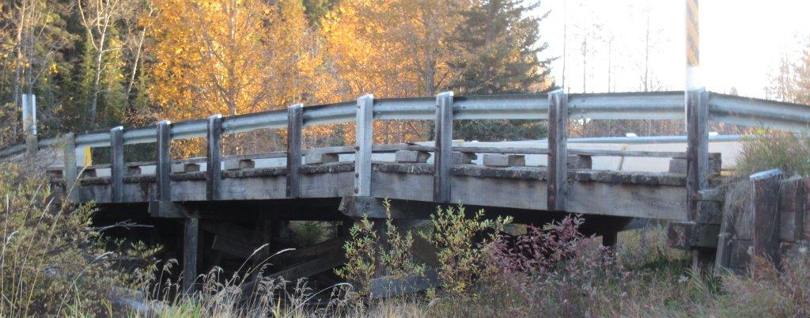
Vertical misalignment - pier heave

Slide 55
Substructure Maintenance
Bearing seats / Caps
  Timber
    sounds hollow, suspect rot
      core
    bulging, end rot, hollow
      replace
      (consider replacing with steel, depends on age)
    rolling
      strut between piles

Slide 56
Substructure Maintenance
(Cont'd)
Concrete
    spalled
      partial of full depth repair with product from approved list
    scaled / stained
      clean and seal (where salt applied)

Slide 57
Substructure Maintenance
(Cont'd)
Steel
    Corrosion and / or section loss
      paint or possible replace
    Damaged galvanized coating (new piles)
      field metalize damaged areas
      touch up with 2 brush coats of zinc rich paint.

Slide 58
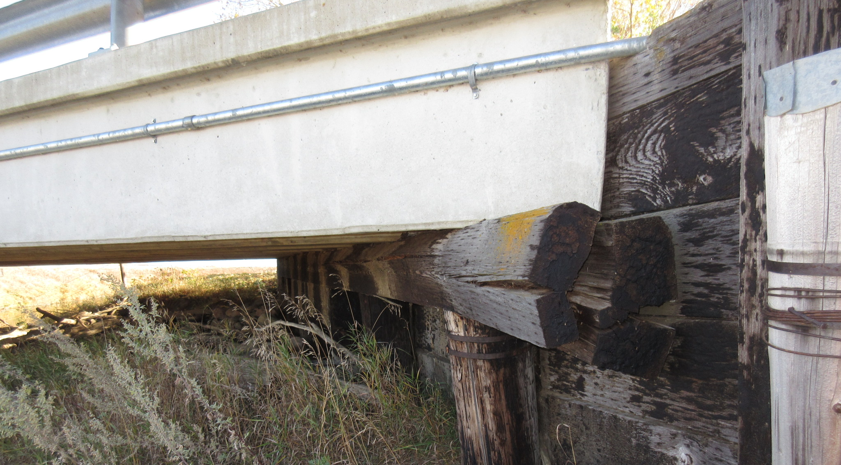

Slide 59
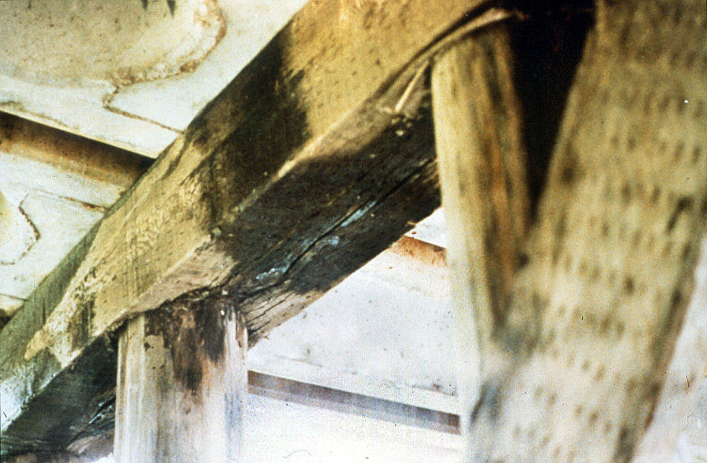
Pier cap crushing over piles.

Slide 60
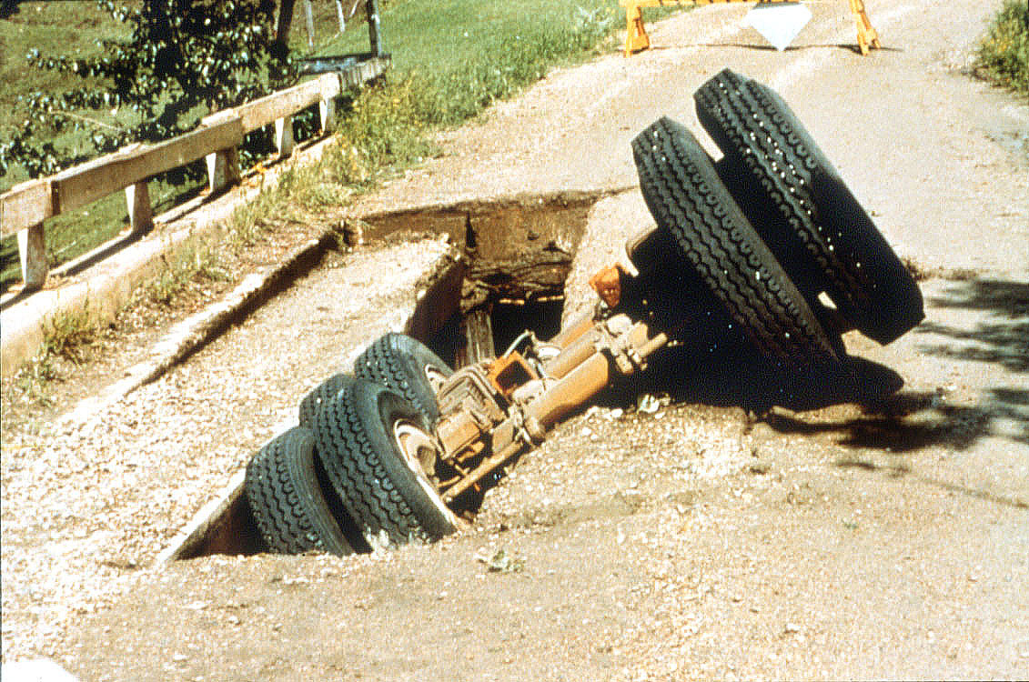
Consequence of pier cap failure.

Slide 61
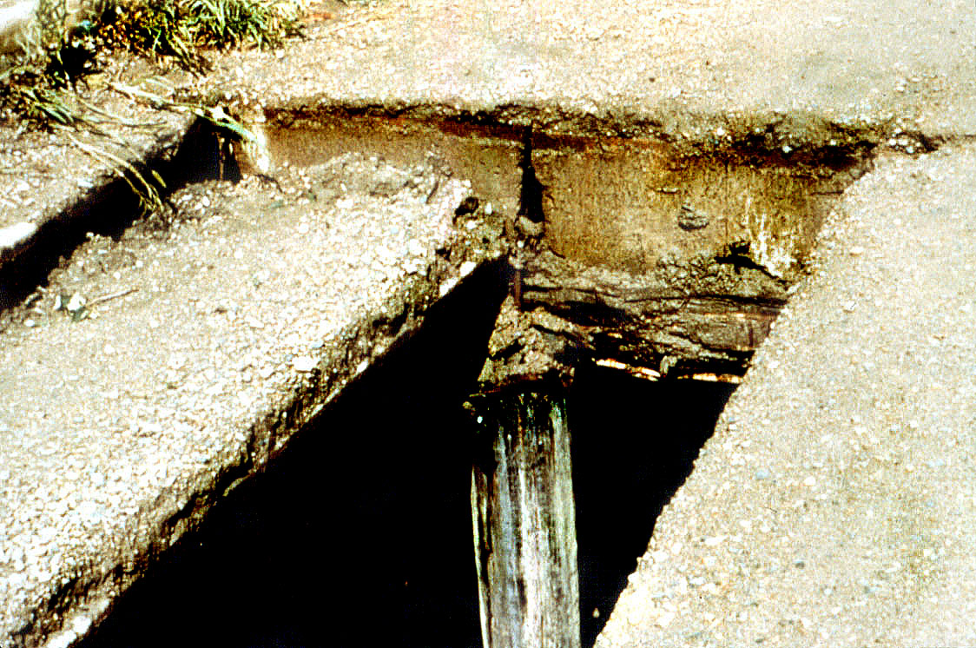
Collapsed girder where cap has failed.

Slide 62
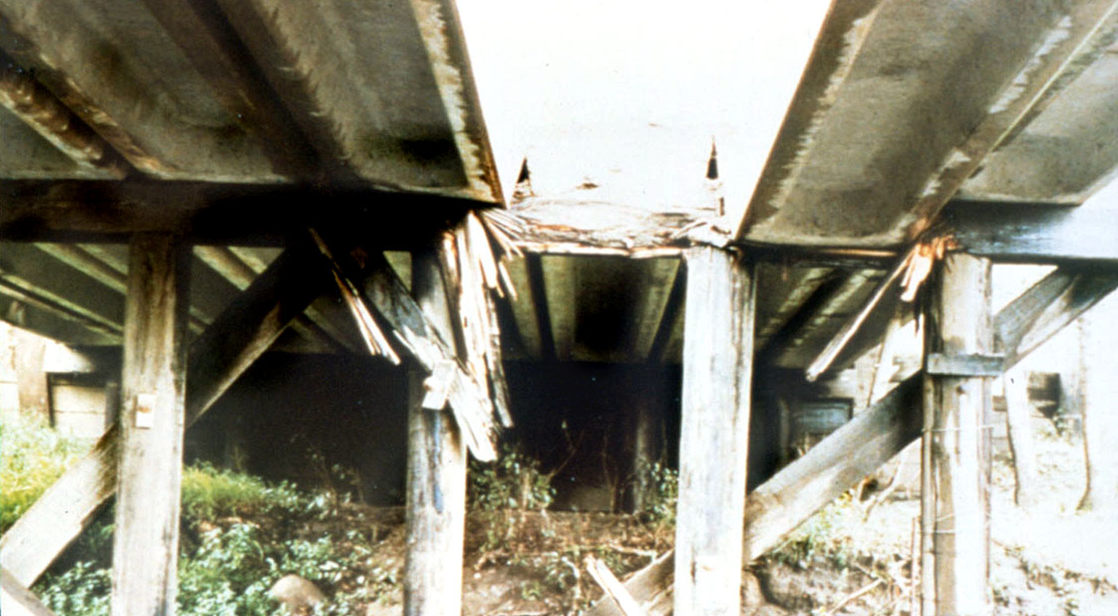
Bottom view of collapsed girder and failed pier cap.

Slide 63
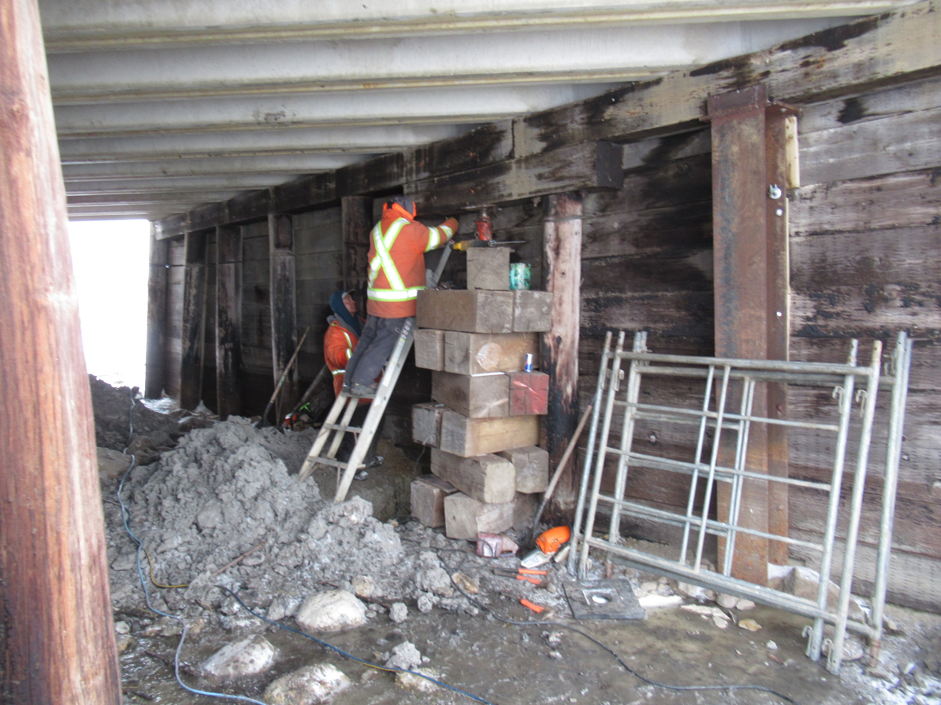
Substructure Maintenance
(Cont'd)
Pier shaft / piles
  Timber
    split piles
      band or replace
    not bearing
      shim
    rotten or broken
      repair with steel splice
      (shown)
    leaning
      strut or replace

Slide 64
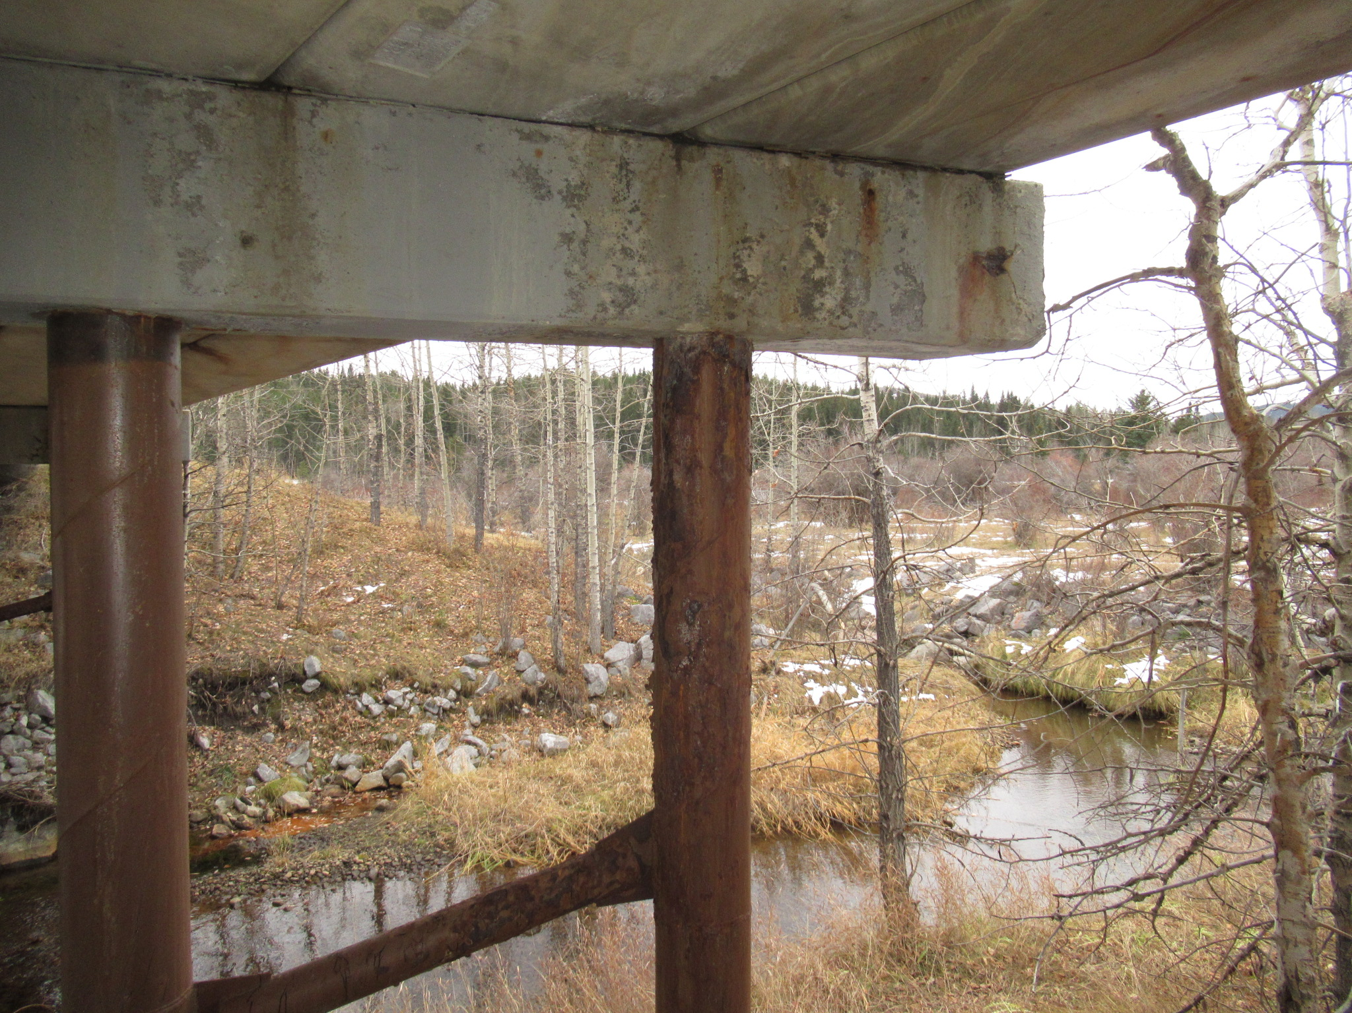
Substructure Maintenance
(Cont'd)
Pier shaft / piles
  Steel
    paint loss / corrosion
      paint (age dependent)

Slide 65
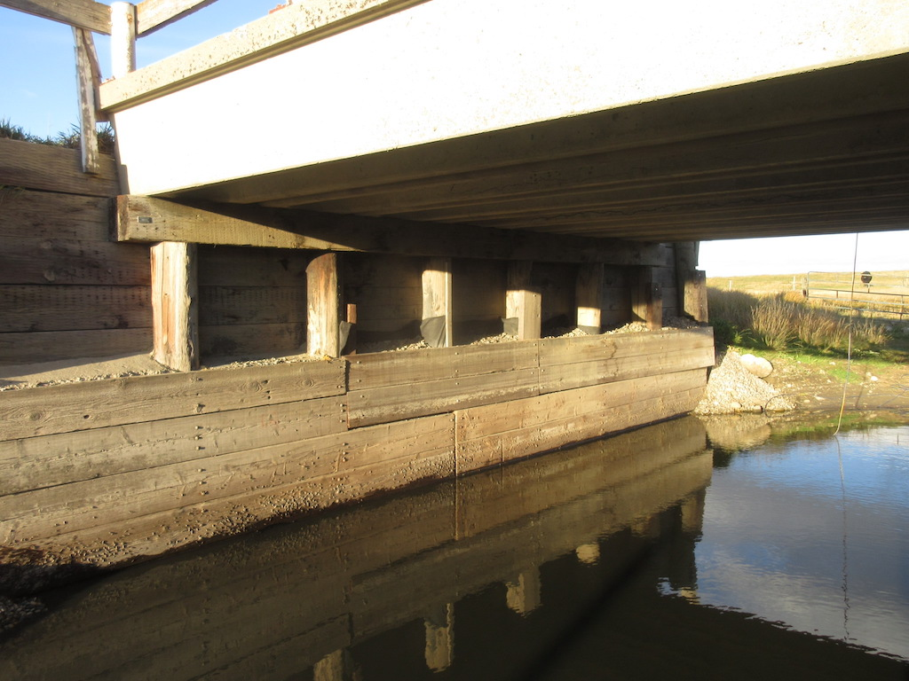
Substructure Maintenance
(Cont'd)
Backwalls and Breastwalls
  rotten / broken timber sheeting:
    replace
  undermined
    lower backwall sheeting
    Install breastwall (streamside of piles)
    place rock rip-rap

Slide 66
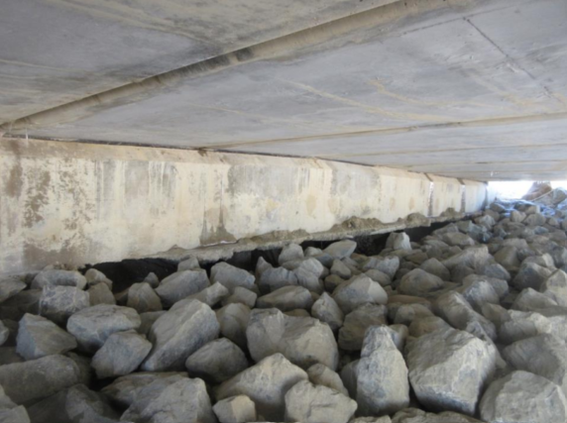
Void under abutment seat due to fill settlement

Slide 67
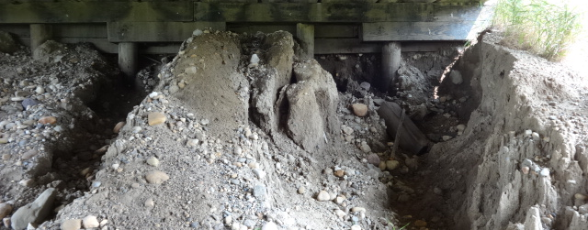
Erosion under backwall sheathing – not low enough

Slide 68
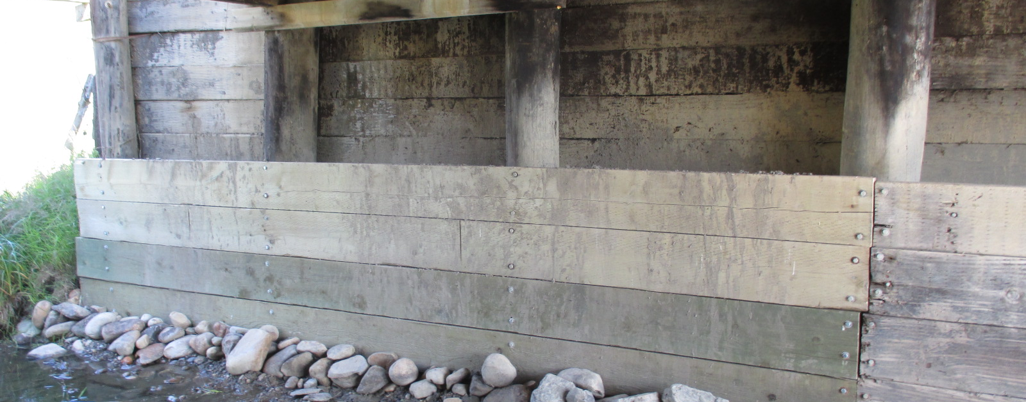
Breastwall added to repair erosion / undermining

Slide 69
Substructure Maintenance
(Cont'd)
Wingwalls
  piles broken / rotten
    replace
  sheeting broken / rotten
    Replace
  Damaged tin caps
    Replace to prevent pile rot

Slide 70
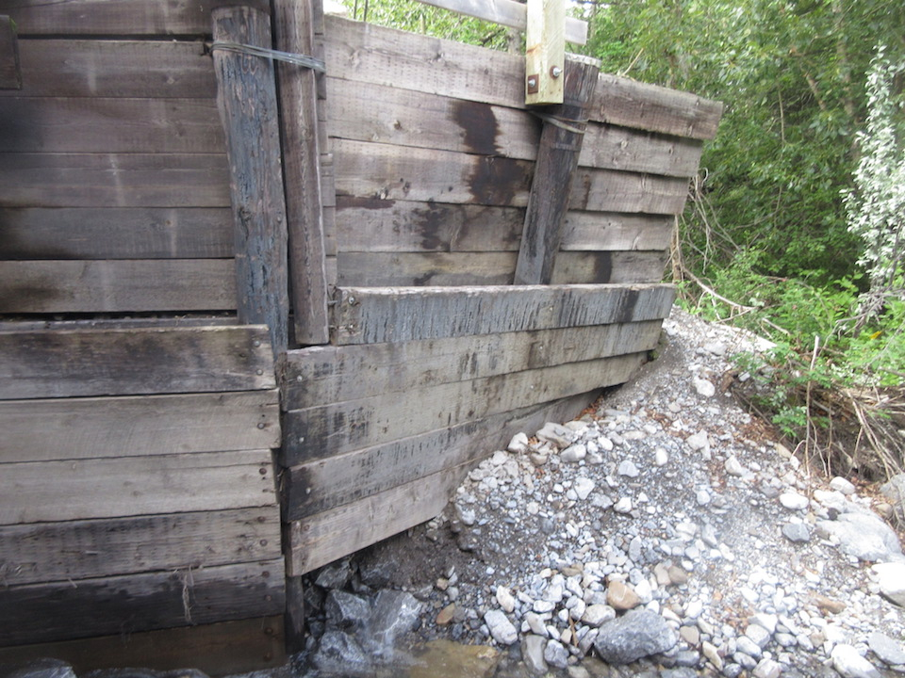
Leaning abutment wingwall.

Slide 71
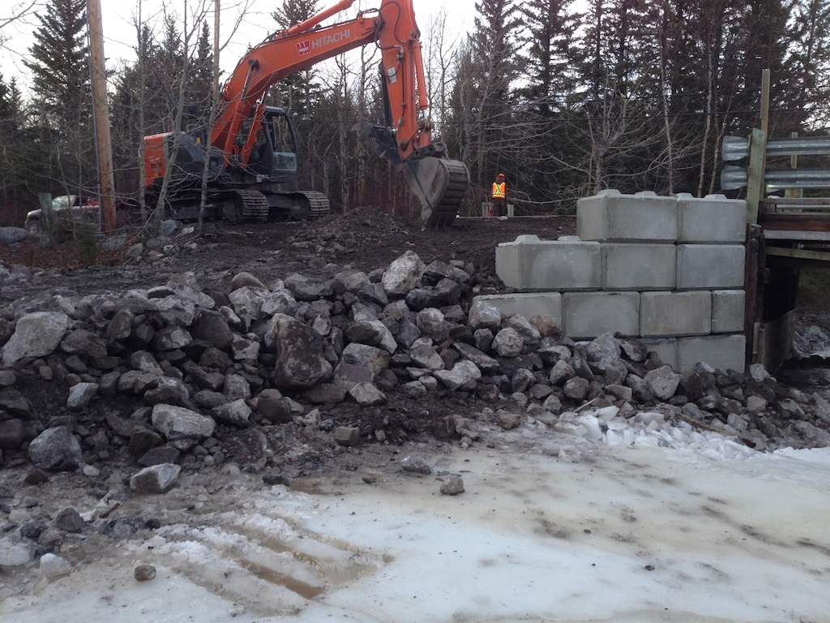
Rebuilt wingwall with concrete lock-blocks

Slide 72
Substructure Maintenance
(Cont'd)
Bracing / struts / sheathing
  split or broken
    replace timber
  broken connections
    replace bolts or reweld connection (steel bracing)

Slide 73
Substructure Maintenance
(Cont'd)
Nose plate
  loose
    reconnect
  not high or low enough
    reposition or extend
  corroded
    re-coat – replace if severe

Slide 74
Substructure Maintenance
(Cont'd)
Paint / Coating
  concrete
    pressure wash & recoat with sealer
  steel
    blast & paint
  often coating only aesthetic

Slide 75
Substructure Maintenance
(Cont'd)
Abutment / Pier stability
  can be serious problem
  if minor
    strutting may help
    allow to stabilize (monitor)
  if serious
    eventually replace substructure

Slide 76
Substructure Maintenance
(Cont'd)
Scour / Erosion
  erosion of headslope
    repair / place rock rip-rap
  scour at piers
    fill hole with rock

Slide 77
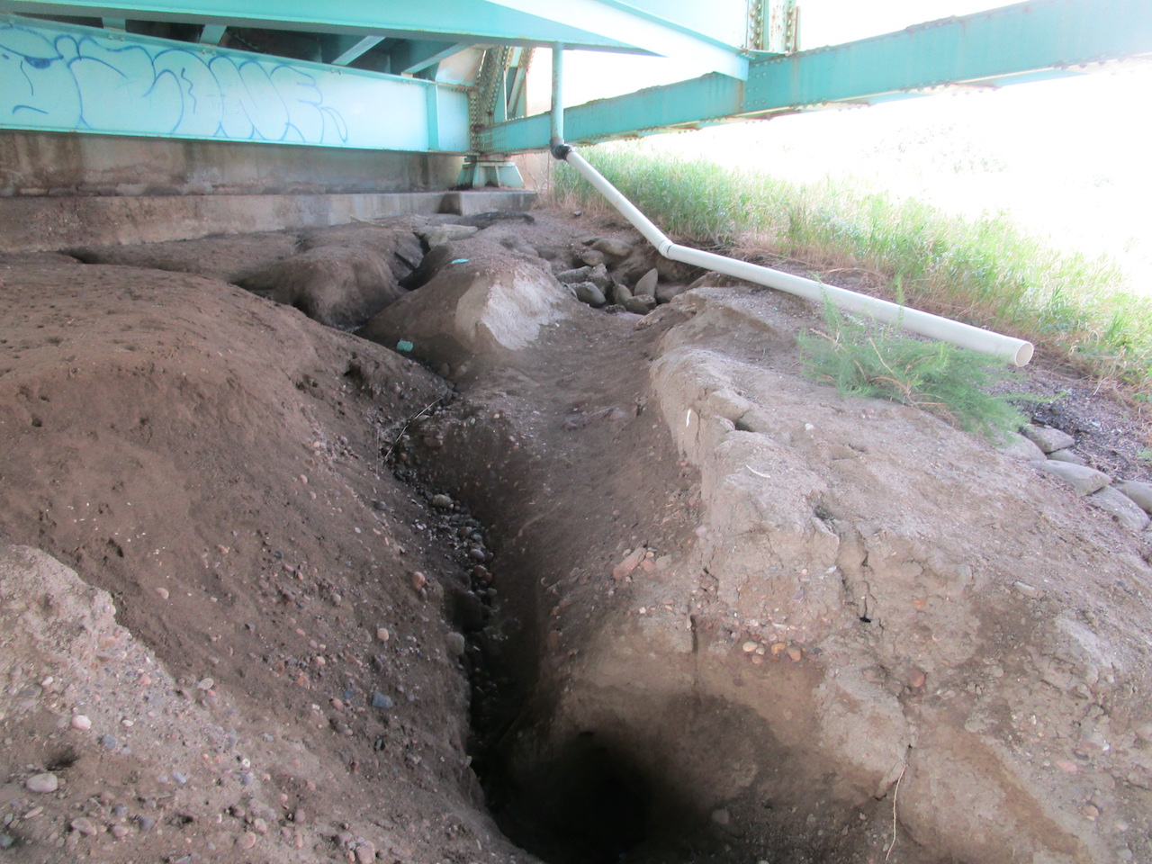
Erosion Gully in Headslope

Slide 78

Headslope erosion in flood

Slide 79

Headslope rebuilt

Slide 80

Eroded abutment and approach road.

Slide 81
Maintenance of Headslopes

Slide 82
Substructure Maintenance
(Cont'd)
Debris
  remove and dispose of drift or old piles
  cut up large drift into 1m lengths

Slide 83

Drift upstream of the bridge.

Slide 84
Channel Maintenance
Channel alignment
  poor alignment causing damage or endangering bridge
    spurs or guidebanks
      (not usual for standard bridges)
    place bank protection

Slide 85

Extended guidebank to contain and direct flow

Slide 86
Channel Maintenance
(Cont'd)
Bank stability
  sliding or undermining near bridge
    place rock rip-rap
    add span/flatten slope
Drift
  if a problem
    remove and dispose or cut up
Slope protection
  eroded or scoured
    repair with rock rip-rap

Slide 87
Channel Maintenance
(Cont'd)
Guidebanks /Spurs
  eroded or scoured
    repair with rock rip-rap
Adequacy of Opening
  add spans to bridge
  raise bridge
  not common on standard bridges

Slide 88

Beaver dam under a timber bridge.

Slide 89

Table 11.1 Maintenance Work Types – Bridges & Culverts

Slide 90
Repair Materials
Concrete
  silica-fume concrete
  fibre reinforced concrete
  latex modified concrete
  corrosion-inhibiting concretes

Slide 91
Repair Materials
(Cont'd)
Polymers
  polymer concretes
  polymer overlays
Specialty products
  concrete patching materials (commonly used for standard bridge repairs)
  grouts
  sealers

Slide 92
Approved Products
Standard testing procedures
Certified laboratories
Testing paid by manufacturer
Approved products list
  concrete sealers
  concrete patching & grouting
  Paints
  http://www.transportation.alberta.ca/planningtools/GMS/ProductList/Product%20List%20Index.pdf

Slide 93
Concrete Sealers
Type 1a
Type 1b
Type 1c
Type 2a
Type 2b
Type 3
- relatively dry decks
- outdoor exposure decks
- outdoor exposure decks
- one component coating
- two component coating
pigmental coating
RMC <55%
RMC <70%
RMC <80%
RMC <70%
RMC <70%
RMC <70%
http://www.transportation.alberta.ca/PlanningTools/GMS/ProductList/BridgeConcreteSealerList.pdf

Slide 94
Concrete Patching Materials
Type NH
  poured horizontal patches, 3 day curing
Type OH-V
  trowelled overhead or vertical patch
Type LTH
  low temperature poured horizontal patch
Type HEH
  high early strength poured horizontal patch
  http://www.transportation.alberta.ca/PlanningTools/GMS/ProductList/patchinglist.pdf

Slide 95
Bridge Coating Systems
Type B2
  Truss / River / little experience
Type B3
  Girder / River / much experience
Type B5 & B6
  Freeway / Overpass
Type 8
  Submerged pipe piles
  http://www.transportation.alberta.ca/PlanningTools/GMS/ProductList/ApprovedBridgeCoatingSystemsPaint.pdf

Slide 96

Questions?

