Slide 1
SUPERSTRUCTURE INSPECTION AND RATING

Slide 2
Introduction
Superstructure Components:
Bearings
Stringers or girders
Deck or subdeck
Deck joints
Deck wearing surface
Drains
Curbs or Wheel Guards
Bridgerail
Sidewalks (if present)
Superstructure is the portion of the bridge above the caps
Purpose
Carry traffic
Transfer loads to substructure
Component materials
Timber
Concrete
Steel
Combination

Slide 3
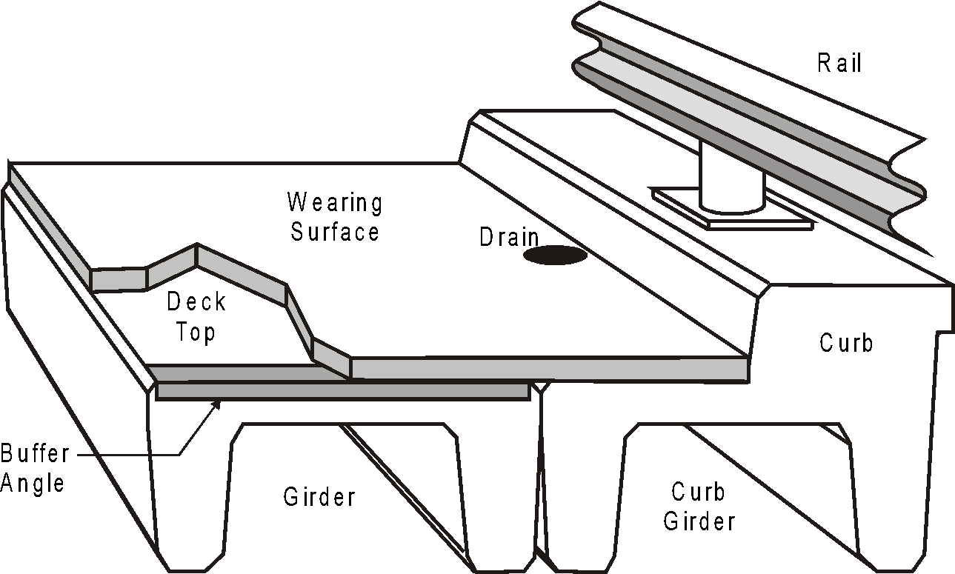
Standard Girder Bridge

Slide 4
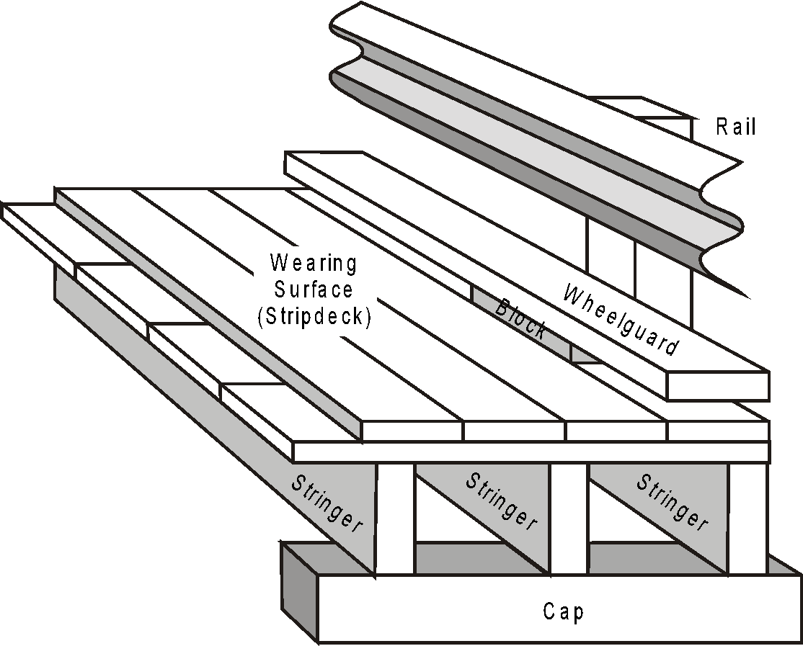
Timber Bridge
Subdeck

Slide 5
Introduction
Two form types;
TT – treated timber bridges
PCS - Standard precast bridges (either plain reinforced or pre-stressed)
Both are tailored for components in each type of bridge

Slide 6
Material Defects

Slide 7
Material Defects - Timber
Decay
caused by fungi
needs moisture, oxygen and conducive temperature
pressure treatment delays growth
look for discoloration (white stains coming from cracks, dampness of wood, ring shrinkage at end grain, hollow sounds, change in geometry
look in areas likely to retain moisture
bearing or contact areas, buried timber
look in areas where treatment is broken/cut
bolts, drifts, dowels, cuts, cap ends
Structural Failure/Degradation
due to loads placed on structural members
overloads, collisions, poor grain pattern
look for cracks, splits, breaks in structural members
stringers, timber posts, rails, etc.

Slide 8
Material Defects - Timber
Volume Change
caused by cycles of wetting and drying creating stress in wood
look for checks, cracks, warps, twists, etc.
Mechanical Wear
caused by abrasion from traffic, snowplows, ice flow, debris
look in area subject to wear/abrasion - deck surface, wheelguard
Fire
easily recognized
reduces the load capacity by reducing the effective section of the member
removes pressure treated zone on the exterior exposing timber to fungal attack

Slide 9
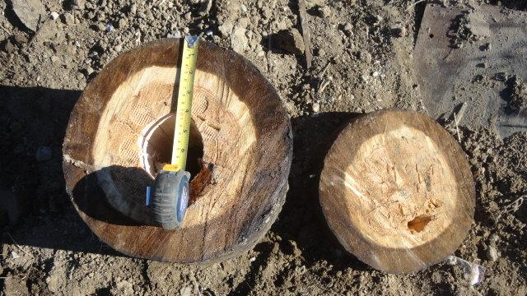

Slide 10
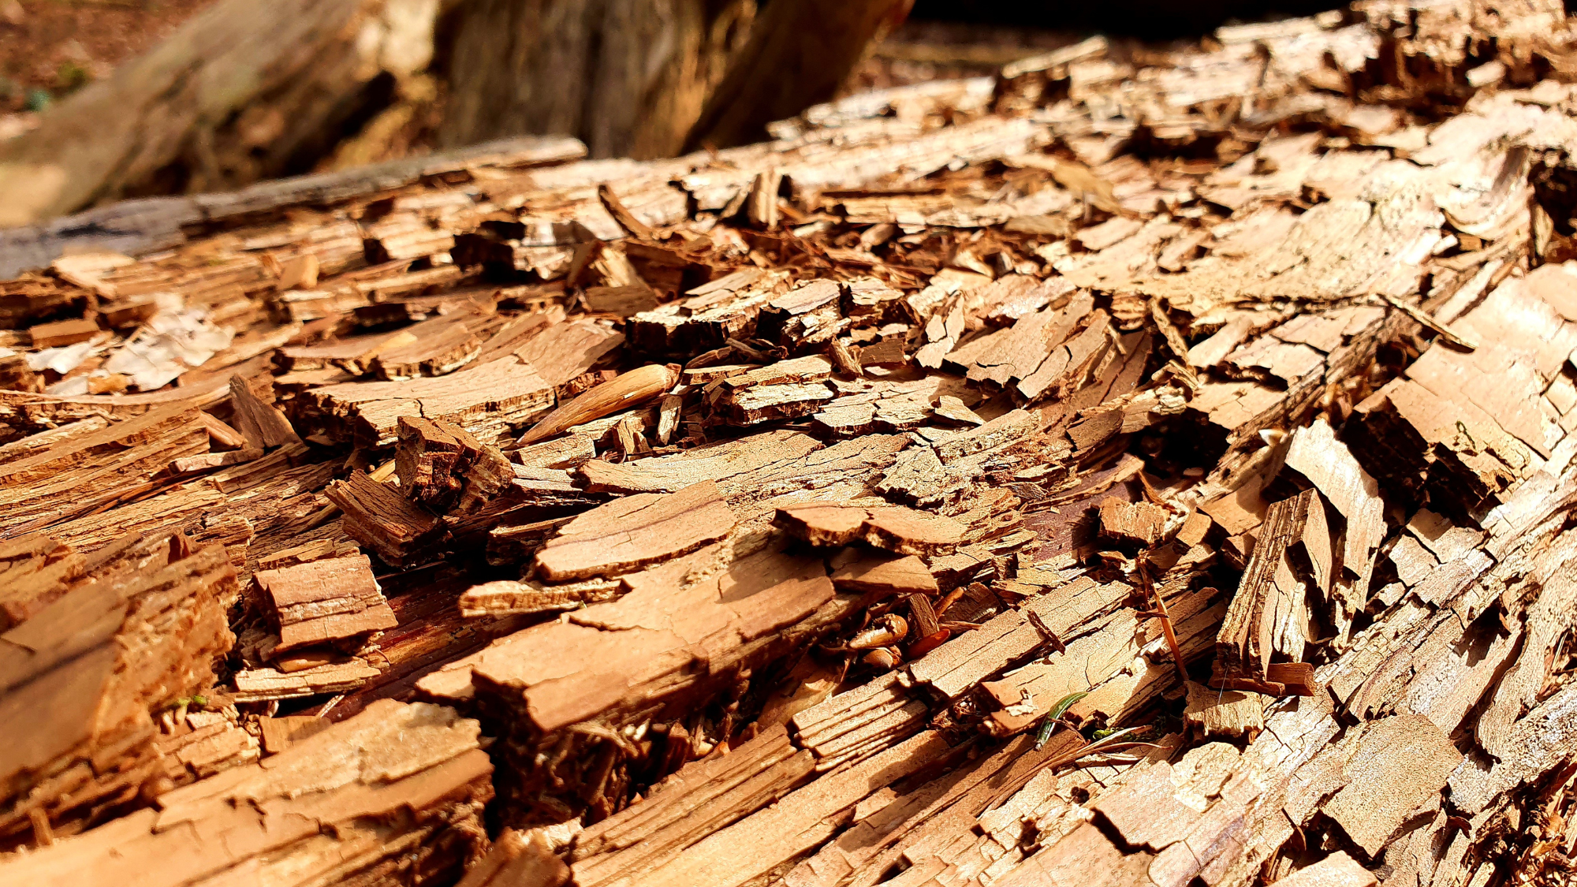
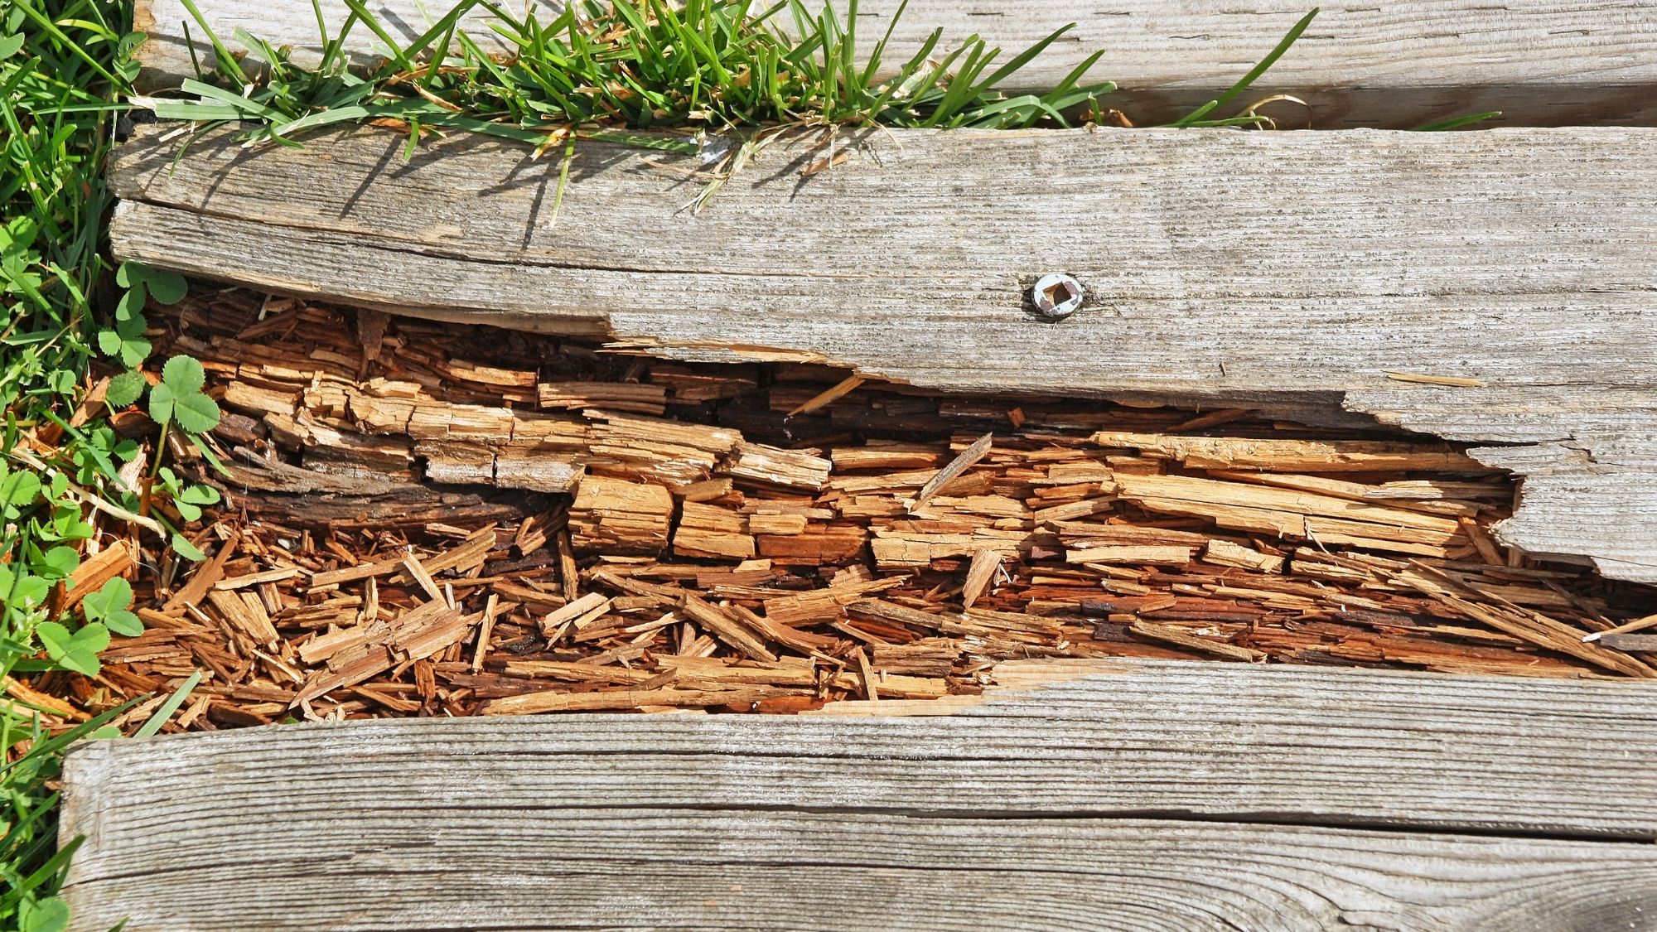

Slide 11
Timber Defects – Rot

Slide 12
Timber Defects – Cracked Stringer – Rated 3

Slide 13
Timber Defects – Cracked Stringer – Rated 3 (+1)

Slide 14
Timber Defects – Gravel Abrasion

Slide 15
Timber Defects – Fire Damage

Slide 16
Material Defects - Concrete
Shrinkage Cracks
caused by rapid drying during hydration
usually not serious by themselves but let moisture and salt into the concrete (e.g., new conc. deck)
Settlement Cracks
caused by settlement of the falsework
Map Cracks
chemical reaction of the aggregate and paste
usually shallow, from over-finishing
can cause scaling
Structural Cracks
caused by stresses higher than design
Flexural – generally not serious unless wide or growing in width
Shear - most serious - can lead to failure
Anchorage can be serious depending on cause

Slide 17
Material Defects - Concrete
Corrosion Cracks
caused by corrosion of steel in the concrete creating delamination's or spalls.
varying widths, locations and orientations
Maintenance or rehab problem
Chipping
caused by external mechanical (grader blade, backhoe arm)
Scaling
caused by freeze/thaw action
related to poor concrete or workmanship
Spalling
caused by corrosion of rebar
Popouts
caused by expansive aggregates
Punchouts
External mechanical that causes tension failure on opposing side

Slide 18
Material Defects - Concrete
Efflorescence
white salt stains
may be associated with cracks which allow water to get into concrete
Exudation
gel-like substance deposited on surface
may be associated with cracks which allow water to get into concrete
Chemical Attack
caused by sulfates in the soil reacting with the concrete
increases the volume of the concrete causing cracks

Slide 19
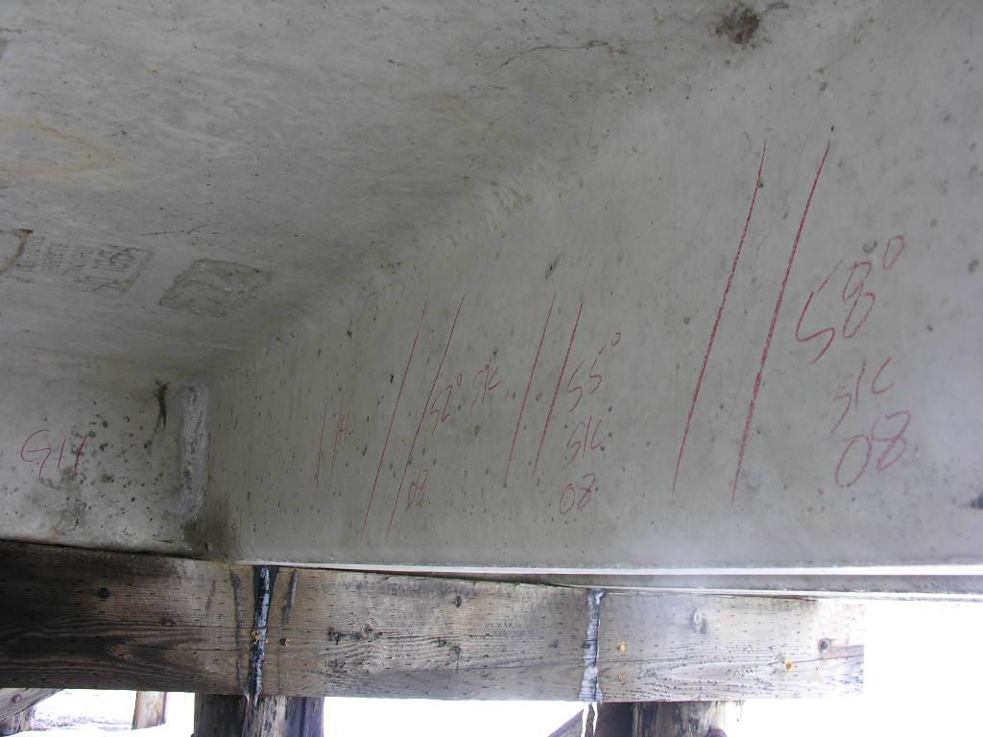
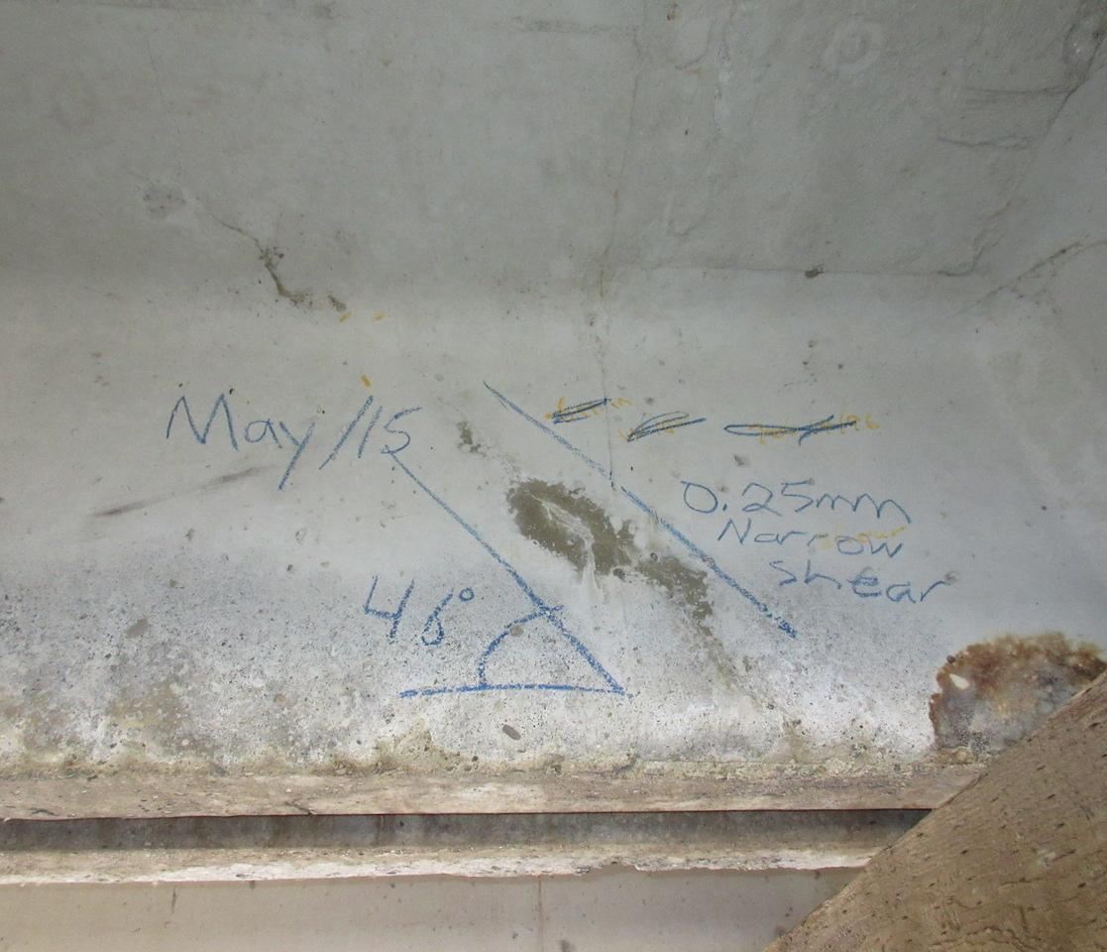
Shear Cracks

Slide 20
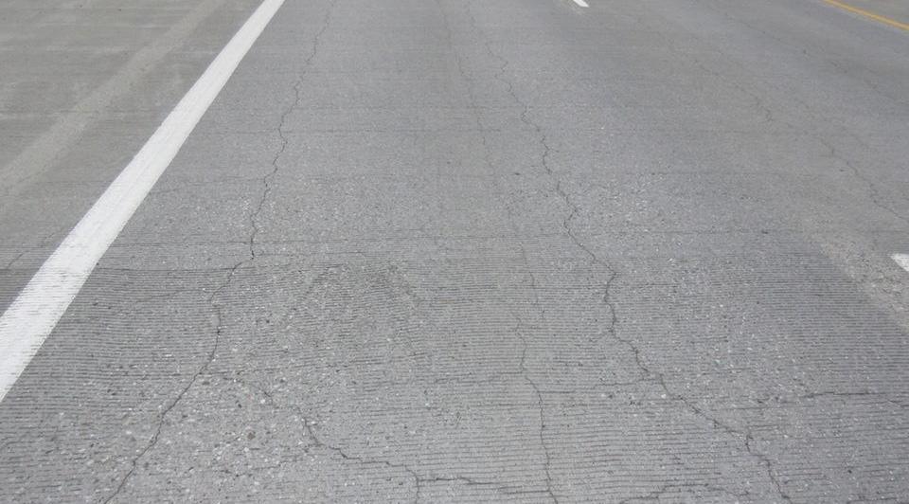

Slide 21
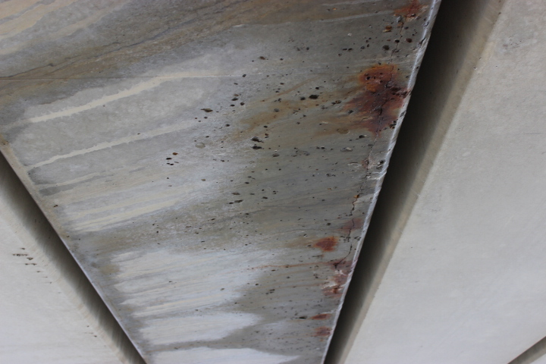
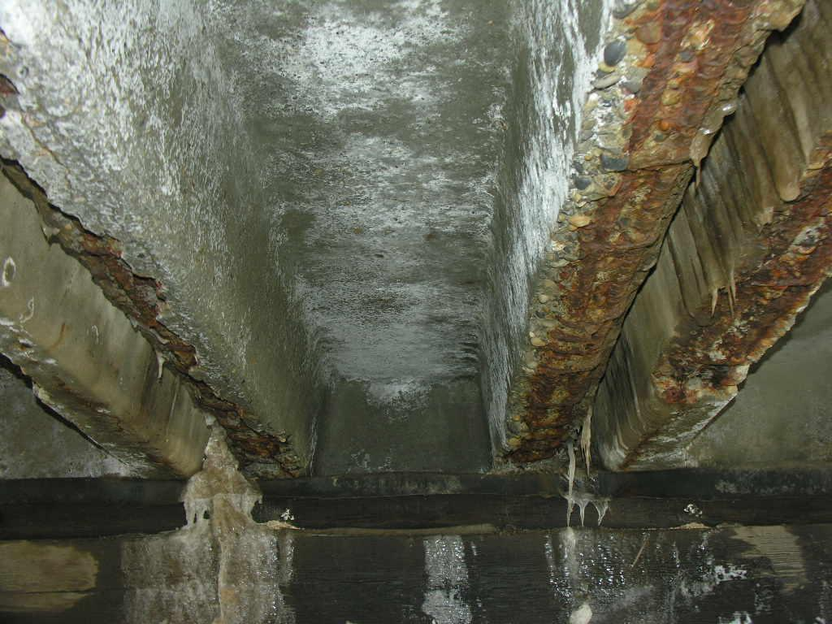

Slide 22
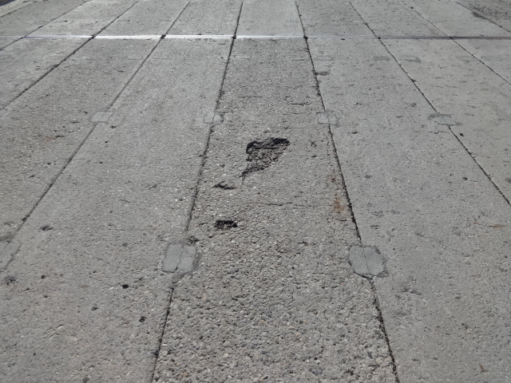
Shallow Deck Spall

Slide 23
SC Girder tops with scaling and section loss

Slide 24
SC Girder-severe scaling and section loss

Slide 25
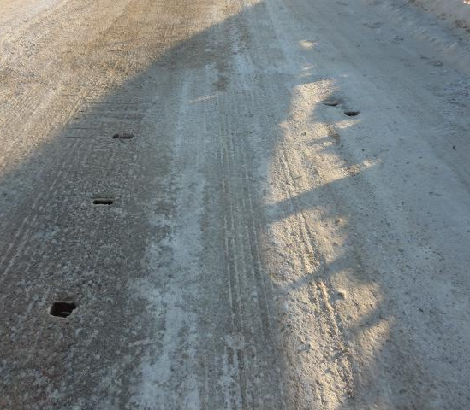
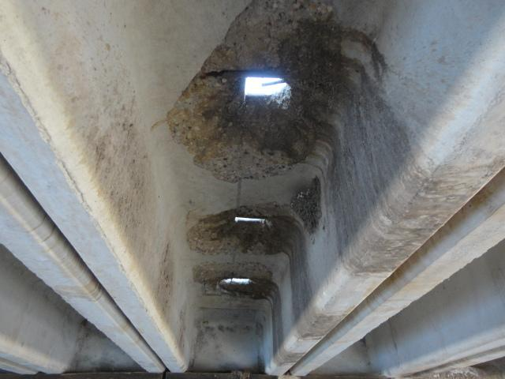
Girder Punchouts

Slide 26
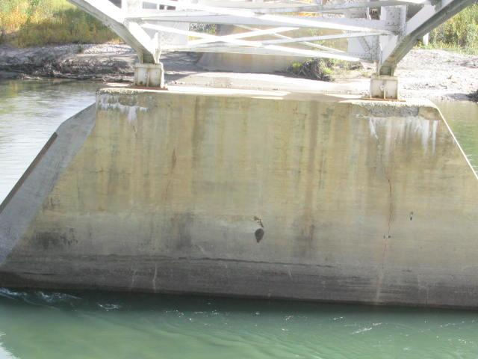
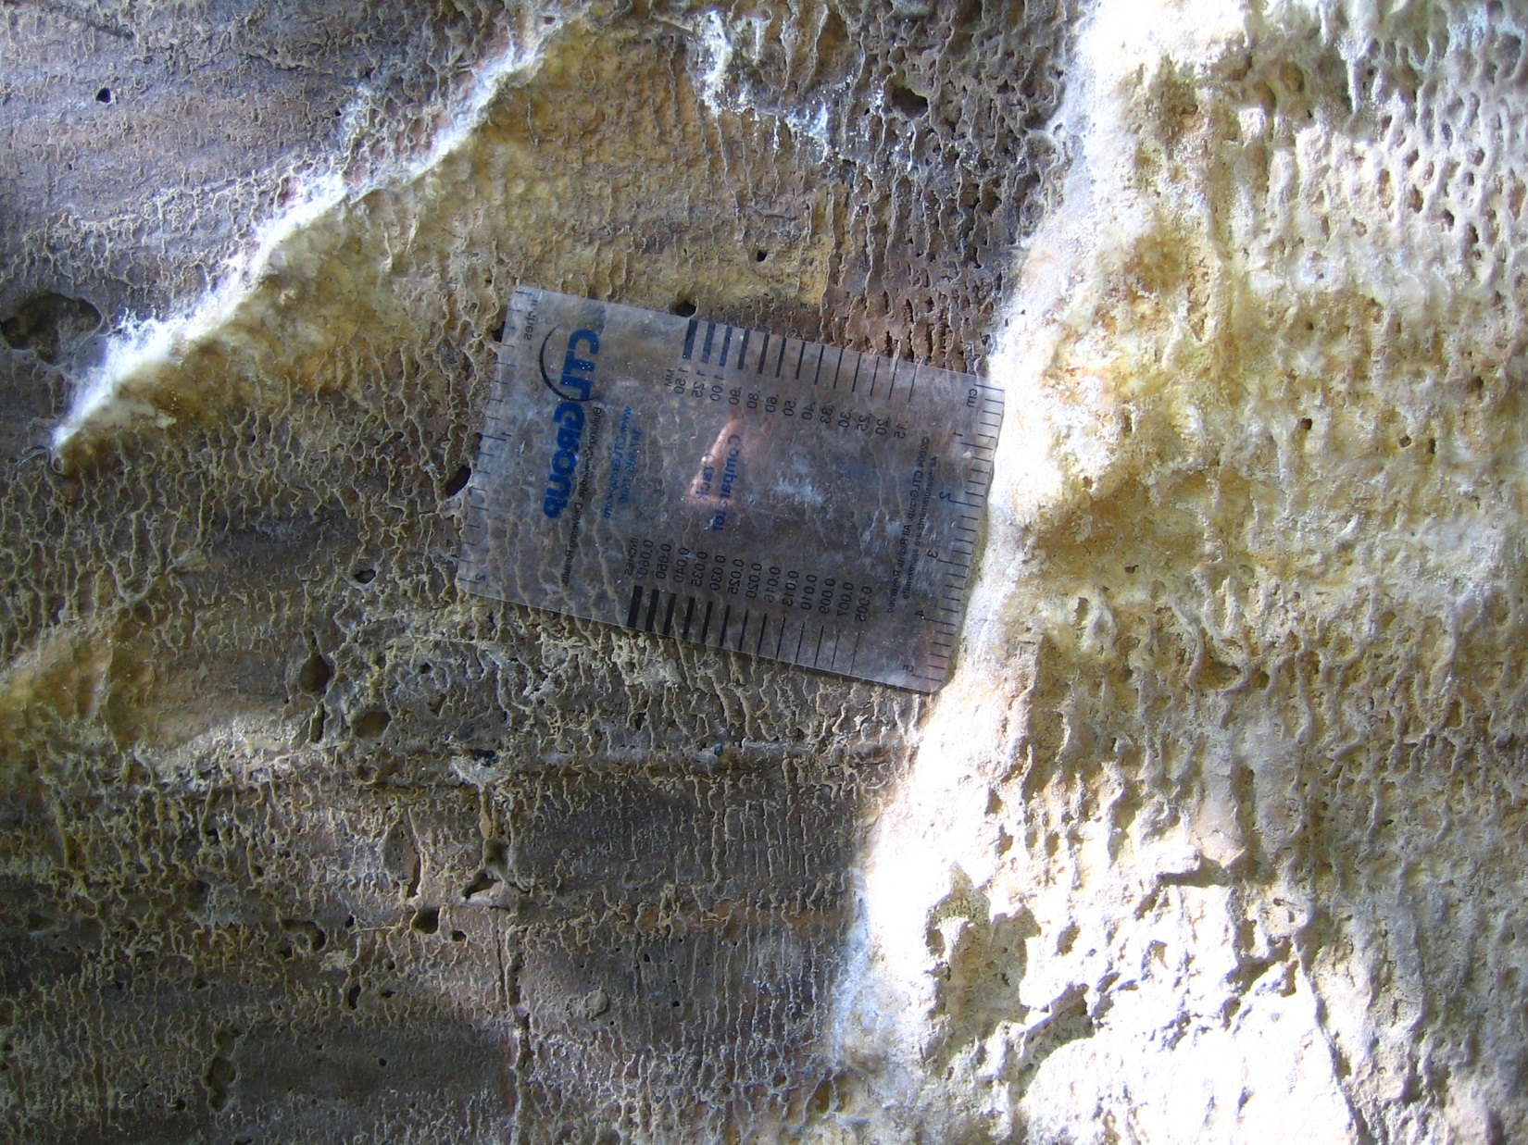

Slide 27
Material Defects - Steel
Corrosion
caused by the presence of oxygen and moisture
reduces section of steel member
can significantly reduce the load-carrying capacity
Increases the risk of fatigue failure
Look in areas prone to the retention of moisture or exposure to salt
Splash areas, under leaky joints or drains, dirt, and debris accumulation
Cracks
Caused by fatigue, overload, or collision
Initially may be too small to be seen by the eye
can progress rapidly
look in high-stress or fatigue-susceptible areas
welds, holes, notches, collision locations, connections, bearing locations

Slide 28
Material Defects - Steel
Deformation
caused by fire, collision, overload or thermal stresses
May be local buckling of part of member I.e., web or flange
entire member may be bent, twisted or buckled
look in high stress areas
collision locations, bearing locations

Slide 29
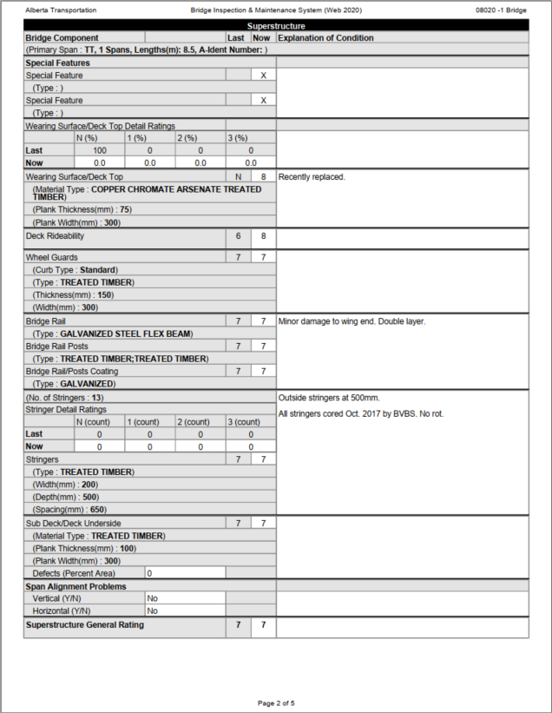
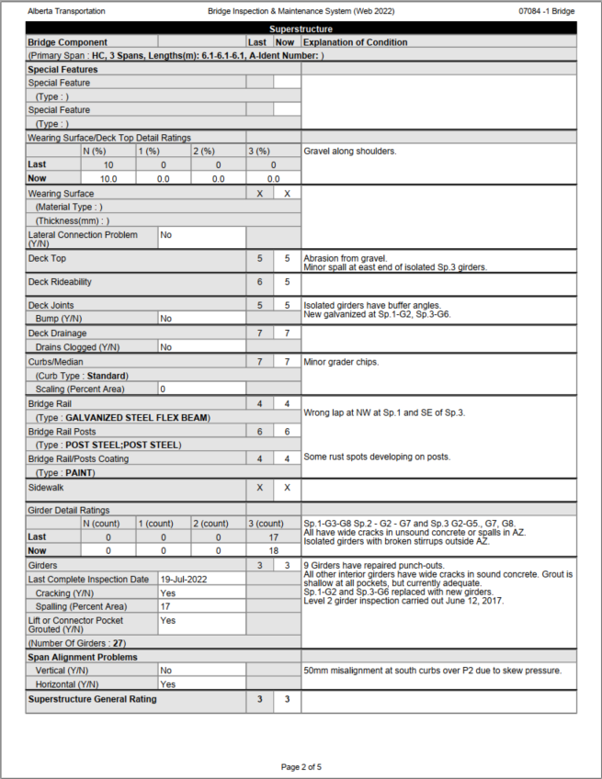
TT Form
PCS form

Slide 30
Special Features
Bridge elements unique to a particular bridge
Which cannot be rated under another element or area of the form
May be permanent or temporary
Lights & WSC station are utilities
Examples include:
strengthening systems, girder clips
temporary bents

Slide 31
Special Features
Record Type(s) – up to 2
Use Explanation of Condition for additional information
description
location
dimensions
Check damage or defects common to the materials and type of component
Provide suitable rating
Make a comment if bird nests are present under the bridge in “Explanation of Condition Field” (e.g., “bird nests at deck underside”)
Refer to Section 7.3 in BIM Manual

Slide 32
Special Features

Slide 33
Special Features

Slide 34
Wearing Surface
TT forms
PCS forms
PCS (precast or pre-stressed standard)

Slide 35
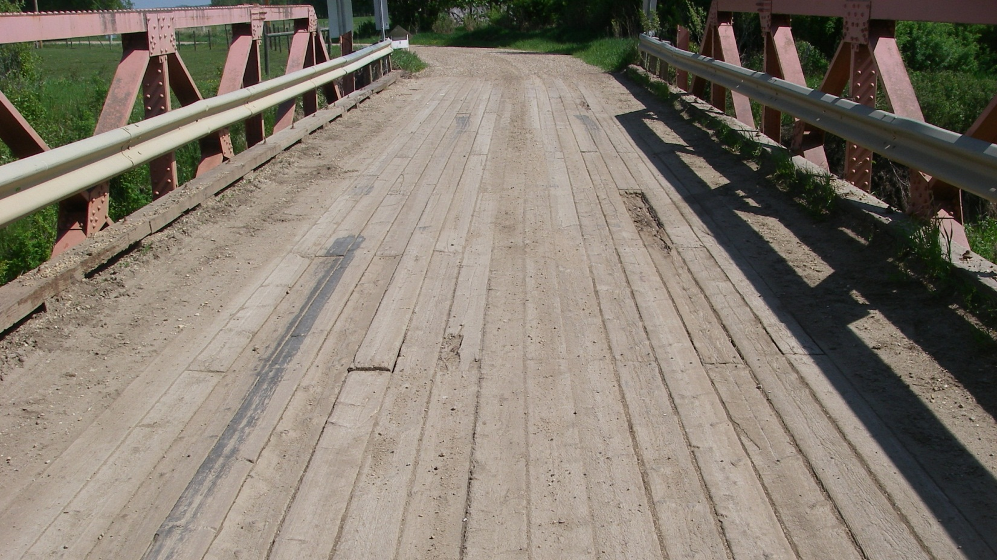

Slide 37
Wearing Surface
Bonded or fastened to the bridge deck
In direct contact with the wheels of the vehicles
List of types in Section 7.4.2 of the BIM manual
Loose or frozen gravel is not a wearing surface
Purpose
Protect the deck
Provide a smooth riding surface
Provide skid resistance

Slide 38
Wearing Surface
TT form combines wearing surface and deck top
If no wearing surface rating is for deck top only
Verify the wearing surface material type on the report
Record or verify the average thickness in mm
Record the width and thickness of timber planks for TT form
Y/N - is there a lateral connection problem between girders? If Y comment
HC - bolted connectors; PA - bolted legs; PE - grout keys; PG, HH – none

Slide 39
Standard Girders with Wear Surface

Slide 40
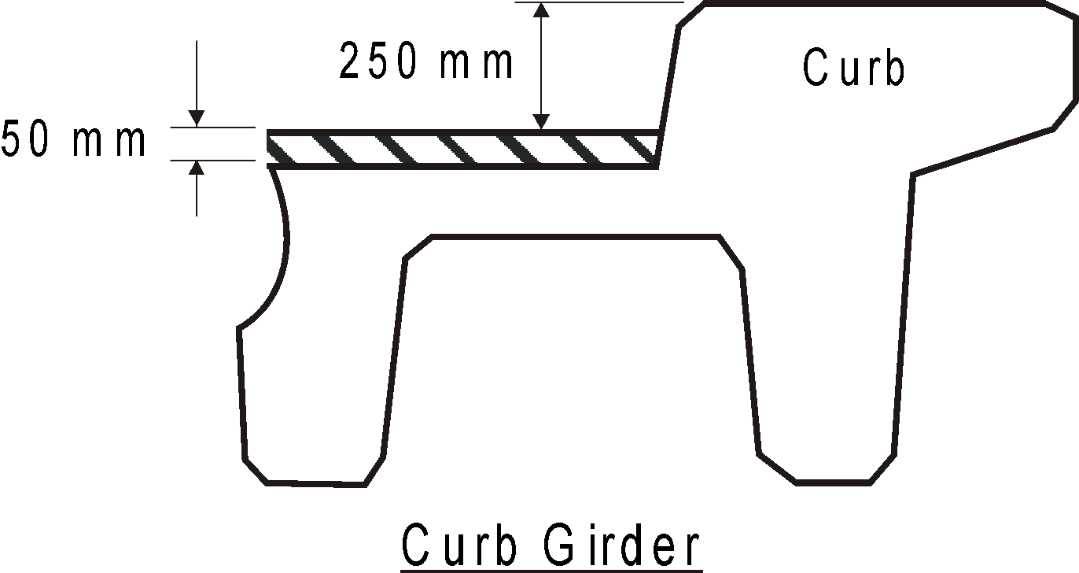
Wearing Surface - Thickness
Measure at curb
Most standards curbs 300mm high
Refer to plans if in doubt
Take readings at ends and midspan, and average
Wearing surface may be thicker at centerline than at curb

Slide 41
Wearing Surface
Drive over the deck at fastest safe speed
Observe traffic to assist in rating
Look for material defects
For asphalt pavement wearing surfaces look for:
cracks (alligator, lane joint, shrinkage and slippage)
distortion (ruts, depressions and corrugations)
disintegration (potholes and raveling)
segregation
Check for delaminations in concrete and asphalt wearing surfaces and record amount in percentage of deck area

Slide 42
Wearing Surface
If surface is without defects and provides a smooth riding surface with proper skid resistance - rate 9
Asphalt longitudinal cracks rate 7 or less,
If speed must be reduced due to cracks, potholes, etc, - rate 4 or less
If wearing surface does not extend to the curbs and creates a wheel trap - rate 4 or less
Asphalt raveling rate 4 or less
Rutting, potholes or debonding rate 4 or less
Hazardous rate 2
Do not rate down due to excessive thickness (100 mm or more)
-Lower curb rating if height insufficient
-Request load rating evaluation
-Recommend reducing thickness

Slide 43
Wearing Surface
Record % of surface area with defects and rated 1, 2 or 3 in Detail Rating boxes
Record % of surface area rated N
Wearing surface rated 4 or above, Detail Ratings are “0”

Slide 44
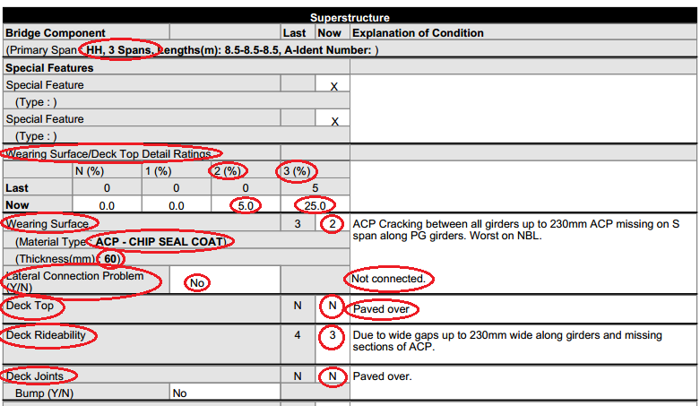
Wearing Surface

Slide 45
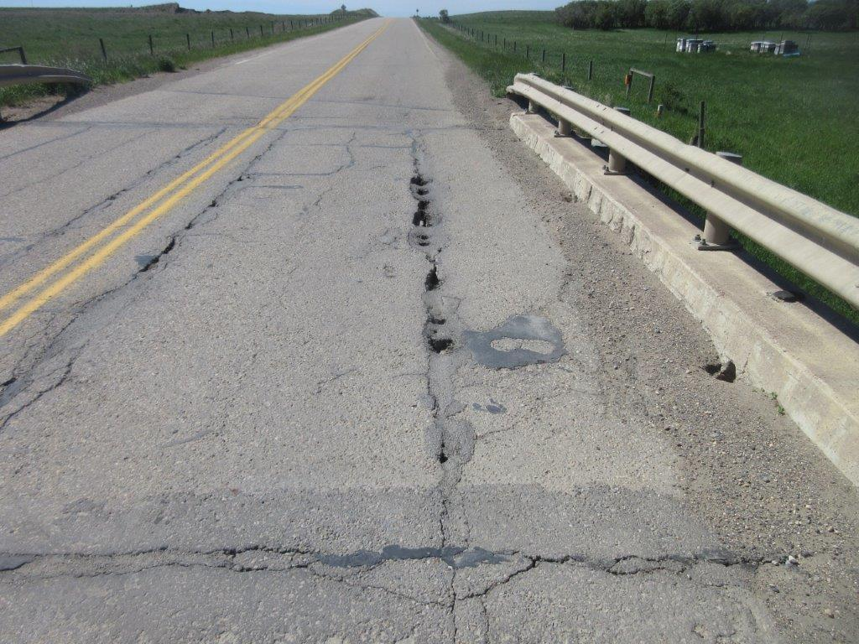
Wide ACP gaps-failed lateral connectors-hazardous WS

Slide 46
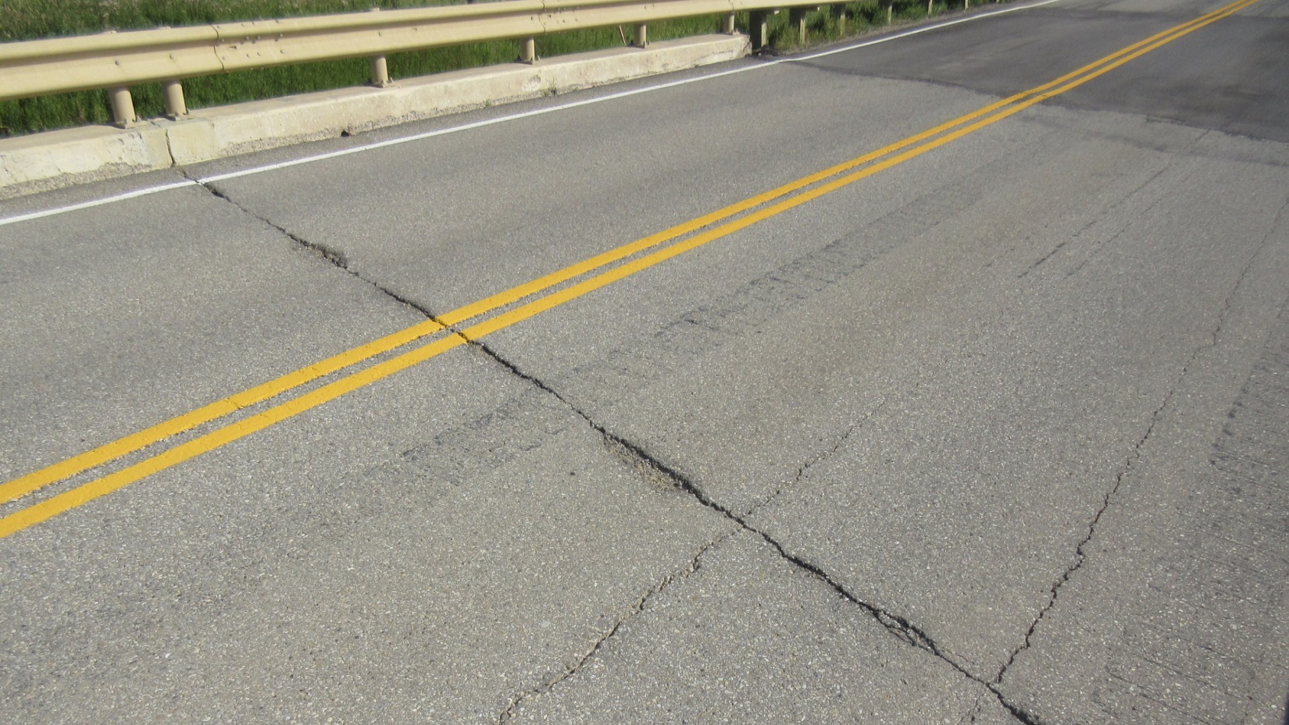

Slide 47
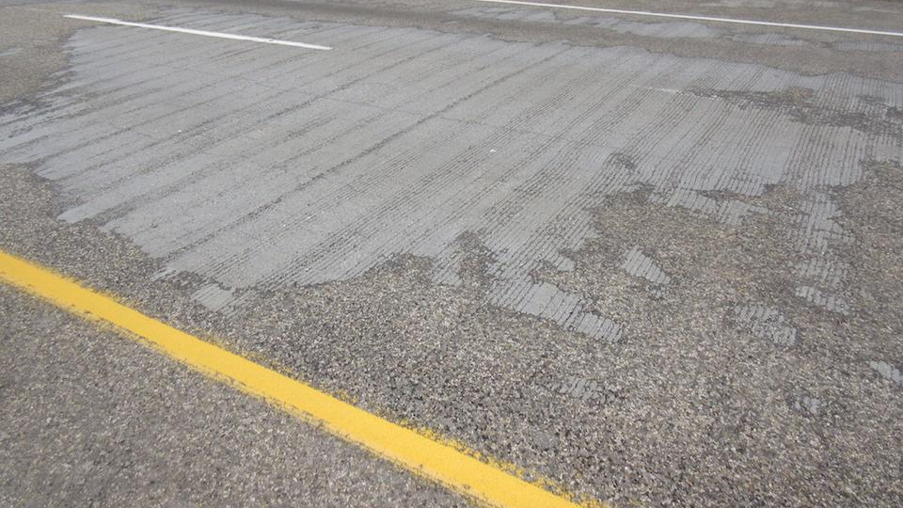

Slide 48
Deck Top
Deck Top is the “structural” part of the deck
The surface on which the wearing surface is bonded
If no wearing surface, the deck top is in direct contact with traffic
Types:
Cast-in-place concrete
Precast concrete girders

Slide 49
Deck Top
Purpose:
Carry traffic
Transfer traffic loads to main structural members
Provide smooth riding surface
Provide skid resistance
Rated with wearing surface on TT forms

Slide 50
Deck Top
Listen for unusual noises and look for deflections under traffic
Look for material defects
Concrete - cracks, scaling, spalling, popouts, abrasion from traffic
Timber - missing and loose planks, cracks, splits, rot, wear from traffic
Look for unfilled lift and connector pockets on precast girders
Rating of wearing surface does not affect the deck top rating

Slide 51
Deck Top
Deck smooth, no defects, rate 9
Good condition with hairline cracks, rate 7
If speed reduced due to potholes, etc., rate 4 or less
Record % area rated 3, 2, 1 and N in Detail Rating boxes
Deck top rating 4 or more record 0 in Detailed Rating boxes
Rate 3 or less for severe scaling/spalling/debonding
Hazardous conditions rate 2
If defect on precast or pre-stressed girder deck top is severe enough to affect load carrying capacity then girder rating should also be consistent

Slide 52
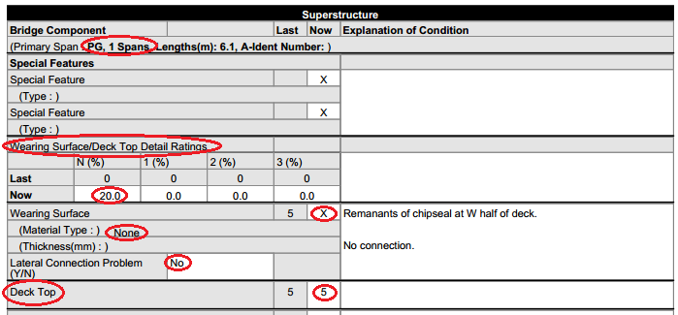
Deck Top

Slide 53
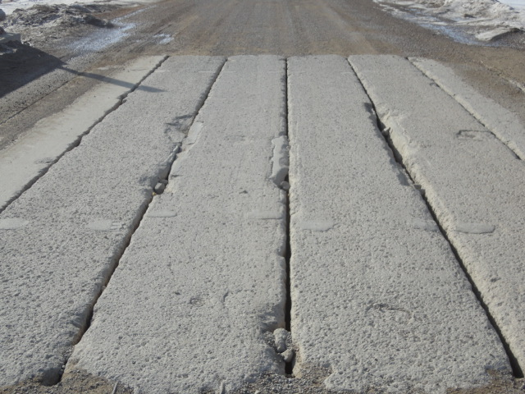
Gravel Abrasion and Edge Spalls

Slide 54
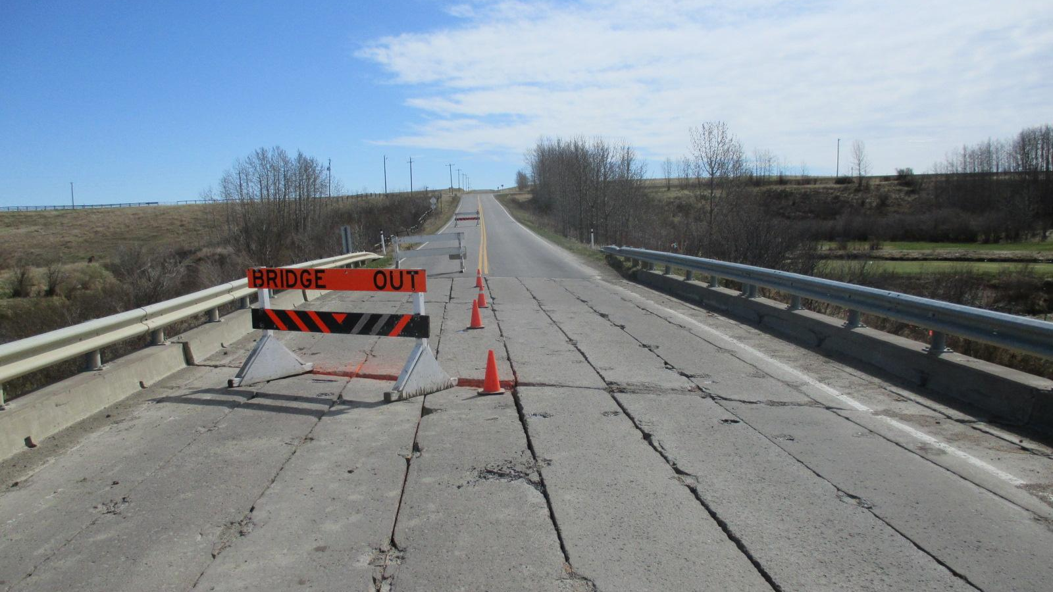

Slide 55
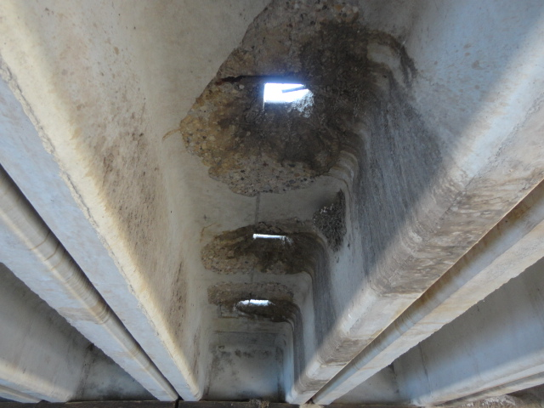
Notes:
Also affects girder rating

Slide 56
Lateral Connection Problem Y/N
PCS (precast or pre-stressed standard)

Slide 57
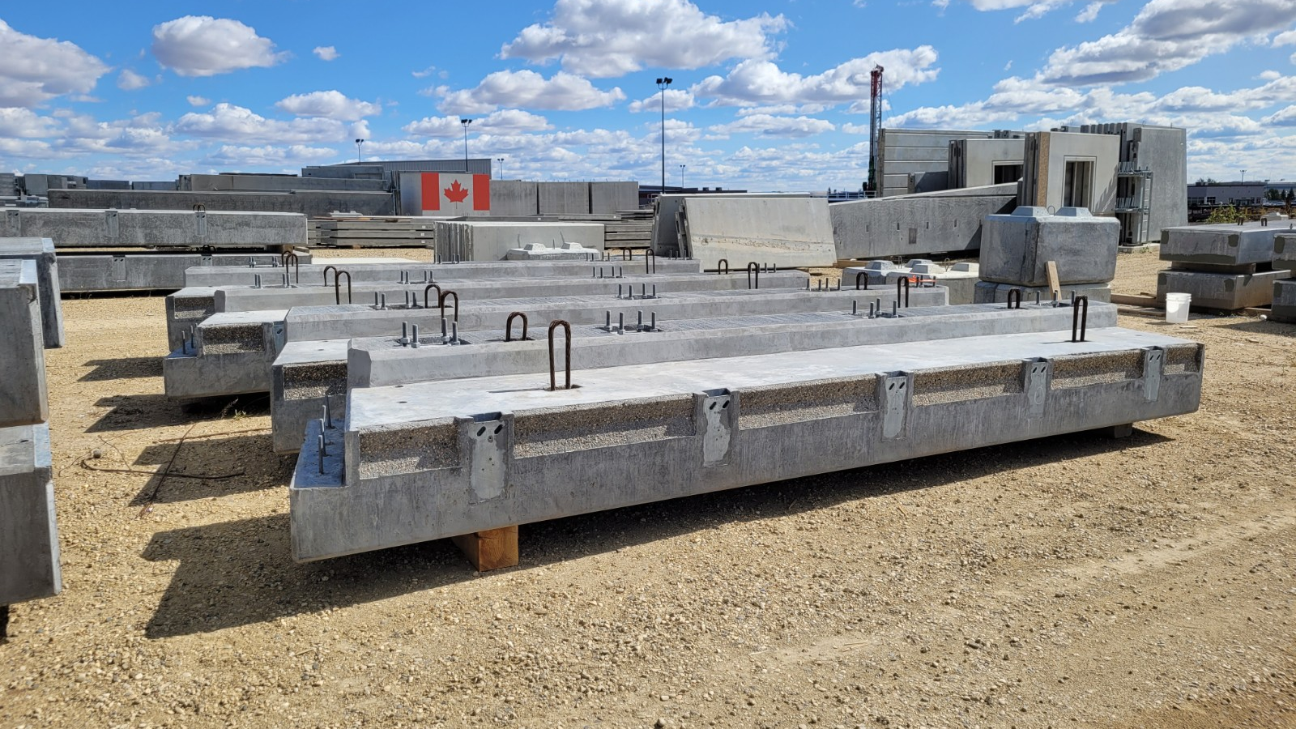
Notes:
Also affects girder rating

Slide 58
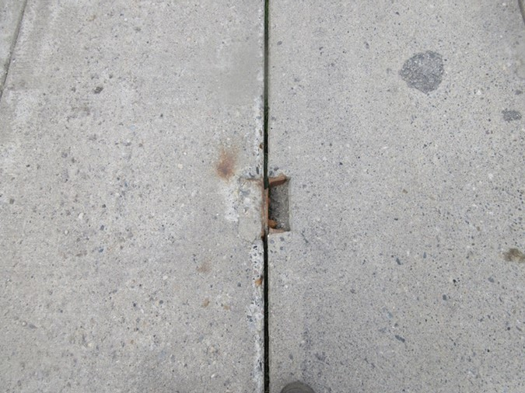
Failed Lateral Connector Pocket – HC Girder
Notes:
Also affects girder rating

Slide 59
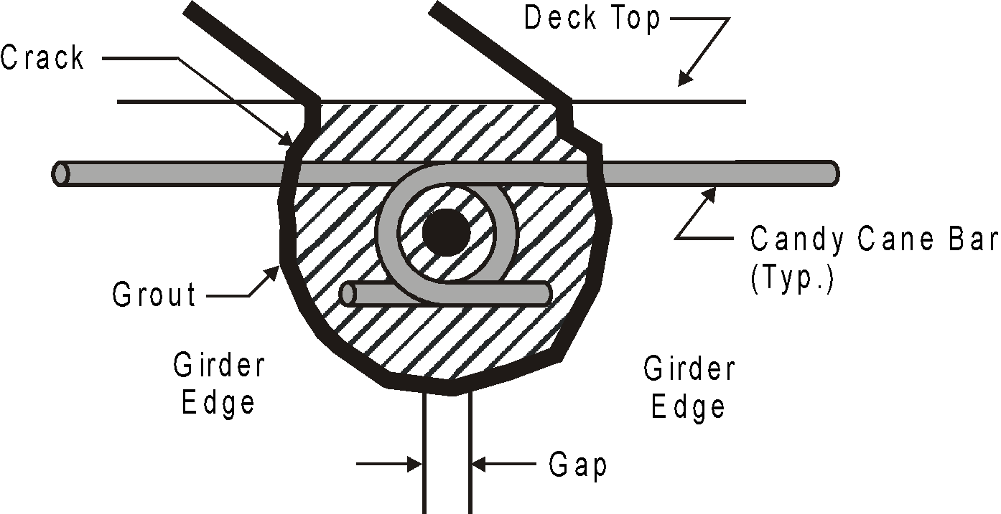
PE Girder Lateral Connection

Slide 60
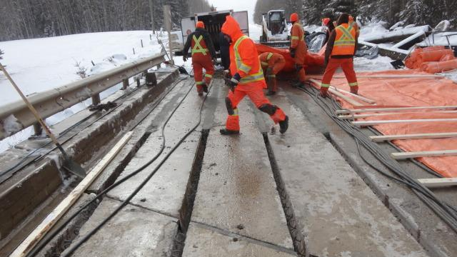

Slide 61
Deck Rideability
A measure of the riding comfort at the legal speed
Influenced by the condition of the wearing surface or deck top and joints (rated separately)
Drive over at legal speeds and assess ride quality
Listen for unusual noise from traffic
Observe traffic for signs of poor rideability such as slowing down or bouncing
Smooth, no speed reduction rate 7 or more
If speed has to be reduced due to potholes, etc. - rate 4 or less
Slipperiness reduces rating

Slide 62
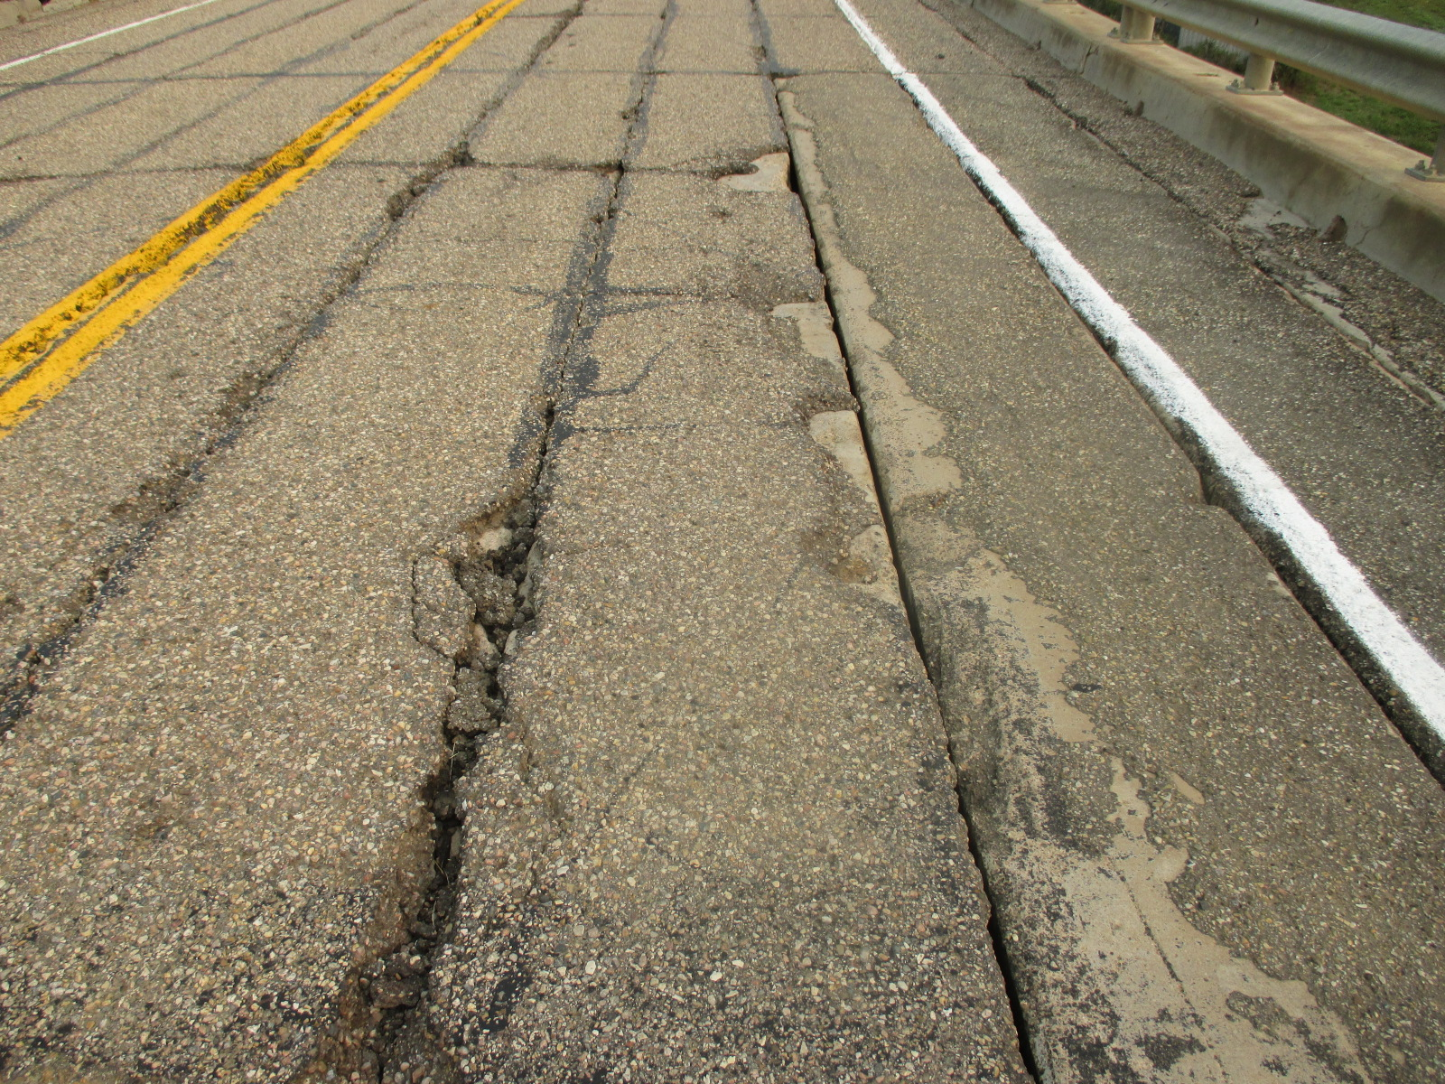
Hazardous Wear Surface due to failing ACP

Slide 63
Deck Joints
Purpose
Provide a structural termination of individual spans
Can be designed to prevent water and salt from leaking down onto substructure
Protects ends of precast girders (buffer angles)
Can be designed to span gap between spans
Provide a smooth transition (reduces bumps)
On standard bridges all joints are considered fixed.
Not applicable to standard TT bridges

Slide 64
Deck Joints
Standard Bridge Types
Buffer angles - steel angles cast into top edge at ends of girder
Compression seal - a compressible seal held in place by steel angles
Strip seal installed at piers of overlays
Others - caulked saw cuts, asphaltic plug joint (Koch or Thorma-joint)
Asphalt fiber board alone is not a joint – rate X
Unprotected girder ends is not a joint – rate X

Slide 65
Deck Joints
Observe traffic crossing over joints
Listen for unusual noises
Watch for movement
Look for:
Vertical alignment
Corrosion
Deteriorating concrete around anchorages
Damage from snowplow
Indicate whether or not a significant bump by Yes or No
If “Yes”, explain location and cause

Slide 66
Deck Joints
Buffer angles should not be rated down because they leak
Damage from leakage rated in substructure
Slightly less than adequate but no maintenance required – rate 4 (missing section of buffer angle)
Joints requiring repair – rate 3
Joints which are a hazard to traffic - rate 2 or less
If joint is not visible:
Rate “X” if it is known that no joint exists
Rate “N” otherwise
Provide explanation

Slide 67
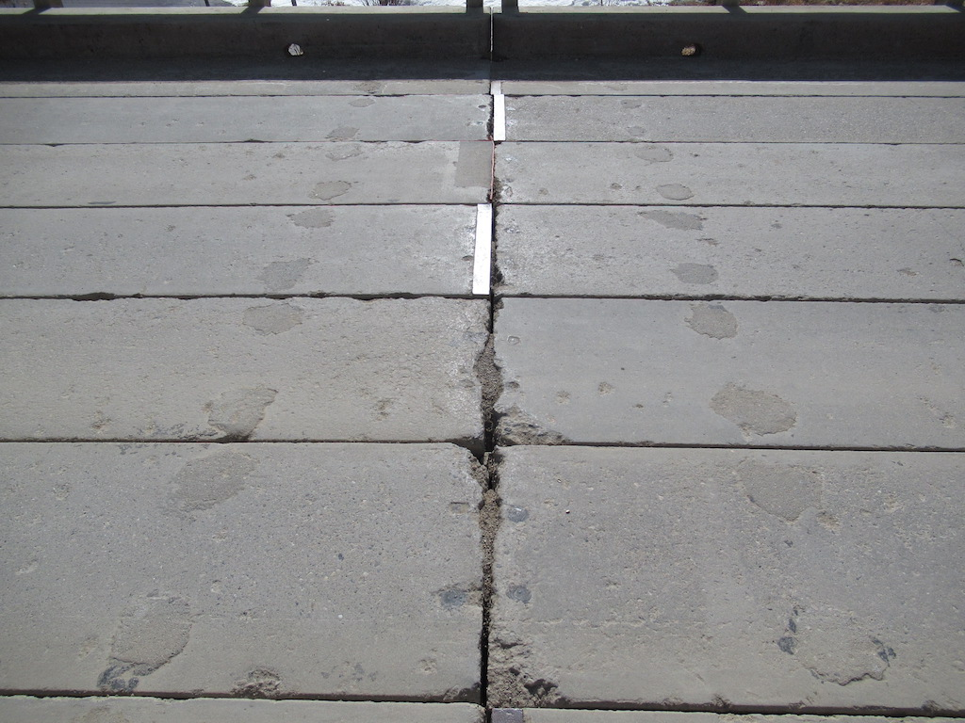
Missing Buffer Angles – Rated 5

Slide 68
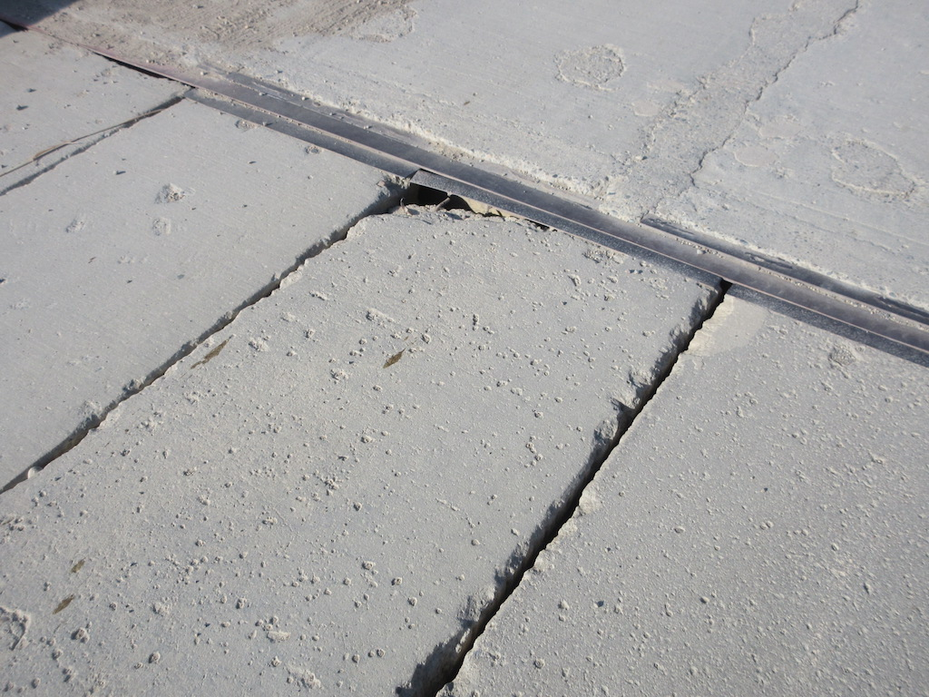
Void under Buffer Angle – Rated 3

Slide 70
Deck Drainage
Ability of the deck to drain and properly dispose of water from its surface
Not applicable to bridges with timber decks
Drainage system includes gutters, inlet boxes, pipes and catch basins

Slide 71
Deck Drainage
Poor drainage
Common cause of deck deterioration
May be hazardous due to hydroplaning or icing
Caused by inadequate design, construction or maintenance practices (grade, crown, debris, etc)
May affect other superstructure components, substructure, headslopes and sideslopes

Slide 72
Deck Drainage
Indicate whether or not the drains are plugged by Yes or No
If no drains, note in Explanation of Condition
Check drainage system - determine if water is properly directed off deck
If there are any deficiencies in the drainage system or significant deterioration of any components - rate 4 or less
If erosion is being caused on the headslopes or sideslopes by deck drainage - rate 4 or less
If water is ponding on deck and creates a hazard for traffic - rate 2 or less
Not a factor on timber decks therefore rate X

Slide 73
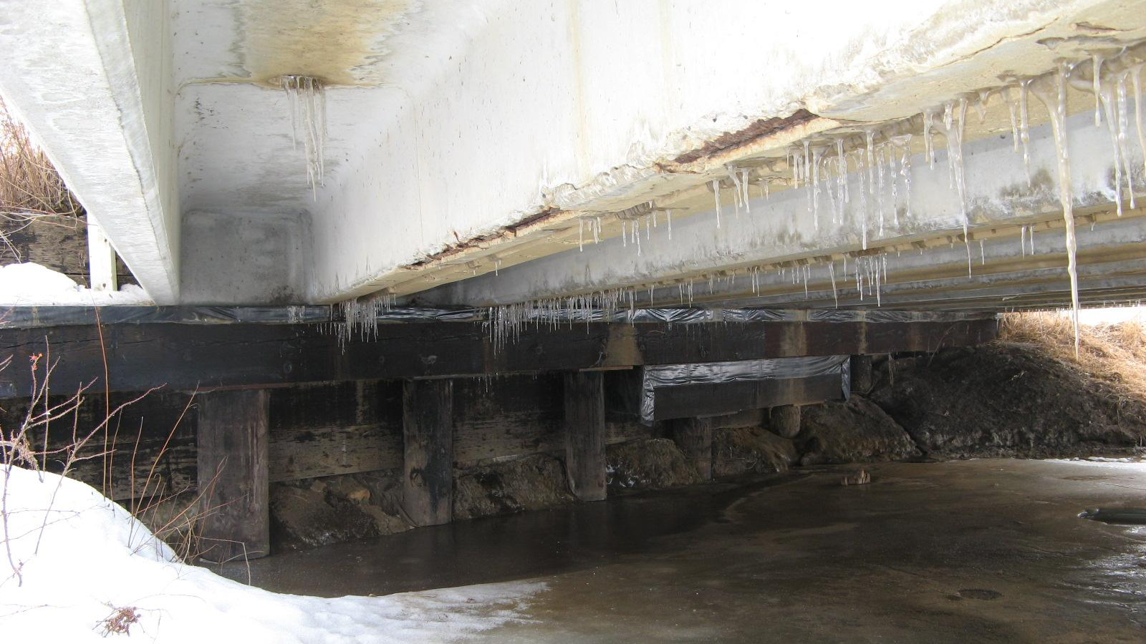

Slide 74
Curbs/ Medians
Raised surface at the edge of the roadway
Purpose
Guide or redirect traffic
Divide the bridge according to travel direction
Anchor railing posts
Applies to concrete only - timber or steel called wheel guards

Slide 75
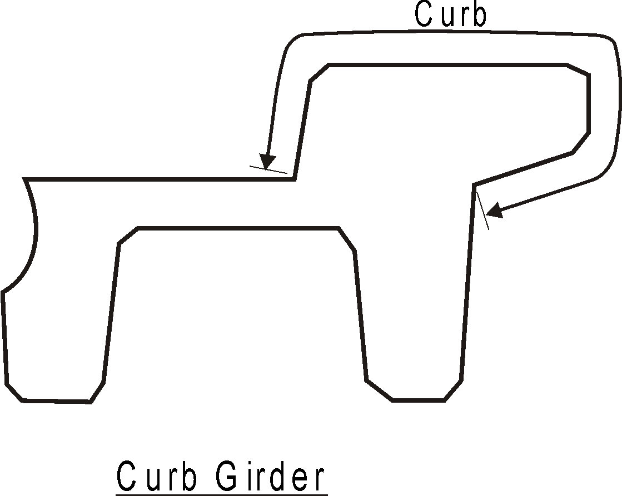
Curbs/ Medians
Curb consists of:
the vertical or sloped face along the edge of the roadway
the raised horizontal surface
the fascia or outside surface down to the deck or girder level

Slide 76
Curbs / Medians
Look for:
Scaling
Other material defects - cracks, delaminations, spalls
Snowplow damage along inside faces
Accident damage
Holes exposing the voids
Water in voids and associated freezing damage
Whether curb lift hook pockets are filled
Estimate the amount of scaling as a percentage of the total area
Record the percentage in the appropriate field
Describe the extent and location in the Explanation of Condition
Scaling is not normally a problem on gravel roads unless using calcium chloride for dust control

Slide 77
Curbs / Medians
Note any loss of height due to excessive roadway paving or accumulation of dirt or gravel
Rate according to condition and ability to perform as designed
Condition of concrete
Ability to withstand and redirect traffic
Ability to contain railing anchors in the event of a collision
Curbs with holes or exposed voids allowing water - rate 4 or less
Severe scaling (>25 mm deep) - rate 4 or less
Reduced height (>25%) due to excess gravel or overlay – rate 4 or less
Spalling or broken concrete affecting post anchorage - rate 3 or less

Slide 78
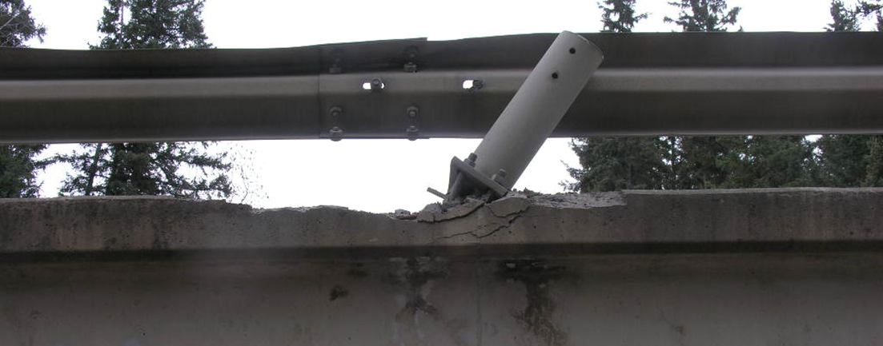
Curb and Post rated 3

Slide 79
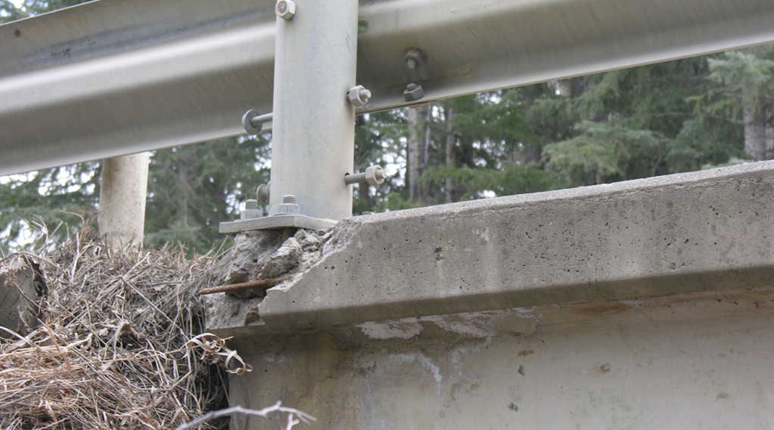
Curb and Post Rated 3

Slide 80
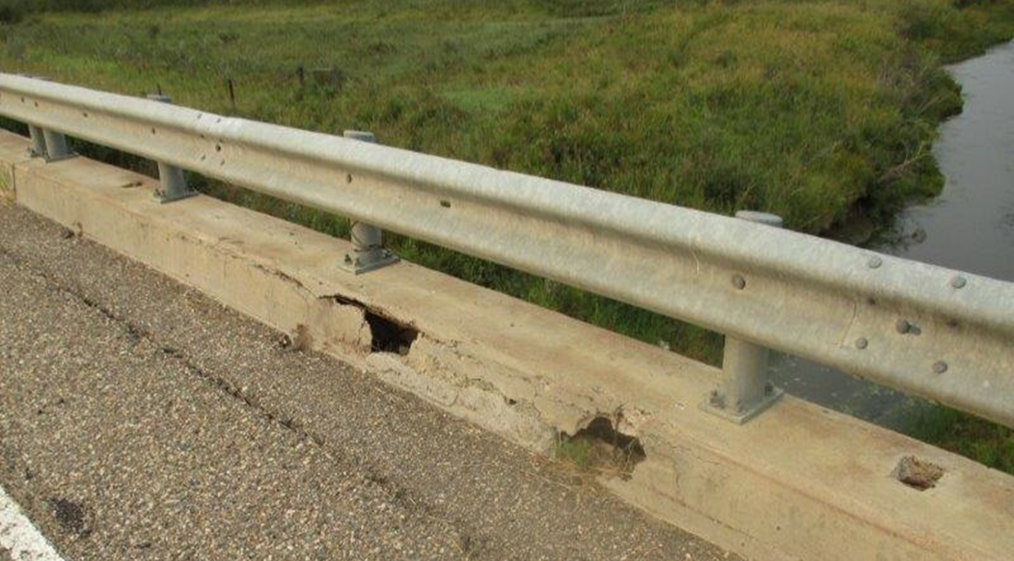
Curb holes – Rated 3

Slide 81
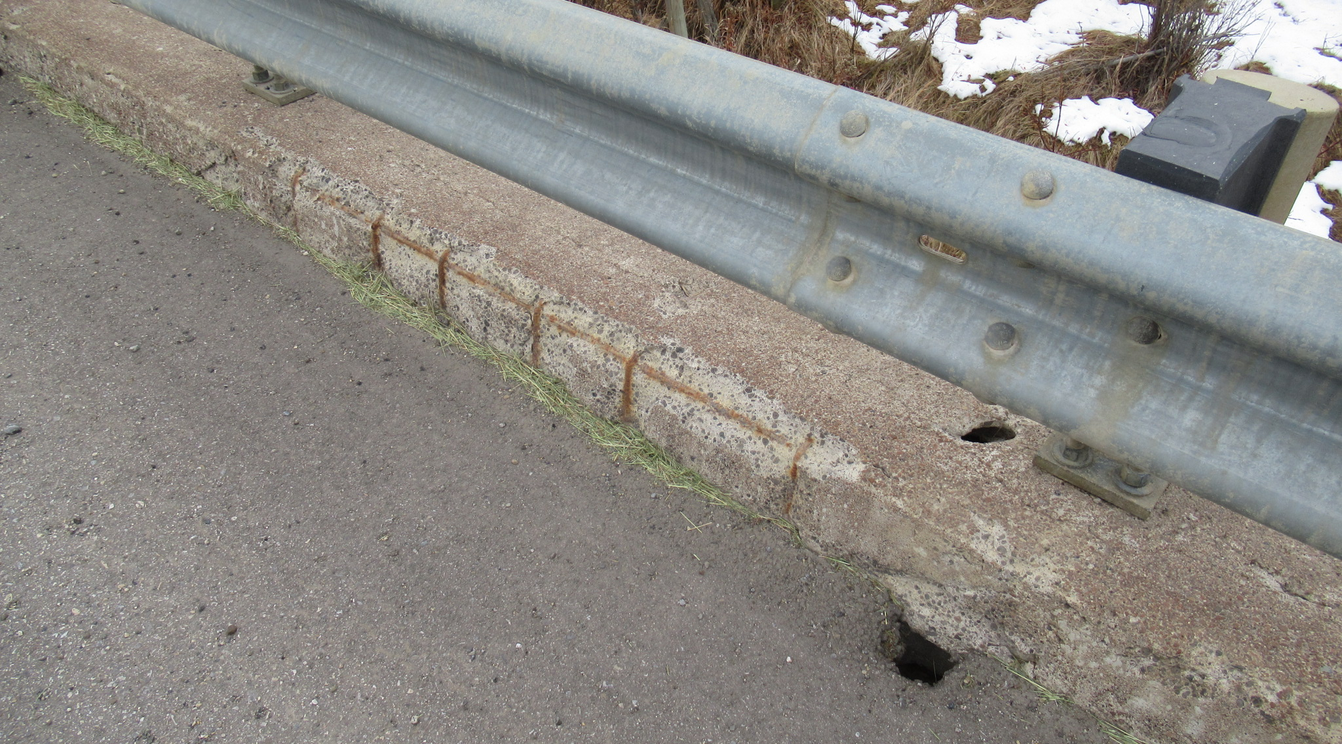
Curb hole rated 3

Slide 82
SC Girder Deterioration at Plinth
Curb is rated “X” in the example
Plinth deterioration is rated under bridgerail post section on form.

Slide 83
Wheel Guard
Curbs made out of timber or steel
Found on timber decks
Verify type, height and width
Record in nominal dimensions (typ. size is 100 x 300 or 150 x 300 but some variations)
Revise as req’ in inventory area on form
Add this information if missing
Record wheel guard block dimensions in comments area if needed

Slide 84
Wheel Guard
Look for:
Poor anchorage
Material defects
Missing or loose bolts
Poor connections
Mis-alignment
Collision damage
Snowplow damage
Missing sections
Note any loss of height due to roadway paving or accumulation of dirt or gravel
Rate according to condition and ability to perform as designed
Minor splits/cracks rate 5
Missing/broken sections, blocks, anchors rate 4 or less

Slide 85
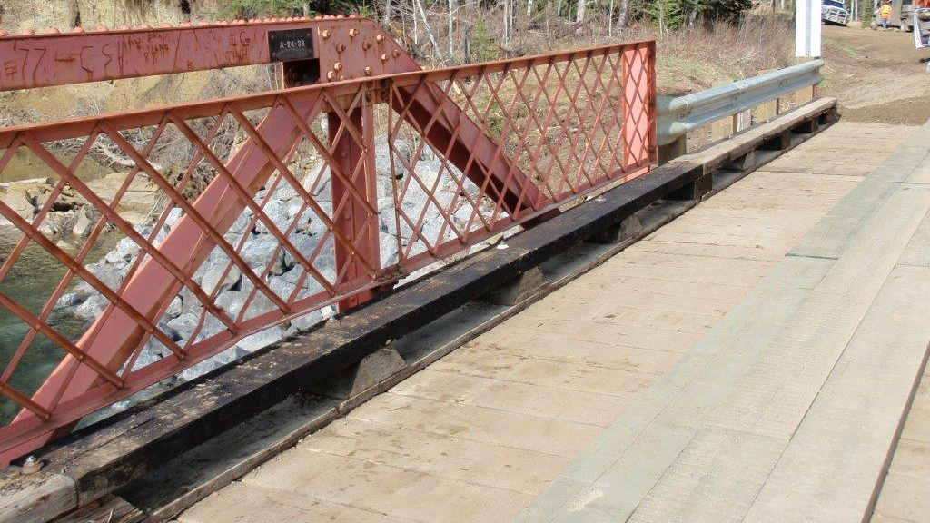

Slide 86
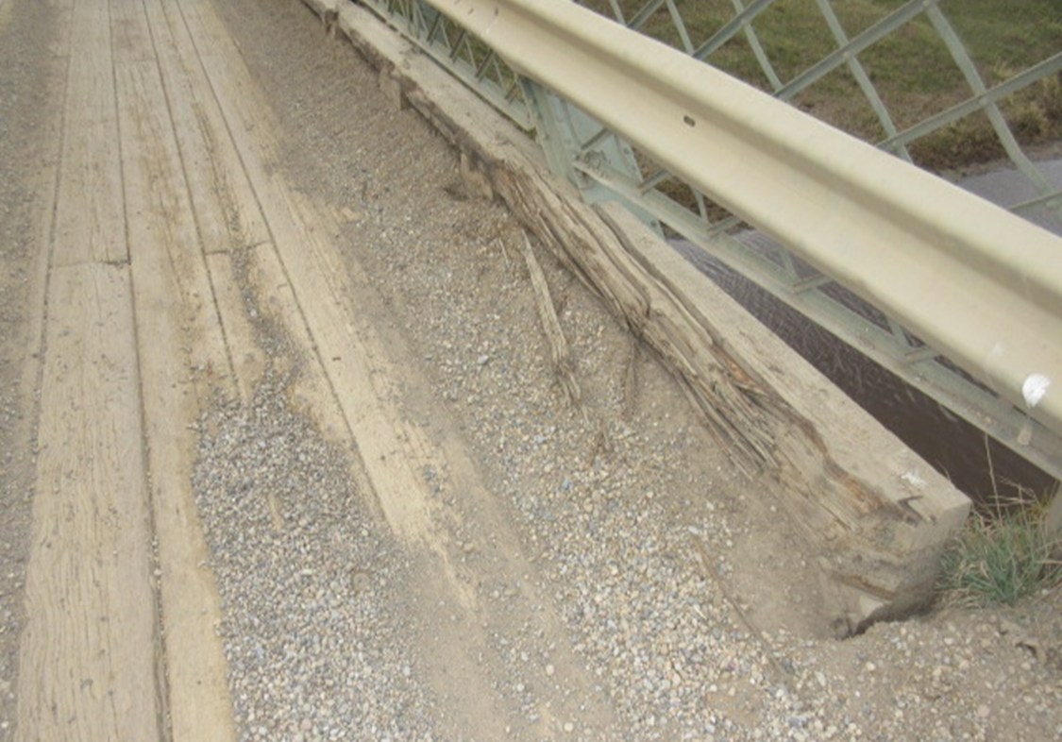
Grader damage to TT Wheelguard – Rated 4 or less

Slide 87
Bridge Rail & Posts
Considered to be safety features
Do not contribute to the strength or load carrying capacity of the bridge
Refer to Section 7.11.2 in the manual for a list of railing and post types
Verify railing and post types – correct/add in inventory area
Record coating type on rails and posts
Record number of layers of flexbeam in comments

Slide 88
Bridge Rail & Posts
Look for:
Material defects (corrosion, cracks)
Collision damage
Horizontal and vertical misalignment
Loose connections
Missing nuts or bolts
Inadequate thread engaged on post anchor nuts (< 2 threads projecting)
Broken or spalled post anchors
Correct lap direction of flexbeam
lapped in direction of traffic
Includes pedestrian rails found on sidewalks

Slide 89
Bridge Rail & Posts
Rate according to condition and not the standard of the rail, posts or coating
Timber rail is substandard but can be rated 9 if in new condition
Timber posts with wrong orientation
Rating for rail and posts does not include the condition of the coating – rated separately unless severe corrosion affecting rail/post
If coating on rail and posts is different, record and rate rail coating. Note post coating type and condition in Comment area
Railing with minor collision damage but still functional and has good connections rate 5
Timber with signs of rot rate 4 or less
Rail connections with missing/loose bolts, improper laps, rate 4 or less
Railing with missing sections - rate 2 or less

Slide 90
Bridge Rail & Posts
Post anchor bolts with at least two threads above the nut rate 8 or more
Post anchor bolts that are engaged with full/flush nut (no thread projection above the nut) or <2 threads projecting above nut rate 7
Post anchor bolts with insufficient thread (negative thread projection) rate 4 or less
Post anchors that are broken or missing anchor nuts and bolts rate 3 or less

Slide 91
Bridge Rail & Posts
For Bridgerail posts on SC Girders:
Concrete section loss that does not extend to edge of post base plate – Rate 3.
Concrete section loss extending up to or below edge of post base plate – Rate 2.
Exposed exterior stirrups within 500 mm longitudinally of bridgerail post – Rate 2.

Slide 92
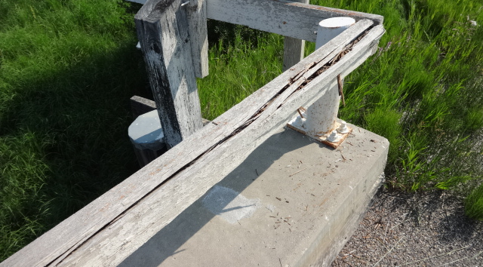
Rotted Timber rail – Rated 3

Slide 93
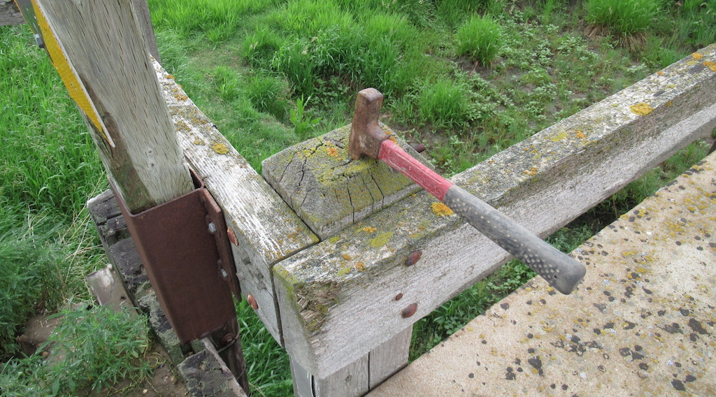
Rot in top of timber rail post – Rated 4

Slide 94
Missing bridgerail section – Rated 2

Slide 95
Missing Rail and Posts – Rated 2

Slide 96
New W-beam Rail – Rated 9

Slide 97
Missing Splice Bolts – Rated 4

Slide 98
Anchor bolts with 2 or more threads projecting above nut – Rated 9

Slide 99
Anchor bolts with flush or < 2 threads projecting above the nut – Rated 7

Slide 100
Anchor bolts with flush or < 2 threads projecting above the nut – Rated 7

Slide 101
Anchor bolts - insufficient thread projection above nut – Rated 4

Slide 102
Loose anchor bolt nuts – Rated 4

Slide 103
Missing anchor bolt nut – Rated 3

Slide 104
SC Girder Deterioration Affecting Post Anchorage – Post Rated 2.

Slide 105
SC Girder Deterioration Affecting Post Anchorage – Post Rated 2

Slide 106
Typ. TT wheelguard, TT posts, galv. rail

Slide 107
Sidewalk
Applicable to PCS bridges
Designed to accommodate pedestrian traffic
Not normally part of the load carrying system of the bridge
If part of the load carrying system, rating & inspection procedures are similar to “Deck Top” and/or Girder”

Slide 108
Sidewalk
Look for:
Smoothness, adequate traction and debris
Accessibility for pedestrians to the sidewalk at both ends of the bridge
Material defects
Condition of structural members and connections
Condition of railings (rate under bridge rail)
Hazards to pedestrian traffic (tripping, slipping, holes, loose boards, etc.) rate 2 or less
Rate according to condition and ability to perform as designed
Rail systems rated with Bridgerail
Some defects may be less serious on a sidewalk than on the bridge

Slide 109
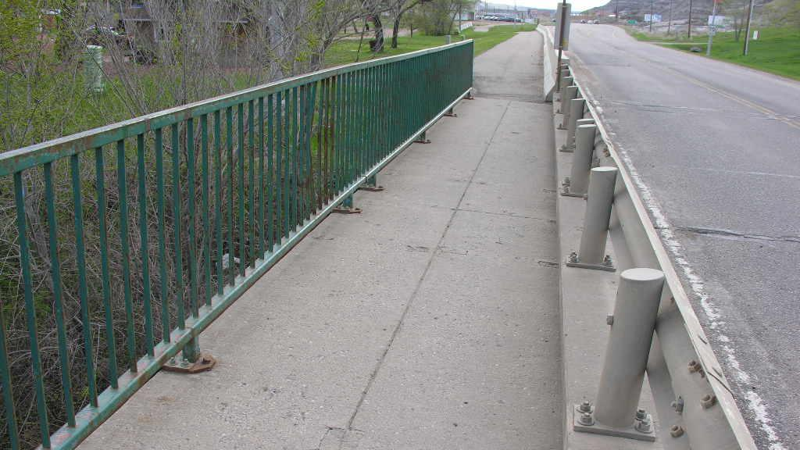

Slide 110
Subdeck
Applies only to Standard TT bridges
The “structural” part of the deck
Strip deck usually installed on top to protect
If no wearing surface, subdeck is in contact with traffic
Consists of timber planks fastened to stringers
Often only visible to inspect at underside and ends
Verify type and revise or add as needed
Record in Inventory area of form.
Record nominal width and thickness – normally 100 x 300mm

Slide 111
Subdeck/Underside
Look for:
Material defects
Loose or broken planks
Deflection under traffic
Estimate the percentage of the area which has defects and record value
Decay, staining, split or broken planks
Minor stains/cracks (concrete) rate 5
Spalls or severe scaling rate 4
Rot/Decay in timber rate 4 or less
Note location in Manual – Section 7.21

Slide 112
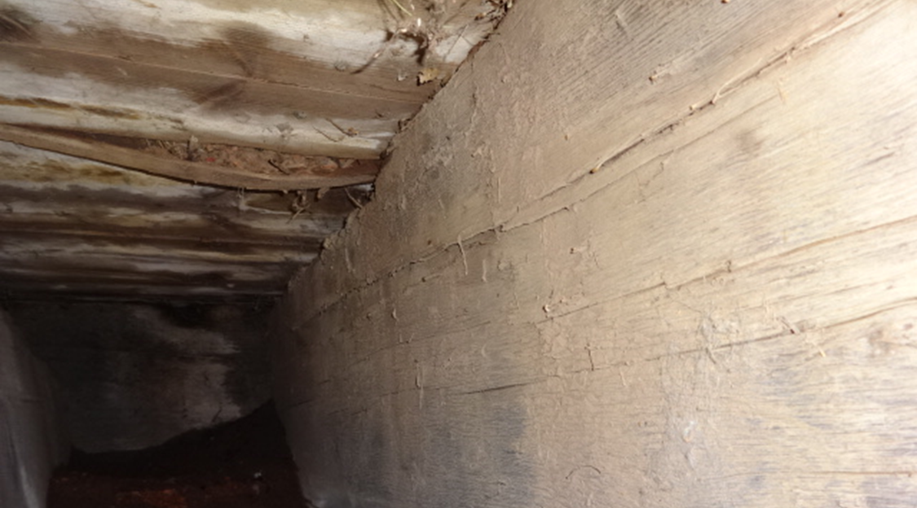
Rot/bulging in Subdeck – Rate 3 or less

Slide 113
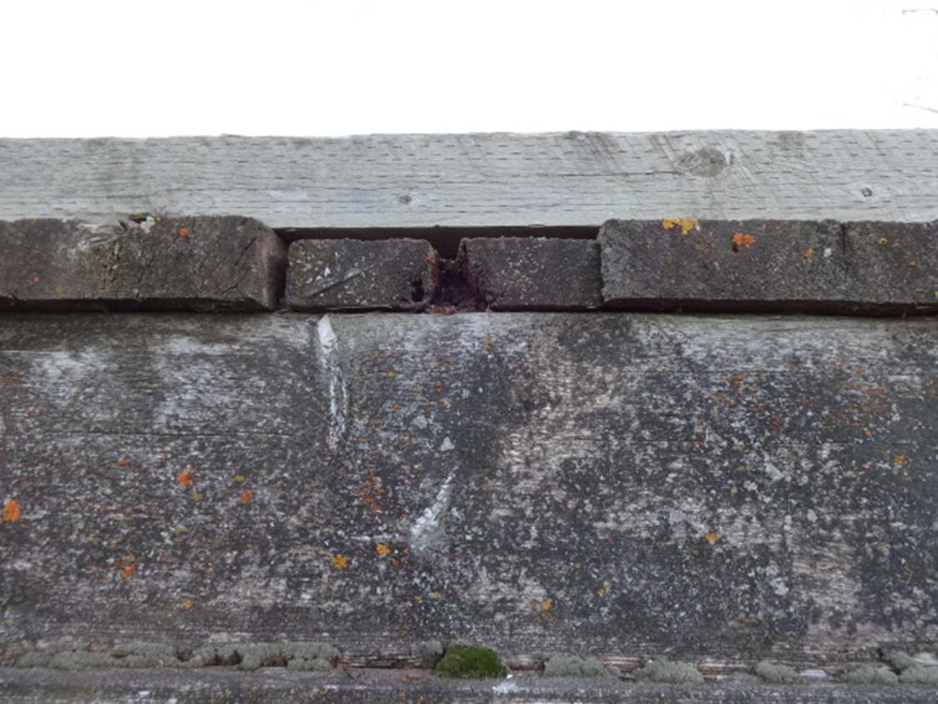
Rot in Subdeck Ends – Rate 4 or less

Slide 114
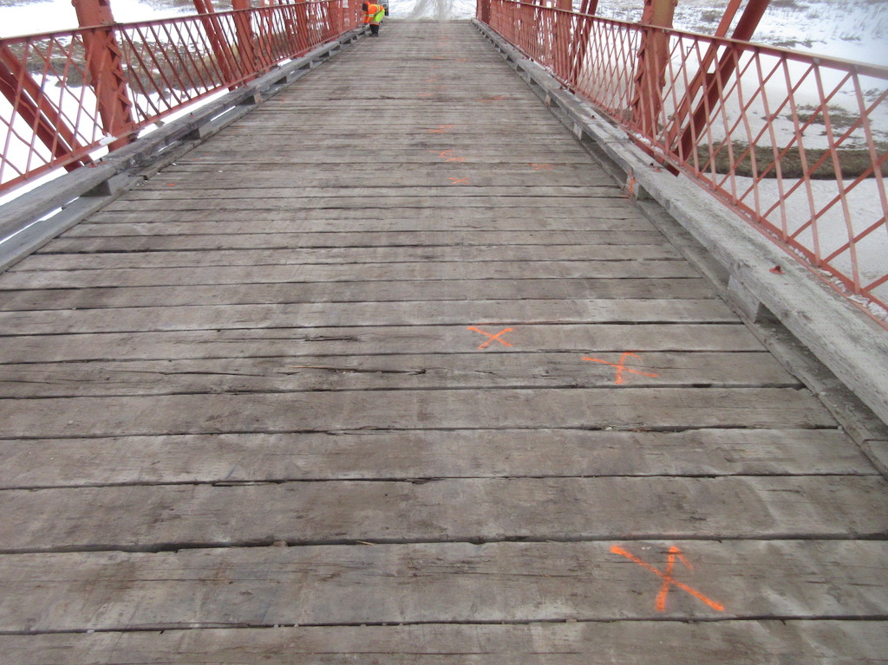

Slide 115
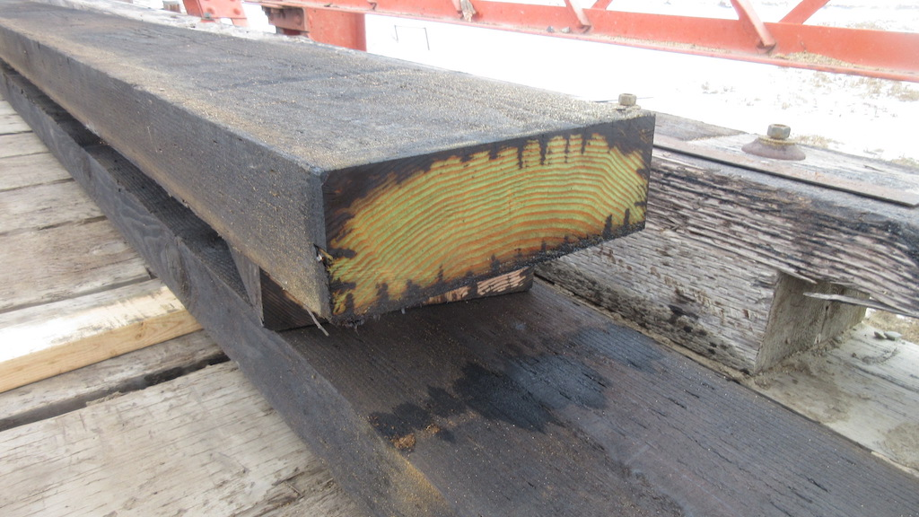

Slide 116
Stringers
Applies only to standard TT bridges
Longitudinal beams resting on the caps and supporting the deck
The main load carrying members of the superstructure
Verify number per span or add if missing
Verify type, size (width and depth), and spacing in nominal dimensions and record in Inventory area of form
Superstructure
(No. of Stringers : )
Stringer Detail Ratings
Stringers
(Type : )
(Width (mm) : )
(Depth (mm) : )
(Spacing (mm) : )

Slide 117
Stringers
Purpose:
Support the deck
Transfer loads to substructure
Critical load carrying members
Repaired or “sistered” stringers count as one stringer (repair must be with equivalent size stringer)
Record if stringers are notched including location

Slide 118
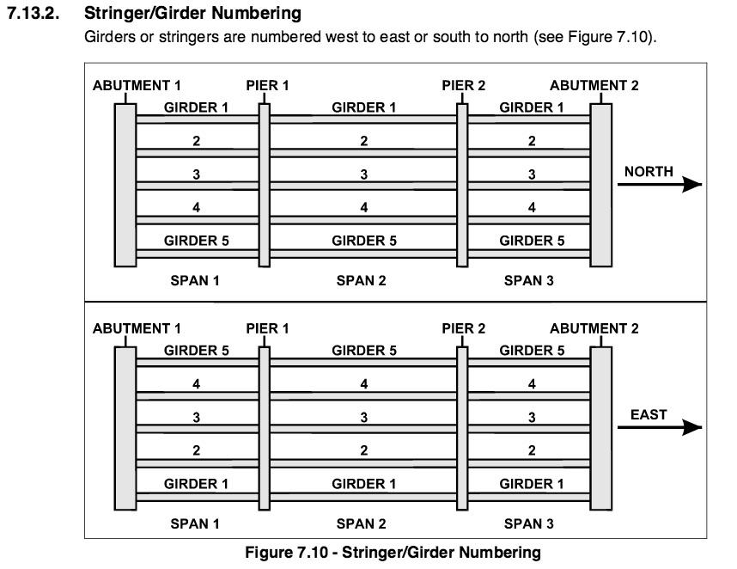
Stringer and Girder Numbering

Slide 119
Stringers
Look for:
Material defects
decay, cracks, checks, fire damage, sags, twists
Broken or missing stringers
Adequate bearing, proper connections and any splitting, crushing or decay in bearing area
Collision damage or abrasion from ice or drift
Notches at ends in bearing zone

Slide 120
Stringers
Cracked stringers rate 3 or less
Stringers with less than 75 mm bearing on the cap rate 3 or less
Stringers with 75 -100 mm bearing on the cap rate 4
Stringers that are bowed or twisted significantly - rate 4 or less
Cracked or broken stringers which have been repaired with additional stringer(s) of equal size may be rated 5 or more
Stringers with notches at ends - rate 7 or less and note in comments area
Record number of stringers rated N, 1, 2 & 3 in Detailed Rating boxes. If number cannot be determined, record as 99
If all stringers are rated 4 or more, Detail Ratings are recorded as ”0”

Slide 121
Rotted subdeck & rotted/cracked timber stringer. Both rated 3 or less.

Slide 122
Cracked Timber Stringer –Rated 3

Slide 123
Cracked Timber Stringer – Rated 3

Slide 124
Cracked Timber Stringer – Rated 3

Slide 125
Notched Timber Stringers – Rate 7 or less. Cracked Stringer Rate 3

Slide 126
Girders
Applies only to concrete girder bridges
Longitudinal beams resting on caps
The main load carrying members of the superstructure
The deck is integral with the girder
Detail ratings only on PCS
Last Complete Inspection Date
Superstructure
Girder Detail Ratings
Girders
Last Complete Inspection Date
Cracking (Y/N)
Spalling (Percent Area)
Lift or Connector Pocket
Grouted (Y/N)
(Number Of Girders : )

Slide 127
Girders
Purpose:
Support the deck
Transfer loads to substructure
Two types in Standard bridges – PCS form used for both
Channel Girders - conventionally reinforced channel girders
Standard Prestressed – short box girders with pre-tensioned reinforcement
Refer to BIM Reference Manual for types of girders

Slide 128
Girders 1.1 from BIM Manual

Slide 129
Girders
Cracks are often the first visible sign of distress or failure
Types of cracks:
Vertical hairline cracks on precast channel girders - common not serious
Vertical cracks in the tension zone – flexure – usually not serious unless wide
Diagonal cracks near supports - shear or combination of shear and flexure, can be serious
Longitudinal cracks in bottom of legs in precast girders – common, corrosion of rebar
Wide longitudinal cracks in bottom of legs with corrosion may lead to spalling
Longitudinal cracks in ends of prestressed girders - stresses from pre-tensioned reinforcement
Wide longitudinal cracks with corrosion in girder undersides of prestressed girders may be from strands and is usually serious.
128

Slide 130
Girders
Look for:
Cracks
Spalling on bottom of legs
Other defects - scaling, staining, etc.
Damaged connectors - deteriorating grout, loose or broken bolts, corrosion on bolts or connector channels
Spalls at dowel locations
Collision damage or abrasion from ice or drift
Punchouts in deck
Look for excessive vibrations or deflections under traffic
Observe whether girders with lateral connections deflect independently

Slide 131
Girders
Indicate cracking by Yes or No
Applies to all types except shrinkage and hairline or narrow flexural cracks
If Yes explain - location, type, size
Mark and date cracks
Record the percentage of spalling on the bottom of the legs
Record 0% if none
Explain if any
Indicate Lift or Connector Pockets Grouted
Yes or No
If Yes provide coment to explain
Verify total number of girders or record number per span if blank

Slide 132
Girders - Rating Guide
Standard reinforced channel girder rating guidelines in Section 7.15.3 –Section 7.15.3.5 and are summarized Table 7.4
Standard prestressed girder ratings in Section 7.15.4 – 7.15.4.4 and summarized in Tables 7.5, 7.6 and 7.9
Rating guidelines for BOTH types 7.14.1 – 7.15.2.7
Ratings given are maximums - decrease as required depending on defect
Reflect condition and functionality
Defect on curb girder only, can increase rating by one if traffic not on girder
Provide girder count for N, 1, 2 & 3 ratings
If girder ratings are 4 or above detail ratings are “0”

Slide 133
Rating Guide – Table 7.4 Standard Reinforced Girders

Slide 134
Rating Guide - Standard Reinforced Concrete Girders

Slide 135
Spall in AZ with <50% of bars embedded in sound concrete – Rated 2.

Slide 136
Spall in AZ with <50% of bars embedded in sound concrete – Rated 2.

Slide 137
Spall in AZ of curb girder with <50% of bars embedded in sound concrete – Rated 2 + 1 = 3

Slide 138
Narrow shear crack – Rated 5

Slide 139
Multiple narrow shear cracks – Rated 5

Slide 140
Spall in end diaphragm extending into legs – Rated 2

Slide 141
Spall in AZ with heavy corrosion and broken shear stirrup – Rated 2

Slide 142
Spall in AZ with heavy corrosion and broken shear stirrup – Rated 2

Slide 143
Spalling in AZ with heavy corrosion and deterioration of deck / girder underside – Rated 3

Slide 144
Delamination / partial punchout at girder underside – Rated 3 or less.

Slide 145
Full depth punchouts at girder underside – Rated 3 or less.

Slide 146
Rating Pre-stressed Girders
Refer to Sections 7.14 to 7.14.3 for general information.
Refer to Section 7.15.4 to 7.15.4.3 for specific information.
Summarized in Tables 7.5, 7.6, and 7.9
Suggest using “3-strike” rule to determine ratings for pre-stressed girders.
Start with Table 7.9 – Exception List for common standard prestressed girder types (VS, SM, SC, SL).
Note that crack width must be narrow – reduce by 1 if corrosion staining is present.
If defect in field matches description in Table 7.9 then rate accordingly.
Refer to Table 7.6 – Exception List for ALL Pre-stressed Girders.
If defect in field matches description in Table 7.4 then rate accordingly.
3. Refer to Table 7.5 – rate accordingly

Slide 147
Rating Guide for Prestressed Girders – Table 7.9 Exception List - SL, SC, SM, VS
Crack | Rating | Description
1 | 5 | Diagonal crack on bottom of girder, not longer than 0.5 m. Crack length must be continuous and not intermittent or staggered. Crack lengths to be measured from the face of the pier cap or abutment seat and along the length of the crack (with no signs of corrosion staining).
 | 3 | Diagonal crack on bottom of girder, not longer than 0.5 m. Crack length must be continuous and not intermittent or staggered. Crack length to be measured from the face of the pier cap or abutment seat and along the length of the crack (with signs of corrosion staining).
2 | 5 | Longitudinal crack on girder underside.
3 | 5 | Longitudinal crack at lower curb fascia.
4 | 5 | Crack in poured connection at fascia over piers (RM, RD,SMC, SCC, SCM, SLC).

Slide 148
Rating Guide Table 7.6 Exception List for ALL Prestressed Girders
Exception List - All Prestressed Girders
Crack | Rating | Description
1 | 6 | Narrow map cracks.
 | 4 | Medium, wide or any map cracking with corrosion staining.
2 | 3 | Vertical crack 50 to 100 mm from end of girders with or without signs of corrosion stains. No further rating reduction applied for presence of stains

Slide 149
Rating Guide for Prestressed Concrete Girders – Table 7.5
Rating | Defects
4 | Hairline cracks with no staining except as noted below.
3 | All other cracks except as noted below. Corrosion stains originating from prestressed strands.
2 | Cracks with signs of corrosion in webs or bottom of boxes or flanges except as noted below. Any cracks which are growing
1 | Any cracks which are opening or closing under traffic or with slippage along the cracks.

Slide 150
Typical Diagonal Cracks & Narrow Longitudinal Cracks – Rated 5

Slide 151
Medium or wide longitudinal crack, no corrosion. Rated 3

Slide 152
Wide longitudinal crack, no corrosion staining. Rated 3

Slide 153
Wide longitudinal crack, with corrosion. Rated 2

Slide 154
Narrow longitudinal crack with corrosion. Rated 4

Slide 155
Narrow longitudinal crack with no corrosion. Rated 5

Slide 156
Partial depth repair of prestressed box girder. Note location of strand inside of rebar.

Slide 157
Minor Corrosion Spots – No Affect on Rating

Slide 158
SC Girder Deterioration
AT first learned of problem in 2012
6 SC girder bridges showing signs of accelerated freeze thaw deterioration on exterior girders.
Investigation revealed deterioration due to substandard aggregates in concrete mixes used in girders fabricated 2003-2007
88 SC girder bridges built in this time frame
36 of 88 bridges now showing deterioration with various degrees of severity.
16 - significant premature deterioration
20 - deterioration may soon become severe
Severe deterioration typically on exteriors especially if exposed to direct sunlight but interior girders are also affected

Slide 159
SC Girder Deterioration
Issues include:
failure of the concrete plinth where bridgerail post anchors into exterior girder,
reduced structural capacity of the exterior girders due to loss of concrete and reinforcing steel embedment,
signs that damage to the tops of girders may soon become a concern for sites with no wearing surface.

Slide 160
SC Girder Deterioration Ratings

Slide 161
SC Girder Deterioration
Extensive scaling exterior girder surfaces , section loss along top and bottom corners.
No exposed stirrups or prestressing strand.
Section loss of Bridgerail post plinth.
Girder rated 3.
BR posts rated 3.

Slide 162
SC Girder Deterioration
Section loss along top and bottom corners of exterior girder.
Girder rated 3.
Bridgerail posts rated 3.

Slide 163
SC Girder Deterioration
Section loss along top corners and top surfaces of interior girders.
Interior girders rated 3.

Slide 164
SC Girder Deterioration
Significant section loss all surfaces extending beneath bridgerail post baseplate.
Exposed stirrups.
Exterior girder rated 2.
Bridgerail posts rated 2.

Slide 165
SC Girder Deterioration
Scaling of exterior face, section loss on top and bottom corners extending beneath the bridgerail post bases.
No exposed strands or stirrups.
Exterior girder rated 3.
Bridgerail posts rated 2.

Slide 166
SC Girder Deterioration
Section loss at top corner of exterior girder that does not extend to the edge of the bridgerail post base plate.
Aggregate popouts on exterior face.
Concrete section loss of bridgerail plinth.
Girder rated 3.
Bridgerail post rated 3.

Slide 167
SC Girder Deterioration – Management Strategy

Slide 168
Span Alignment Problems
Applies only to
the vertical and horizontal alignment of the superstructure
No rating is required
Mis-alignments may indicate distress in the superstructure and/or substructure
Superstructure
Last
Now
Vertical (Y/N)
Horizontal (Y/N)

Slide 169
Span Alignment Problems

Slide 170
Span Alignment Problems
Look along edges of girders, curbs, railing for signs of sags, bows, movement, buckling, twisting, etc.
Look for vertical mis-alignment and uneven gaps at deck joints
Indicate vertical and horizontal alignment problem by Yes or No
If Yes, provide an explanation of the location, type, possible cause and seriousness

Slide 171
Span Alignment Problem - Vertical

Slide 172
Span Alignment Problem - Horizontal

Slide 173
General Rating
Refer to Sections 1.10.2 and
Governed by
Structural load carrying members (girders, stringers, subdeck)
Safety concerns rated 2 or less (e.g. missing bridgerail, severe bump, severe span alignment problem)
Hazardous conditions rate 2 or less (e.g. ponding/icing, wide ACP cracks/ruts in wheelpath)
Bridgerail not present (rated X) but creating a hazard results in General Rating of 2

Slide 174
Questions?

