Slide 1
Maintenance and Rehabilitation of Culverts
Maintenance and Rehabilitation
of Culverts

Slide 2
Maintenance and Rehabilitation of Culverts
Introduction
Widely used, started in 1950
  low cost alternative to bridges
  road system expansion in 60s and 70s
Installed by road builders
  local road authorities
  district forces
Designs by Bridge Engineering then Regional Bridge staff

Slide 3
Maintenance and Rehabilitation of Culverts
Technical Developments
Early history - many problems
  spectacular uplift failures
  undersized
  deformation and cracking
Need for quality backfill and compaction not recognized
Importance of end treatments

Slide 4
Maintenance and Rehabilitation of Culverts
Culvert Inspection
Regular inspection initiated in mid-80s
  before major problems or failures reported
inspection provides early detection of changes
most defects develop slowly
poor backfill often detected at first inspection
As constructed records shape at ends, quarterpoints and middle

Slide 5
Maintenance and Rehabilitation of Culverts
Structural Problems
Include:
  Deformation
  Cracked seams
  Corrosion
Usual causes
  poor quality backfill
  frozen backfill
  poor compaction
  poorly prepared foundation
  corrosive environment
  piping

Slide 6
Maintenance and Rehabilitation of Culverts
Structural Problems
Deformation
Heaving floors
Bulging walls
Sagging roof
Severity measured as percent of design shape
Contributing factors
  backfill low shear strength
  culvert material low bending strength
  load carried in ring compression and soil-steel interaction

Slide 7
Maintenance and Rehabilitation of Culverts
Structural Problems
Cracked Seams
Primary cause is deformations
  sometimes deformations small; 5%
  may occur at one or more seams
Contributing factors
  incorrect laps
  Over or under torquing bolts
  improperly curved plate
Severity measure
  number of seams cracked
  location of seams
  remaining steel between cracks

Slide 8
Maintenance and Rehabilitation of Culverts
Structural Problems
Corrosion
Corrosion
  electrochemical process that converts metal to natural state
Environmental requirements
  differences in potential
  electrolyte
  oxygen
Corrosion types
  electrolytic
  galvanic
Severity measure
  percent rust pitting or perforation
  static potential

Slide 9
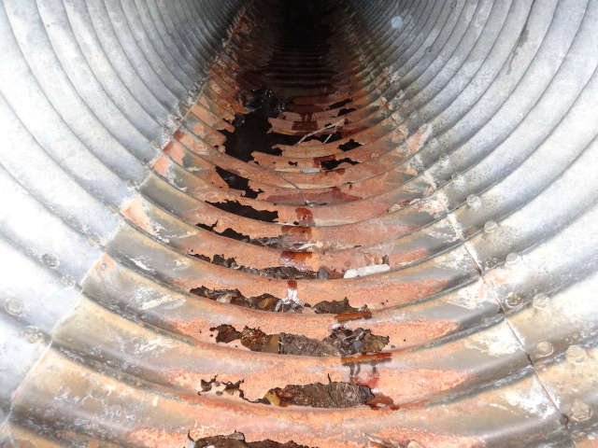
Maintenance and Rehabilitation of Culverts
Waterside Corrosion on Culvert Floor

Slide 10
Maintenance and Rehabilitation of Culverts
Soil-Side Corrosion Damage

Slide 11
Maintenance and Rehabilitation of Culverts
Corrosion
Electrolytic corrosion
  caused by external stray currents
  other cathodic systems
  overhead power lines
Galvanic corrosion
  materials of different potential in an electrolyte
  impurities in metal
  differences in coatings
  surface defects
  moist soil good electrolyte
  generates own current

Slide 12
Maintenance and Rehabilitation of Culverts
Electrolytic Corrosion Mechanism

Slide 13
Maintenance and Rehabilitation of Culverts
Galvanic Corrosion Mechanism

Slide 14
Maintenance and Rehabilitation of Culverts
Repair and Maintenance
Monitoring
Strutting
Liners
Crack repairs
Cathodic protection
Concrete Floors
Extensions
Scour/Piping Repairs

Slide 15
Maintenance and Rehabilitation of Culverts
Monitoring
First option, low cost
  structure may stabilize
  Review BIM history
Provides ongoing record
  mark ends of cracks
  measure magnitude and location of deformations
  establish reference points
  photographs

Slide 16
Maintenance and Rehabilitation of Culverts
Strutting
Oldest, often cheapest method
Effective for extreme distress
Not suitable for drift and ice locations
Components
  vertical struts between sleepers
  cut to length, jacked in place
  timber or steel
Life 25 years

Slide 17
Maintenance and Rehabilitation of Culverts
Timber Strut with Adjustable Turn-screw

Slide 18
Maintenance and Rehabilitation of Culverts
Strut Layout for Horizontal Ellipse Culvert

Slide 19
Maintenance and Rehabilitation of Culverts
Timber Strutting of Metal Culverts

Slide 20
Maintenance and Rehabilitation of Culverts
Installing Struts

Slide 21
Maintenance and Rehabilitation of Culverts
Completed Installation

Slide 22
Maintenance and Rehabilitation of Culverts
Liners
Used when culvert cracked or corroded
Reduces hydraulic capacity
May increase velocities, back water
Not suitable for large deformations
Life 30 to 60 years

Slide 23
Maintenance and Rehabilitation of Culverts
Culvert Liners

Slide 24
Maintenance and Rehabilitation of Culverts
Liner Types
CSP culvert
  1.5m to 3.0m culverts
SPCSP
  larger than 3.0m culverts
  limited length
Tunnel liner
  large culverts and long length
Smooth wall pipe
  Generally less than 1.5m culverts

Slide 25
Maintenance and Rehabilitation of Culverts
Installing CSP Liner into Existing SPCSP Culvert

Slide 26
Maintenance and Rehabilitation of Culverts
Pulling Assembled SPCSP into Concrete Box Culvert

Slide 27
Maintenance and Rehabilitation of Culverts
SPCSP Liner Inside Concrete Box

Slide 28
Maintenance and Rehabilitation of Culverts
Victaulic Connector for Concrete Pump

Slide 29
Maintenance and Rehabilitation of Culverts
Installing Tunnel Liner Inside Culvert

Slide 30
Maintenance and Rehabilitation of Culverts
Tunnel Liner Ready for Grouting

Slide 31
Maintenance and Rehabilitation of Culverts
Concrete Floors
Repair severe perforations of invert
Reinforce cracked seams and sidewall deformation of arch culverts
Reduces hydraulic capacity

Slide 32
Maintenance and Rehabilitation of Culverts
Details of Concrete Floor for SPCSP Arch

Slide 33
Maintenance and Rehabilitation of Culverts
Reinforcing Steel Arrangement

Slide 34
Maintenance and Rehabilitation of Culverts
Concrete Floor Casts

Slide 35
Maintenance and Rehabilitation of Culverts
Floor and Sidewall in Place

Slide 36
Maintenance and Rehabilitation of Culverts
Crack Repair Methods
Stop drilling crack ends
welding cracks
reinforcing plates
  welded
  bolted
reinforced concrete
  arch culverts
shotcrete

Slide 37
Maintenance and Rehabilitation of Culverts
Shotcrete Reinforcing
Preferred method for repairing cracks
Stiffens joint and transfers ring compression
Sprayed over shear connectors and rebar
Not suitable for:
  small cracks
  severe corrosion
  large deformations

Slide 38
Maintenance and Rehabilitation of Culverts
Longitudinal Seam Reinforcing
Longitudinal Cross Section

Slide 39
Maintenance and Rehabilitation of Culverts
Pump and Mixer for Prewetting

Slide 40
Maintenance and Rehabilitation of Culverts
Detail of Reinforcing and Shear Connectors

Slide 41
Maintenance and Rehabilitation of Culverts
U-bracket Shear Connector

Slide 42
Maintenance and Rehabilitation of Culverts
Sandblast Equipment

Slide 43
Maintenance and Rehabilitation of Culverts
Heaters

Slide 44
Maintenance and Rehabilitation of Culverts
Reinforcing and Shear Connectors Ready for Shooting

Slide 45
Maintenance and Rehabilitation of Culverts
Shooting Concrete Mix

Slide 46
Maintenance and Rehabilitation of Culverts
Completed Crack Reinforcing Beam

Slide 47
Maintenance and Rehabilitation of Culverts
Cathodic Protection
Prevents corrosion
  impressed uniform potential
  anode sacrificed to protect structure
  soil side corrosion only
System types
  impressed current system
  passive system

Slide 48
Maintenance and Rehabilitation of Culverts
Cathodic Protection
Impressed current system
  20 to 60 volts and 4 to 16 amps
  available power on site, 120/240 AC
  power supply, anode bed, electrolyte
  life - 15 to 25 years
Passive system
  dissimilar metals create current and potential
  many magnesium anodes sacrifice to protect structure
  1 to 2 amps and 1 to 2 volts
  life - 15 to 25 years

Slide 49
Maintenance and Rehabilitation of Culverts
Passive Cathodic Protection

Slide 50
Maintenance and Rehabilitation of Culverts
Impressed Current System

Slide 51
Maintenance and Rehabilitation of Culverts
Anodes

Slide 52
Maintenance and Rehabilitation of Culverts
Anode in Trench

Slide 53
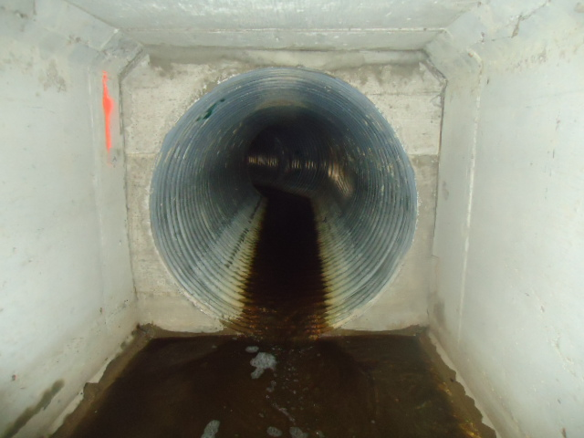
Maintenance and Rehabilitation of Culverts
Culvert Extension

Slide 54
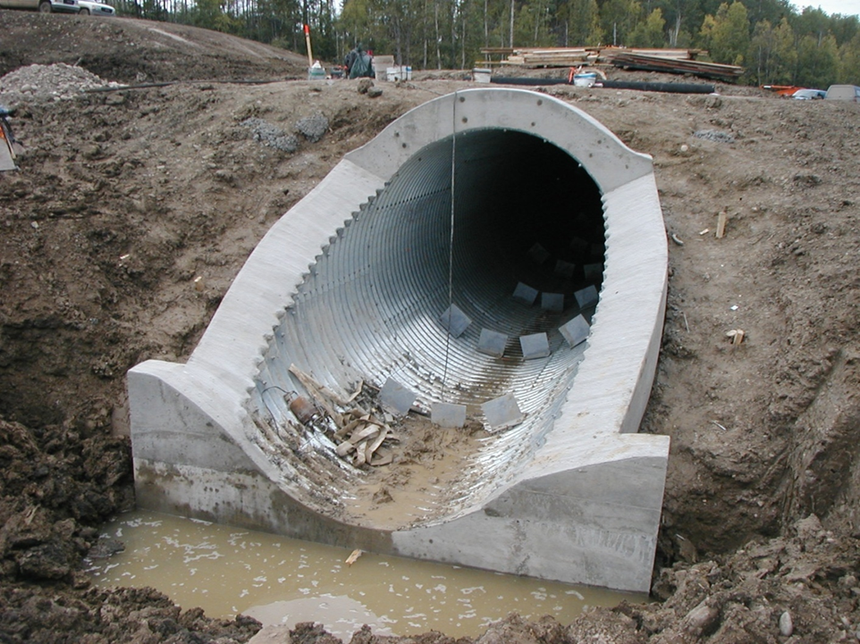
Maintenance and Rehabilitation of Culverts
Cut-off Wall - Piping

Slide 55
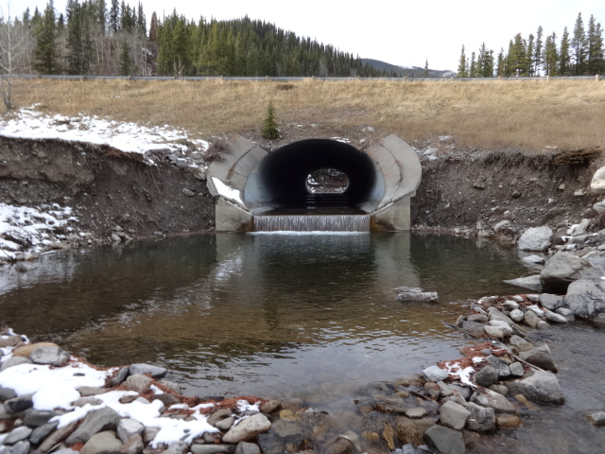
Maintenance and Rehabilitation of Culverts
Downstream Restoration

Slide 56
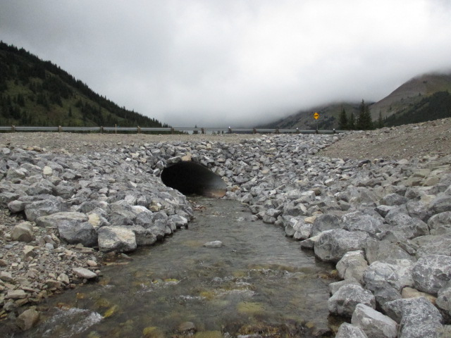
Maintenance and Rehabilitation of Culverts
Downstream Restoration

Slide 57
Maintenance and Rehabilitation of Culverts
Jacking Culvert Under Highway

Slide 58
Maintenance and Rehabilitation of Culverts
Environment Controls - Siltation Fence

Slide 59
Maintenance and Rehabilitation of Culverts
Questions??

